Slide 1
caTRIP Scientific Overview and Demo
Patrick McConnell
Duke Comprehensive Cancer Center

Slide 2
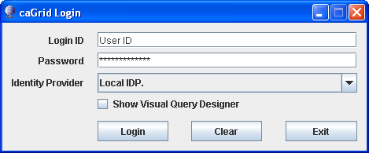
Notes:
The first step to entering the caTRIP system is to login to caGrid and determine whether to use the visual query designer (advanced) or the simplified interface. caTRIP will leverage the caGrid security infrastructure for authentication and authorization, which includes Dorian, the IdP Service, and the Commons Security Module (CSM).

Slide 3
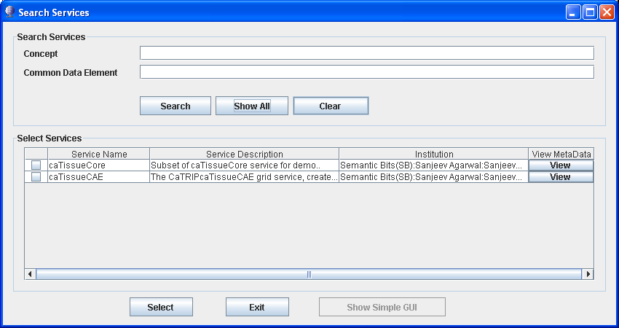
Notes:
When using the query designer, the user can choose which grid services to use. These can be dynamically discovered using the caGrid Index Service.

Slide 4
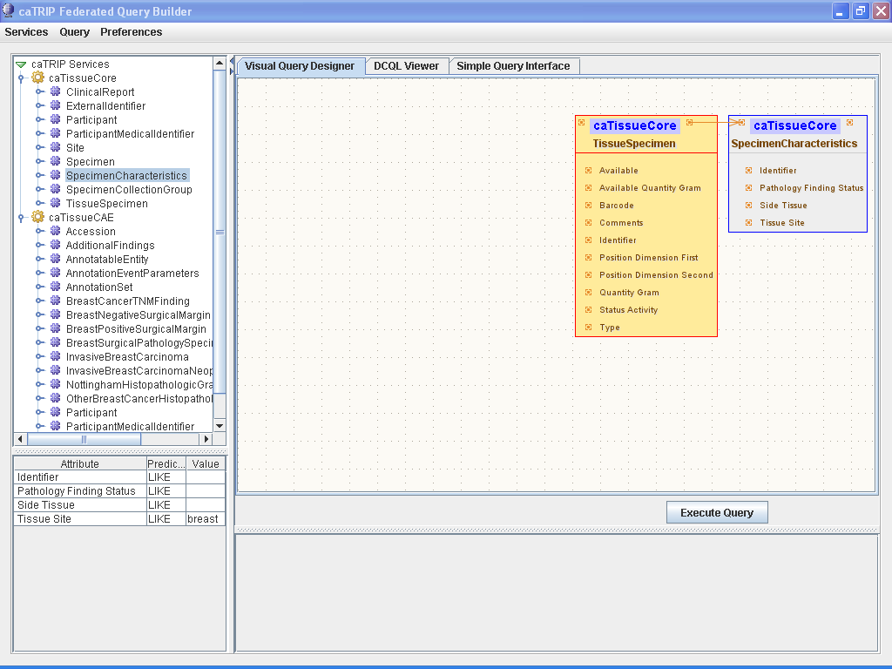
Notes:
The visual query designer allows you to drag-and-drop classes from the list of services on the left to the main window on the right. The classes and attributes are derived dynamically from the CDEs registered in the caDSR. Associations can be drawn between classes, and filter criteria can be added by selecting a class and entering attribute values on the bottom left.

Slide 5
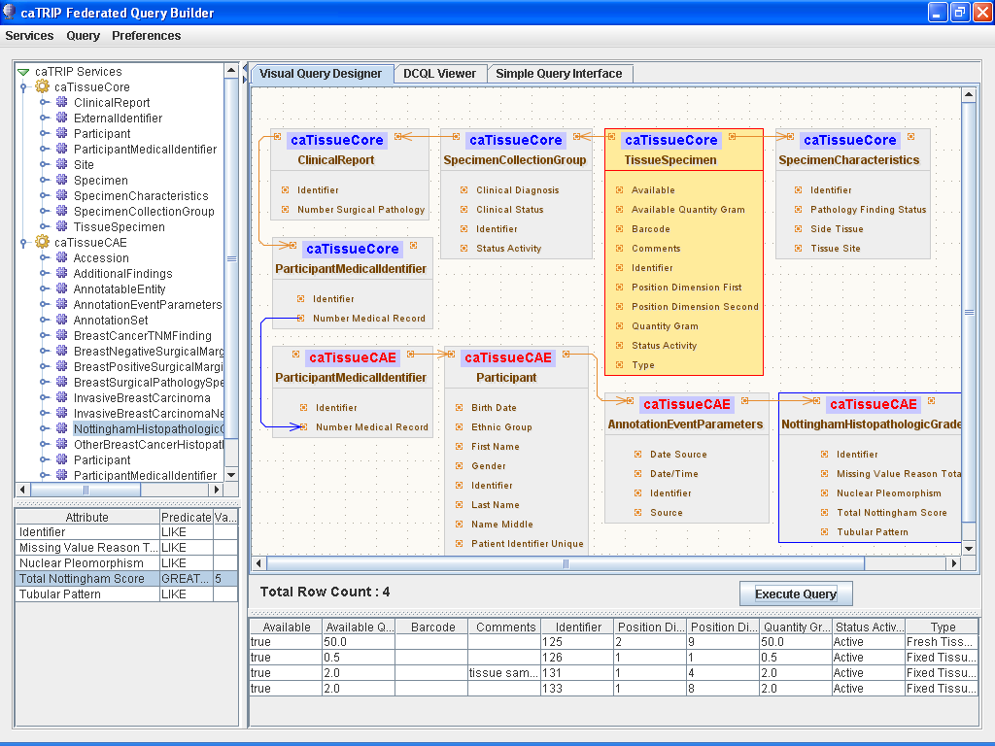
Notes:
Here we design a query to “give me all the tissue specimens from the breast from patients with a Total Nottingham Score greater than or equal to 5”. This performs a distributed query across caTissue CORE and Clinical Annotation Engine (CAE) grid services using a foreign association between the caTissue CORE and CAE participant medical record numbers. Results are shown in a tabular report in the bottom of the screen. In Phase 2, this report will be more dynamic, allowing for data mining-type activities.

Slide 6
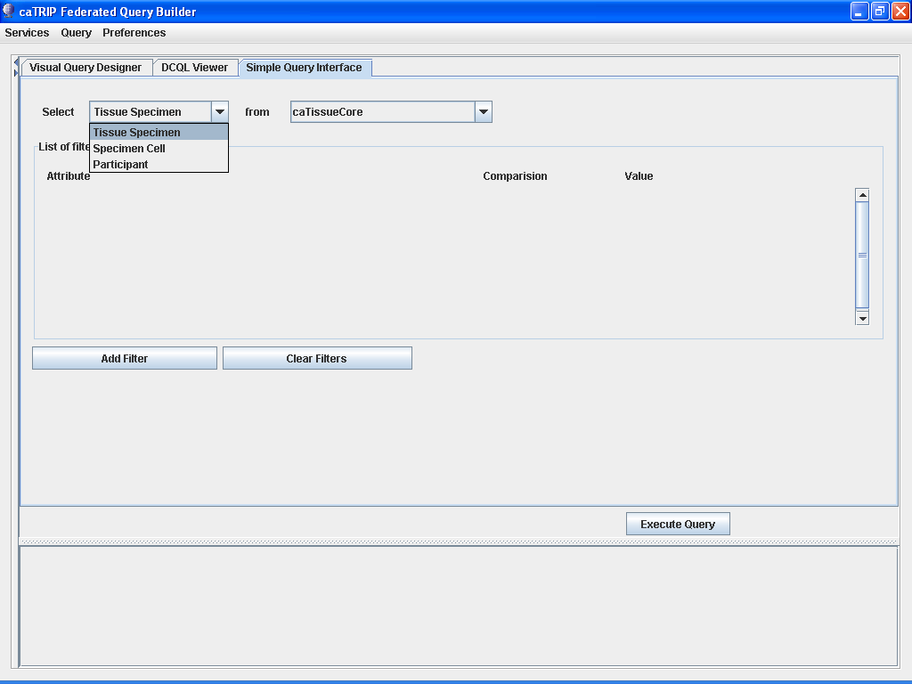
Notes:
The simplified interface allows users to select predefined services and target classes to filter and query on. The caTRIP team is working closely with oncologists at Duke to make the interface easily usable.

Slide 7
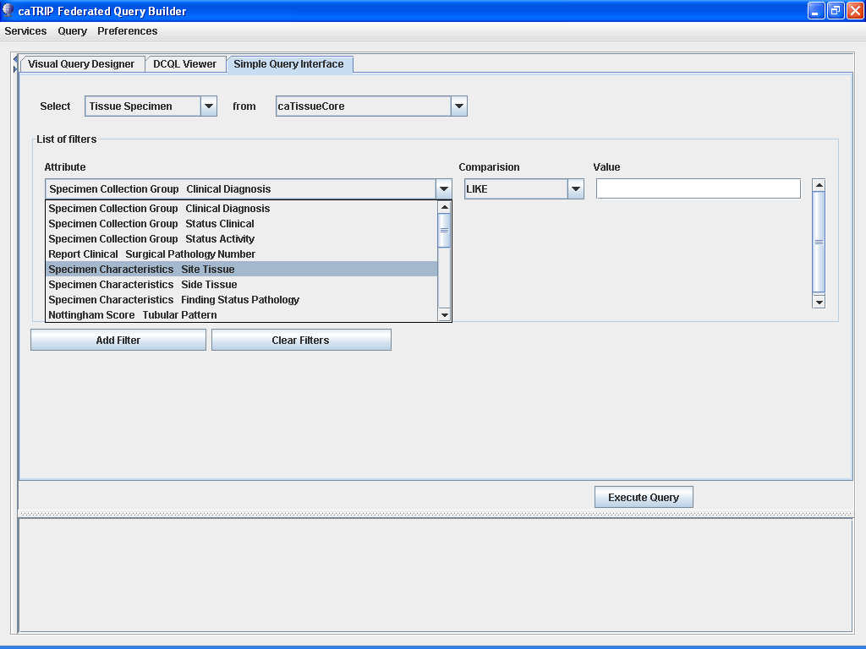
Notes:
Filters from all the available services can be added via drop-down menus, which are configured by the administrator of a given cancer center. In Phase 2, caTRIP will provide drop-down menus for available filter values.

Slide 8
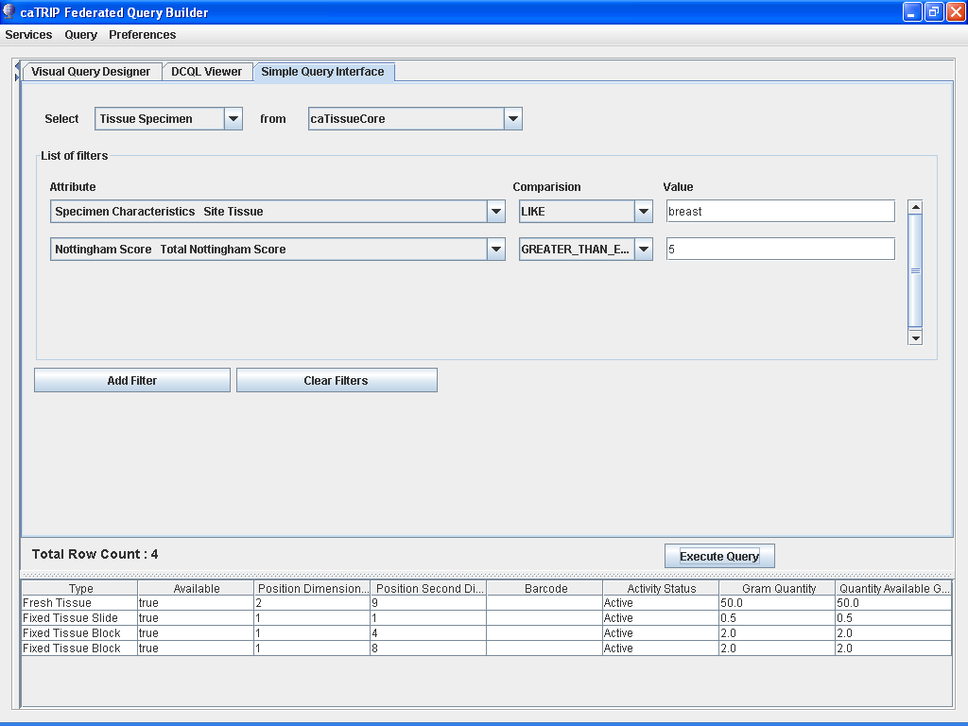
Notes:
Here we design a query to “give me all the tissue specimens from the breast from patients with a Total Nottingham Score greater than or equal to 5”. The caTRIP GUI determines the appropriate associations between objects to traverse, and performs a distributed query across caTissue CORE and Clinical Annotation Engine (CAE) grid services. Patient medical record numbers are used to perform the distributed join, though caTRIP can be configured to use any attribute to perform a join.

