Slide 1
caTRIP Silver Review
Patrick McConnell¹, Bill Mason²
¹Duke Comprehensive Cancer Center
²5AM Solutions

Slide 2
Agenda
Project overview
  Background, use cases, architecture
Models
  Overview, details, Tumor Registry, CAE
APIs
  Overview, details, existence
Submission package
  Artifacts, questions

Slide 3
Who is involved
Duke Bioinformatics
  Jamie Cuticchia (PI)
  Patrick McConnell
  (lead architect)
Duke Information Systems
  Bob Annechiarico (PM)
  Wilma Stanley (developer)
  Mark Peedin (developer)
  Mohamad Farid (DBA)
  Jeff Allred (IT manager)
Duke Pathology
  Raj Dash (domain expert)
  Chris Hubbard (developer)
Duke CALGB
  Kimberly Johnson
  (DataMart liaison)
Semantic Bits
  Ram Chilukuri (lead developer)
  Vinay Kumar (developer)
  Sanjeev Agarwal (developer)
  Srini Akkala (developer)
5 AM Solutions
  Bill Mason (developer)
3rd Millennium
  Julie Klemm (ICR WS lead)
NCI
  Carl Shaefer (NCI rep)
  Subha Madhavan
  (caIntegrator PM)

Slide 4
Background
Cancer Translational Research
Informatics Platform
Translational tool for connecting data systems
  caTissue CORE, CAE, Tumor Registry, caIntegrator SNP, caTIES
Phase 1: six months just completed
  Focus: demonstratable prototype
  Use cases: 3 of 7
  caGrid 1.0 reference implementation
Phase 2: complete by 5/2007
  Focus: production, deployable system

Slide 5
Scientific use cases
Find available tumor tissue
Find factors of survival
Find patients for trials
Determine the distribution of disease factors over time
Determine correlation of factors pre and post surgery
Find pathology reports of interest
Find SNP results correlated with factors

Slide 6
Phase 1 details
GUI
  Drag-and-drop and drop-down menu interfaces
  Metadata driven (caDSR service, metadata extract)
  Discovery API to find services via IndexService
  Java Webstart application
Distributed query engine
  Decomposes DCQL into CQL
  Aggregates and joins
Domain services
  caCORE SDK-built silver services
  caGrid Introduce-built grid services
  HQL CQL-processor
  Oracle backend

Slide 7
Phase 2 details
GUI
  IdP service for authentication
  Customized reporting
  Saving/sharing queries
  Drop-down menus for enumerated value domains
  Drop-down menus for available values
DQE
  Will use generic grid client, XML results
  Define returned objects/attributes
  Enhanced query optimization
Domain services
  CSM for authorization
  Common auditing/logging module
  Define returned objects/attributes

Slide 8

caTRIP architecture
GUI
query
Distributed
Query
Engine
authenticate
discover
Core Grid Services
Domain Grid Services
IdP
Service
Index
Service
caTissue
CORE
caTIES
CAE
TR
CGEMS
SNP
Duke
Domain
Controller
caTissue
CORE
caTIES
CAE
TR
caIntegrator
MAW3
Tumor Registry
SAS, Illumina

Slide 9
Service implementation
Index Service
advertise
advertise
Distributed
Query
Engine
caGrid Data Service
CQL Query
caCORE SDK
CQL Engine
domain
model
Object-relational
mapping
database

Slide 10
Model overview
For review
  Tumor Registry (new model)
    Endpoint and summary data
  Clinical Annotation Engine (modification)
    Just the breast annotations
Reused
  caTissue CORE
    Tissue banking data
  caIntegrator SNP
    SNP data, findings, analysis groups

Slide 11
Modeling details
caCORE SDK
  id attributes, “Collection” associations
  Java primitives for datatypes
Tumor Registry items of interest
  All treatment classes inherit from Activity
CAE items of interest
  Moved participant identifiers from AnnotationSet to backbone objects
  Added ParticipantMedicalIdentifier class
  Added EGFRStatus to BreastCancerBiomarkers

Slide 12
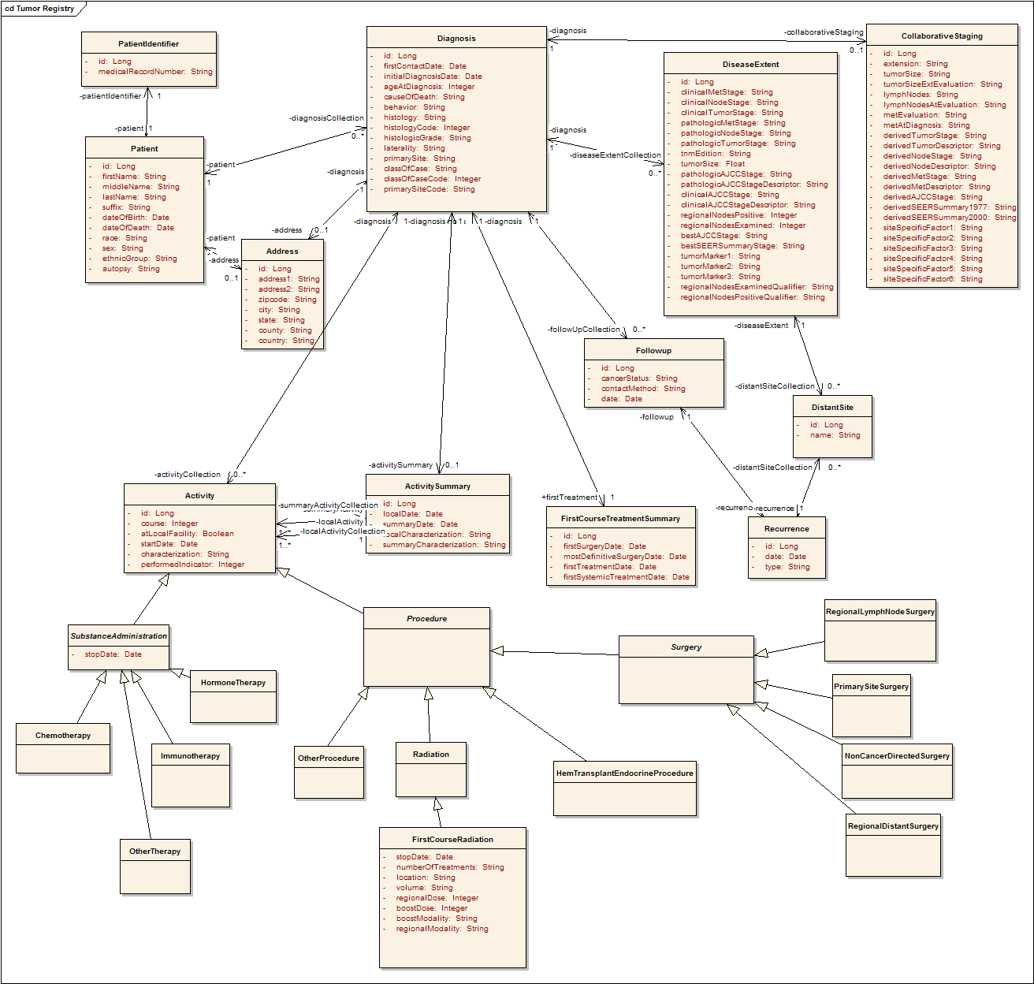
Tumor Registry
Full model
Participant
Diagnosis
Collaborative
Staging
Follow up and
Recurrence
Treatment

Slide 13
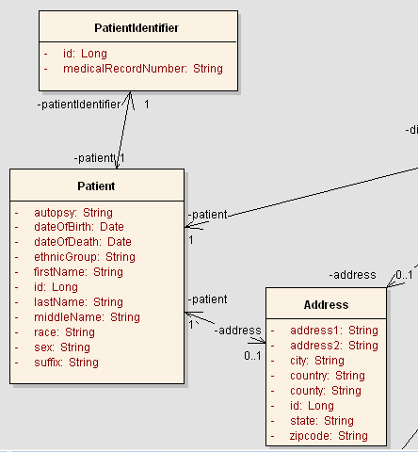
Tumor Registry
Patient

Slide 14
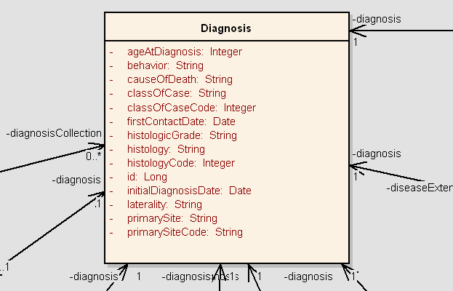
Tumor Registry
Diagnosis

Slide 15
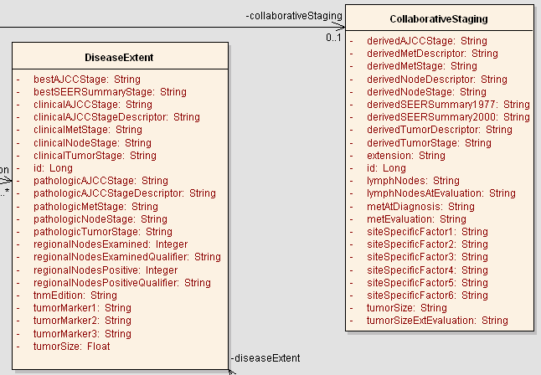
Tumor Registry
CollaborativeStaging

Slide 16
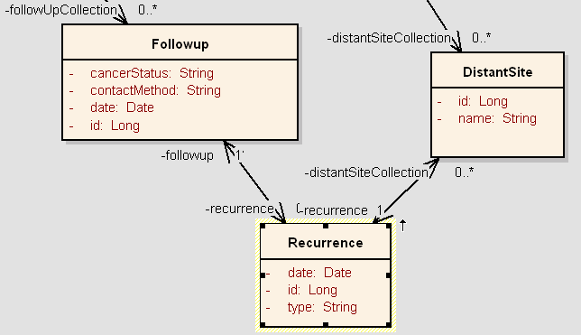
Tumor Registry
Followup/Recurrance

Slide 17
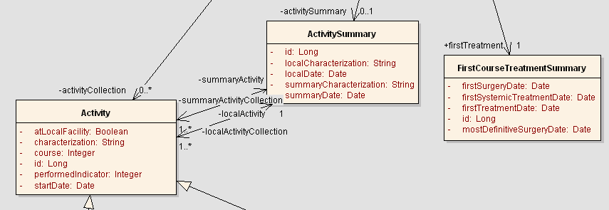
Tumor Registry
Activity

Slide 18
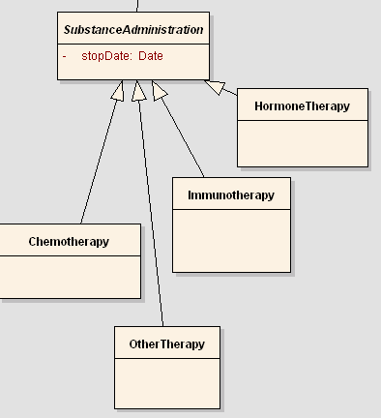
Tumor Registry
SubstanceAdministration

Slide 19
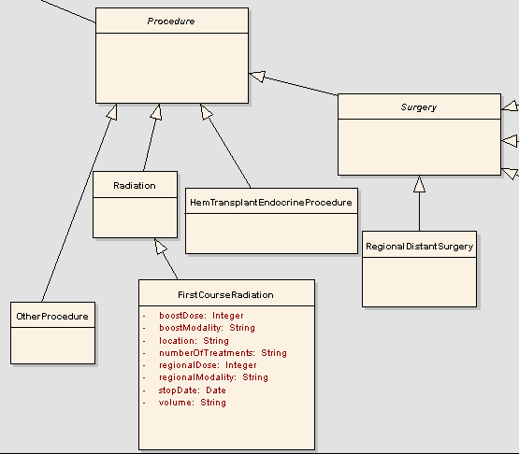
Tumor Registry
Procedure

Slide 20
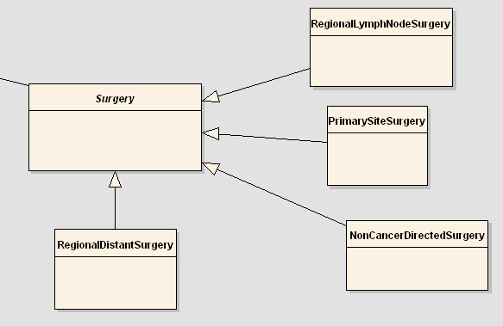
Tumor Registry
Surgery

Slide 21
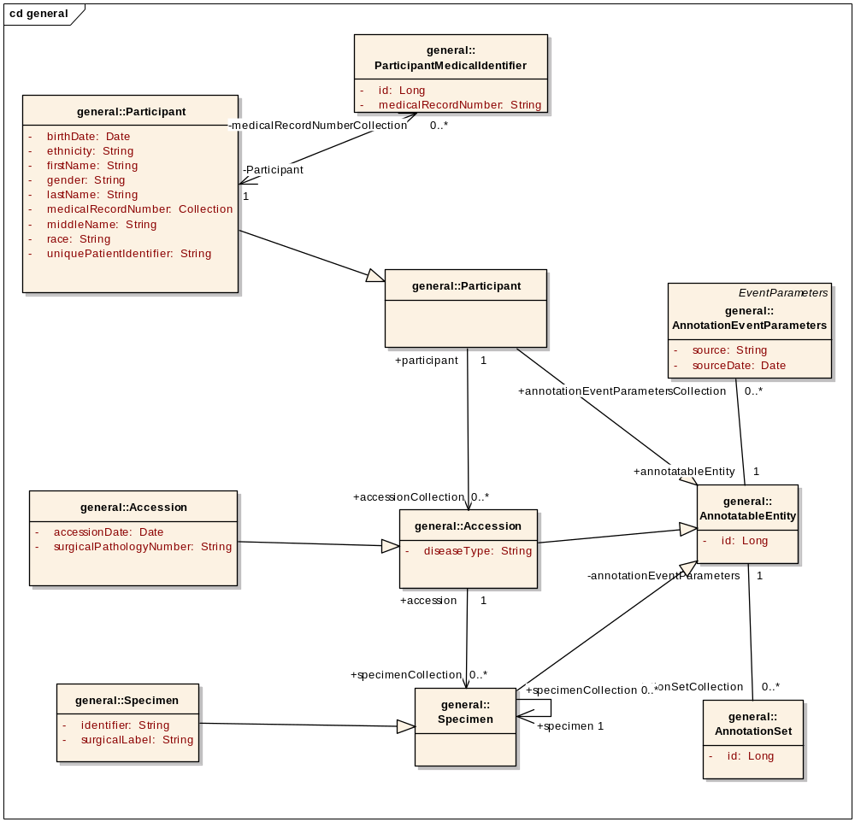
CAE
Backbone model
Participant
Annotations
Accession
Specimen

Slide 22
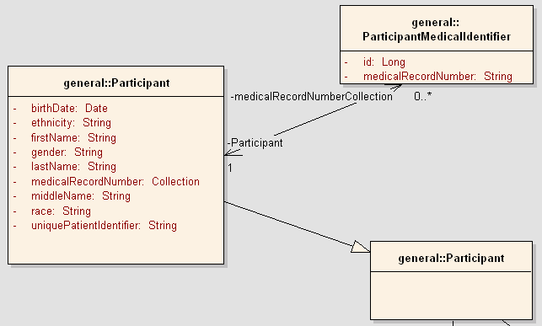
CAE
Participant

Slide 23
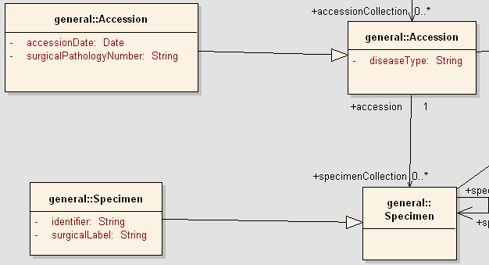
CAE
Accession/Specimen

Slide 24
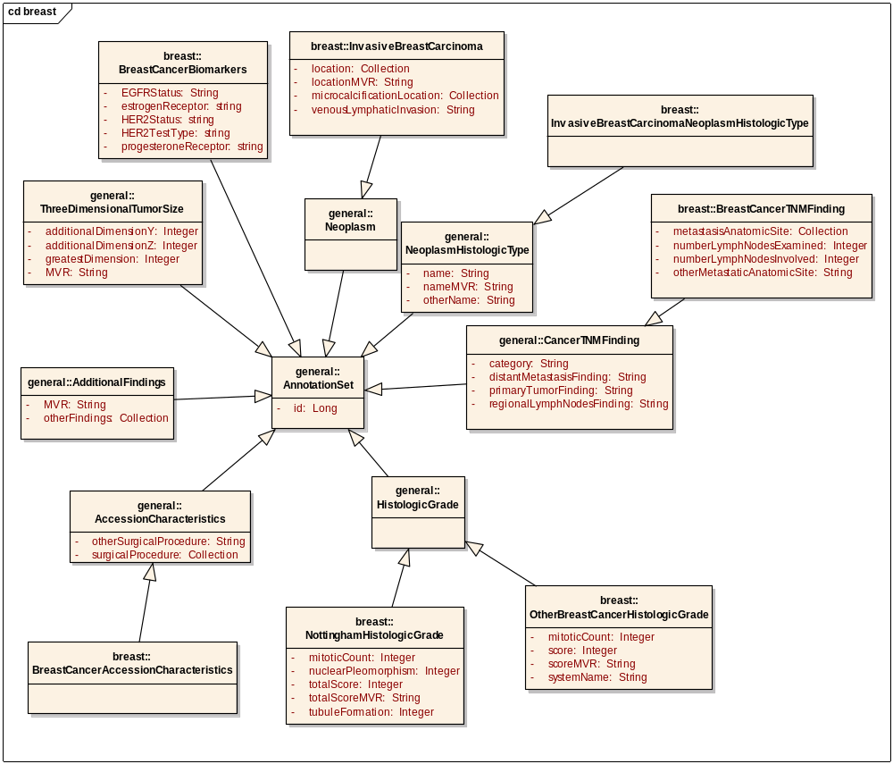
CAE
Breast annotations

Slide 25
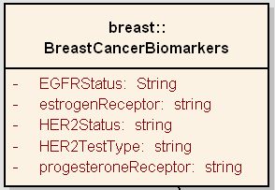
CAE
BreastCancerBiomarkers

Slide 26
API overview
Hibernate maps Java objects to RDMS
  caTissue CORE, CAE, Tumor Registry, caIntegrator SNP
Grid query service uses HQL query processor
  Java client APIs provide access to grid service
We request review of the Java query API for all 4 domain services

Slide 27
API details
public CQLQueryResults query(CQLQuery cqlQuery)
throws RemoteException, QueryProcessingExceptionType, MalformedQueryExceptionType
CQLQuery describes the objects and filter criteria to search for
CQLQueryResults describes the returned objects
The exceptions are not registered
Input and output types are being registered by the caGrid team

Slide 28
Existence
Test scripts
  Java program
  Reads queries from files
  Writes results to files
Test logs
  XML serialization of results into files

Slide 29
Submission package
  This presentation
  Use case document
  SRS
  Architecture guide
  EA model
  Semantically annotated XMI
  SIW report
  UML loader checklist
  Vocabulary report
  Value domain report
  Standards report
  CDE use report
  API document
  Test log
  Test scripts
  Test approach
http://gforge.nci.nih.gov/plugins/scmcvs/cvsweb.php_x000b_/catrip/documentation/silver_review/catrip_silver_review_package.doc_x000b_?cvsroot=catrip

Slide 30
Discussion
Questions, comments?

