Slide 1
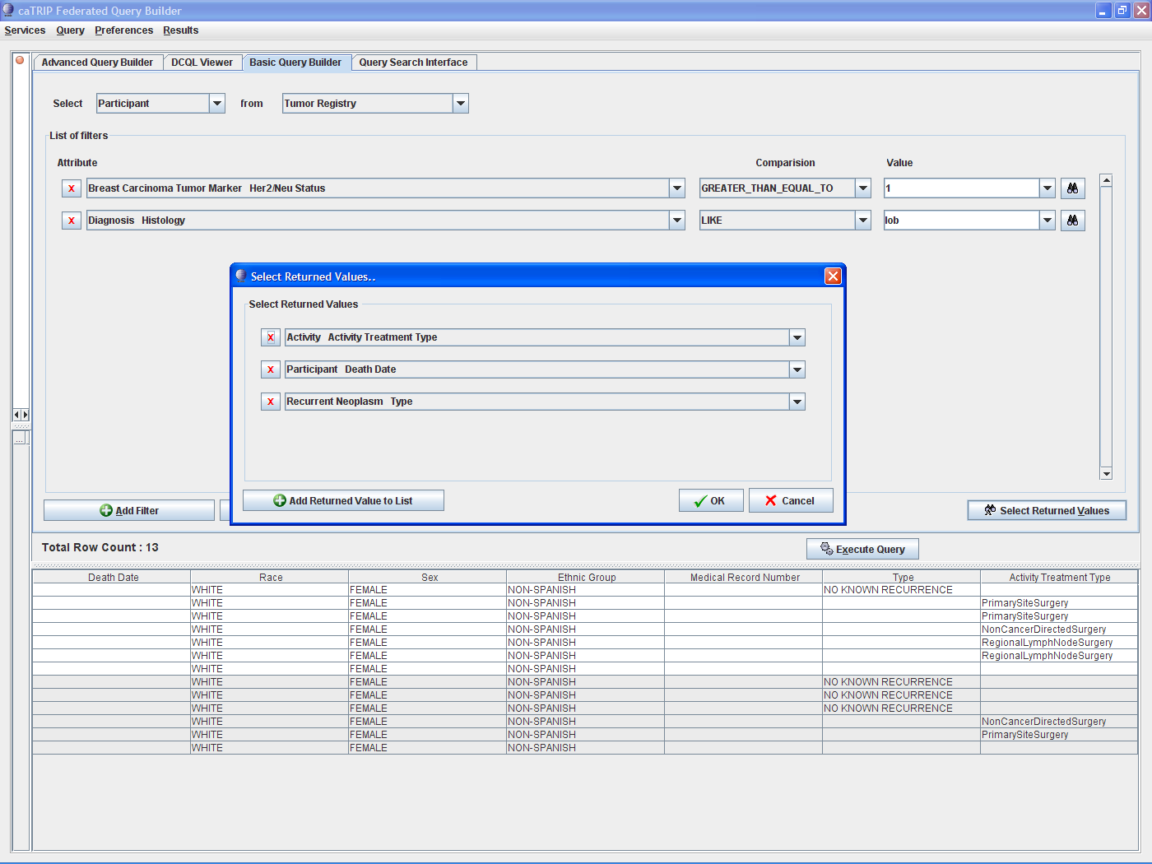
Notes:
Outcomes analysis

Slide 2
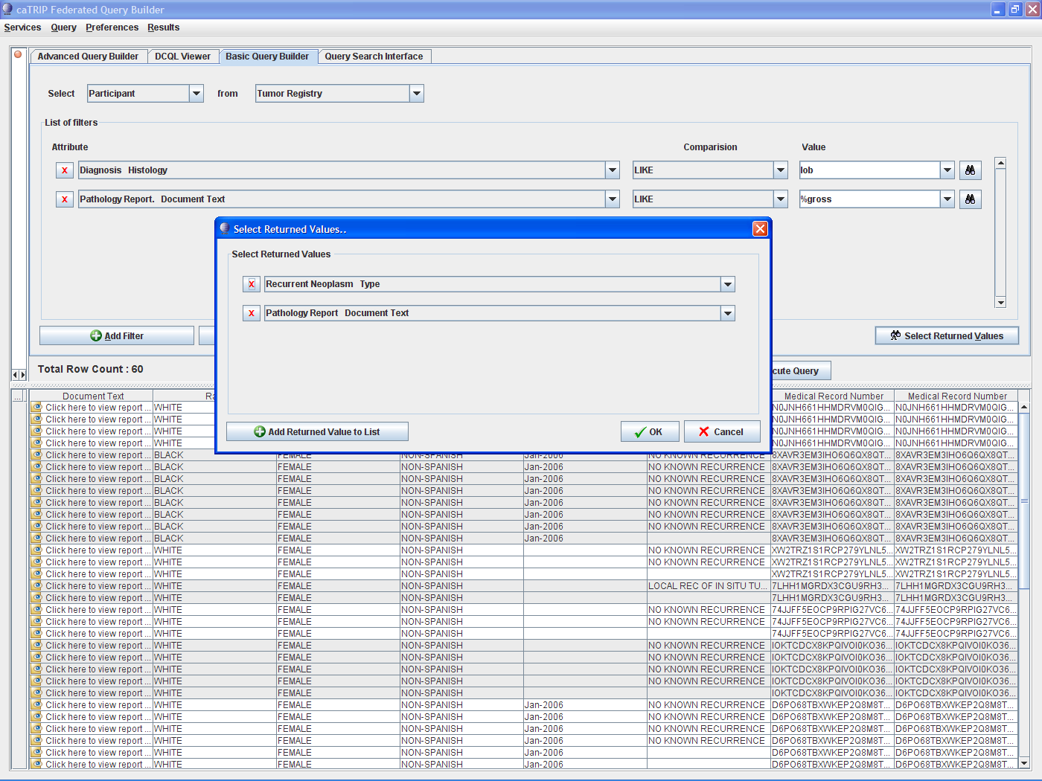
Notes:
Path Report – double click on eyeball

Slide 3
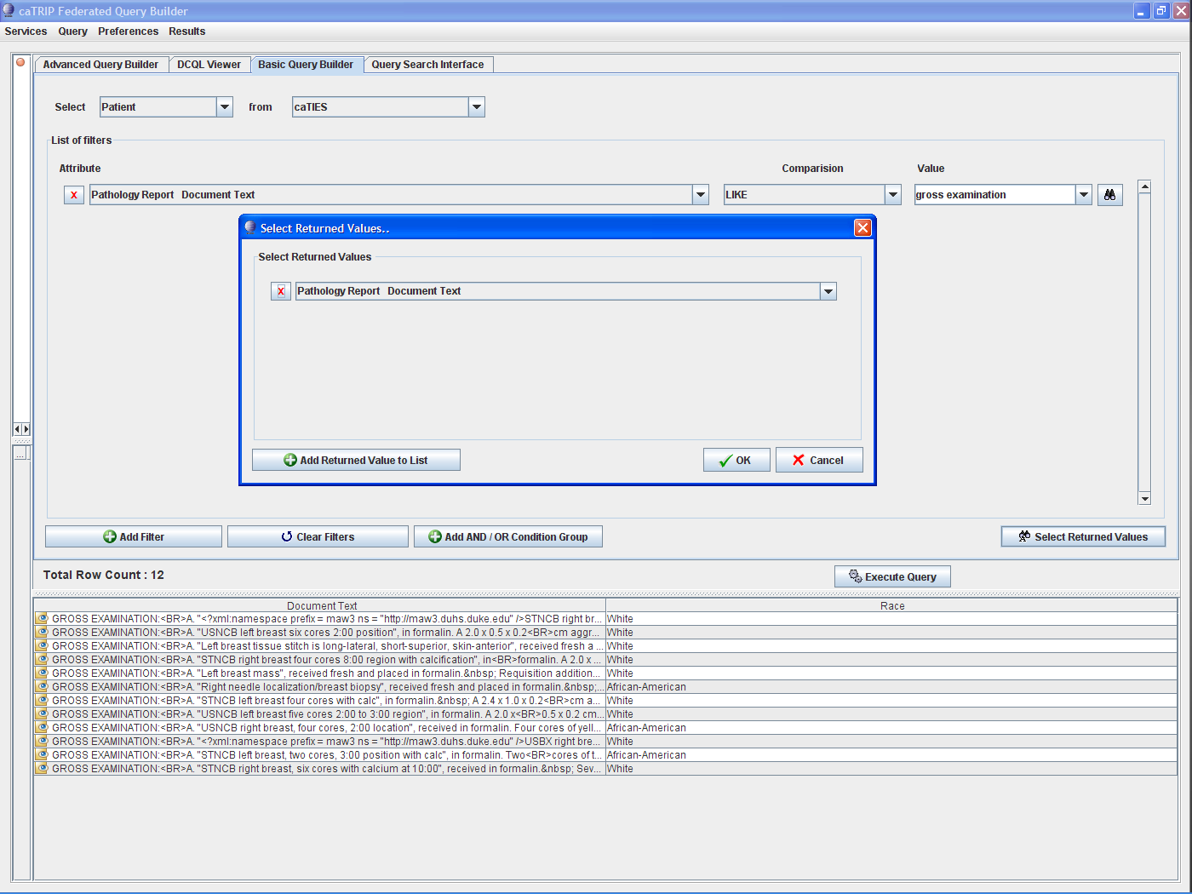
Notes:
Pathology report simple – double click on eyeball

Slide 4
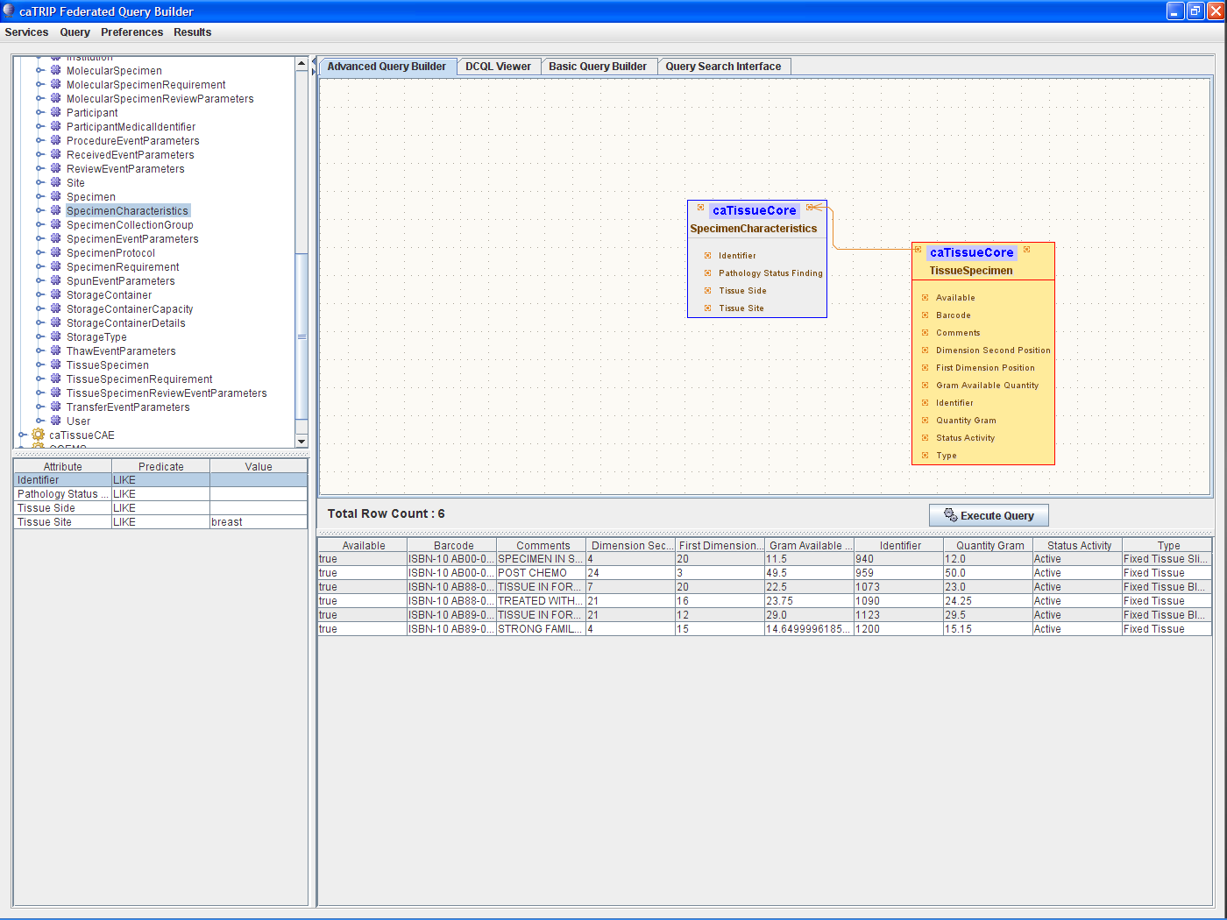
Notes:
Advanced GUI (don’t forget available=true on the tissue specimen, and hit tab or enter after adding a filter)

