Slide 1
caTRIP Status Update
Patrick McConnell¹, Bill Mason²
¹Duke Comprehensive Cancer Center
²Semantic Bits

Slide 2
Agenda
Quick caTRIP review
Task summary
Overview of demo
Problems with caCORE SDK
Problems with hibernate
Discussion

Slide 3

Proposed solution diagram
GUI
query
Distributed
Query
Engine
discover
Index Service
Domain Grid Services
caTissue
CORE
caTIES
CAE
CAE
CTOM
CTOM
CGEMS
SNP
Duke Databases
MAW3
DSR
Tumor
Registry
caIntegrator

Slide 4
Task summary
Working to get demo ready
Scientific use cases
  Translating feedback from clinicians into use cases
Domain services
  Finalized CAE 1.1 reengineering
  Install of caTissue CORE
Distributed query engine
  Hardening implementation
  Finalized DCQL schema
  Writing test cases
GUI
  Integration of metadata extract
  CQL generation

Slide 5
Overview of demo
Demo
  CAE and caTissue CORE models
  Service WSDL
  GUI query building
  Query submittal with DQE debug messages
Issues
  caCORE SDK
  caGrid
Source code release
  Ant tasks
  Tests
  Reports

Slide 6
Demo queries
What are all the patients that have a tissue specimen available that has more than 30 grams
What are all the patients have a NottinghamHistologicGrade mitoticCount of N
What are all the patients that have breast tissue specimen with a ThreeDimensionalTumorSize greatestDimension greater than N

Slide 7
Issues with caCORE SDK
Exceptions were very cryptic
We were informed that when creating attributes to select "String" from the attribute type drop down, do not type it in from the keyboard. If it was typed in the exception was very cryptic
  [java] Exception in thread "main" gov.nih.nci.codegen.core.GenerationException: Error generating
  [java] at gov.nih.nci.codegen.core.Generator.execute(Unknown Source)
  [java] at gov.nih.nci.codegen.core.GeneratorImpl.main(Unknown Source)
  [java] Caused by: java.lang.NullPointerException
  [java] at gov.nih.nci.codegen.core.template.jet.Bean.generate(Unknown Source)
  [java] at gov.nih.nci.codegen.core.template.jet.Bean.execute(Unknown Source)
  [java] at gov.nih.nci.codegen.core.transformer.JETTransformer.execute(Unknown Source)

Slide 8
Issues with caCORE SDK
The compile will fail if there is inheritance across packages - known bug.
We created our own .hbm files and ran the SDK. Next we would run our client we would get the error:
  "Exception in the ORMDAOFactory org.hibernate.MappingException:
  Resource: edu/pitt/cabig/cae/domain/general/impl/EventParametersImpl.hbm.xml not found“
  We copied and rename our hbm files to Impl.hbm files to get past this error.
Once both the hbm and Impl.hbm files were there, the client ran but we got back duplicate rows. Probably due to the classes being mapped twice: once in the hbm file and once in the Impl.hbm file.

Slide 9
Issues with hibernate
“How many Specimen Collection Groups contain Molecular Specimens with a quantityInMicrogram equal to 30”
Using the Hibernate Criteria API and using SpecimenCollectionGroup as the target object
We cannot specify the MolecularSpecimen subclass
  [java] gov.nih.nci.system.applicationservice.ApplicationException:
  Exception Hibernate problem org.hibernate.WrongClassException:
  Object with id: 100 was not of the specified subclass:
  edu.wustl.catissuecore.domainobject.impl.SpecimenImpl (loaded object was of wrong class)

Slide 10
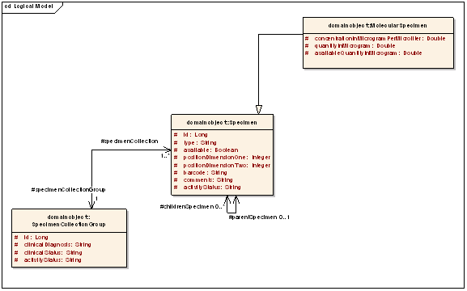
Issues with hibernate

Slide 11
Discussion

