Slide 1
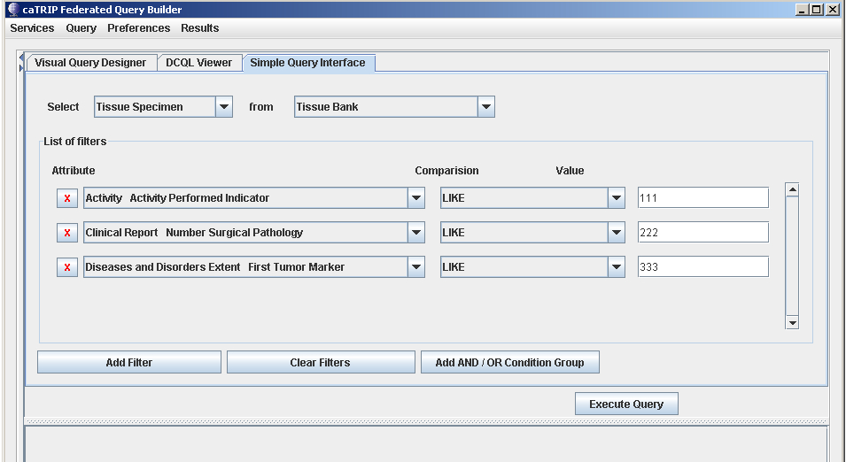
Approach-1 : Filters / Filter Groups in Combo-box
Choose all the filters first and then select And / OR condition

Slide 2
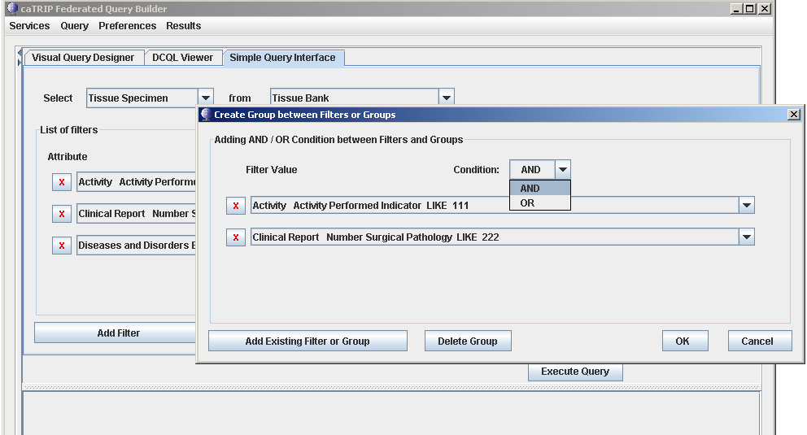
Approach-1 : Filters / Filter Groups in Combo-box
The combo-box here contains only the filters chosen in the main GUI
Select condition: AND / OR
Add filters to the current group

Slide 3
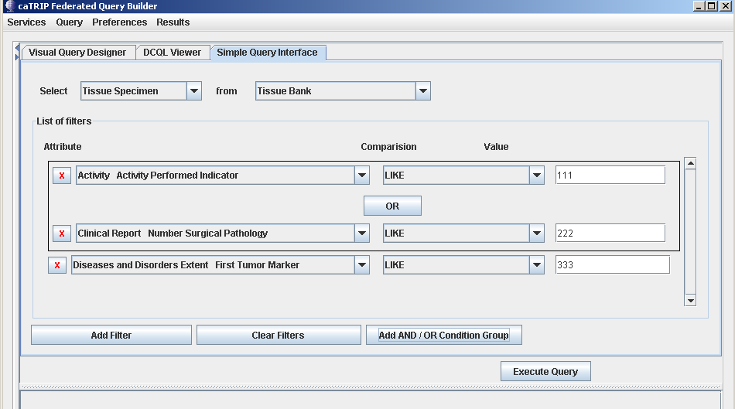
Approach-1 : Filters / Filter Groups in Combo-box
The grouping information is reflected in the main GUI

Slide 4
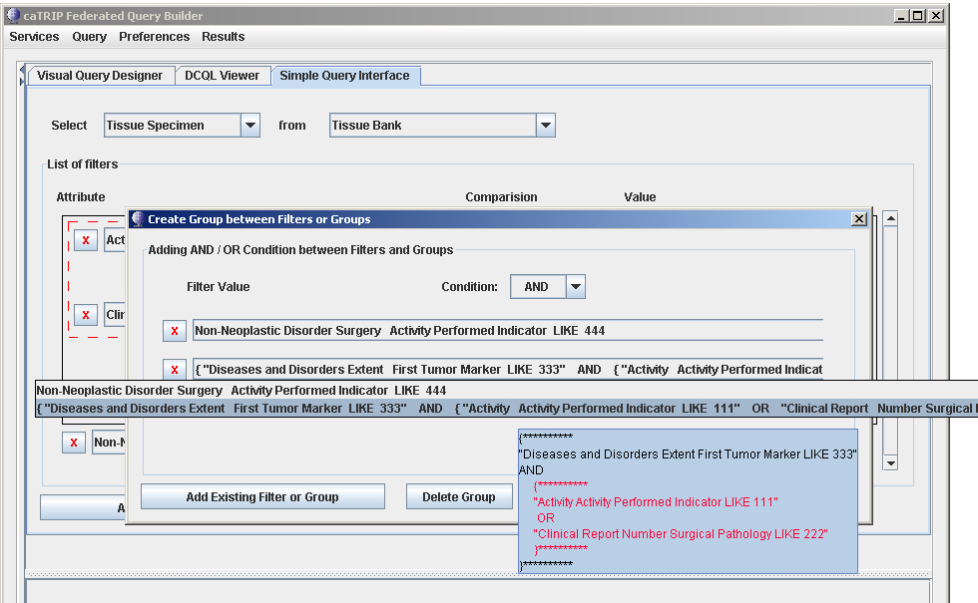
Approach-1 : Filters / Filter Groups in Combo-box
Group the previous group and any remaining filter
Select condition: AND / OR
Add filters or groups to the current group
Group Information.

Slide 5
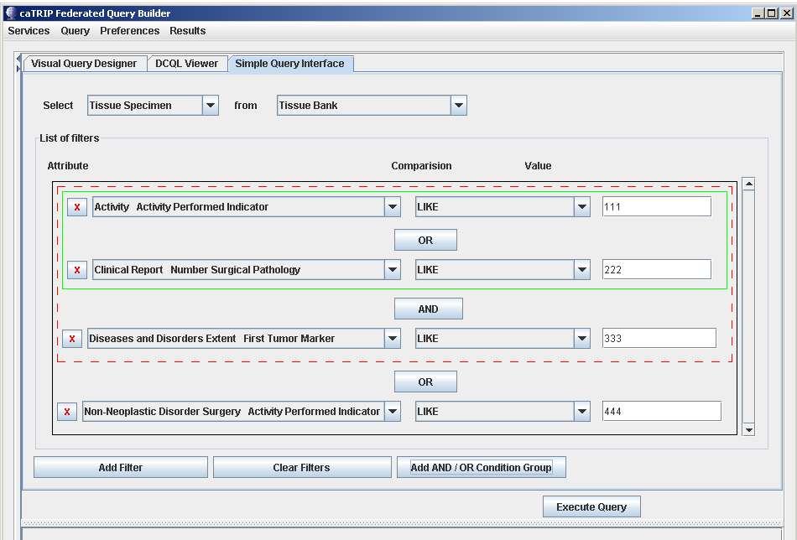
Approach-1 : Filters / Filter Groups in Combo-box
The grouping information is reflected in the main GUI
Outer group border
Inner group border

Slide 6
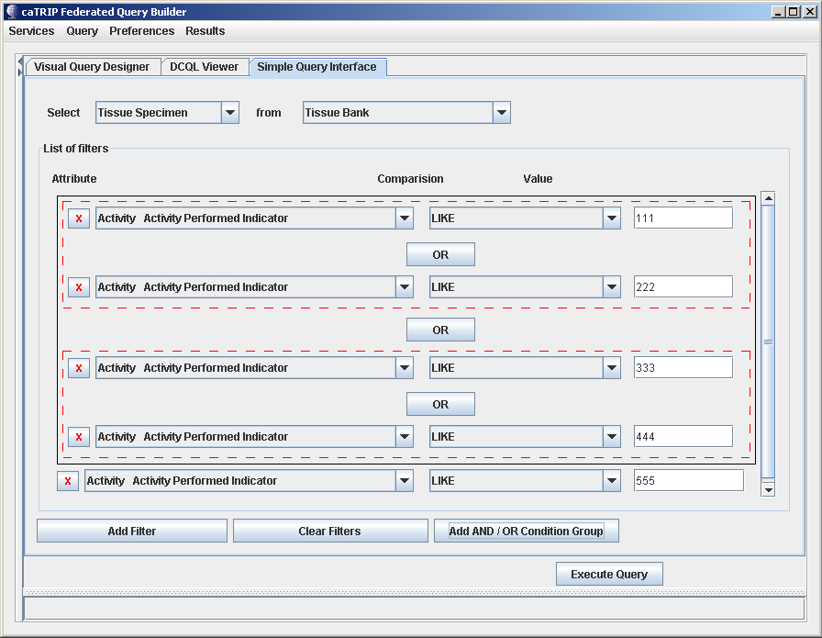
Approach-1 : Filters / Filter Groups in Combo-box
Modifying group properties
Click to edit group properties

Slide 7
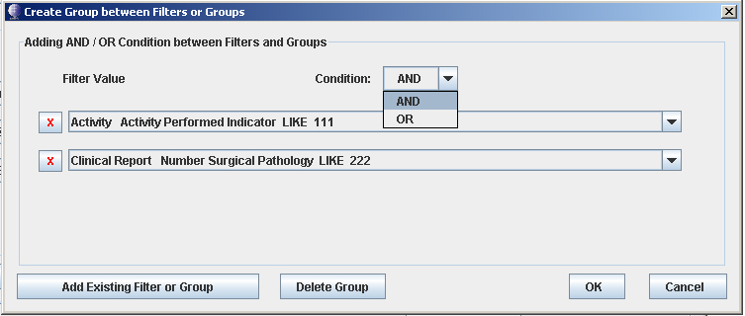
Approach-1 : Filters / Filter Groups in Combo-box
Add/delete filters to the group or delete the group itself.
Remove filter from the group
change the condition type
Add more filter to the group
Delete group

