Slide 1

GUI
query
Distributed
Query
Engine
authenticate
discover
Core Grid Services
Domain Grid Services
IdP
Service
Index
Service
Grid
Grouper
authorize
caTissue
CORE
caTIES
CAE
TR
CGEMS
SNP
Duke
Domain
Controller
caTissue
CORE
caTIES
CAE
TR
caIntegrator
MAW3
Tumor Registry
Illumina

Slide 2
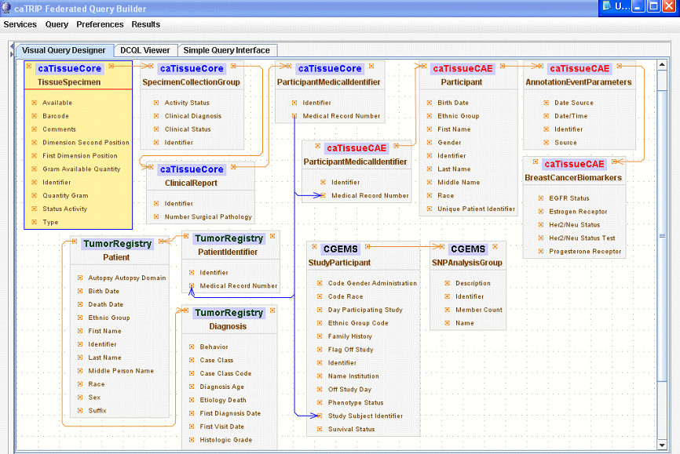

Slide 3
authorization
User Grid
Certificate
authentication
Grid
Data Service
User
Credentials
SAML
Assertion
Dorian
CSM
Trust Fabric
caGrid
Authentication Service
Grid
Grouper
backend
data
Duke
Authentication Plugin
Duke Domain Controller
NT Security

