Slide 1
caTRIP GUI Overview
Session Length: approx 15 minutes
Target Audience: Medical Doctors and Clinicians
Trainer: Self-paced
Creation Date: May 23, 2007

Slide 2
Session Details
Target Audience:
  Medical Doctors and Clinicians that need to access data records pertaining to information on patients, clinical trials, and their survival, surgery, and treatment in order to help them make decisions on treatment for other patients.
Prerequisites:
  General working knowledge of:
    Querying relational databases
    Html, Excel and CSV file formats
Acronyms Defined:
  GUI – Graphic User Interface
  SNP – Single Nucleotide Polymorphism
  CSV – Comma Separated Values
  caTRIP – Cancer Translational Research Informatics Platform
  DCQL – Distributed Common Query Language
  CDE – Common Data Element

Slide 3
Session Details:
Session Objectives
By the end of this session, you should be able to
  Describe the caTRIP GUI
  Describe in what ways it is useful
  Describe how to use it to access data

Slide 4
Session Details:
Lesson Plan
Topic 1: Introduction to caTRIP GUI
Topic 2: Overview of the “Basic Query Builder”
Topic 3: A Comprehensive Look at the “Basic Query Builder”
Topic 4: Overview of the “Query Search Interface”
Topic 5: A Comprehensive Look at the “Query Search Interface”
Topic 6: Overview of the “Advance Query Builder”
Topic 7: A Comprehensive Look at the “Advance Query Builder”

Slide 5
Topic 1: Introduction to caTRIP GUI
In this Topic, an overview of the application will be discussed:
  What is the caTRIP GUI
  The goal of the tool
  Databases involved
  caBIG systems being used
  Launching the application
  Layout of the GUI

Slide 6
Topic 1: Introduction to caTRIP GUI
What is caTRIP GUI?
  A web based tool for querying multiple database
  Designed to bring together 2 very important steps in patient care:
    Basic research that occurs in the lab
    Patient care that occurs in the clinic
  “Translational Medicine”
    A branch of medical research that attempts to more directly connect basic research to patient care
  How does it work:
    It bridges the gap using open standards/APIs and harmonized semantics

Slide 7
Topic 1: Introduction to caTRIP GUI
What is its Goals?
  Assist in Outcomes Analysis by:
    Using data from existing patients to the treatment of other patients
    Leveraging clinical, pathology, tissue, and basic science data
    Providing an interface to allow clinicians to query across disparate data types in a user-friendly manner

Slide 8
Topic 1: Introduction to caTRIP GUI
What Legacy Databases are involved:
  Medical Assistant on the World Wide Web (MAW3)
    Tissue banking, pathology, and some clinical annotations
  Tumor Registry (TR)
    Endpoint data since 1980
  Decision Support Repository (DSR)
    Patient clinical data, crossing all medical specialties, lab data
  Genetic Modifiers of BRCA1 and BRCA2 (GEMS)
    Basic science SNP data on germ line BRCA1/2 mutation carriers
  Other data sources from different institutions could be included in the GUI

Slide 9
Topic 1: Introduction to caTRIP GUI
To Launch the caTRIP GUI:
  The URL for the test GUI
    http://152.16.96.114/catrip-webstart/
    Note: each institution will have it’s own, unique URL - the above is Duke’s
  Notes:
    The first time you launch the application it will take a little longer because it has to download and setup libraries, resources, and directories on your local drive
    Subsequent sessions of the GUI should load much faster.

Slide 10
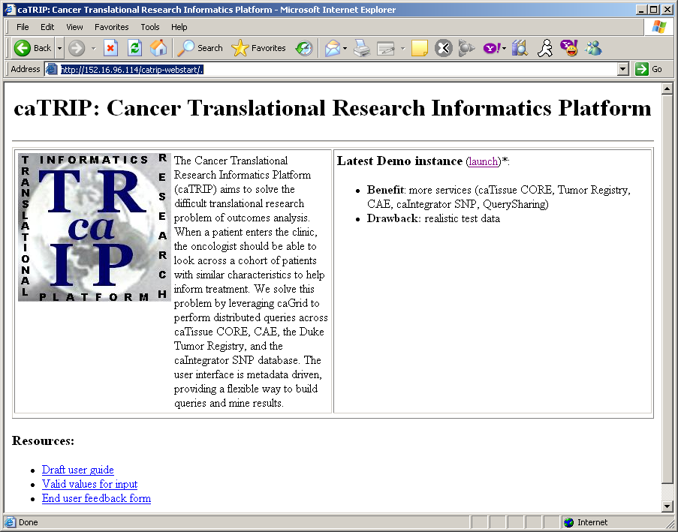
Topic 1: Introduction to caTRIP GUI
caTRIP GUI: Startup Page
1 Click Launch

Slide 11
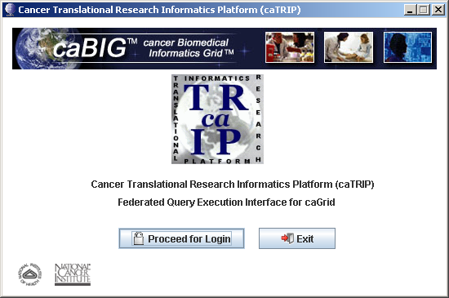
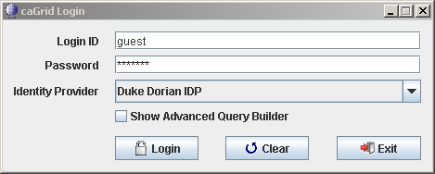
Topic 1: Introduction to caTRIP GUI
caTRIP GUI: Login Page
Note:
For Training, use the ‘guest’ account, otherwise, contact your institutional administrator for a local login
Notes:
BYTEit2MSP: i do need to get info from someone about the 'protocol' for users to get a login/pass - per the reviewer of the training mod...
pmccon012: ok - i think the way they will do it is use their instituational login (e.g. their workstation login) or get a user name/password from an administrator
pmccon012: either way, they should ask their administrator i think
BYTEit2MSP: k, thx

Slide 12
Topic 1: Introduction to caTRIP GUI
caTRIP GUI: Login Page
  How to go about getting login and password?
    For training, you should use the ‘guest’ account
    Otherwise, you should use your institutional login (e.g. your workstation login) or get a user name/password from an administrator
  Who is allowed access the system?
    Clinicians and doctors should have access to the system to help them make decisions on treatment for other patients
  How to get qualified to use it?
    Your administrator at your institution should help determine who qualifies to use the GUI

Slide 13
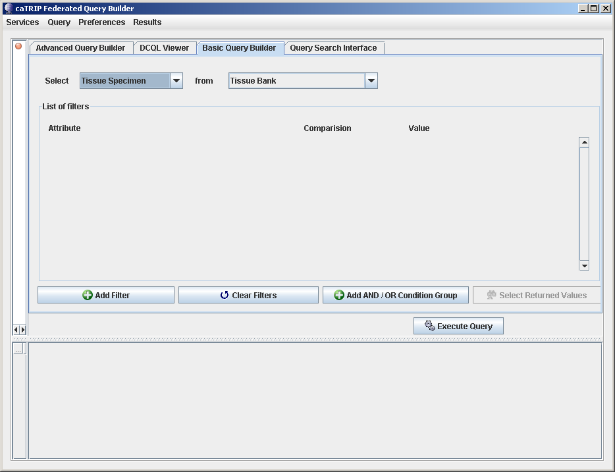
Topic 2: Overview of the “Basic Query Builder”
Basic Query Builder Layout
Menu Bar
Query Tabs
Query Building
& Filtering Canvas
Target Data Elements
Data Source
Query Results
Notes:
‘Menu Bar’
Services (allows adding or deleting services)
Query (allows to retrieve, create, save , delete or execute a query)
Preferences (allow for adding or selecting a search engine, or add a search engine by url)
Results (allows for exporting results to either HTML, Excel or CSV formatted data files)
‘Query Tabs’
Advance Query Builder – Not yet implimented
DCQL Viewer – Allows to view and query, using DCQL
Basic Query Builder – Most commonly used query tool
Query Search Interface – Used to load previously built and saved queries
‘Query Builder & Filtering’ – Where the columns, tables and filters are defined for querying
‘Query Results’ – Where returned record results are displayed

Slide 14
Topic 2: Overview of the “Basic Query Builder”
Basic Query Builder Layout
Menu Bar
Query Tabs
Query Building
& Filtering Canvas
Target Data Elements
Data Source
Used for adding Filtering ‘Where’ Clauses
Query Results
Notes:
‘Menu Bar’
Services (allows adding or deleting services)
Query (allows to retrieve, create, save , delete or execute a query)
Preferences (allow for adding or selecting a search engine, or add a search engine by url)
Results (allows for exporting results to either HTML, Excel or CSV formatted data files)
‘Query Tabs’
Advance Query Builder – Not yet implimented
DCQL Viewer – Allows to view and query, using DCQL
Basic Query Builder – Most commonly used query tool
Query Search Interface – Used to load previously built and saved queries
‘Query Builder & Filtering’ – Where the columns, tables and filters are defined for querying
‘Query Results’ – Where returned record results are displayed

Slide 15
Topic 2: Overview of the “Basic Query Builder”
Basic Query Builder Layout
Menu Bar
Query Tabs
Query Building
& Filtering Canvas
Target Data Elements
Data Source
Used for adding Filtering ‘Where’ Clauses
Add ‘And/Or’ Grouping to the Filtering ‘Where’ Clauses
Execute Query after it has been built
Query Results
Notes:
‘Menu Bar’
Services (allows adding or deleting services)
Query (allows to retrieve, create, save , delete or execute a query)
Preferences (allow for adding or selecting a search engine, or add a search engine by url)
Results (allows for exporting results to either HTML, Excel or CSV formatted data files)
‘Query Tabs’
Advance Query Builder – Not yet implimented
DCQL Viewer – Allows to view and query, using DCQL
Basic Query Builder – Most commonly used query tool
Query Search Interface – Used to load previously built and saved queries
‘Query Builder & Filtering’ – Where the columns, tables and filters are defined for querying
‘Query Results’ – Where returned record results are displayed

Slide 16
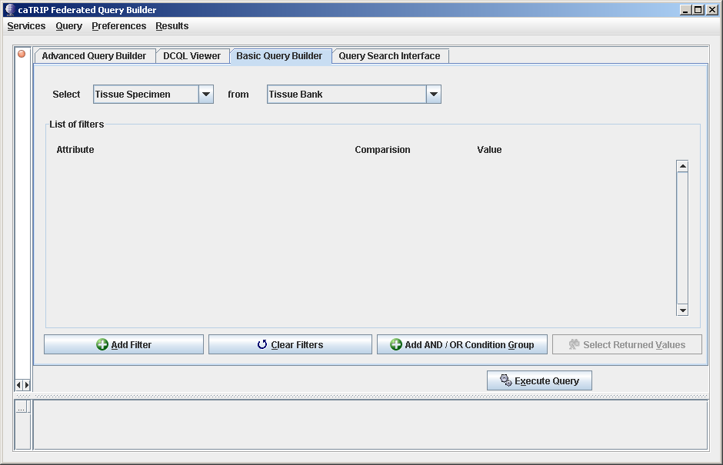
Topic 3: Comprehensive look at the “Basic Query Builder”
Example query #1: Find all the tissue specimens from patients that have a her2/new status of positive
1
2
Select the ‘Target Data Elements’ = Tissue Specimen
Select the ‘Data Source’ = Tissue Bank
Notes:
To build a query, do the following:
Select the ‘return’ data
Select the table
Add filters to the query by:
Clicking on the ‘Add Filter’, ‘Clear Filters’ and ‘Add ADD/OR Condition Group’ buttons, as needed
Then select the ‘Attributes’, ‘Comparison’ and the ‘Value’ for each filter
Note: to populate the codelist for the ‘Value’ pulldown, click on the binoculars
Once the filters have been defined, click on the ‘Execute Query’ button and results will appear on the bottom half of the GUI window

Slide 17
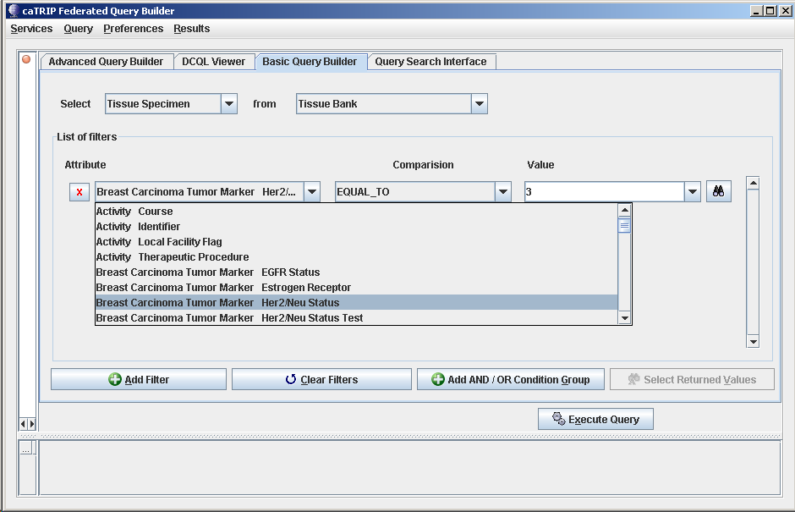
Topic 3: Comprehensive look at the “Basic Query Builder”
Example query #1: Find all the tissue specimens from patients that have a her2/new status of positive
Note: To populate the codelist for the ‘Value’ pulldown, click on the binoculars
2
3
4
Click on ‘Add Filter’
Select ‘Attribute’
Set ‘Comparison’ = Equal_To
Select ‘Value’ = 3 (for positive)
1
Notes:
To build a query, do the following:
Select the ‘return’ data
Select the table
Add filters to the query by:
Clicking on the ‘Add Filter’, ‘Clear Filters’ and ‘Add ADD/OR Condition Group’ buttons, as needed
Then select the ‘Attributes’, ‘Comparison’ and the ‘Value’ for each filter
Note: to populate the codelist for the ‘Value’ pulldown, click on the binoculars
Once the filters have been defined, click on the ‘Execute Query’ button and results will appear on the bottom half of the GUI window

Slide 18
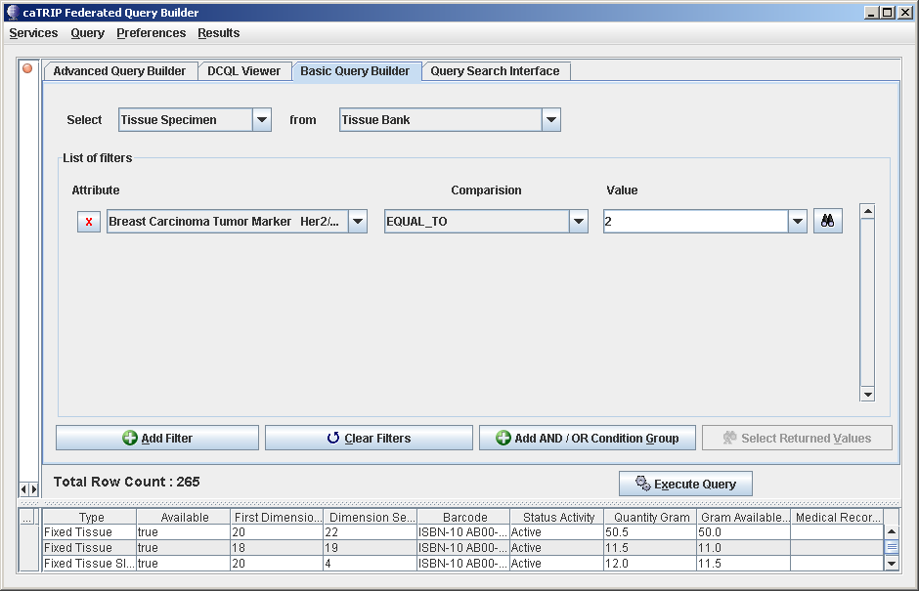
Topic 3: Comprehensive look at the “Basic Query Builder”
Example query #1: Find all the tissue specimens from patients that have a her2/new status of positive
Click on ‘Execute Query’
Returned results to the ‘Query Results Canvas’
1
2
Notes:
To build a query, do the following:
Select the ‘return’ data
Select the table
Add filters to the query by:
Clicking on the ‘Add Filter’, ‘Clear Filters’ and ‘Add ADD/OR Condition Group’ buttons, as needed
Then select the ‘Attributes’, ‘Comparison’ and the ‘Value’ for each filter
Note: to populate the codelist for the ‘Value’ pulldown, click on the binoculars
Once the filters have been defined, click on the ‘Execute Query’ button and results will appear on the bottom half of the GUI window

Slide 19
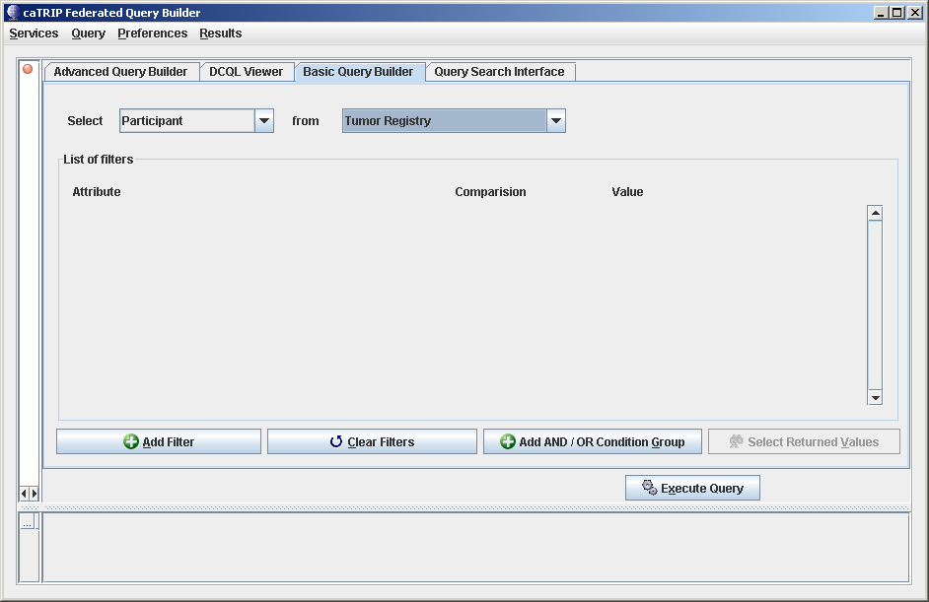
Topic 3: Comprehensive look at the “Basic Query Builder”
Example query #2: Find all the tissue specimens from patients that have a tissue dimension of 3 OR 4 mm.
1
2
Select the ‘Target Data Elements’ = Participant
Select the ‘Data Source’ = Tissue Bank
Notes:
To build a query, do the following:
Select the ‘return’ data
Select the table
Add filters to the query by:
Clicking on the ‘Add Filter’, ‘Clear Filters’ and ‘Add ADD/OR Condition Group’ buttons, as needed
Then select the ‘Attributes’, ‘Comparison’ and the ‘Value’ for each filter
Note: to populate the codelist for the ‘Value’ pulldown, click on the binoculars
Once the filters have been defined, click on the ‘Execute Query’ button and results will appear on the bottom half of the GUI window

Slide 20
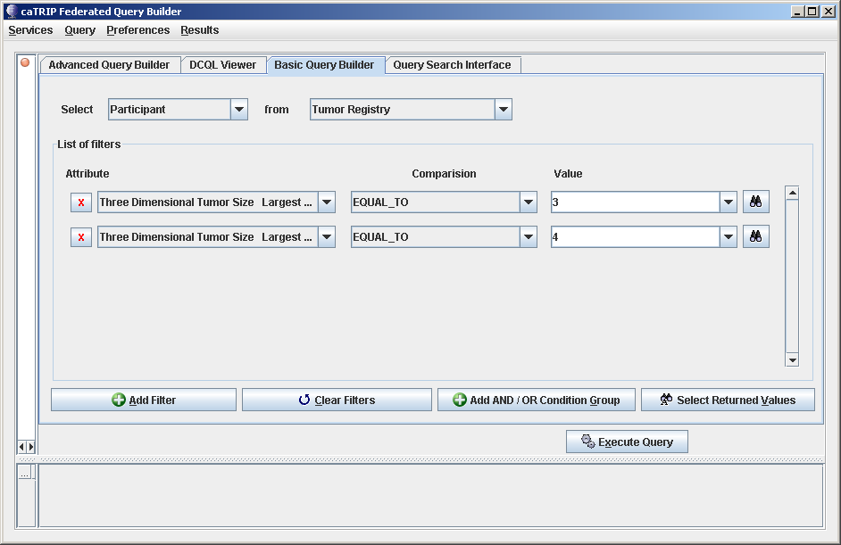
Topic 3: Comprehensive look at the “Basic Query Builder”
Example query #2: Find all the tissue specimens from patients that have a tissue dimension of 3 OR 4 mm.
Note: To populate the codelist for the ‘Value’ pulldown, click on the binoculars
2
3
4
Click on ‘Add Filter’, twice, to create 2 attribute filters
Select ‘Attribute’ = ‘Three Dimensional Tumor Size Largest Dimension’, for each filter
Set ‘Comparison’ = Equal_To, of each
Select ‘Value’ = 3, for the 1st filter and ‘Value’ = 4, for the 2nd filter, after clicking the binoculars
1
Notes:
To build a query, do the following:
Select the ‘return’ data
Select the table
Add filters to the query by:
Clicking on the ‘Add Filter’, ‘Clear Filters’ and ‘Add ADD/OR Condition Group’ buttons, as needed
Then select the ‘Attributes’, ‘Comparison’ and the ‘Value’ for each filter
Note: to populate the codelist for the ‘Value’ pulldown, click on the binoculars
Once the filters have been defined, click on the ‘Execute Query’ button and results will appear on the bottom half of the GUI window

Slide 21

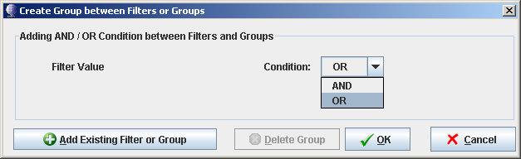
Topic 3: Comprehensive look at the “Basic Query Builder”
Example query #2: Find all the tissue specimens from patients that have a tissue dimension of 3 OR 4 mm.
Click on ‘Add AND / OR’, to ‘OR’ the 2 attribute filters
A popup box will appear
Click on the ‘OR’ Condition and then the ‘OK’ button
1
2
3
Notes:
To build a query, do the following:
Select the ‘return’ data
Select the table
Add filters to the query by:
Clicking on the ‘Add Filter’, ‘Clear Filters’ and ‘Add ADD/OR Condition Group’ buttons, as needed
Then select the ‘Attributes’, ‘Comparison’ and the ‘Value’ for each filter
Note: to populate the codelist for the ‘Value’ pulldown, click on the binoculars
Once the filters have been defined, click on the ‘Execute Query’ button and results will appear on the bottom half of the GUI window

Slide 22
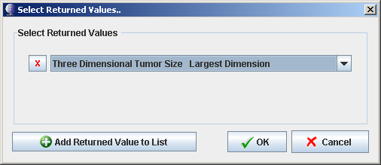
Topic 3: Comprehensive look at the “Basic Query Builder”
Example query #2: Find all the tissue specimens from patients that have a tissue dimension of 3 OR 4 mm.
To, additional return values, click on ‘Select Returned Values’ and a popup box will appear
Click on ‘Add Return Values To List’
Select value (repeat this step for each additional value wanted)
Then click the ‘OK’ button
1
3
2
4
Notes:
To build a query, do the following:
Select the ‘return’ data
Select the table
Add filters to the query by:
Clicking on the ‘Add Filter’, ‘Clear Filters’ and ‘Add ADD/OR Condition Group’ buttons, as needed
Then select the ‘Attributes’, ‘Comparison’ and the ‘Value’ for each filter
Note: to populate the codelist for the ‘Value’ pulldown, click on the binoculars
Once the filters have been defined, click on the ‘Execute Query’ button and results will appear on the bottom half of the GUI window

Slide 23
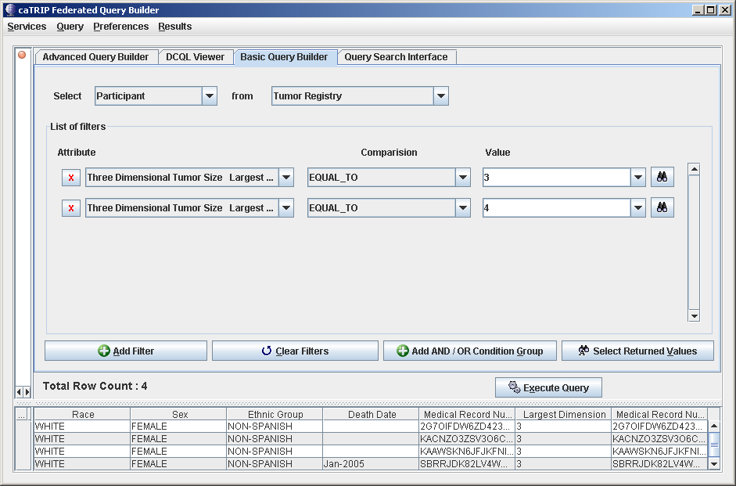
Topic 3: Comprehensive look at the “Basic Query Builder”
Example query #2: Find all the tissue specimens from patients that have a tissue dimension of 3 OR 4 mm.
Click on ‘Execute Query’
Returned results to the ‘Query Results Canvas’
Note: The additional ‘Largest Dimension’ column
1
2
Notes:
To build a query, do the following:
Select the ‘return’ data
Select the table
Add filters to the query by:
Clicking on the ‘Add Filter’, ‘Clear Filters’ and ‘Add ADD/OR Condition Group’ buttons, as needed
Then select the ‘Attributes’, ‘Comparison’ and the ‘Value’ for each filter
Note: to populate the codelist for the ‘Value’ pulldown, click on the binoculars
Once the filters have been defined, click on the ‘Execute Query’ button and results will appear on the bottom half of the GUI window

Slide 24
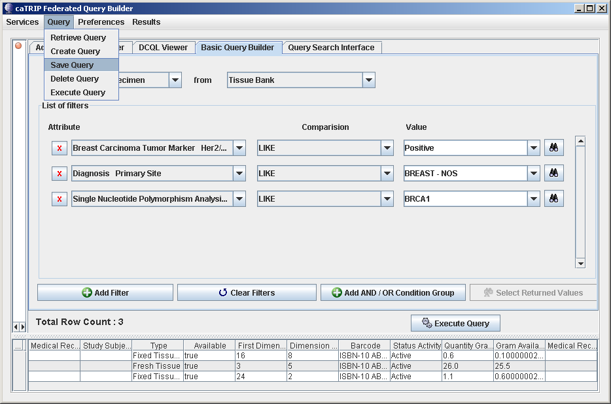
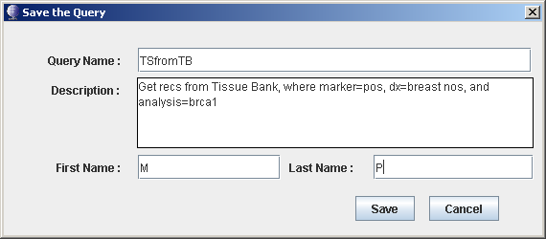
Topic 3: Comprehensive Look at the “Basic Query Builder”
Saving a query:
1 To save a query that has been created, select the ‘Save Query’ for the ‘Query’ pulldown
Enter info about query and click ‘Save’ 2
Notes:
To save a query for using again later:
On the toolbar, click: Query -> Save Query
A popup appears, allowing the user to ‘Name’ and the ‘Description’ of the query
Then, by entering the user’s name and clicking ‘Save’
The query and be retrieved for later use

Slide 25
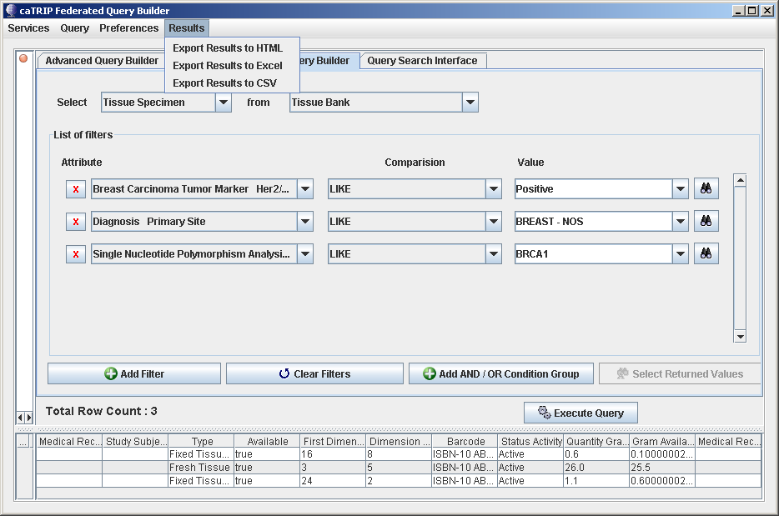
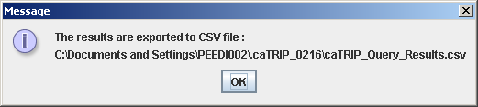
Topic 3: Comprehensive Look at the “Basic Query Builder”
Saving the results:
1 Click on ‘Results’ and select either: ‘Export Results to HTML’, ‘Export Results to Excel’ or ‘Export Results to CSV’
Once the results format has been selected, the output is written to the file system and a message box will appear. 2
Notes:
To save the results of a query, to the file system:
On the toolbar, click:
Results -> Export Results to HTML (to save to a HTML doc)
Results -> Export Results to Excel (to save to a Excel doc)
Results -> Export Results to CSV (to save to a comma delimited doc)

Slide 26
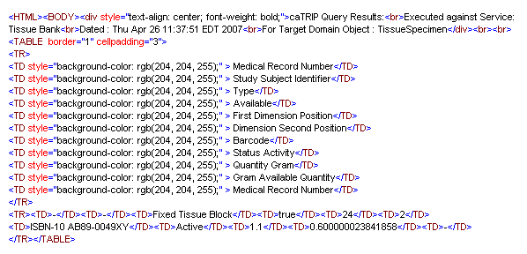
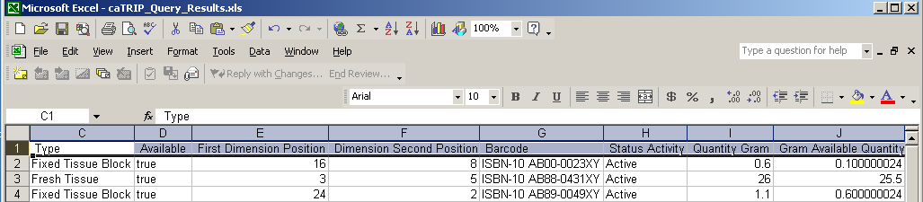
Topic 3: Comprehensive Look at the “Basic Query Builder”
Saving the results - Snippet of the output files of results:
  HTML Format:
  Excel Format:

Slide 27
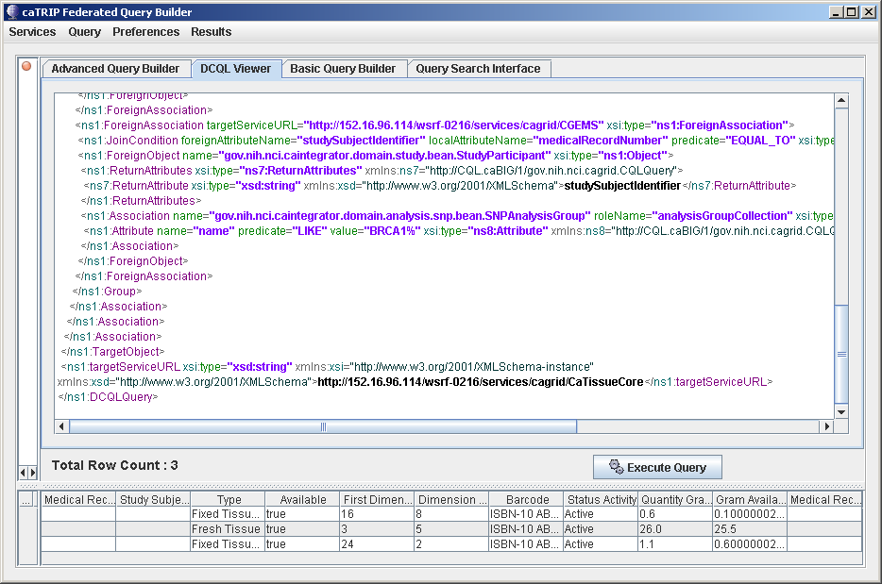
Topic 3: Comprehensive Look at the “Basic Query Builder”
Viewing the DCQL:
This allows for viewing the ‘behind the scenes’ view of the DCQL code…
Note: This area is ‘Read Only’ text area of what the ‘Basic Query’ looks like in DCQL
Notes:
To view the DCQL for the ‘Basic Query’ created:
Click on the ‘DCQL Viewer’ tab

Slide 28
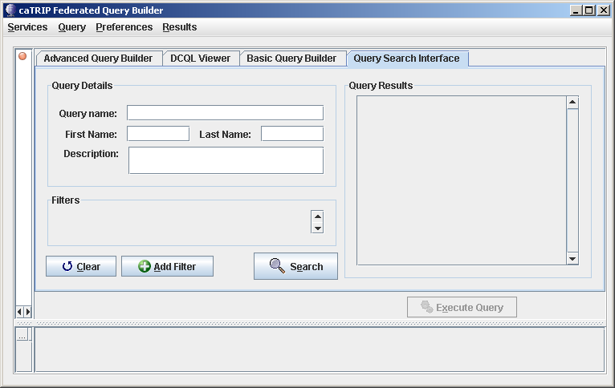
Topic 4: Overview of the “Query Search Interface”
Retrieving saved queries:
Query Details about the query saved, to help in the ret
Resulting queries will be listed here, after the search
Clear and add filters to the query
Search for saved queries, according to what is entered into the ‘Query Details’
Execute Query after it has been retrieved
Notes:
To save the results of a query, to the file system:
Click on the ‘Query Search Interface’ tab
Click on the ‘Search’ button
And all the queries that are saved will appear in the ‘Query Results’
To retrieve the query and run it:
Select the query
Then, either click ‘Run’ next to the query or ‘Execute Query’ button
Results from executing the query will appear in the bottom half of the GUI

Slide 29
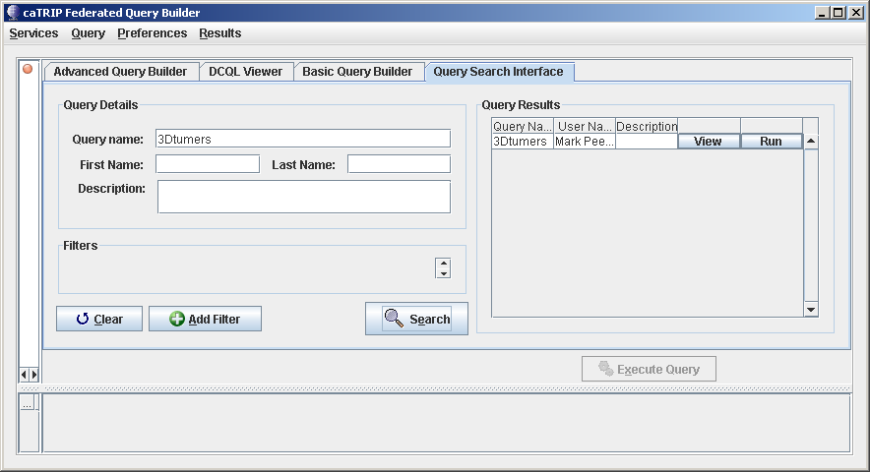
Topic 5: Comprehensive Look at the “Query Search Interface”
Retrieving a query, by ‘Query name’:
1
3
2
Enter the name of the saved query
Click on the ‘Search’ button
The resulting query will be populated in the ‘Query Results
Notes:
To save the results of a query, to the file system:
Click on the ‘Query Search Interface’ tab
Click on the ‘Search’ button
And all the queries that are saved will appear in the ‘Query Results’
To retrieve the query and run it:
Select the query
Then, either click ‘Run’ next to the query or ‘Execute Query’ button
Results from executing the query will appear in the bottom half of the GUI

Slide 30
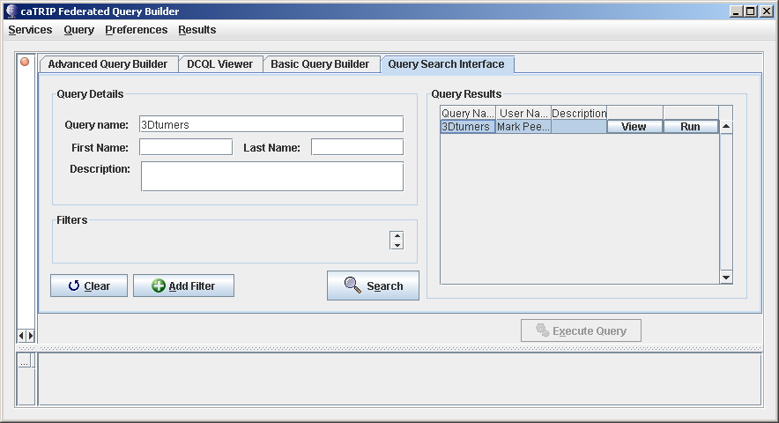
Topic 5: Comprehensive Look at the “Query Search Interface”
Executing a selected retrieved query:
2
1
Select the query in the ‘Query Results’, to run
Click on the ‘Run’ button
If there are results, they will be populated in the results pane.
3
Notes:
To save the results of a query, to the file system:
Click on the ‘Query Search Interface’ tab
Click on the ‘Search’ button
And all the queries that are saved will appear in the ‘Query Results’
To retrieve the query and run it:
Select the query
Then, either click ‘Run’ next to the query or ‘Execute Query’ button
Results from executing the query will appear in the bottom half of the GUI

Slide 31
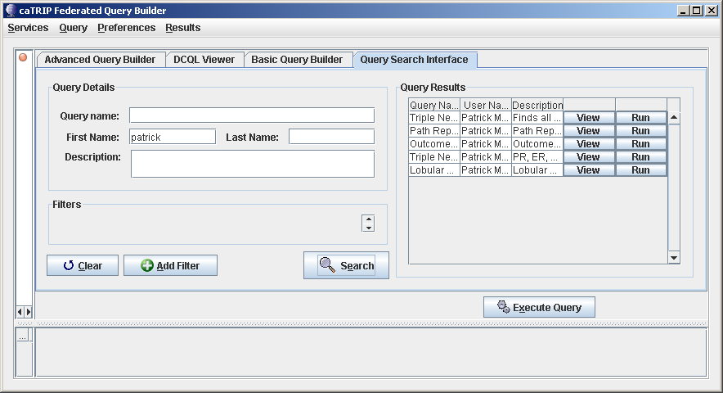
Topic 5: Comprehensive Look at the “Query Search Interface”
Retrieving a query, by ‘First Name / Last Name’:
1
1
3
2
Enter all or part of the first and last name, that was entered as the author of the saved query (ies)
Click on the ‘Search’ button
The resulting query (ies) will be populated in the ‘Query Results
Notes:
To save the results of a query, to the file system:
Click on the ‘Query Search Interface’ tab
Click on the ‘Search’ button
And all the queries that are saved will appear in the ‘Query Results’
To retrieve the query and run it:
Select the query
Then, either click ‘Run’ next to the query or ‘Execute Query’ button
Results from executing the query will appear in the bottom half of the GUI

Slide 32
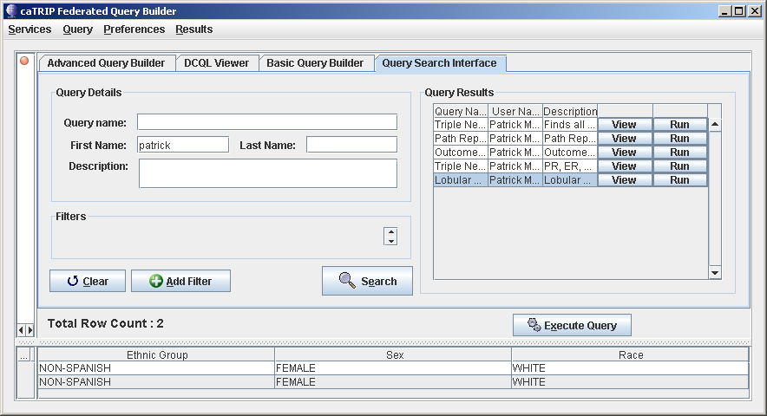
Topic 5: Comprehensive Look at the “Query Search Interface”
Executing a selected retrieved query:
1
2
Select the query in the ‘Query Results’, to run
Click on the ‘Execute Query’ button
The results will be populated in the results pane.
3
Notes:
To save the results of a query, to the file system:
Click on the ‘Query Search Interface’ tab
Click on the ‘Search’ button
And all the queries that are saved will appear in the ‘Query Results’
To retrieve the query and run it:
Select the query
Then, either click ‘Run’ next to the query or ‘Execute Query’ button
Results from executing the query will appear in the bottom half of the GUI

Slide 33
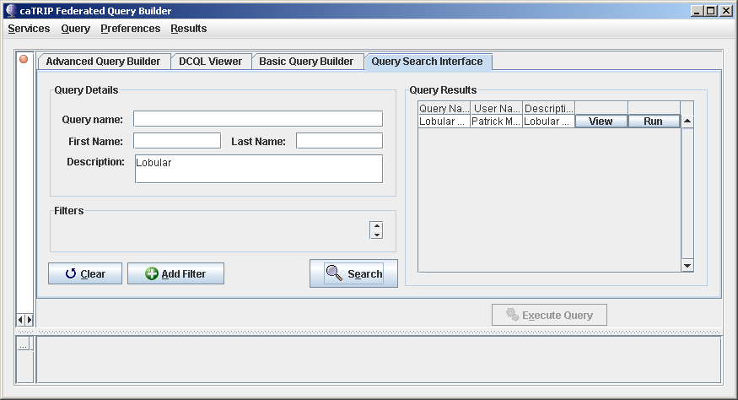
Topic 5: Comprehensive Look at the “Query Search Interface”
Retrieving a query, by ‘Description’:
3
1
2
Enter all or part of the description, that was entered when the query was saved
Click on the ‘Search’ button
The resulting query will be populated in the ‘Query Results’
Notes:
To save the results of a query, to the file system:
Click on the ‘Query Search Interface’ tab
Click on the ‘Search’ button
And all the queries that are saved will appear in the ‘Query Results’
To retrieve the query and run it:
Select the query
Then, either click ‘Run’ next to the query or ‘Execute Query’ button
Results from executing the query will appear in the bottom half of the GUI

Slide 34
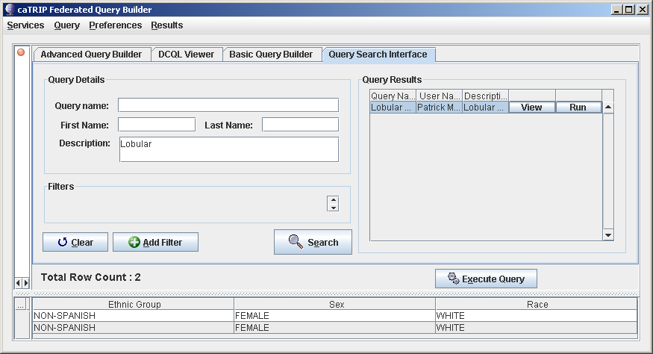
Topic 5: Comprehensive Look at the “Query Search Interface”
Executing a selected retrieved query:
2
1
Select the query in the ‘Query Results’, to run
Click on the ‘R’ button, to run the query
The results will be populated in the results pane.
3
Notes:
To save the results of a query, to the file system:
Click on the ‘Query Search Interface’ tab
Click on the ‘Search’ button
And all the queries that are saved will appear in the ‘Query Results’
To retrieve the query and run it:
Select the query
Then, either click ‘Run’ next to the query or ‘Execute Query’ button
Results from executing the query will appear in the bottom half of the GUI

Slide 35
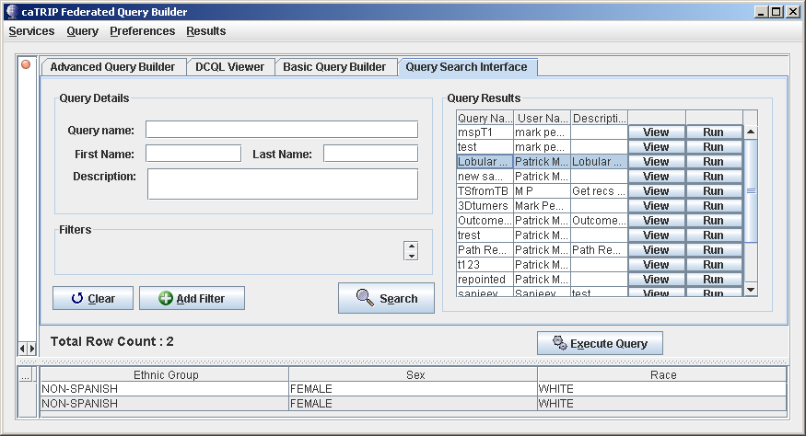
Topic 5: Comprehensive Look at the “Query Search Interface”
Retrieving all saved queries and executing selected one:
2
3
1
Leave ‘Query Details’ blank and click on the ‘Search’ button, populating in the ‘Query Results’
Select the query in the ‘Query Results’, to run
Click on the ‘Run’ button, to run the query
The results will be populated in the results pane.
4

Slide 36
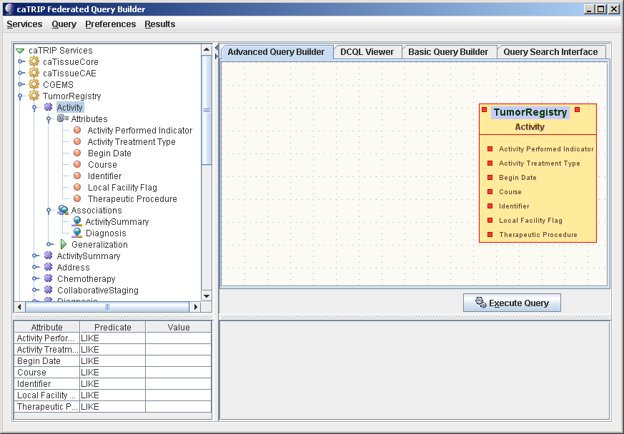
Topic 6: Overview of the “Advanced Query Builder”
Advanced Query Layout:
Data Sources
Attributes of Data Element
Associations between Data Elements
Data Elements
Filter Area of Attributes of Data Element

Slide 37
Topic 6: Overview of the “Advanced Query Builder”
Advanced Query Layout:
Canvas Area
Data Element
Search Results Area

Slide 38
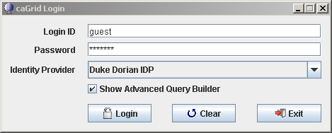
Topic 6: Overview of the “Advanced Query Builder”
1st, Need to select the ‘Show Advance Query Builder’:
Need to make sure that you check this box, upon logging in
1
And click [Login]
2

Slide 39
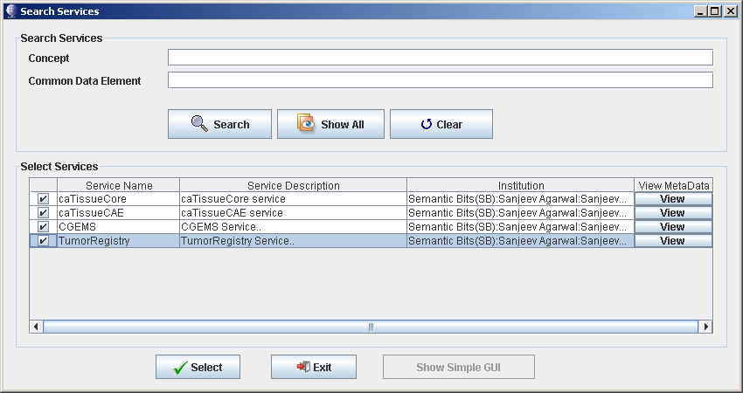
Topic 7: Comprehensive Look at “Advanced Query Builder”
2nd, Need to select the Search Services:
1
Click [Show All] button, to get all services available
Select the data services wanted
Then, click [Select]
2
3

Slide 40
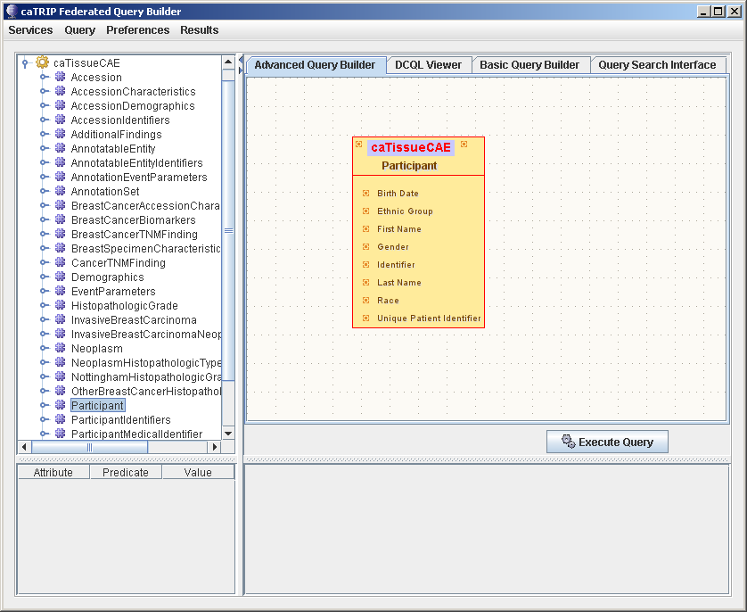
Topic 7: Comprehensive Look at “Advanced Query Builder”
3rd, Select the table objects from the services:
2
1
Select Data Element
Drag them to the Canvas Area

Slide 41
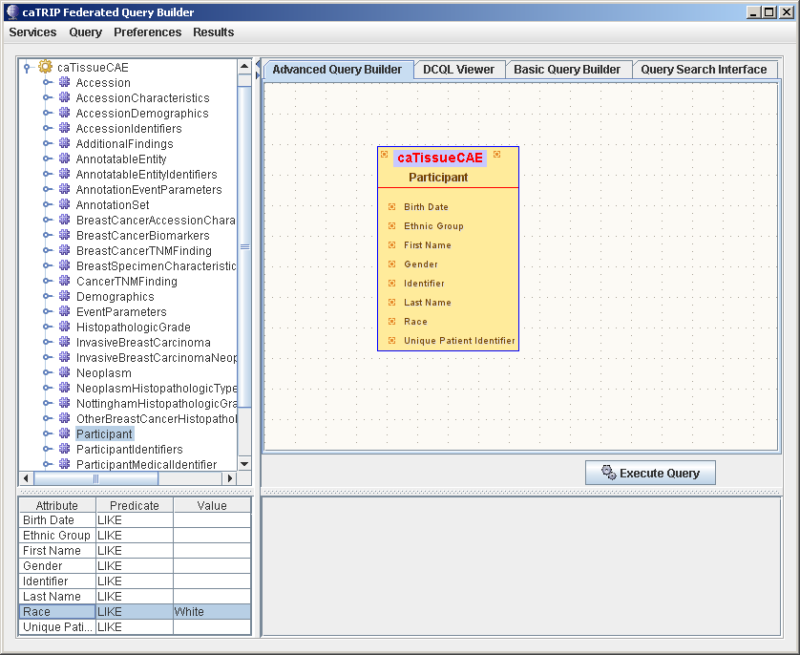
Topic 7: Comprehensive Look at “Advanced Query Builder”
4th, Click on the table object(s), to populate the attribute pain and enter any filtering values
3
2
1
Select data element (s)
Drag them to the canvas
Once the data element is on the canvas, click on the element
And the attributes will appear here, for filtering and enter necessary filter values
4

Slide 42
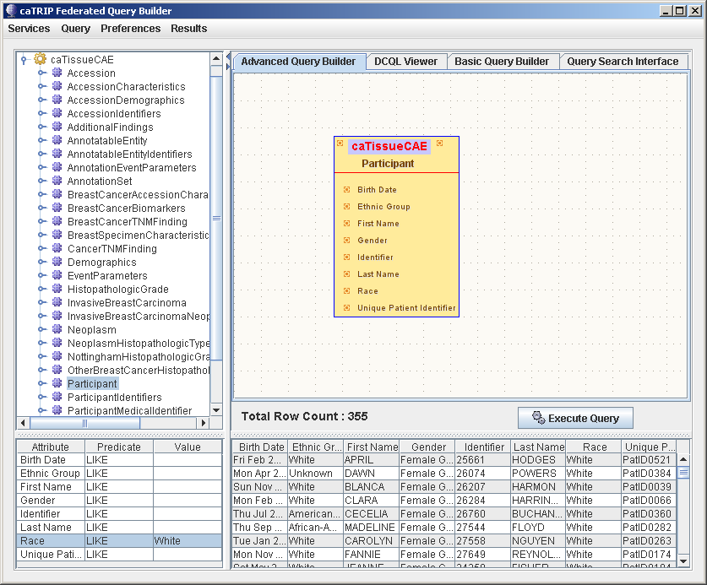
Topic 7: Comprehensive Look at “Advanced Query Builder”
5th, Click on the [Execute Query] button and the results will be populated in the results pane
1
Click [Execute Query]
Results appear here
2

Slide 43
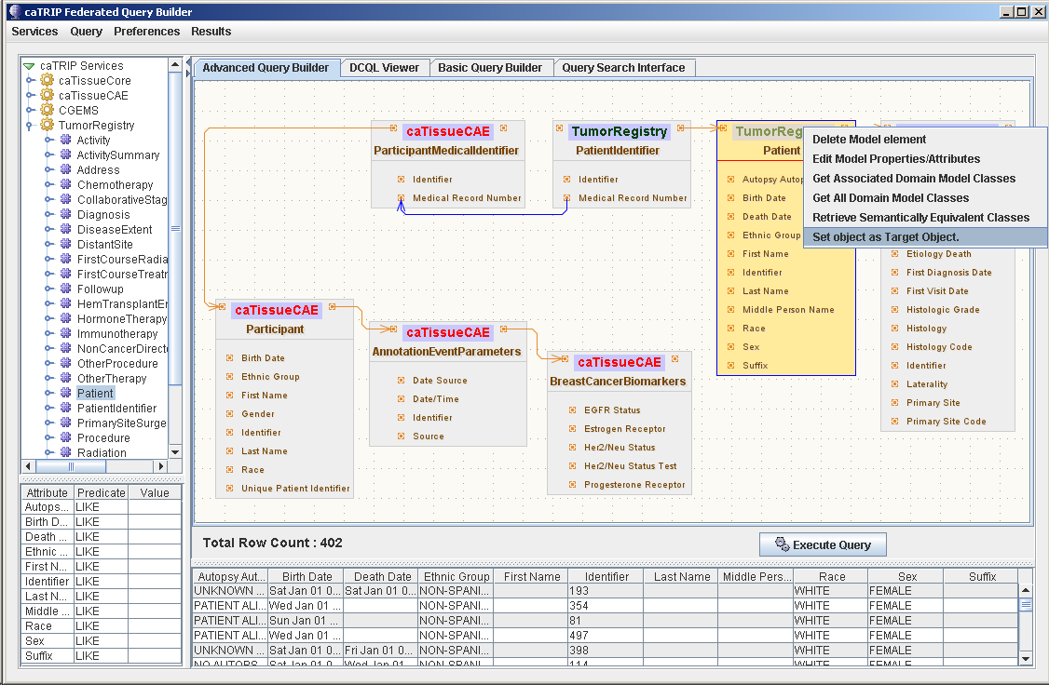

Topic 7: Comprehensive Look at “Advanced Query Builder”
Another example of an Advanced Query
Note:
Right click on the top part of the class object and a ‘pulldown’ appears, of what can be done to the object
Note:
Hovering the mouse over the top part of the class object and service & package names appear

Slide 44
Session Review
Now that you have successfully completed this training, you should be able to
  Describe what is the caTRIP GUI
  Describe will benefit from the caTRIP GUI
  Launch and use the caTRIP GUI
  Use the “Basic Query Builder”
  Use the “Query Search Interface”
  Use the “Advance Query Builder”

Slide 45
Session Review:
Questions?
Please send us your questions and/or suggestions to:
  catrip-training@gforge.nci.nih.gov
You can also refer to the user’s guide for more information:
caTRIP_End_User_Manual.doc (http://gforge.nci.nih.gov/projects/catrip)

