Slide 1
The Cancer Translational Research Informatics Platform (caTRIP)
Architecture/VCDE Topics
Patrick
Duke Comprehensive Cancer Center
patrick.mcconnell@duke.edu
August 6, 2007

Slide 2
Agenda
Background (5 min)
  Focus, distributed systems, architectural components
Demonstration (5 min)
  Clinical scenario
Architecture and VCDE Implications (10 min)
  Architecture, security, return values, complexity, data sharing, CDE reuse
Next Steps (2 min)
  Cross-institutional queries, HTP, reporting, UI integration, querying
Discussion (8 min)
  Documentation, training instance, release

Slide 3
Who is involved in caTRIP?
Duke Bioinformatics
  Jamie Cuticchia (PI)
  Patrick McConnell (lead architect)
Duke Information Systems
  Bob Annechiarico (PM)
  Wilma Stanley (developer)
  Mark Peedin (developer)
  Mohamad Farid (DBA)
  Jeff Allred (IT manager)
Duke Pathology
  Raj Dash (domain expert)
  Chris Hubbard (developer)
Duke Oncology
  Kelley Marcom (domain expert)
  Gretchen Kimmick (domain expert)
  Kimberly Blackwell (domain expert)
  Lee Wilke (domain expert)
Duke CALGB
  Kimberly Johnson (DataMart liaison)
^{Software Developers}
^{Managers and Architects}
SemanticBits
  Ram Chilukuri (lead developer)
  Srini Akkala (developer)
  Sanjeev Agarwal (developer)
5 AM Solutions
  Bill Mason (developer)
NCI
  Juli Klemm (NCI rep)
  Carl Shaefer (NCI)
  Subha Madhavan (NCI)
BAH
  Curtis Lockshin (WS lead)
  Mehul Shah (tech support)
^{Database Developers and IT}
^{NCI/BAH}
^{Domain Experts}

Slide 4
Background
Initial focus
Our initial focus was on connecting existing data systems to enhance patient care
Initial problem scenario: outcomes analysis
  Use data from existing patients to inform the treatment of another patient
  Leverage clinical, pathology, tissue, and basic science data
Scenario:
Patient A enters the clinic. What treatments were applied with success on other patients with similar characteristics (race, sex, symptoms, pathology results, adverse events, biomarkers).

Slide 5
Background
Broadened focus: scientific use cases
Find available tumor tissue
  What are all the tissue specimens from her2/neu positive patients that have a primary tumor in the breast and are BRCA1 positive?
Find factors of survival
  What are all the ER positive patients that have survived breast cancer after radiation treatment?
Find patients for trials
  What are all the patients that are triple negative (ER, PR, and HER2/NEU negative)?
Determine the distribution of disease factors over time
  Does a change in pathology biomarkers over time contribute to recurrence or death?
Determine correlation of factors pre and post surgery
  Does a change in ER or PR status before and after surgery correlate with other factors?
Find pathology reports of interest
  Show me all of the pathology reports for Her2/Neu positive patients with a lobular carcinoma.

Slide 6
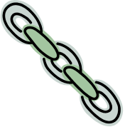
Background
Connecting disparate data systems
^{CAE}
^{Pathology Biomarkers}
^{Tumor Registry}
^{Diagnosis, Treatment,}
^{Recurrence, Follow-up}
^{caTissue CORE}
^{Tissue Bank}
^{MRN}
caTRIP
caTRIP
caTRIP
caTRIP
^{caIntegrator}
^{SNP Data}
^{caTIES}
^{Pathology Reports}

Slide 7




Background
Components
Graphical User Interface
Distributed Query Engine
Core caGrid Services
Grid Services
…
…
Institutional Services
Relational Databases
…
…

Slide 8
Demonstration
Clinical scenario
Clinical scenario for demonstration
  A patient enters the clinic and is diagnosed with a lobular carcinoma
  The Her2/Neu biomarker test comes back positive
  What are the treatments and outcomes of other patients with similar characteristics?
  Query for diagnosis date, treatment, survival, recurrence, and BRCA1 and BRCA2 status
  Look for treatments given with success and correlation between BRCA status in case test should be ordered

Slide 9

Architecture and VCDE Implications
Architecture
GUI
query
Distributed
Query
Engine
authenticate
discover
Core Grid Services
Domain Grid Services
IdP
Service
Index
Service
Grid
Grouper
authorize
caTissue
CORE
caTIES
CAE
TR
CGEMS
SNP
Duke
Domain
Controller
caTissue
CORE
caTIES
CAE
TR
caIntegrator
MAW3
Tumor Registry
Illumina

Slide 10
Architecture and VCDE Implications
Security architecture
authorization
User Grid
Certificate
authentication
Grid
Data Service
User
Credentials
SAML
Assertion
Dorian
CSM
Trust Fabric
caGrid
Authentication Service
Grid
Grouper
backend
data
Duke
Authentication Plugin
Duke Domain Controller
NT Security

Slide 11
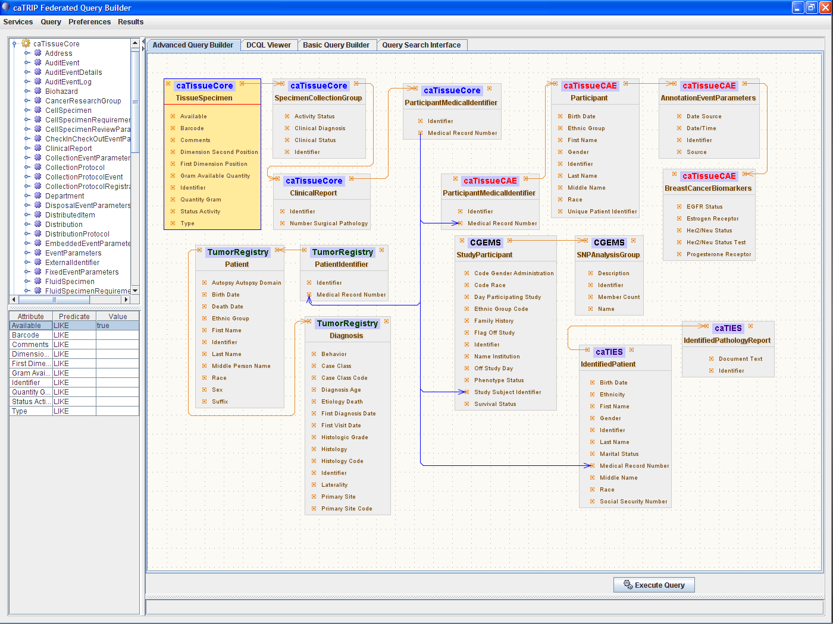
Architecture and VCDE Implications
Hiding the complexity
What are all the tissue specimens from her2/neu positive patients that have a primary tumor in the breast, are BRCA1 positive, and have a pathology report?
caTissue CORE
CAE
Participant
Medical Record Number
Tumor Registry
caTIES
CGEMS

Slide 12
Architecture and VCDE Implications
Hiding complexity
Service A
Service B
TissueSpecimen
SpecimenCollectionGroup
BreastCancerBiomarkers
Target
ClinicalReport
Linking Object
Join Condition
Associated
Classes
ParticipantMedicalIdentifier
Association Direction
Filter
Object
SpecimenCharacteristics
Associated Object Tree
Foreign Association inbound Paths
Linking Object
Join Condition
Join Condition: CDE ex. MRN
Target
Association Direction
Service A
Service B
Foreign Association Outbound Path
Foreign Association

Slide 13
Architecture and VCDE Implications
DQE/FQP: return values
CQL
caGrid data
service
database
data
objects
DCQL
Distributed
Query
Engine
CQL
caGrid data
service
database
data
objects
data
objects
CQL
database
caGrid data
service
data
objects

Slide 14


Architecture and VCDE Implications
Data sharing
Data is owned by different groups across the cancer center
Traditional deidentification: data manager deidentifies an entire dataset then throws away the key
Distributed deidentification: trusted service provider (TSP) deidentifies discreet values
Traditional approach is not scalable – requires a middle-man
IRB approval required for distributed approach because it deviates from traditional deidentification (at Duke)
Can join on GHI789, which is a deidentified ID
Distributed
Query
Engine
^{CAE}
^{caTissue}
^{CORE}
CAE
caTissue
CORE
GHI789
Trusted Service
Provider
GHI789
MRN3
MRN3
Data owners submit PHI to be deidentified by the TSP
^{Data Owner}
^{Data Owner}

Slide 15
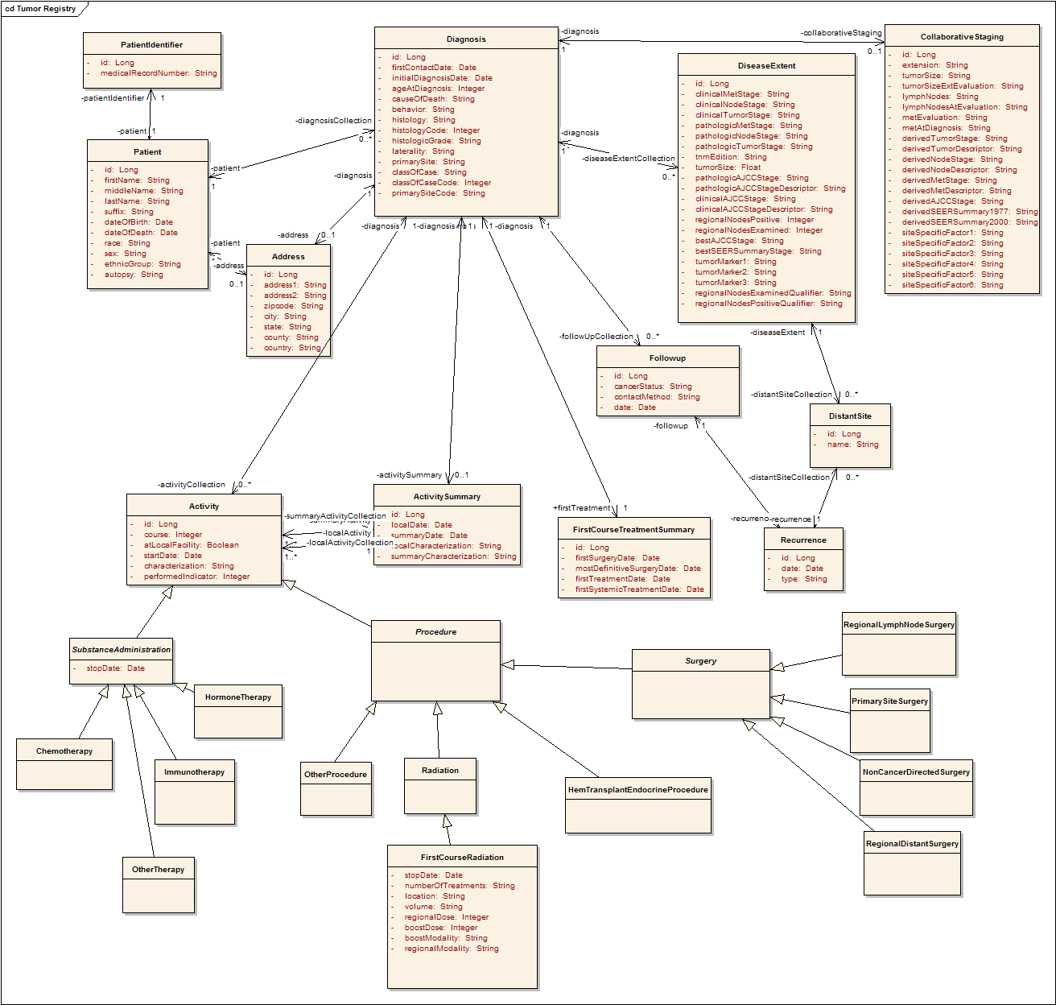
Architecture and VCDE Implications
Tumor Registry model
Participant
Diagnosis
Collaborative
Staging
Follow up and
Recurrence
Treatment

Slide 16
Architecture and VCDE Implications
Tooling for CDE reuse

Slide 17
Next Steps
Wider spread adoption of caTRIP and underlying tools
Cross-institutional queries
  What are all of the breast tissue specimens on the grid from patients that are positive for the estrogen receptor biomarker?
Enhanced support for high throughput datasets
  Now give me all the microarray experiments for those patients.
Enhanced reporting
  I want to export the data to Excel with an automated pivot on key data columns.
Integration at a user interface level
  I’ve identified some patients of interest, now let me order the tissue samples.
Enhanced querying
  I know my query is going to take a long time, so just email me the results when they are done

Slide 18
Discussion
Architecture and VCDE Implications
  Distributed architecture, security architecture
  Return values from CQL/DCQL queries
  Hiding the complexity of underlying models
  Data sharing and deidentification
  Tooling for CDE reuse
For more information
  Documentation (Docs tab at: http://gforge.nci.nih.gov/projects/catrip/)
    End user guide, training module, technical guide/installation manual, administration guide, release notes
  Training instance: http://152.16.96.114/catrip-webstart/
  Release (Files tab at http://gforge.nci.nih.gov/projects/catrip/)

Slide 19
Cancer Translational Research Informatics Platform (caTRIP)
Backup demonstration

Slide 20
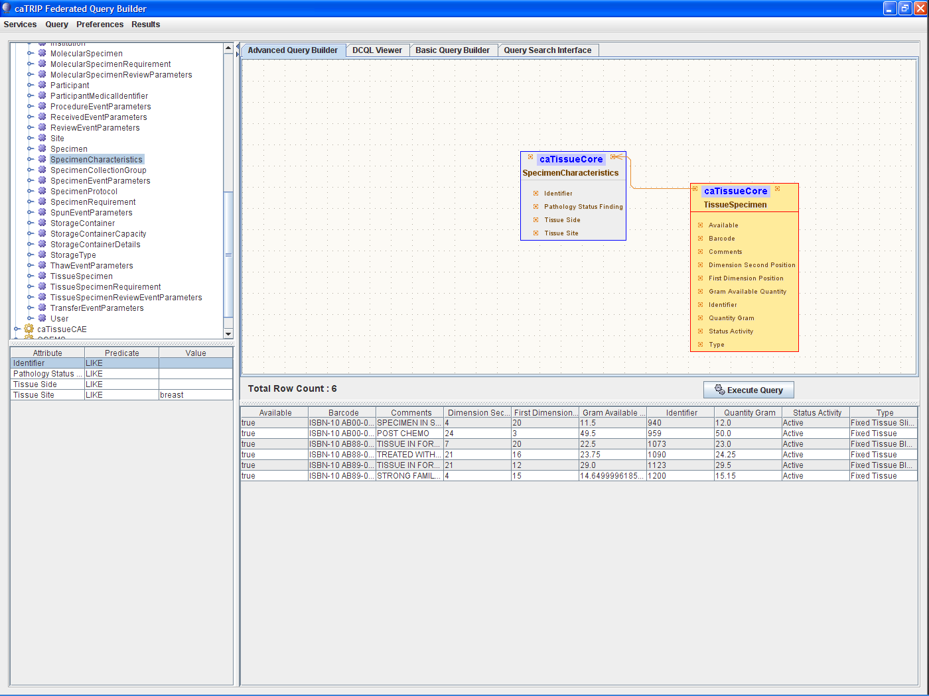

Slide 21
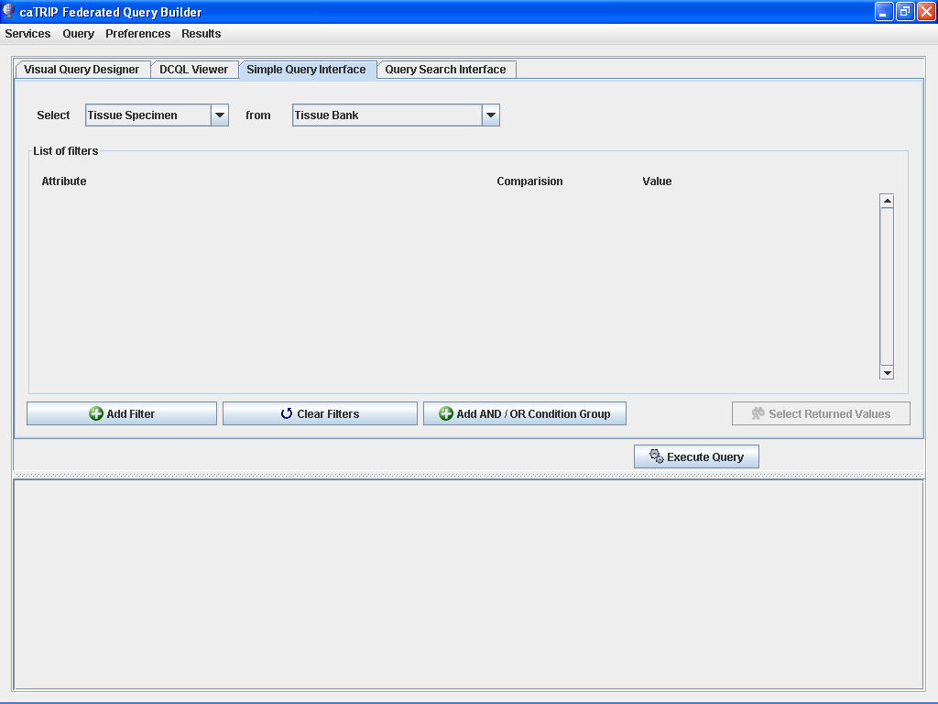

Slide 22
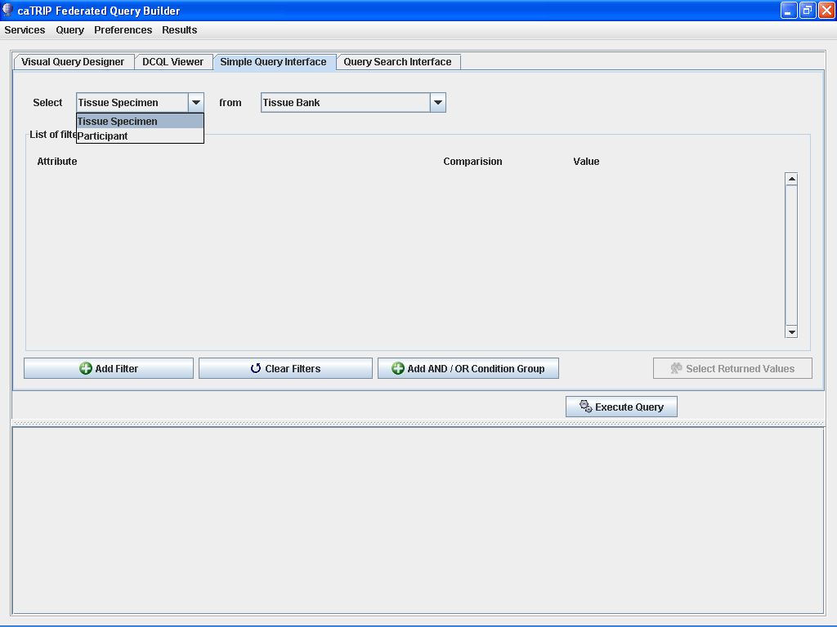

Slide 24
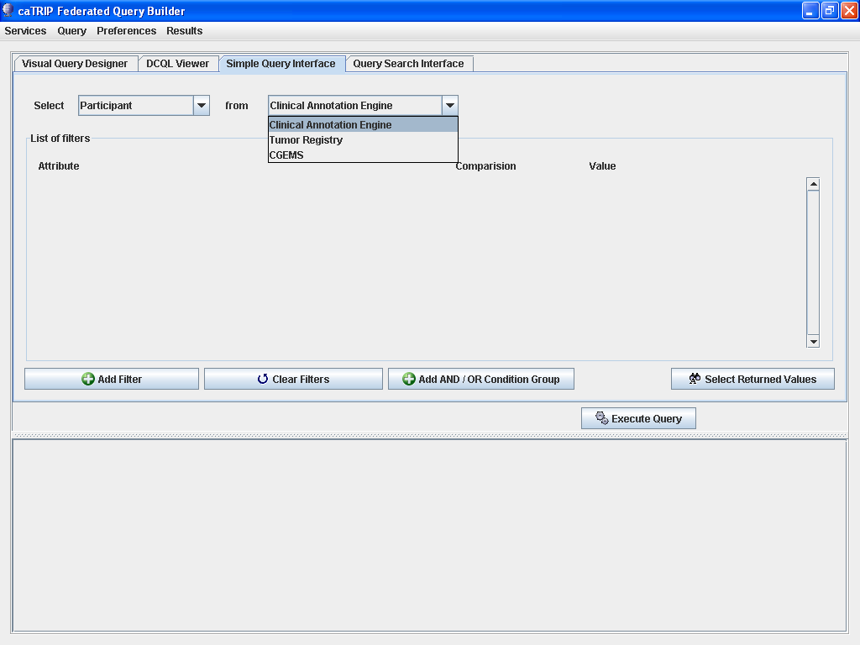

Slide 25
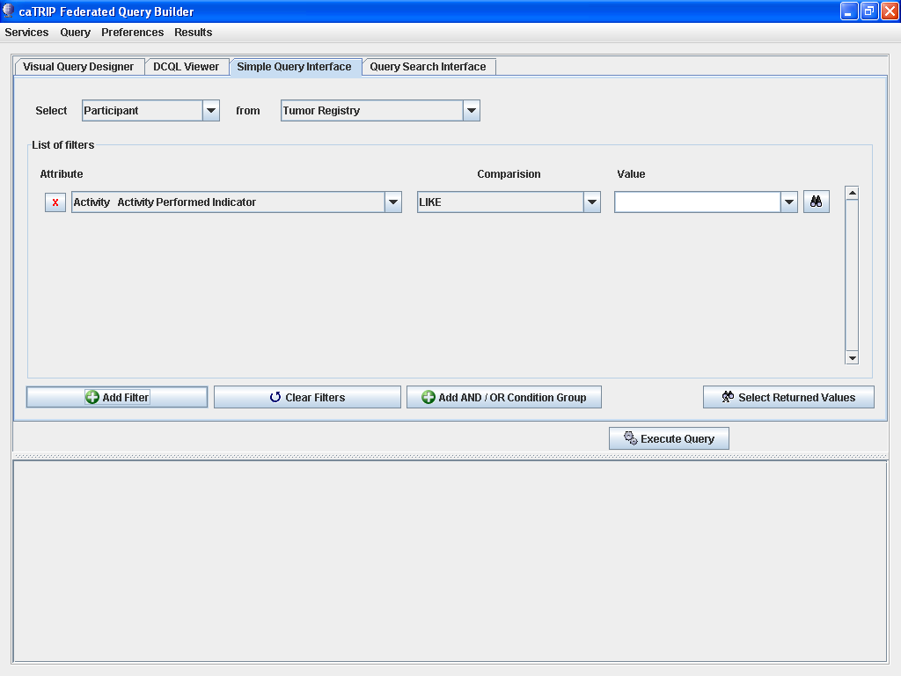

Slide 26
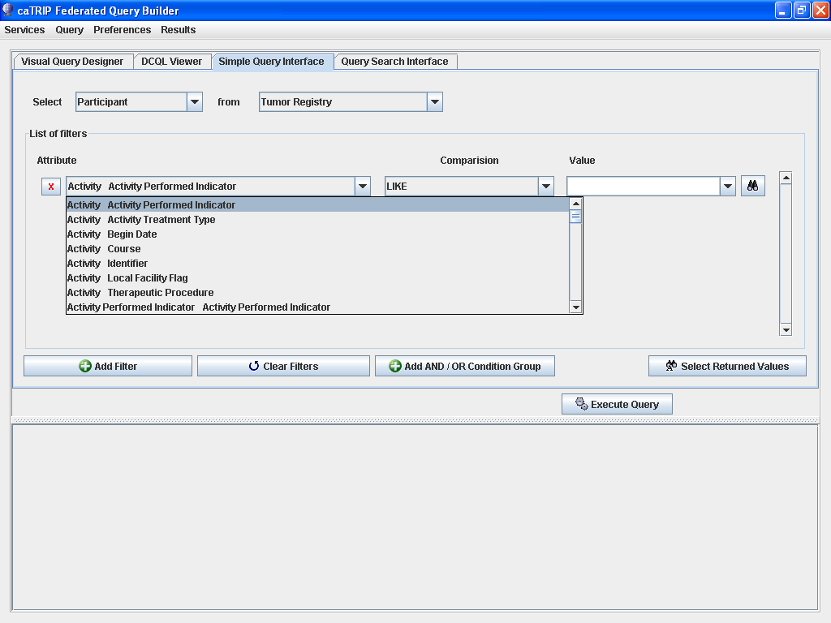

Slide 27
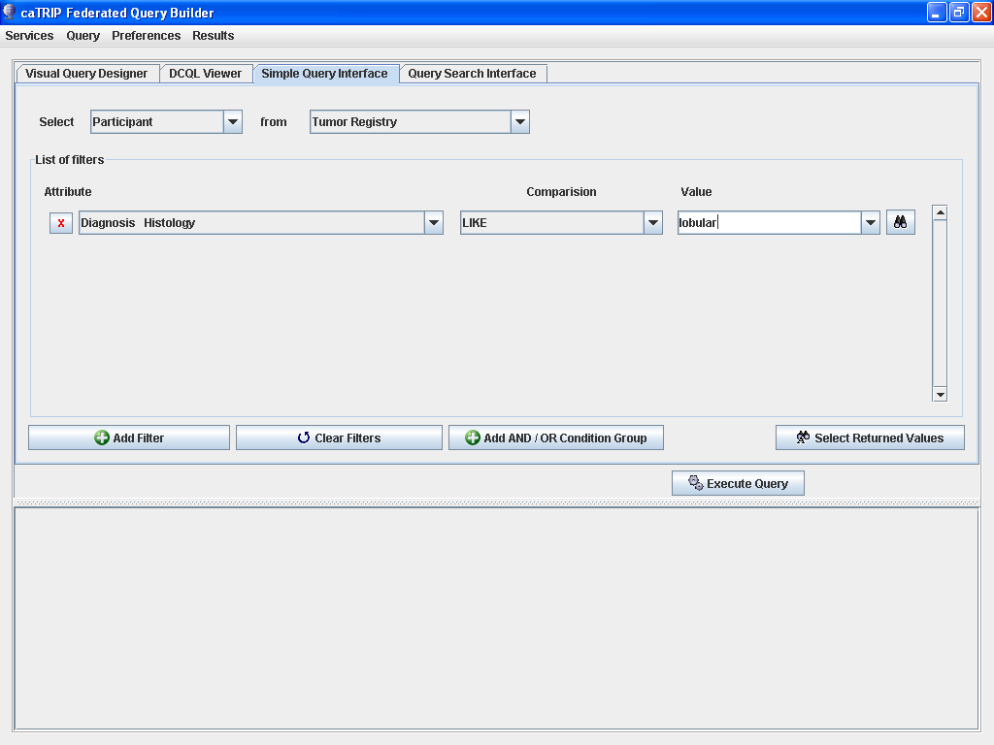

Slide 28
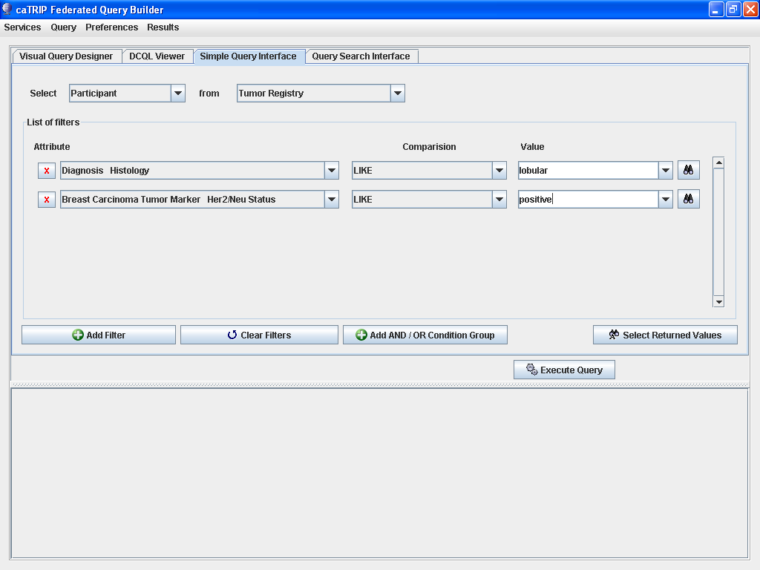

Slide 29
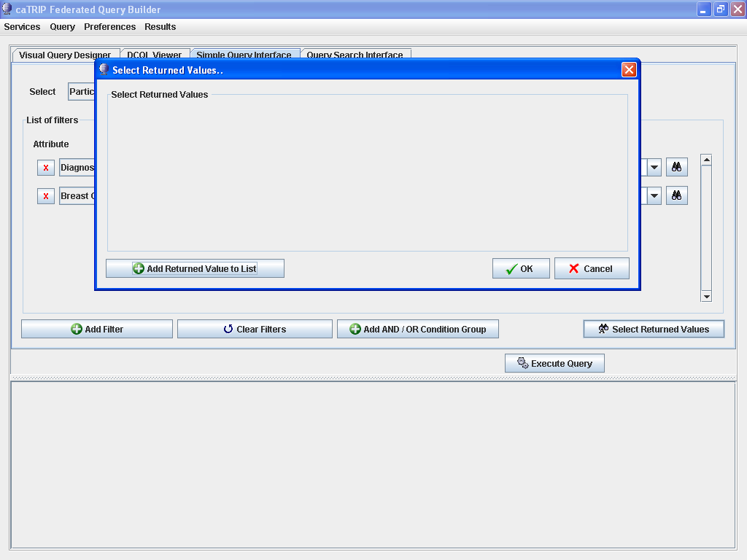

Slide 30
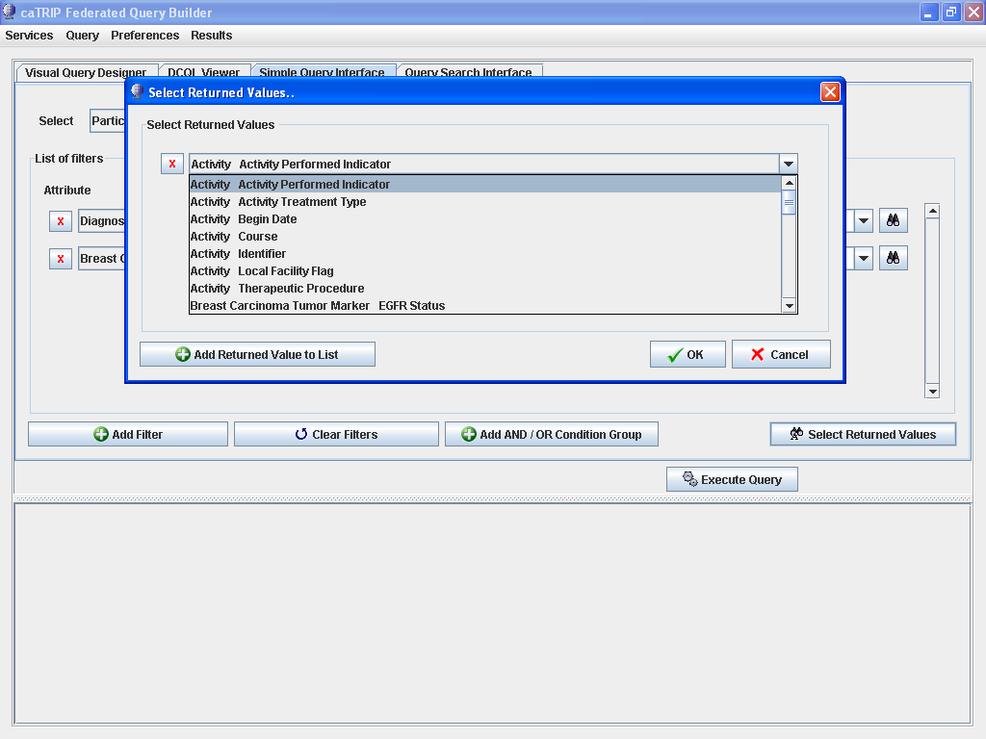

Slide 31
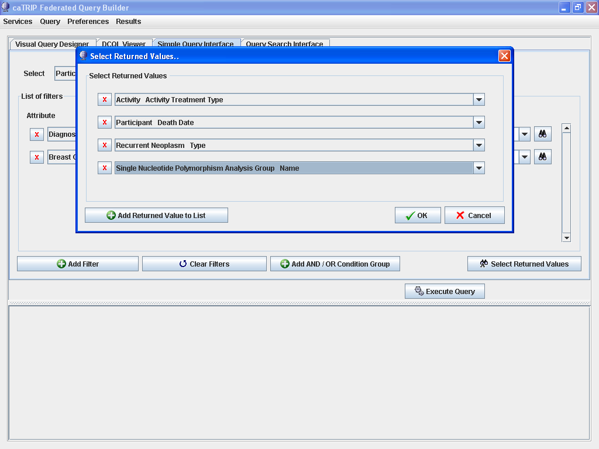

Slide 32
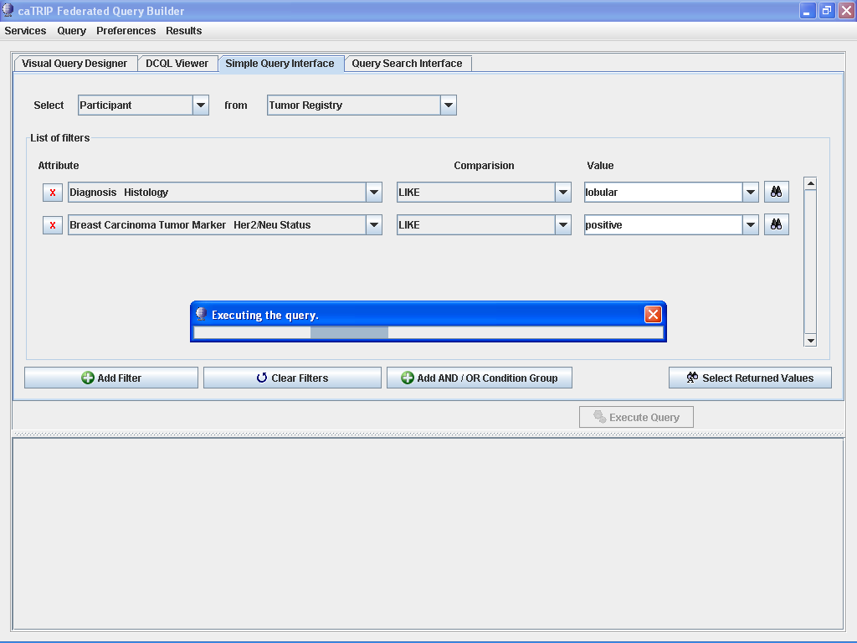

Slide 33
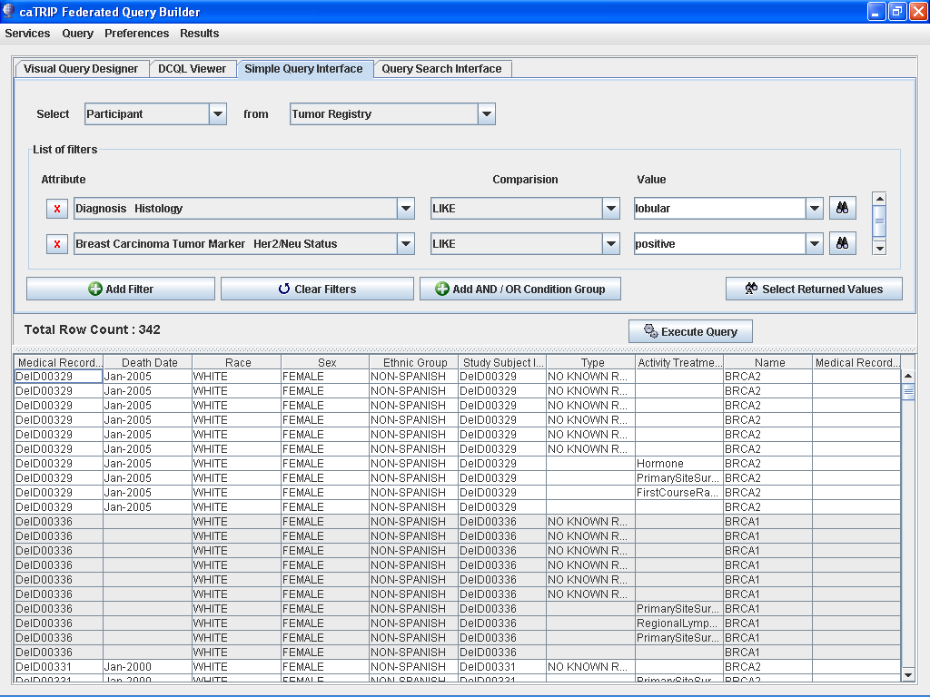

Slide 34
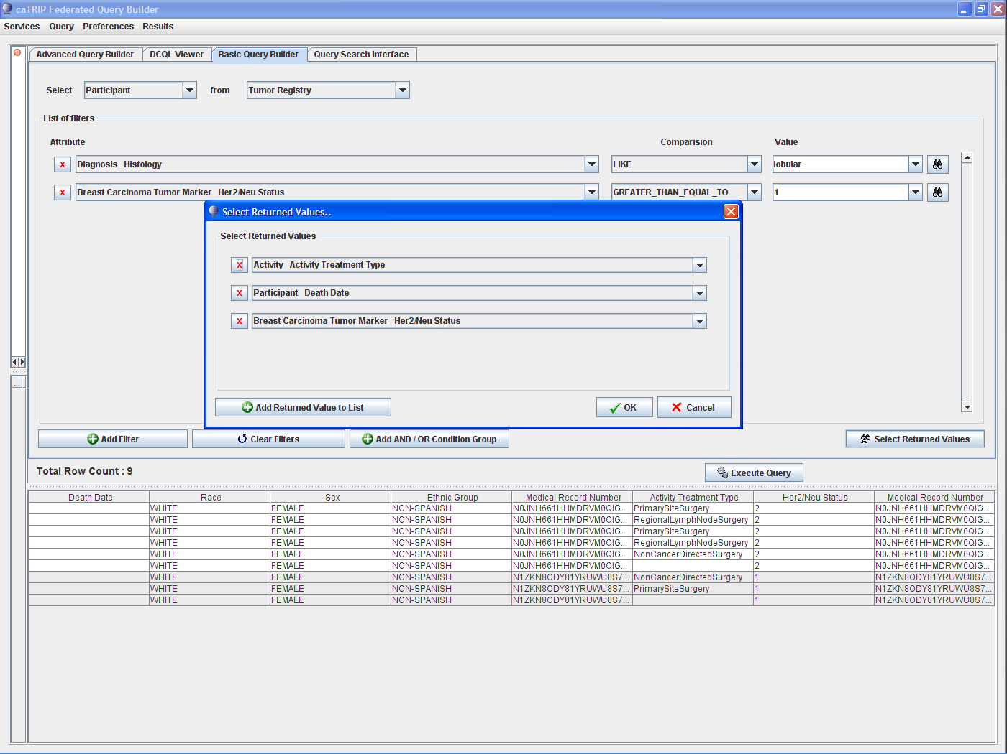

Slide 35
