Slide 1

caGrid Data Service Overview
Builds XML CQL query
query(CQL Query)
caGrid
Data Service
caGrid
Client
Deserialized Data Objects
CQLQueryResults
processQuery(CQLQuery)
CQLQueryResults
Serialized to XML
Query Processor
ResultSet
createQuery(HQL Query)
Data Source

Slide 2
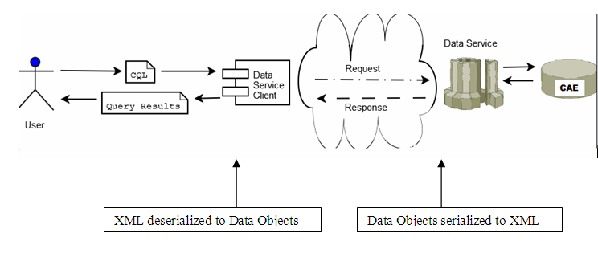
caGrid Data Service Overview

Slide 3
caGrid Data Service Invocation
Client builds CQL Query
CQL query is submitted as part of request to the query() method of the caGrid data service via standard grid protocol
Data service deserializes XML representation of CQL query into a CQLQuery object and then passes it to configured CQL Query Processor implementation class
CQL query processor converts CQL into HQL and queries the underlying data source to generate the result set.
Results are serialized as XML and returned to the client as a single CQLQueryResults object.
Introduce generated data service client iterates thru the result set and deserializes the XML into java object

Slide 4
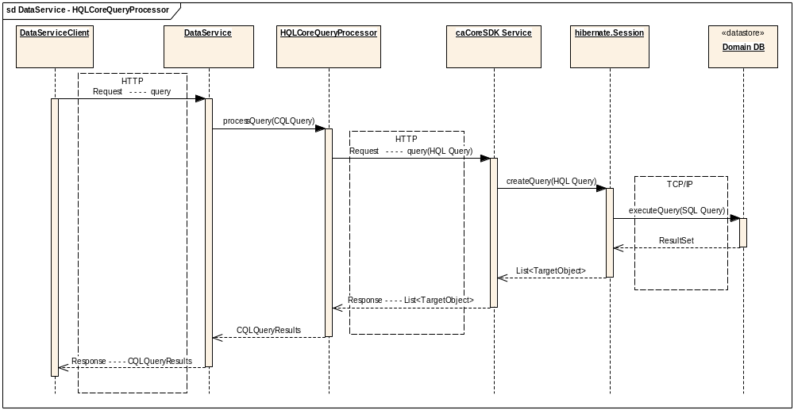
Data Service - HQLCoreQueryProcessor

Slide 5
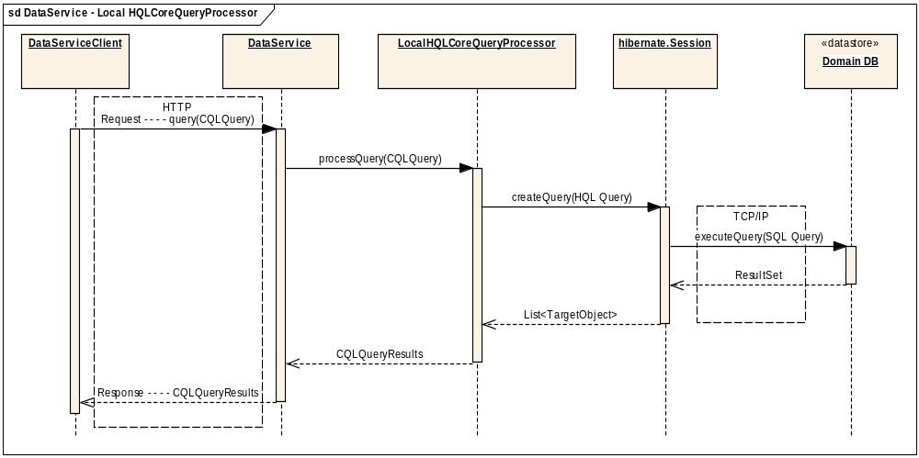
Data Service - LocalHQLCoreQueryProcessor

Slide 6
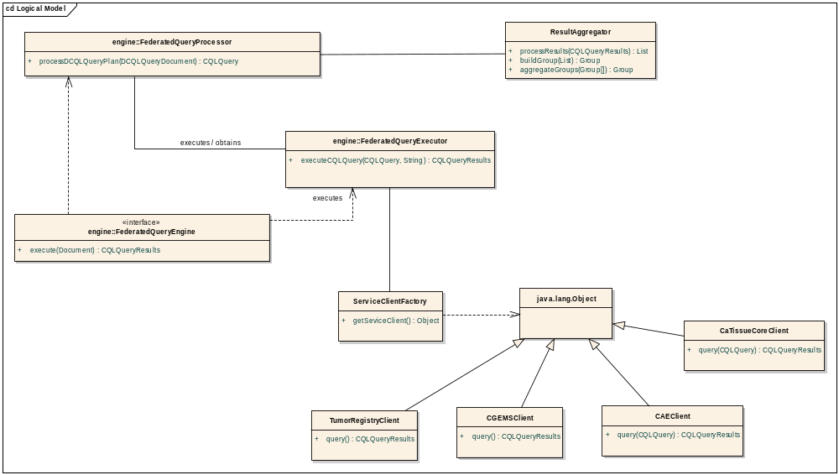
Federated Query Engine

Slide 7
High-level Classes
FederatedQueryEngine
Entry point to the system. caTRIP GUI provides DCQLQuery Object to this class.
FederatedQueryProcessor
Decomposes DCQL into individual data service CQLs
FederatedQueryExecutor
Issues CQL Query to corresponding data service
ServiceClientFactory
Instantiates appropriate Data Service and returns the instance to Federated Query Executor
ResultAggregator
Performs right and left joins on CDEs and builds criteria and returns the criteria as Group

Slide 8
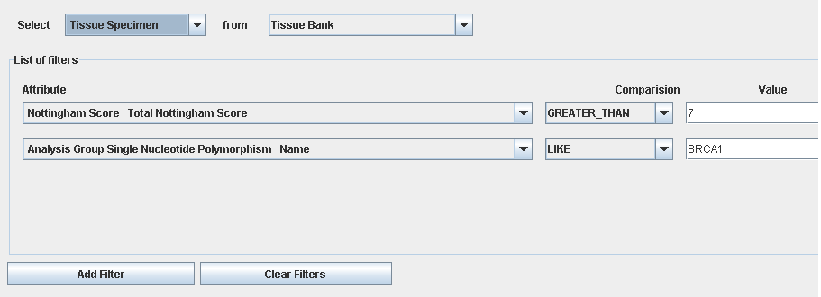
Federated Query process flow
Example DCQL

Slide 9
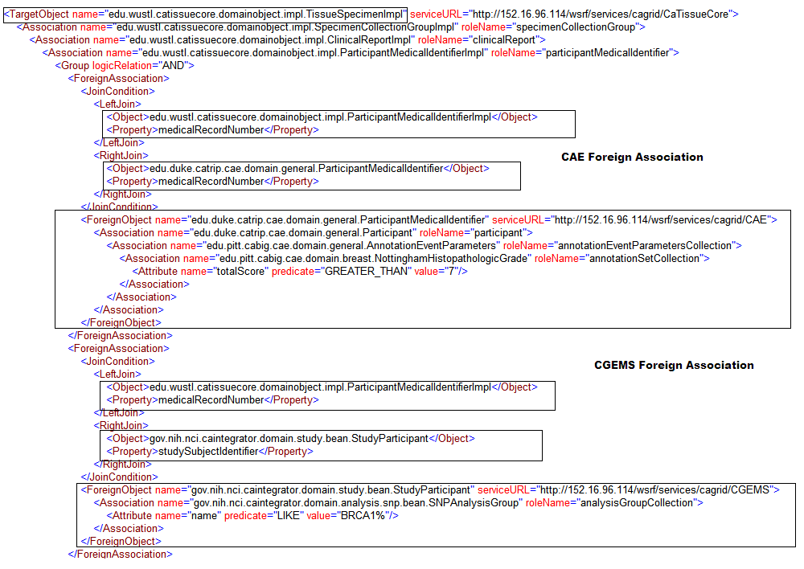
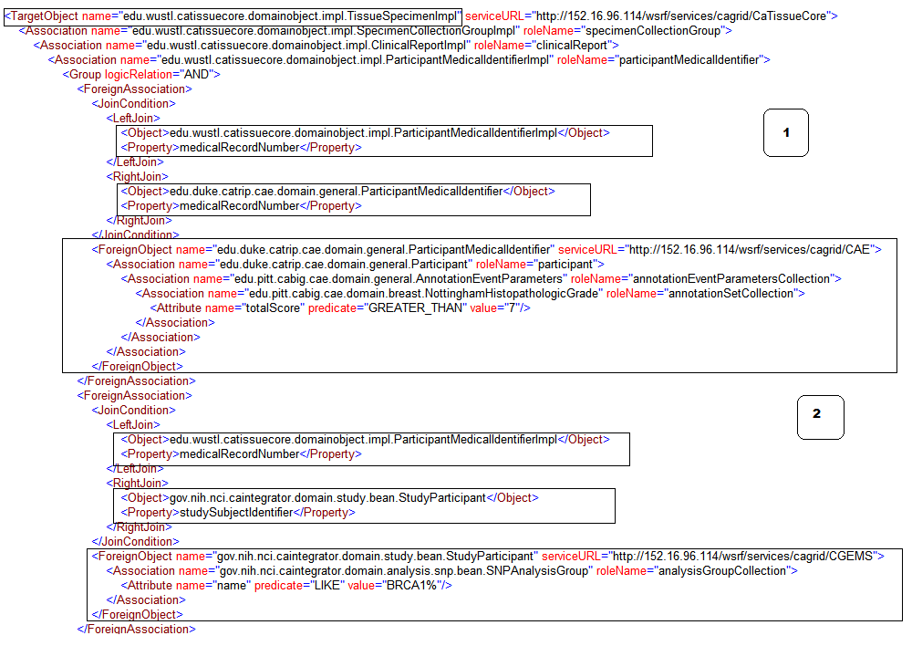
DCQL

Slide 10
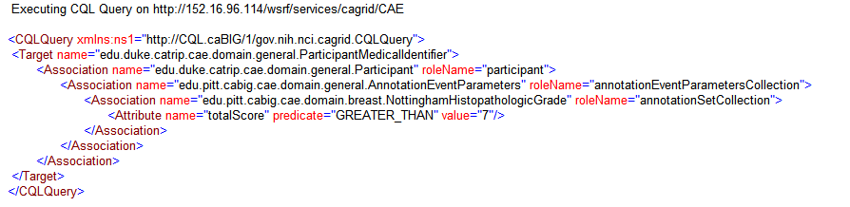
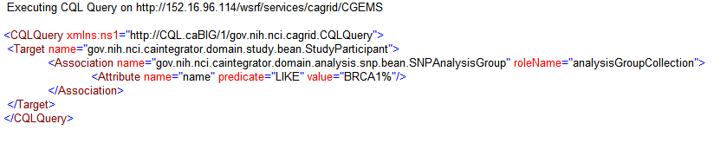
Decomposing into CQL
CAE CQL
CGEMS CQL

Slide 11
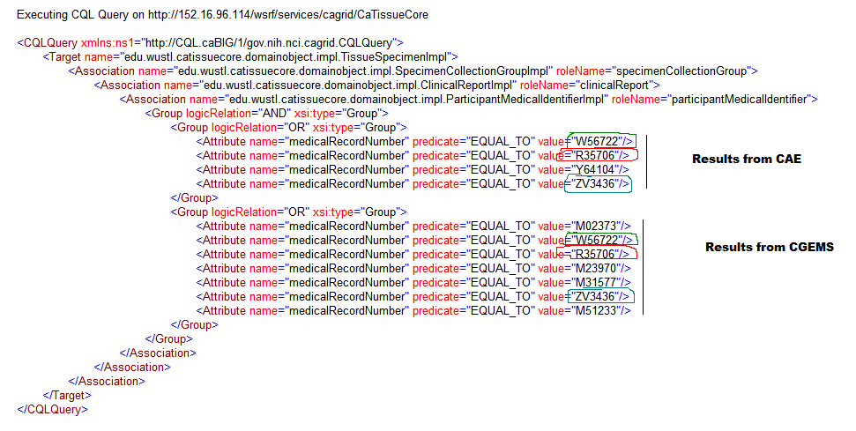
Final CQL

Slide 12
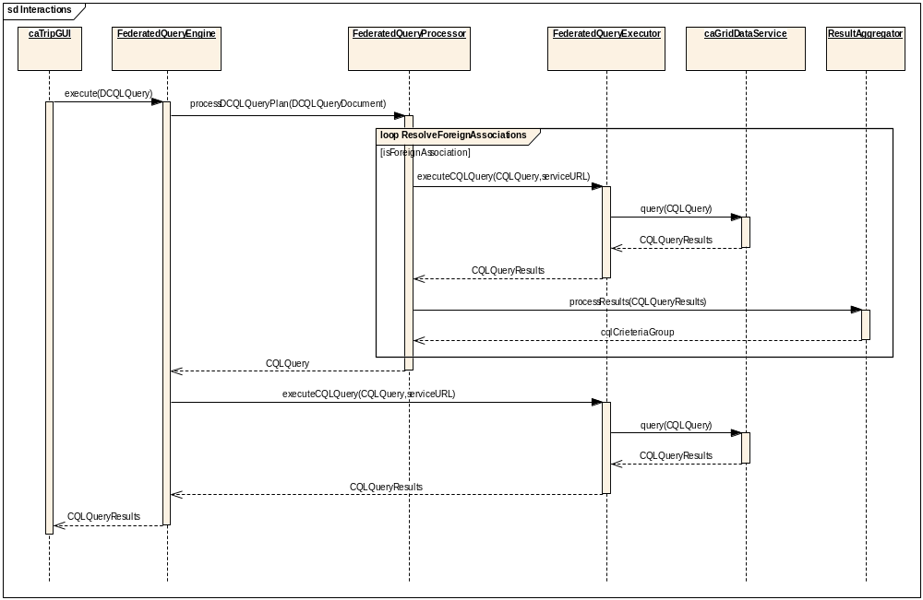
Federated Query Engine

