Slide 1
Enabling Translational Research and Medicine
caTRIP: Cancer Translational Research Informatics Platform
Patrick McConnell
Duke Comprehensive Cancer Center

Slide 2
What is translational research?
Bench-to-Bedside
Wikipedia (the source of all knowledge):
Translational medicine is a branch of medical research that attempts to more directly connect basic research to patient care.
Basic research occurs in the lab
Patient care occurs in the clinic
Translational research broadened…
Translational medicine can also have a much broader definition, referring to the development and application of new technologies in a patient driven environment - where the emphasis is on early patient testing and evaluation.
…facilitate the interaction between basic research clinical medicine, particularly in clinical trials.

Slide 3
caTRIP initial focus
Our initial focus was on connecting existing data systems, including basic science data, to enhance patient care
Initial problem scenario: outcomes analysis
  Use data from existing patients to inform the treatment of another patient
  Leverage clinical, pathology, tissue, and basic science data
Scenario:
Patient A enters the clinic. What treatments were applied with success on other patients with similar characteristics (race, sex, symptoms, pathology results, adverse events, biomarkers, etc.)?

Slide 4
Broadened focus: scientific use cases
Find available tumor tissue
  What are all the tissue specimens from her2/neu positive patients that have a primary tumor in the breast and are BRCA1 positive?
Find factors of survival
  What are all the ER positive patients that have survived breast cancer after radiation treatment?
Find patients for trials
  What are all the patients that are triple negative (ER, PR, and HER2/NEU negative)?
Determine the distribution of disease factors over time
  Does a change in pathology biomarkers over time contribute to recurrence or death?
Determine correlation of factors pre and post surgery
  Does a change in ER or PR status before and after surgery correlate with other factors?
Find pathology reports of interest
  Show me all of the pathology reports for Her2/Neu positive patients with a lobular carcinoma.

Slide 5

Connecting disparate data sources
^{Clinical}
^{Annotation}
^{Engine}
^{Pathology biomarkers}
^{Diagnosis}
^{Treatment}
^{Recurrence}
^{Follow-up}
^{Tumor}
^{Registry}
^{caTissue}
^{CORE}
^{Tissue specimens}
^{Specimen characteristics}
^{Specimen locations}
^{Pathology reports}
^{Keywords}
^{Cancer Text}
^{Information}
^{Extraction}
^{System}
^{Cancer}
^{Integrator}
^{SNP}
^{SNP locations}
^{Findings}
^{Study groups}

Slide 6
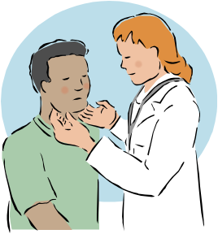
Clinical scenario for demonstration
A patient enters the clinic and is diagnosed with a lobular carcinoma
The Her2/Neu biomarker test comes back positive
What are the treatments and outcomes of other patients with similar characteristics?
Query for diagnosis date, treatment, treatment date, survival, recurrence, and BRCA1 and BRCA2 status
Look for treatments given with success and correlation between BRCA status in case test should be ordered

Slide 7
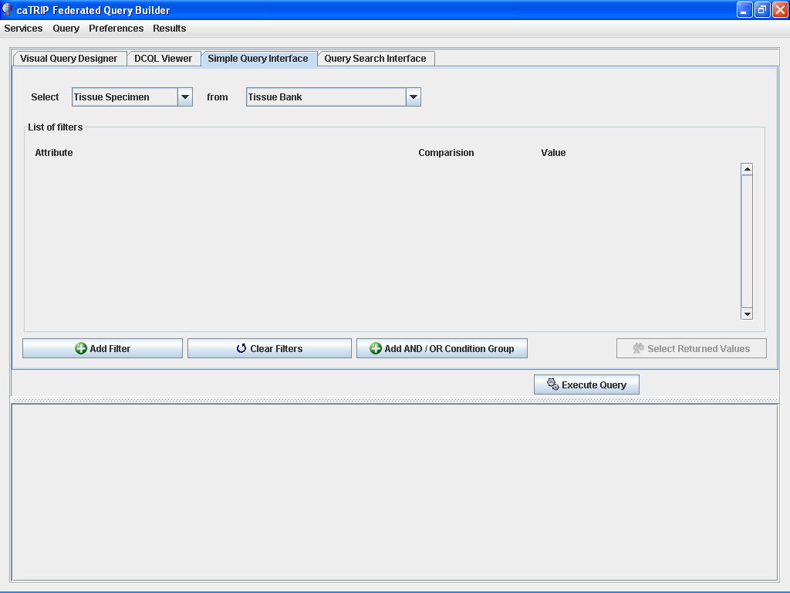
^{0. caTRIP Modules}
^{1. Data Source}
^{2. Filters}
^{3. Controls}
^{4. Results}

Slide 8
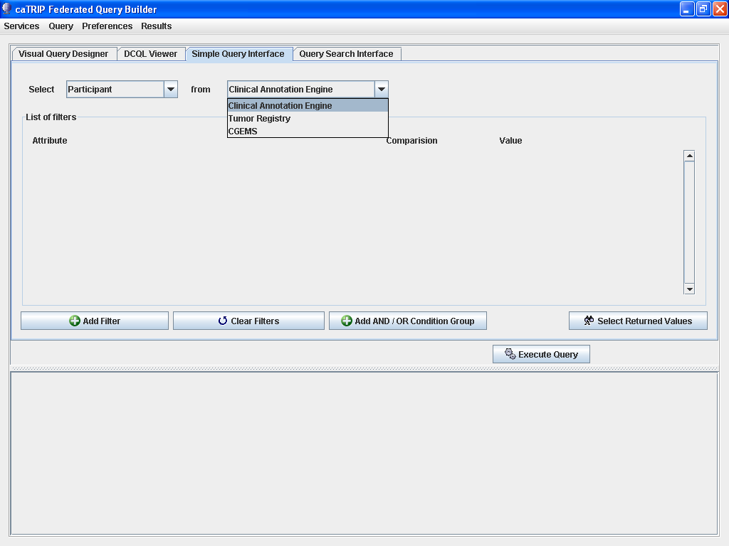
^{Select data root}

Slide 9
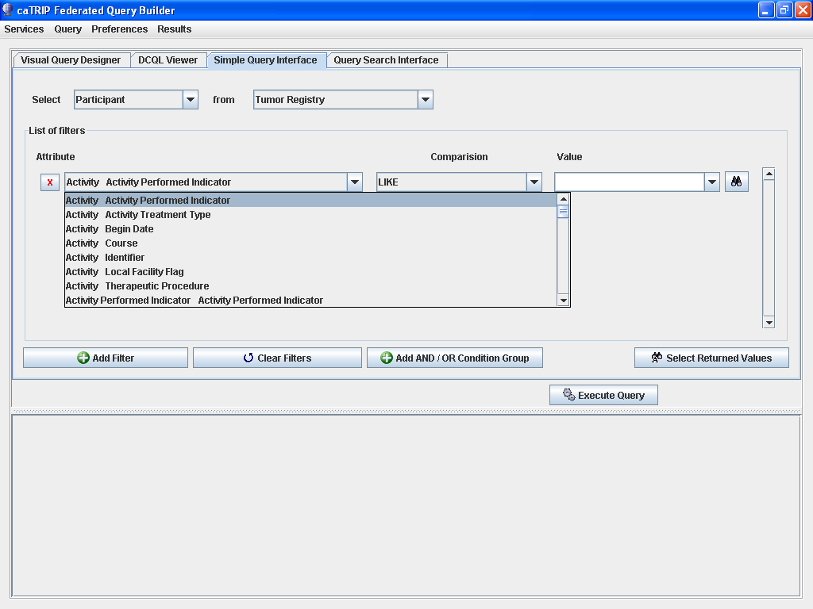
^{Select filters}

Slide 10
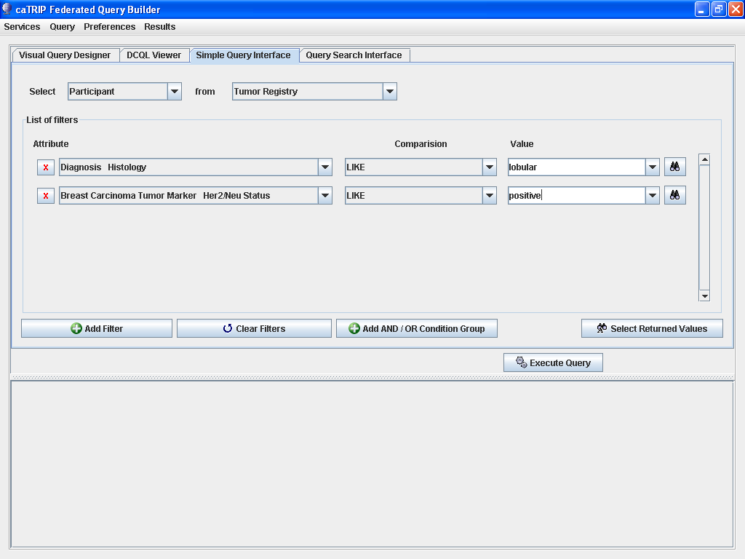
^{Select filters}

Slide 11
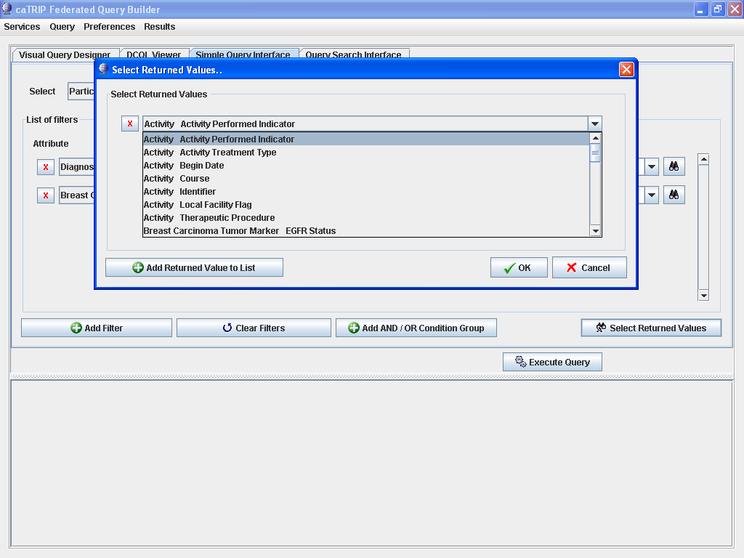
^{Select return values}

Slide 12
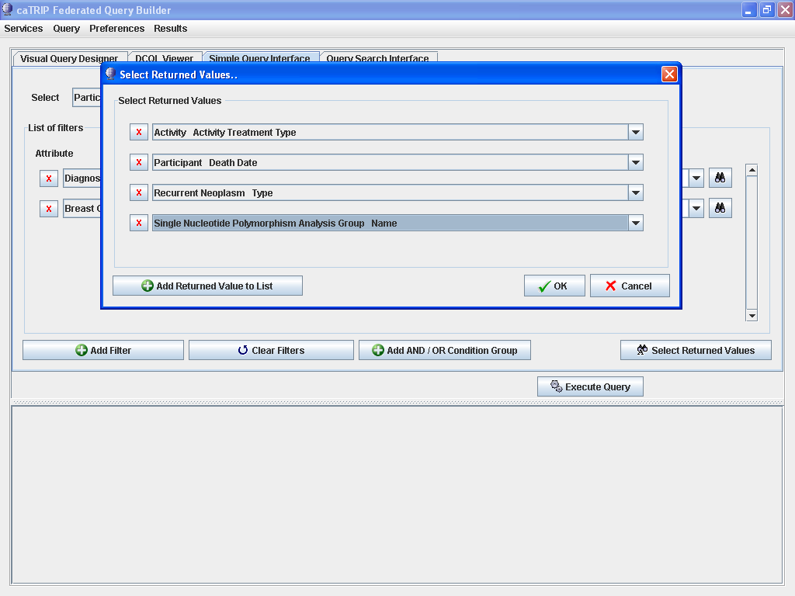
^{Select return values}

Slide 13
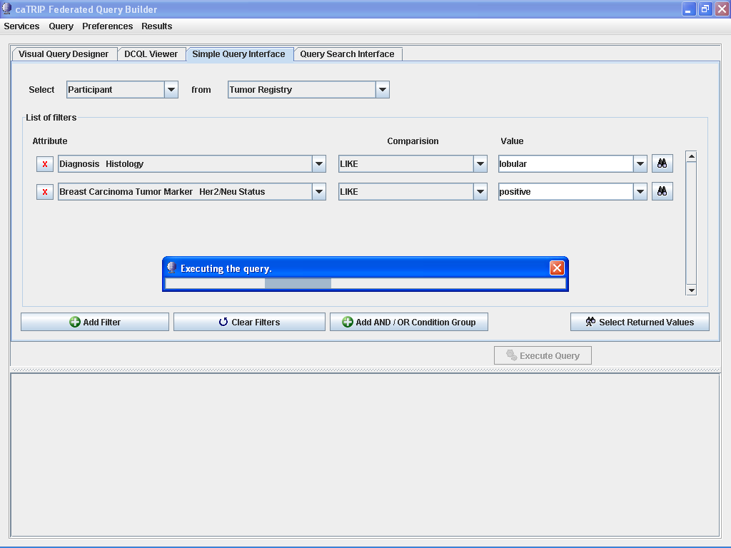
^{Execute query}

Slide 14
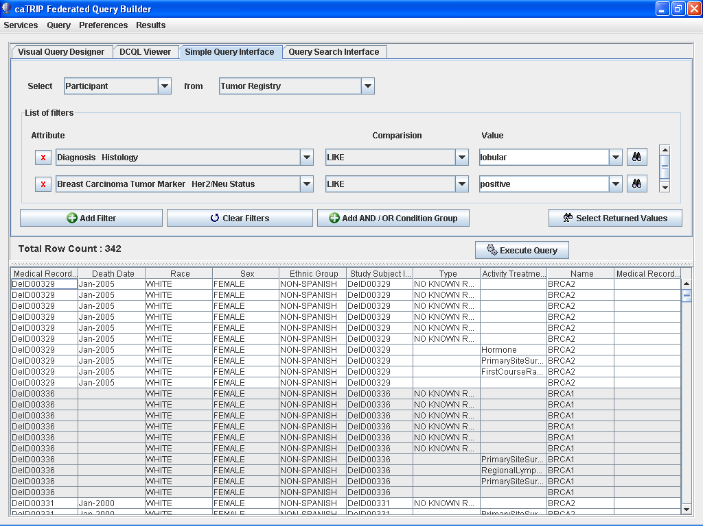
^{Review results}

Slide 15
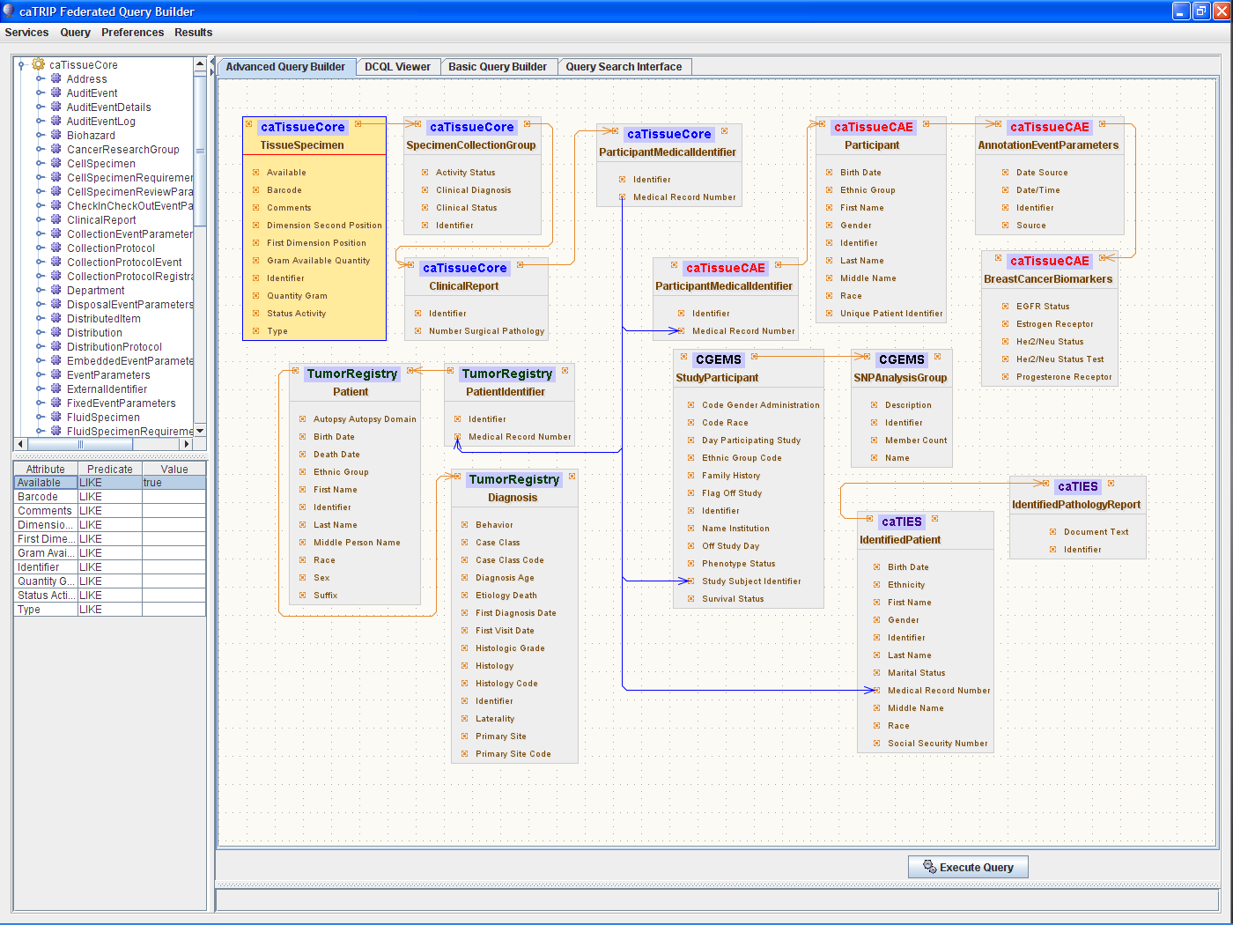
Advanced Query Builder
caTissue CORE
CAE
Participant
Medical Record Number
Tumor Registry
CGEMS
caTIES
What are all the tissue specimens from her2/neu positive patients that have a primary tumor in the breast, are BRCA1 positive, and have a pathology report?

Slide 16


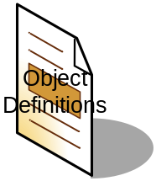

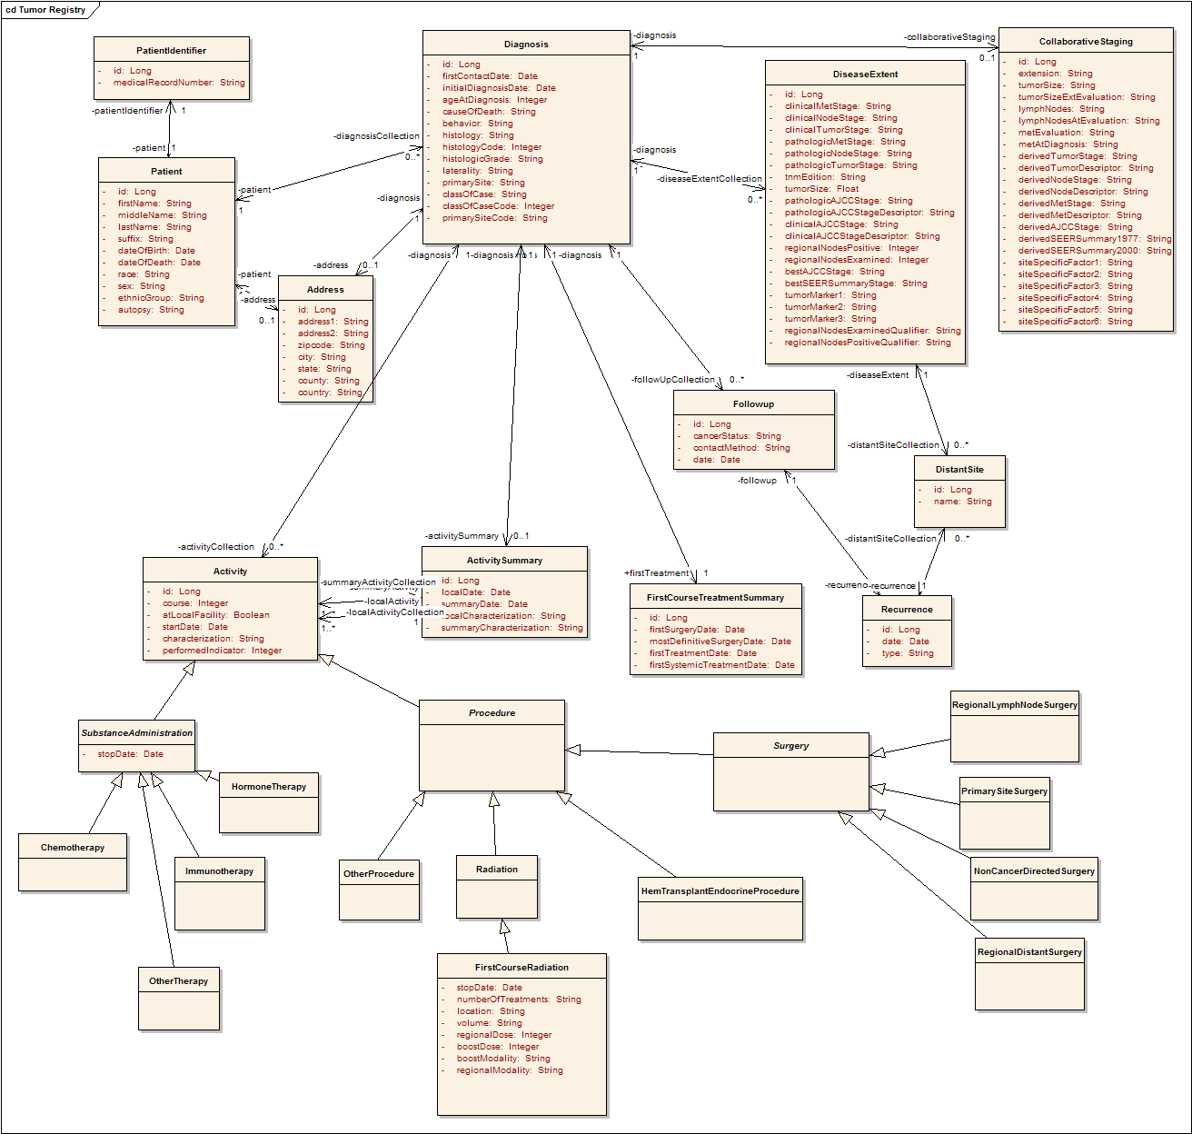


Behind the scenes
^{Discover Metadata}
^{Query}
^{Discover Services}
^{Invoke}
^{Distributed Query Engine}
^{Register}
^{Query}
^{Query}
^{Query}
^{Grid}
^{Service}
^{Grid}
^{Service}
^{Grid}
^{Service}
…
^{Model}
Database
^{Database}
^{Database}
…

Slide 17
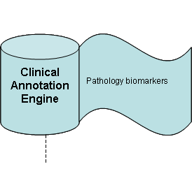
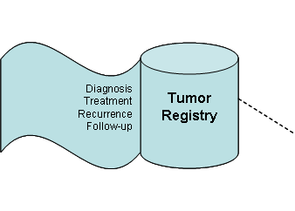

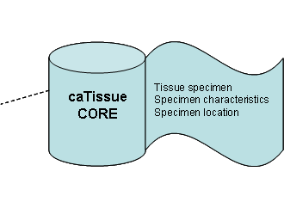
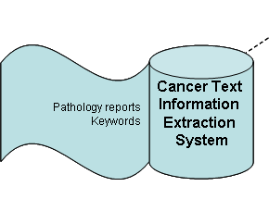
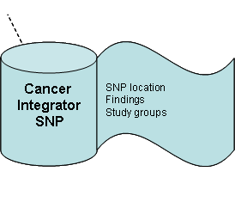
Scaling caTRIP
^{Share}
^{Register}

Slide 18
For more information
Documentation (docs tab at: http://gforge.nci.nih.gov/projects/catrip/)
  End user guide, training module, technical guide/installation manual, administration guide, release notes
Training instance: http://152.16.96.114/catrip-webstart/
Open release (files tab at: http://gforge.nci.nih.gov/projects/catrip/)
Duke Bioinformatics
  Jamie Cuticchia (PI)
  Patrick McConnell (lead architect)
Duke Information Systems
  Bob Annechiarico (PM)
  Wilma Stanley (developer)
  Mark Peedin (developer)
  Mohamad Farid (DBA)
  Jeff Allred (IT manager)
Duke Pathology
  Raj Dash (domain expert)
  Chris Hubbard (developer)
Duke Oncology
  Kelley Marcom (domain expert)
  Gretchen Kimmick (domain expert)
  Kimberly Blackwell (domain expert)
  Lee Wilke (domain expert)
SemanticBits
  Ram Chilukuri (lead developer)
  Srini Akkala (developer)
  Sanjeev Agarwal (developer)
5 AM Solutions
  Bill Mason (developer)
NCI
  Juli Klemm (NCI rep)
  Carl Shaefer (NCI)
  Subha Madhavan (NCI)
BAH
  Curtis Lockshin (WS lead)
  Mehul Shah (tech support)

Slide 19
Enabling Translational Research and Medicine
Backup Slides
Patrick McConnell
Duke Comprehensive Cancer Center

Slide 20
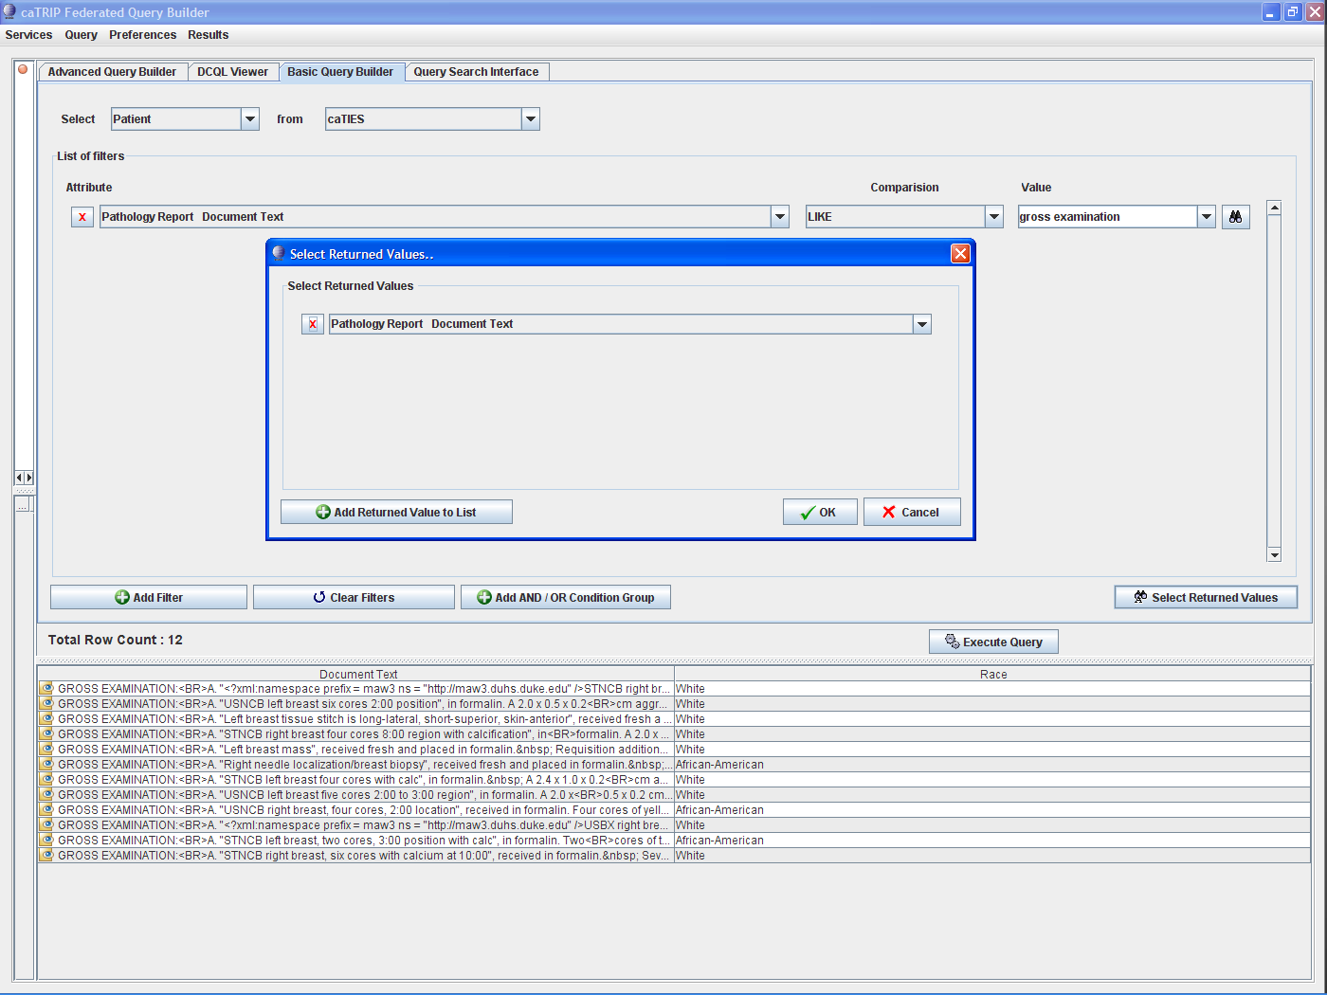

Slide 21
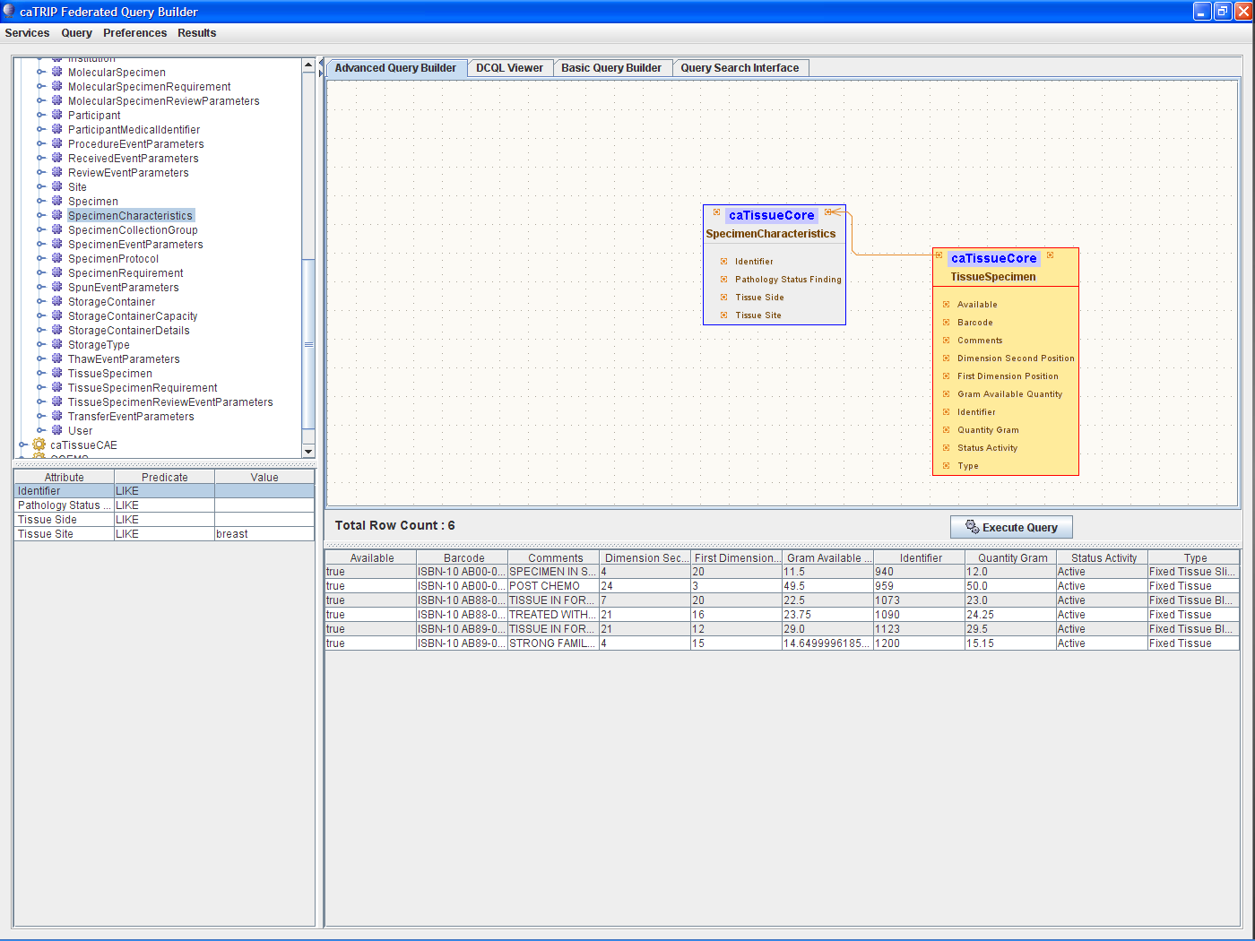

Slide 22
Page Title Here
Page Subhead Here
demo—slide ware emphasizing integration of diverse data by end user; will also show ‘under the hood’ picking up on Charlie’s broader presentation and showing how it works for specific app
This presentation will describe the cancer Translational Research Informatics Platform (caTRIP), which aggregates clinical and molecular data in a fashion that is easily accessible as well as compliant with regulatory requirements of privacy and security.

Slide 23
caTRIP in-depth
Why not write DCQL?
What are all the tissue specimens from her2/neu positive patients that have a primary tumor in the breast and are BRCA1 positive?
<DCQLQuery xmlns="http://caGrid.caBIG/1.0/gov.nih.nci.cagrid.dcql">
<TargetObject name="edu.wustl.catissuecore.domainobject.impl.TissueSpecimenImpl" serviceURL="http://152.16.96.114/wsrf/services/cagrid/CaTissueCore">
<Association name="edu.wustl.catissuecore.domainobject.impl.SpecimenCollectionGroupImpl" roleName="specimenCollectionGroup">
<Association name="edu.wustl.catissuecore.domainobject.impl.ClinicalReportImpl" roleName="clinicalReport">
<Association name="edu.wustl.catissuecore.domainobject.impl.ParticipantMedicalIdentifierImpl" roleName="participantMedicalIdentifier">
<Group logicRelation="AND">
<ForeignAssociation>
<JoinCondition>
<LeftJoin>
<Object>edu.wustl.catissuecore.domainobject.impl.ParticipantMedicalIdentifierImpl</Object>
<Property>medicalRecordNumber</Property>
</LeftJoin>
<RightJoin>
<Object>edu.duke.catrip.cae.domain.general.ParticipantMedicalIdentifier</Object>
<Property>medicalRecordNumber</Property>
</RightJoin>
</JoinCondition>
<ForeignObject name="edu.duke.catrip.cae.domain.general.ParticipantMedicalIdentifier" serviceURL="http://152.16.96.114/wsrf/services/cagrid/CAE">
<Association name="edu.duke.catrip.cae.domain.general.Participant" roleName="participant">
<Association name="edu.pitt.cabig.cae.domain.general.AnnotationEventParameters" roleName="annotationEventParametersCollection">
<Association name="edu.pitt.cabig.cae.domain.breast.BreastCancerBiomarkers" roleName="annotationSetCollection">
<Attribute name="HER2Status" predicate="LIKE" value="POSITIVE%"/>
</Association>
</Association>
</Association>
</ForeignObject>
</ForeignAssociation>
<ForeignAssociation>
<JoinCondition>
<LeftJoin>
<Object>edu.wustl.catissuecore.domainobject.impl.ParticipantMedicalIdentifierImpl</Object>
<Property>medicalRecordNumber</Property>
</LeftJoin>
<RightJoin>
<Object>edu.duke.cabig.tumorregistry.domain.PatientIdentifier</Object>
<Property>medicalRecordNumber</Property>
</RightJoin>
</JoinCondition>
<ForeignObject name="edu.duke.cabig.tumorregistry.domain.PatientIdentifier" serviceURL="http://152.16.96.114/wsrf/services/cagrid/CaTRIPTumorRegistry">
<Association name="edu.duke.cabig.tumorregistry.domain.Patient" roleName="patient">
<Association name="edu.duke.cabig.tumorregistry.domain.Diagnosis" roleName="diagnosisCollection">
<Attribute name="primarySite" predicate="LIKE" value="BREAST%"/>
</Association>
</Association>
</ForeignObject>
</ForeignAssociation>
<ForeignAssociation>
<JoinCondition>
<LeftJoin>
<Object>edu.wustl.catissuecore.domainobject.impl.ParticipantMedicalIdentifierImpl</Object>
<Property>medicalRecordNumber</Property>
</LeftJoin>
<RightJoin>
<Object>gov.nih.nci.caintegrator.domain.study.bean.StudyParticipant</Object>
<Property>studySubjectIdentifier</Property>
</RightJoin>
</JoinCondition>
<ForeignObject name="gov.nih.nci.caintegrator.domain.study.bean.StudyParticipant" serviceURL="http://152.16.96.114/wsrf/services/cagrid/CGEMS">
<Association name="gov.nih.nci.caintegrator.domain.analysis.snp.bean.SNPAnalysisGroup" roleName="analysisGroupCollection">
<Attribute name="name" predicate="LIKE" value="BRCA1%"/>
</Association>
</ForeignObject>
</ForeignAssociation>
</Group>
</Association>
</Association>
</Association>
</TargetObject>
</DCQLQuery>
Select tissue
Foreign Join w/ CAE
HER2/NEU Positive
Foreign Join w/ Tumor Registry
Primary Site Breast
Foreign Join w/ CGEMS
BRCA1 Positive

Slide 24
caTRIP in-depth
Architecture
GUI
query
Distributed
Query
Engine
authenticate
discover
Core Grid Services
Domain Grid Services
IdP
Service
Index
Service
Grid
Grouper
authorize
caTissue
CORE
caTIES
CAE
TR
CGEMS
SNP
Duke
Domain
Controller
caTissue
CORE
caTIES
CAE
TR
caIntegrator
MAW3
Tumor Registry
Illumina

Slide 25
caTRIP in-depth
Service implementation
Index Service
advertise
advertise
Distributed
Query
Engine
caGrid Data Service
CQL Query
caCORE SDK/
Hibernate
CQL Engine
domain
model
Object-relational
mapping
database

Slide 26
caTRIP in-depth
Security
authorization
User Grid
Certificate
authentication
Grid
Data Service
User
Credentials
SAML
Assertion
Dorian
CSM
Trust Fabric
caGrid
Authentication Service
Grid
Grouper
backend
data
Duke
Authentication Plugin
Duke Domain Controller
NT Security

Slide 27
caTRIP in-depth
Distributed query engine
CQL
caGrid data
service
database
data
objects
DCQL
Distributed
Query
Engine
CQL
caGrid data
service
database
data
objects
data
objects
CQL
database
caGrid data
service
data
objects

Slide 28
caTRIP in-depth
Simple GUI configuration
Service A
Service B
TissueSpecimen
SpecimenCollectionGroup
BreastCancerBiomarkers
Target
ClinicalReport
Linking Object
Join Condition
Associated
Classes
ParticipantMedicalIdentifier
Association Direction
Filter
Object
SpecimenCharacteristics
Associated Object Tree
Foreign Association inbound Paths
Linking Object
Join Condition
Join Condition: CDE ex. MRN
Target
Association Direction
Service A
Service B
Foreign Association Outbound Path
Foreign Association

Slide 29
caTRIP in-depth
Tumor Registry model
Participant
Diagnosis
Collaborative
Staging
Follow up and
Recurrence
Treatment

Slide 30


Architecture and VCDE Implications
Data sharing
Data is owned by different groups across the cancer center
Traditional deidentification: data manager deidentifies an entire dataset then throws away the key
Distributed deidentification: trusted service provider (TSP) deidentifies discreet values
Traditional approach is not scalable – requires a middle-man
IRB approval required for distributed approach because it deviates from traditional deidentification (at Duke)
Can join on GHI789, which is a deidentified ID
Distributed
Query
Engine
^{CAE}
^{caTissue}
^{CORE}
CAE
caTissue
CORE
GHI789
Trusted Service
Provider
GHI789
MRN3
MRN3
Data owners submit PHI to be deidentified by the TSP
^{Data Owner}
^{Data Owner}

Slide 31
Clinical scenario for demonstration
A patient enters the clinic and is diagnosed with a lobular carcinoma
The Her2/Neu biomarker test comes back positive
What are the treatments and outcomes of other patients with similar characteristics?
Query for diagnosis date, treatment, treatment date, survival, recurrence, and BRCA1 and BRCA2 status
Look for treatments given with success and correlation between BRCA status in case test should be ordered

