Slide 1
Cancer Translational Research Informatics Platform (caTRIP)
caBIG Enabling Translational Research
Patrick McConnell
Duke Comprehensive Cancer Center
patrick.mcconnell@duke.edu

Slide 2
Disclosure Information
AACR 2007
Patrick McConnell
I have no financial relationships to disclose.
- and -
I will not discuss off label use and/or investigational use in my presentation.

Slide 3
Who is involved in caTRIP?
Duke Bioinformatics
  Jamie Cuticchia (PI)
  Patrick McConnell (lead architect)
Duke Information Systems
  Bob Annechiarico (PM)
  Wilma Stanley (developer)
  Mark Peedin (developer)
  Mohamad Farid (DBA)
  Jeff Allred (IT manager)
Duke Pathology
  Raj Dash (domain expert)
  Chris Hubbard (developer)
Duke Oncology
  Kelley Marcom (domain expert)
  Gretchen Kimmick (domain expert)
  Kimberly Blackwell (domain expert)
  Lee Wilke (domain expert)
Duke CALGB
  Kimberly Johnson (DataMart liaison)
SemanticBits
  Ram Chilukuri (lead developer)
  Srini Akkala (developer)
  Sanjeev Agarwal (developer)
5 AM Solutions
  Bill Mason (developer)
NCI
  Juli Klemm (NCI rep)
  Carl Schaefer (NCI)
  Subha Madhavan
  (NCI)
BAH
  Curtis Lockshin (ICR WS lead)
  Mehul Shah (tech support)
^{Managers and Architects}
^{Software Developers}
^{Database Developers and IT}
^{NCI/BAH}
^{Guidance}
^{Domain Experts}

Slide 4
Agenda
caTRIP overview
  Translational informatics, goals, approach, data types
Demonstration
  Clinical scenario, research scenario
Technical details
  Interfaces, metadata, and modeling
Challenges in data sharing
  Deidentification and security
Next steps

Slide 5
Overview
What is translational research?
Bench-to-Bedside
Wikipedia (the source of all knowledge):
Translational medicine is a branch of medical research that attempts to more directly connect basic research to patient care.
Basic research occurs in the lab
Patient care occurs in the clinic
Translational research broadened…
Translational medicine can also have a much broader definition, referring to the development and application of new technologies in a patient driven environment - where the emphasis is on early patient testing and evaluation.
…facilitate the interaction between basic research clinical medicine, particularly in clinical trials.

Slide 6
Overview
Initial focus
Our initial focus will be on connecting existing data systems, including basic science data, to enhance patient care
Initial problem scenario: outcomes analysis
  Use data from existing patients to inform the treatment of another patient
  Leverage clinical, pathology, tissue, and basic science data
Scenario:
Patient A enters the clinic. What treatments were applied with success on other patients with similar characteristics (race, sex, symptoms, pathology results, adverse events, biomarkers).

Slide 7
Overview
Broadened focus: scientific use cases
Find available tumor tissue
  What are all the tissue specimens from her2/neu positive patients that have a primary tumor in the breast and are BRCA1 positive?
Find factors of survival
  What are all the ER positive patients that have survived breast cancer after radiation treatment?
Find patients for trials
  What are all the patients that are triple negative (ER, PR, and HER2/NEU negative)?
Determine the distribution of disease factors over time
  Does a change in pathology biomarkers over time contribute to recurrence or death?
Determine correlation of factors pre and post surgery
  Does a change in ER or PR status before and after surgery correlate with other factors?
Find pathology reports of interest
  Show me all of the pathology reports for Her2/Neu positive patients with a lobular carcinoma.

Slide 8
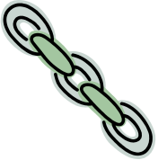
Overview
Connecting disparate data systems
^{CAE}
^{Pathology Biomarkers}
^{Tumor Registry}
^{Diagnosis, Treatment,}
^{Recurrence, Follow-up}
^{caTissue CORE}
^{Tissue Bank}
^{MRN}
caTRIP
caTRIP
caTRIP
caTRIP
^{caIntegrator}
^{SNP Data}
^{caTIES}
^{Pathology Reports}

Slide 9
Overview
Approach to meeting these use cases
Before caBIG
  Researcher or oncologist would have to contact a data analyst
  Approach each data owner to get the datasets
  Load each dataset into a single database
  Write a query to answer the question
  Process is manually intensive and long
After caBIG
  Expose the datasets as a caBIG grid service
  Use caTRIP to query based on a common identifier (e.g. MRN)
    caTRIP can dynamically discover the services
    Service metadata (data about the service) tells caTRIP what can be queried on and how it should be queried
    Construct query and execute
  All the work is done up front when exposing the datasets using
  standard data formats and interfaces

Slide 10
Demonstration
Clinical and research
Clinical scenario for demonstration
  A patient enters the clinic and is diagnosed with a lobular carcinoma
  The Her2/Neu biomarker test comes back positive
  What are the treatments and outcomes of other patients with similar characteristics?
  Query for diagnosis date, treatment, treatment date, survival, recurrence, and BRCA1 and BRCA2 status
  Look for treatments given with success and correlation between BRCA status in case test should be ordered
Research scenario for demonstration
  Is there a correlation between recurrence, mortality, histologic grade, and Her2/Neu status for breast cancer patients diagnosed with lobular carcinoma?
  Query caTRIP for recurrence type, date of death, histologic grade, and Her2/Neu status for patients diagnosed with lobular carcinoma
  Correlation is determined in Microsoft Excel
  Investigate gene biomarkers that correlate with a Her2/Neu status of negative and survival
  Query caTRIP for all available tissue to order for microarray experiments

Slide 11





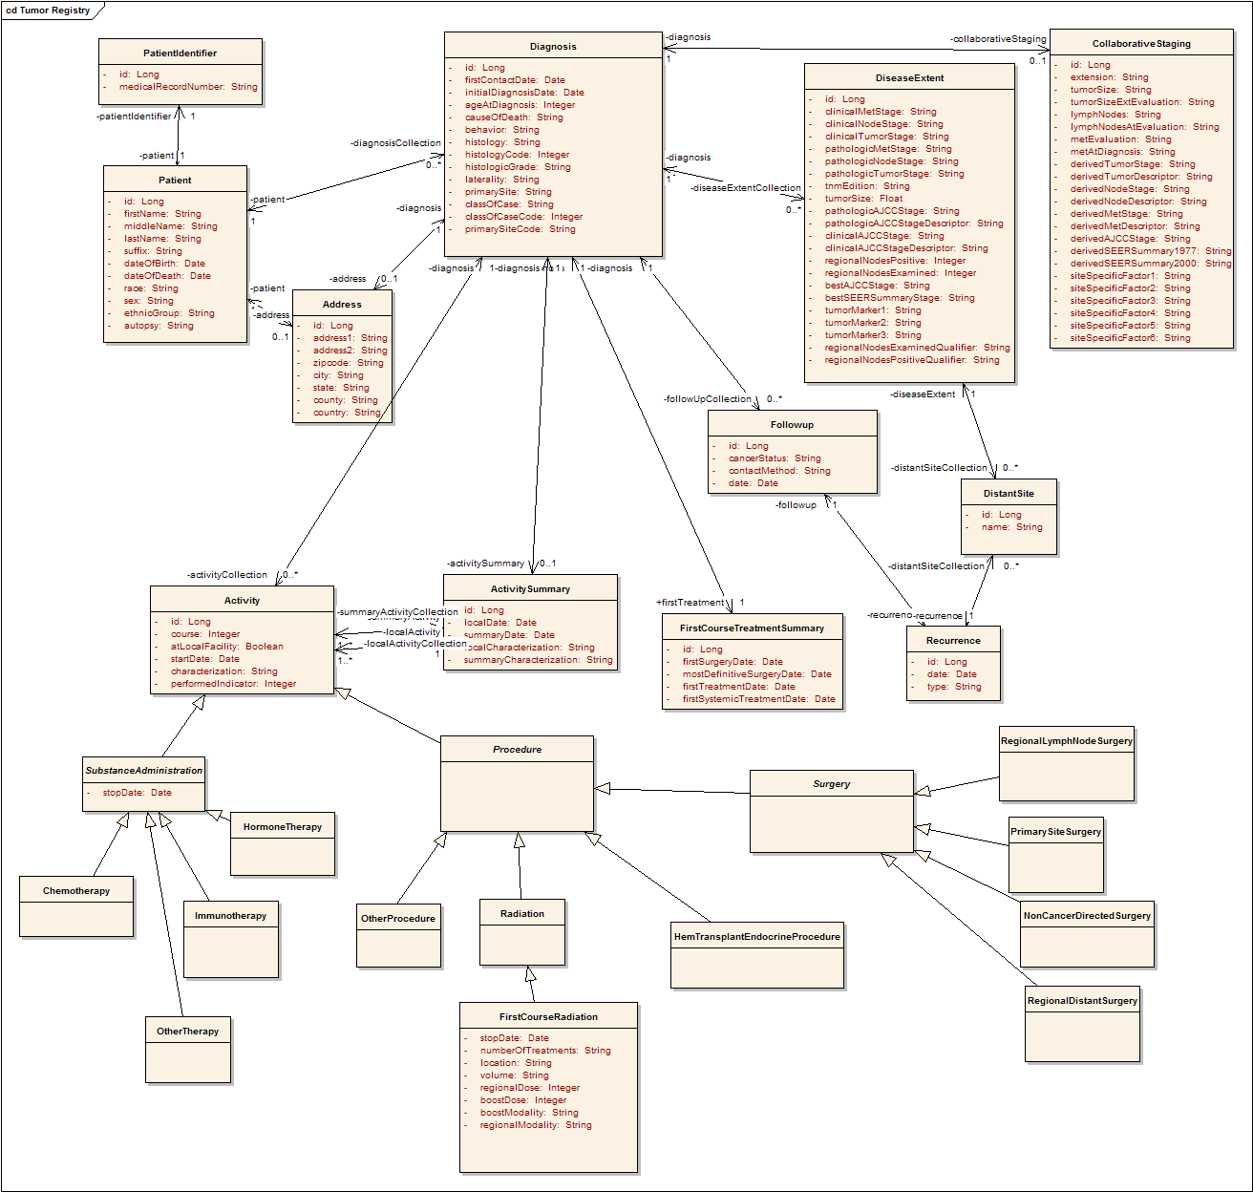


Technical details
Interfaces and metadata
^{Discover Metadata}
^{Query}
^{Discover Services}
^{Invoke}
^{Distributed Query Engine}
^{Register}
^{Query}
^{Query}
^{Query}
^{Grid}
^{Service}
^{Grid}
^{Service}
^{Grid}
^{Service}
…
^{Model}
Database
^{Database}
^{Database}
…

Slide 12
Technical details
Tumor Registry domain model
Participant
Diagnosis
Collaborative
Staging
Follow up and
Recurrence
Treatment
Notes:
Explain what a data model is – way to represent information

Slide 13
Challenges in data sharing
Data systems and deidentification
Building data-oriented systems
  Duke requires IRB approval to gain access to identifiable data
  We worked around by leveraging people already on IRB protocols
Deidentifying data
  Data is owned by different groups across the cancer center
  Traditional deidentification: data manager deidentifies an entire dataset then throws away the key
  Distributed deidentification: trusted service provider (TSP) deidentifies discreet values
  Traditional approach is not scalable – requires a middle-man
  IRB approval required for distributed approach because it deviates from traditional deidentification (at Duke)

Slide 14


Challenges in data sharing
Distributed deidentification
Can join on GHI789, which is a deidentified ID
Distributed
Query
Engine
^{CAE}
^{caTissue}
^{CORE}
CAE
caTissue
CORE
GHI789
Trusted Service
Provider
GHI789
MRN3
MRN3
Data owners submit PHI to be deidentified by the TSP
^{Data Owner}
^{Data Owner}

Slide 15
Challenges in data sharing
Security
Challenge
  Security in a distributed grid environment is a difficult problem
  The caGrid security infrastructure is still very new (caGrid 1.0 is released)
authentication
User
Credentials
SAML
Assertion
User Grid
Certificate
authorization
Grid
Data Service
caGrid
Authentication Service
Dorian
CSM
Trust Fabric
Duke
Authentication Plugin
Grid
Grouper
backend
data
Duke Domain Controller
NT Security

Slide 16
Documentation
Developer
Technical Guide
Installation Guide
Administration Guide
Release Notes
Adopters
End user manual
Training modules
Overview/hands-on
Technical Manual (Architecture):
Describes architecture, systems requirements, APIs, and other tools that integrate with the software and their implementation.
^{Release Notes:}
Written before product release: lists new features and functionalities, addresses known issues, and lists appropriate documentation and websites.
^{Installation Guide:}
Outlines the supported configurations and technical installation instructions for software application. Can include basic test procedures.
^{End User Manual:}
Includes software authorizations, interface design, protocols, workflow, tools, data sources, database(s), data search, data management, and integration with component software.
^{Administration Guide:}
Describes process for updating and maintaining application, importing and deleting data, creating authorization for user groups.
^{Training Modules:}
Give users general information about the application (Overview), and practical examples and handson exercises (HandsOn).

Slide 17
Next Steps
Wider spread adoption of caTRIP and underlying tools
Cross-institutional queries
  What are all of the breast tissue specimens on the grid from patients that are positive for the estrogen receptor biomarker?
Enhanced support for high throughput datasets
  Now give me all the microarray experiments for those patients.
Enhanced reporting
  I want to export the data to Excel with an automated pivot on key data columns.
Integration at a user interface level
  I’ve identified some patients of interest, now let me order the tissue samples.
Enhanced querying
  I know my query is going to take a long time, so just email me the results when they are done

Slide 18
Cancer Translational Research Informatics Platform (caTRIP)
Backup Demonstration

Slide 19
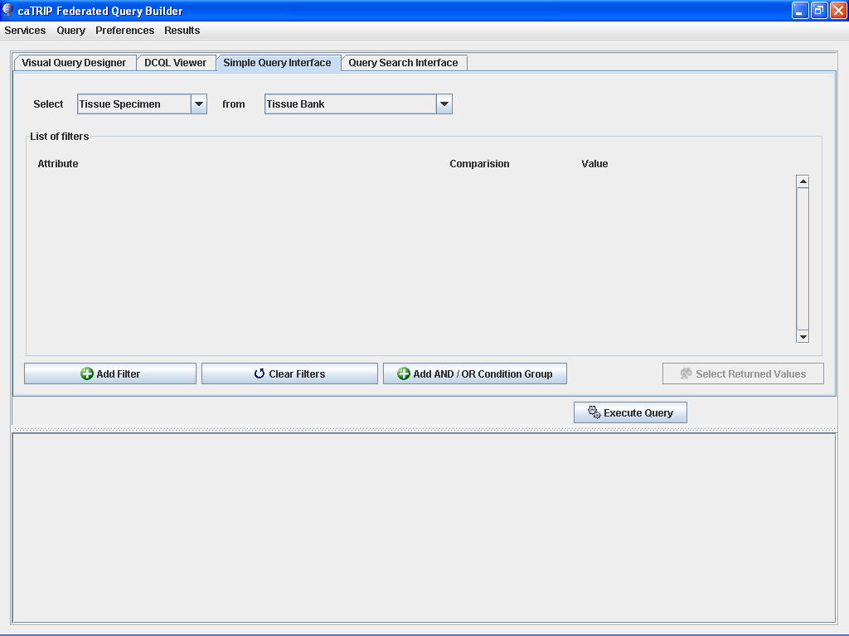

Slide 20
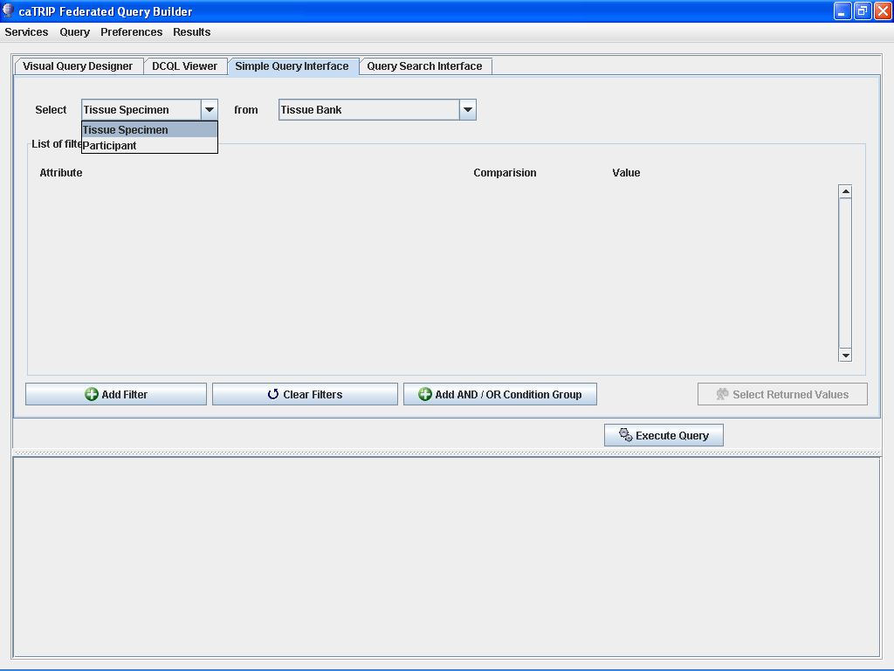

Slide 22
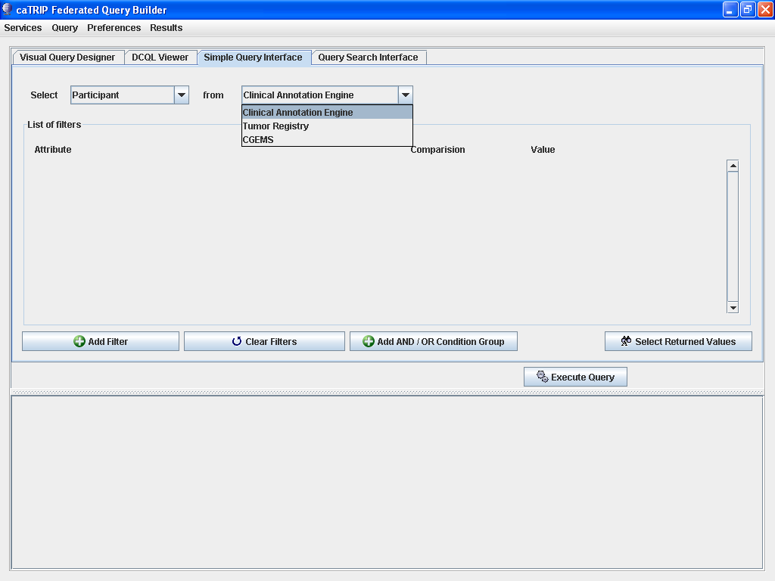

Slide 23
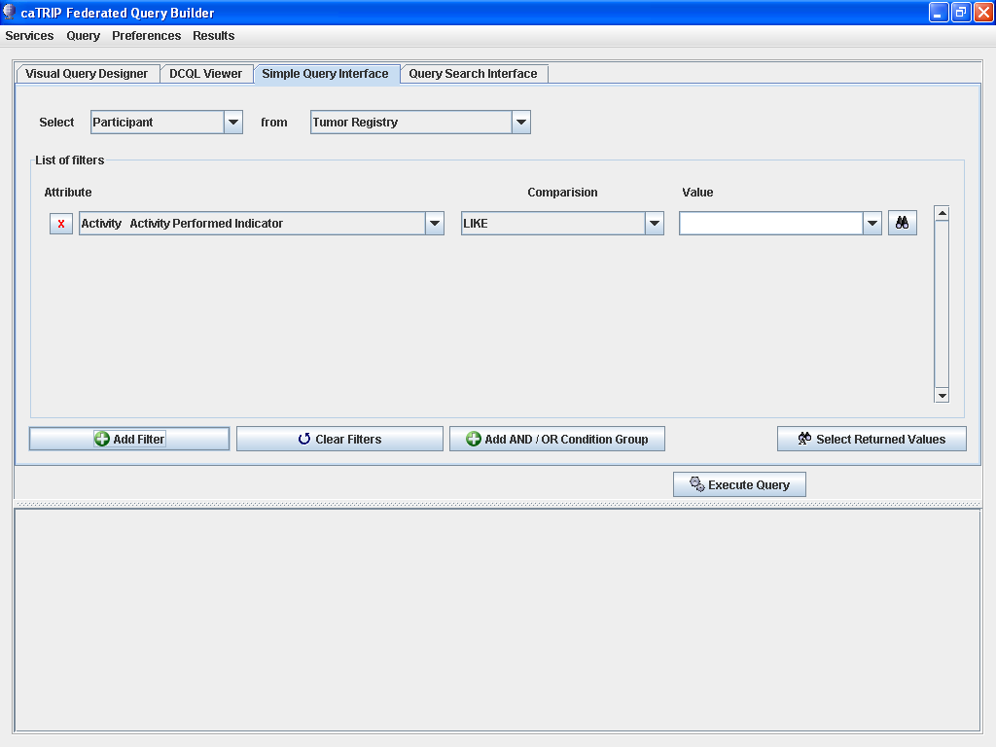

Slide 24
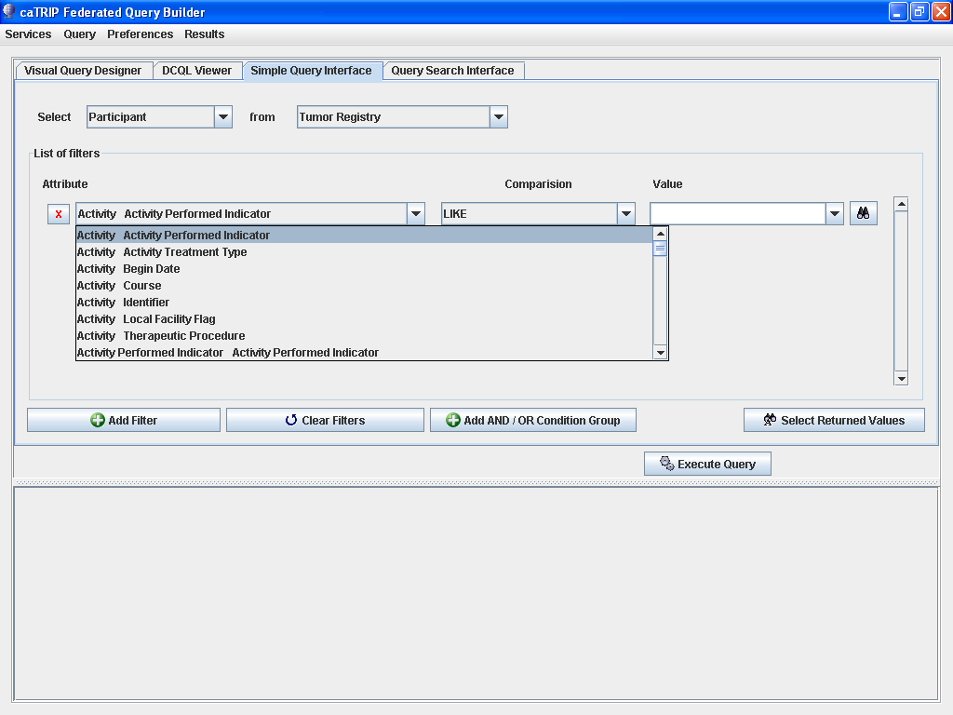

Slide 25
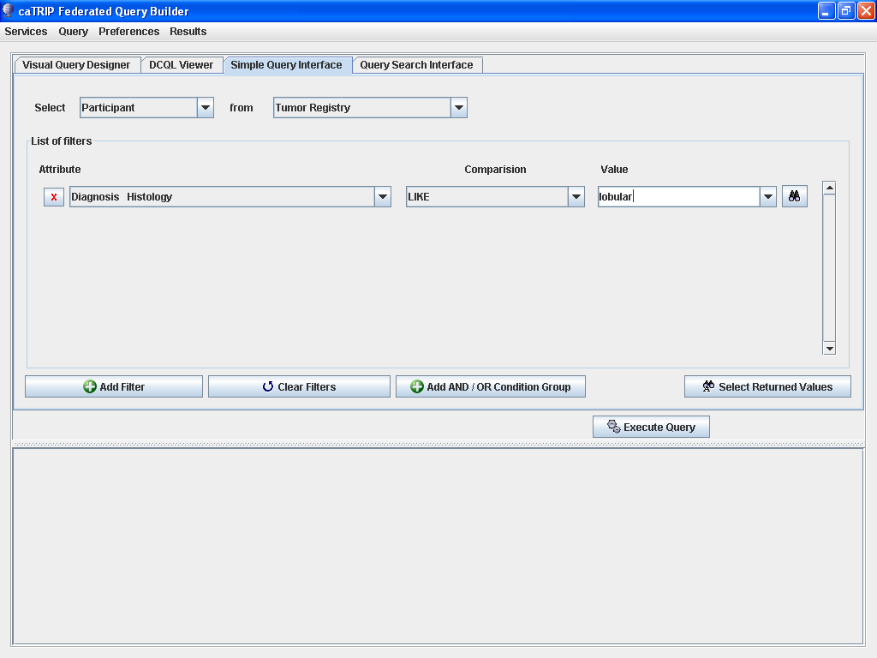

Slide 26
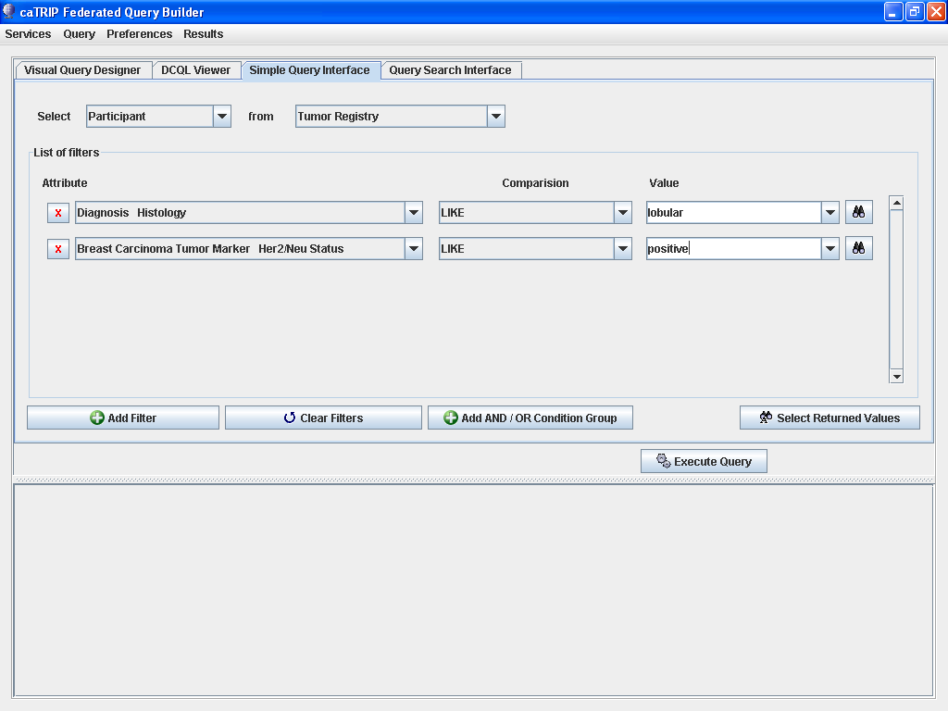

Slide 27
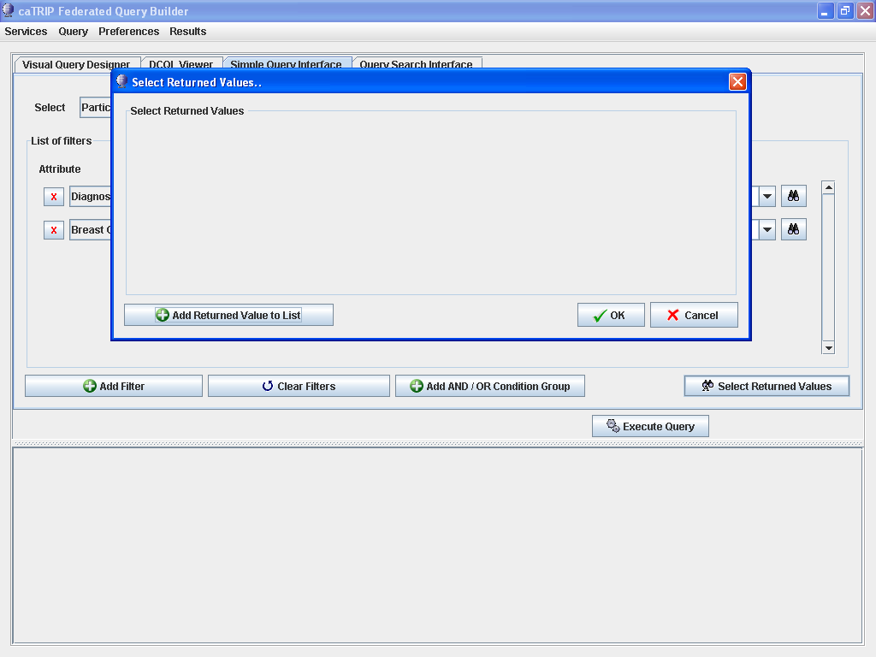

Slide 28
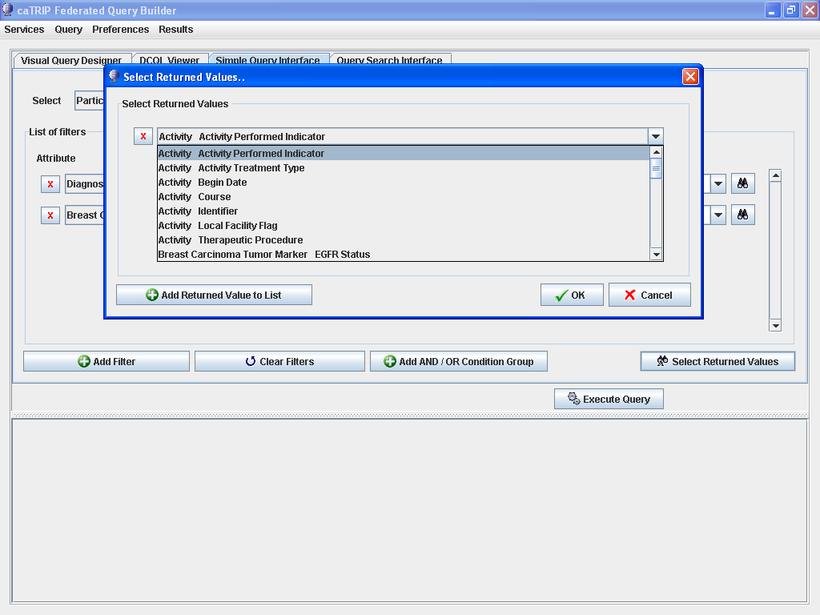

Slide 29
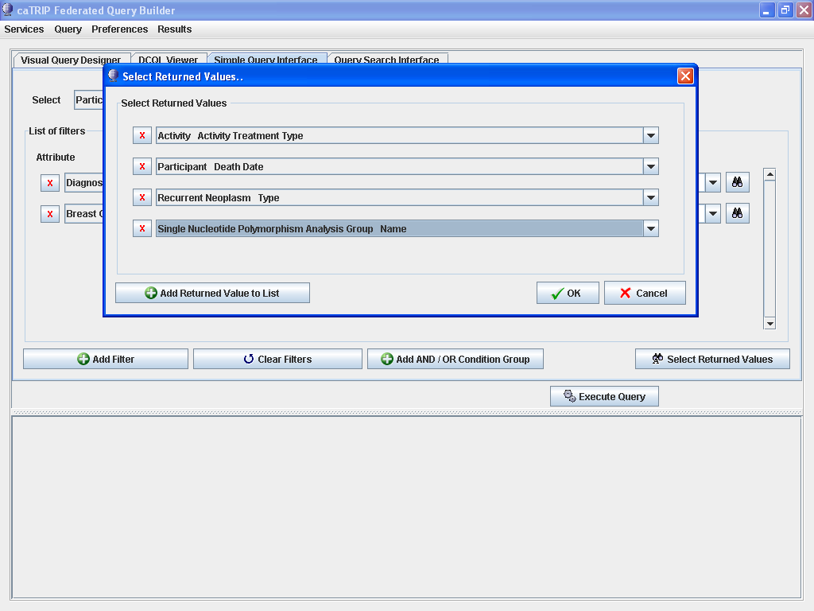

Slide 30
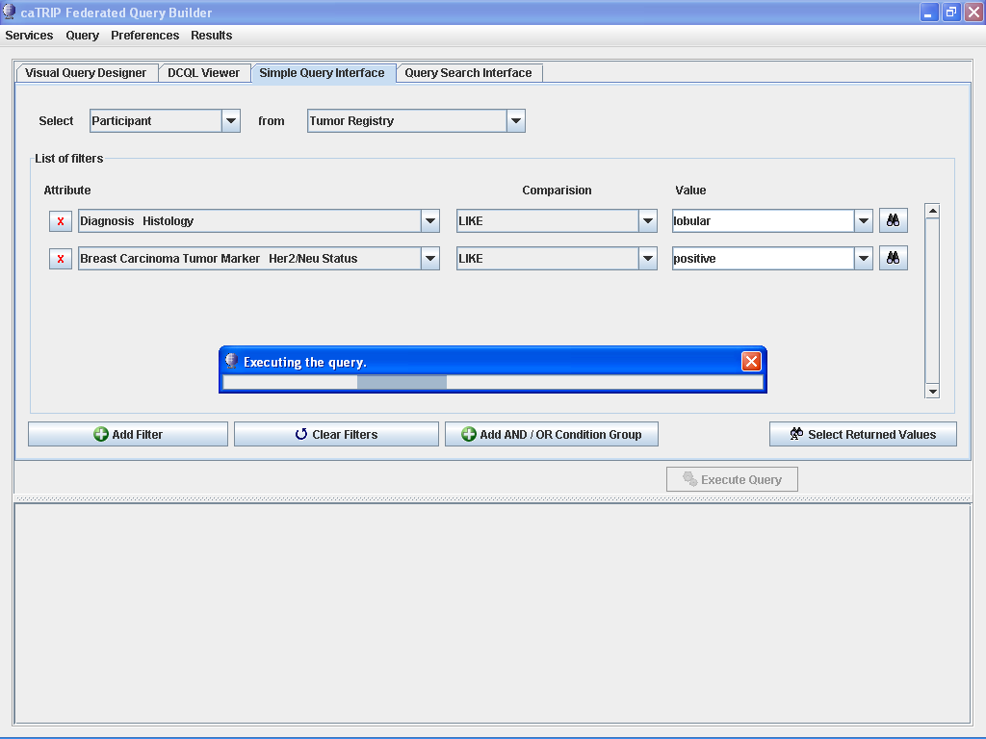

Slide 31
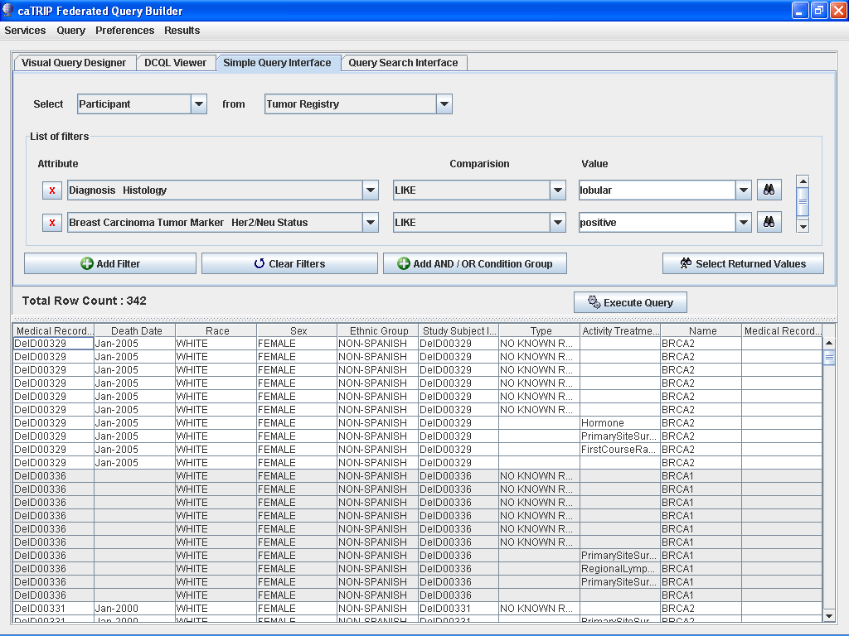

Slide 32
Cancer Translational Research Informatics Platform (caTRIP)
Backup Slides

Slide 33
caBIG Compatibility
Architecture overview
GUI
query
Distributed
Query
Engine
authenticate
discover
Core Grid Services
Domain Grid Services
IdP
Service
Index
Service
Grid
Grouper
authorize
caTissue
CORE
caTIES
CAE
TR
CGEMS
SNP
Duke
Domain
Controller
caTissue
CORE
caTIES
CAE
TR
caIntegrator
MAW3
Tumor Registry
Illumina

Slide 34
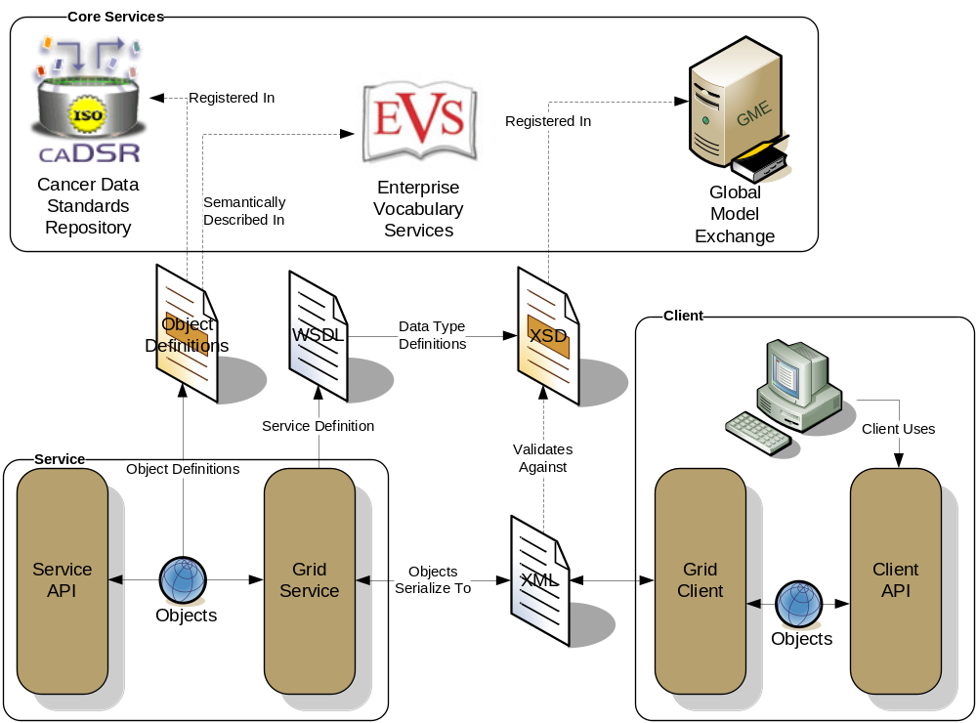
caBIG Compatibility caGrid Metadata Infrastructure

Slide 35
A success story?
Distributed deidentification
Secure connection
MRN3
MRN3
GHI789
Trusted Service
Provider
GHI789
Has IRB approval to see identifiable data
Has IRB approval to see identifiable data
Has IRB approval to store identifiable data
PHI | DEID
MRN1 | ABC123
MRN2 | DEF456
. . . | . . .
PHI | DEID
MRN1 | ABC123
MRN2 | DEF456
MRN3 | GHI789
. . . | . . .
Randomly generated

Slide 36
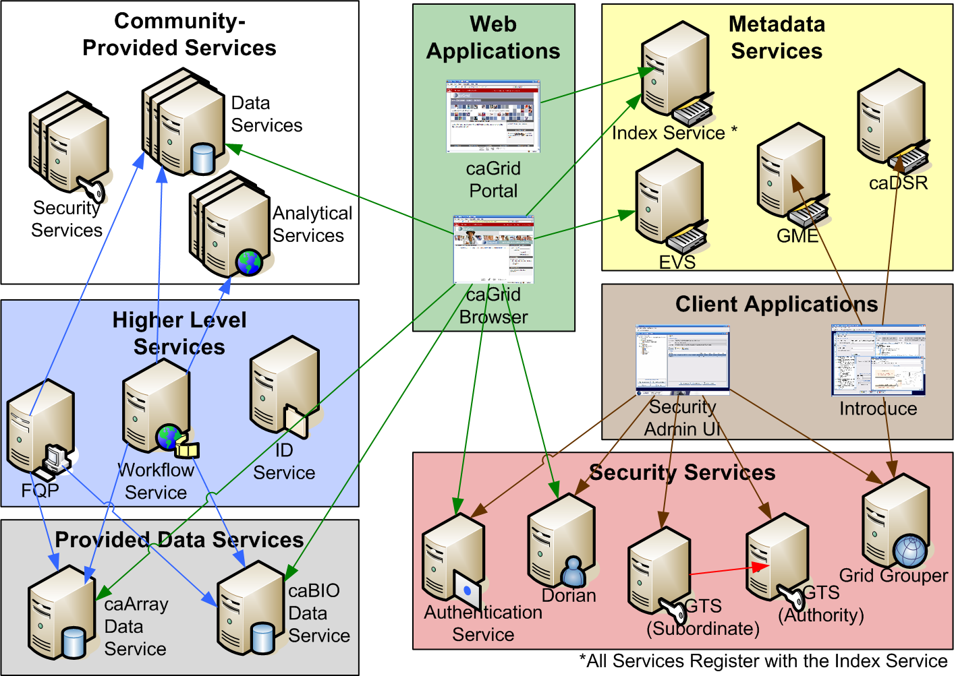
caGrid background
Where does workflow fit in?

Slide 37
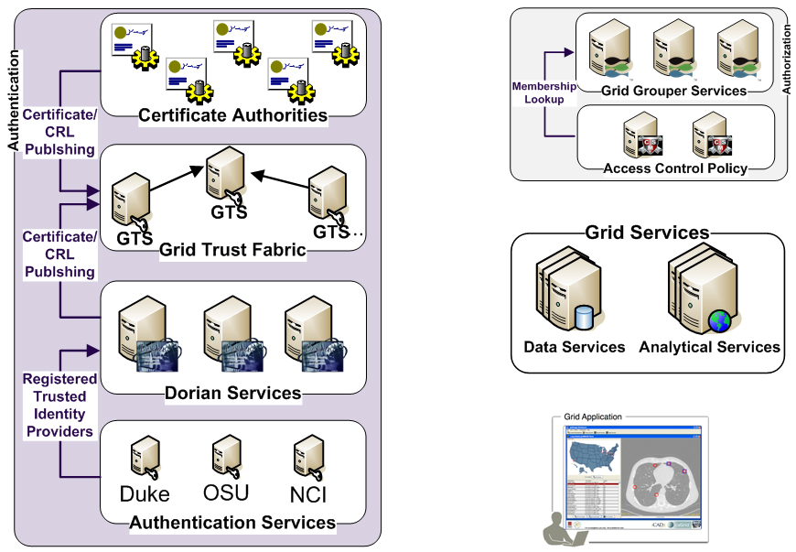
CTMS Interoperability Project caGrid Security
Is member of?
Should I trust the
credential signer?
Is
Authorized?
SAML Assertion
Grid
Credentials
Grid
Credentials
Authenticate with
Local Credential Provider
SAML Assertion

