Slide 1
caTRIP Quick Training

Slide 2
Caveats
Between each query, clear filters
  You can’t modify return values after you add them once
  You can’t modify filters after you execute a query
Between each query, remove returned attributes
  Returned attributes still stick around after cleared filter
caTissue CORE limitations
  You can’t return caTissue CORE attributes from a query that doesn’t start from Tissue Specimen
Grouping limitations
  Can’t select return attributes with an OR group
  Can’t create an OR group across services

Slide 3
Outcomes Analysis

Slide 4
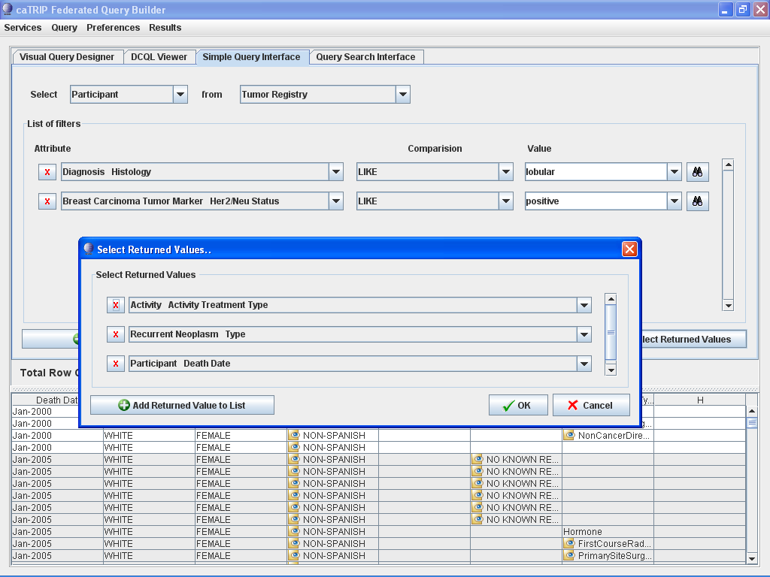
Notes:
What are the treatments, recurrence, and survival for all Her2/neu positive patients with a lobular carcinoma.

Slide 5
Research
Requires post-processing

Slide 6
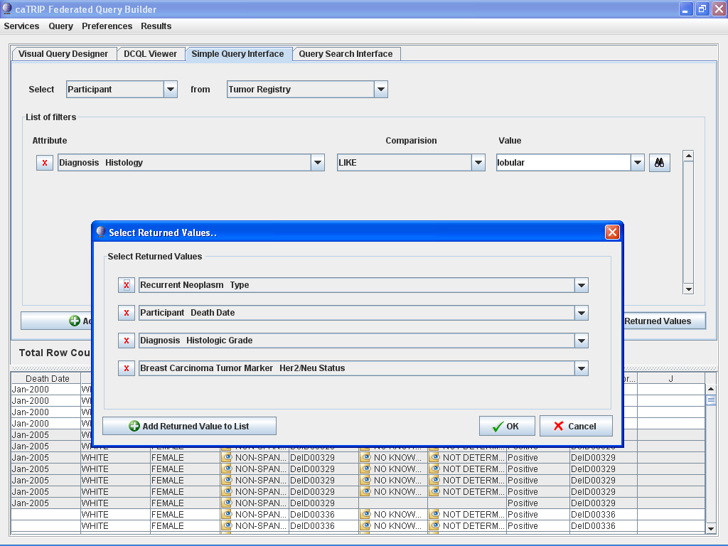
Notes:
Is there a correlation between recurrence, mortality, histologic grade, and Her2/Neu status for breast cancer patients diagnosed with lobular carcinoma?

Slide 7
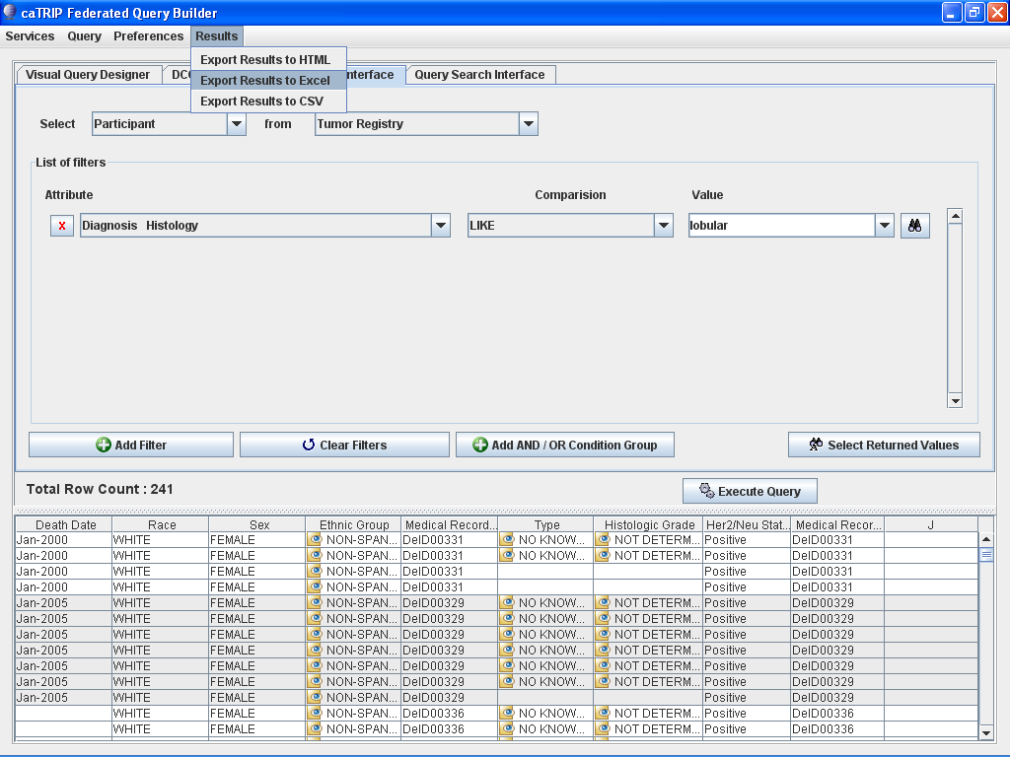
Notes:
Is there a correlation between recurrence, mortality, histologic grade, and Her2/Neu status for breast cancer patients diagnosed with lobular carcinoma?

Slide 8
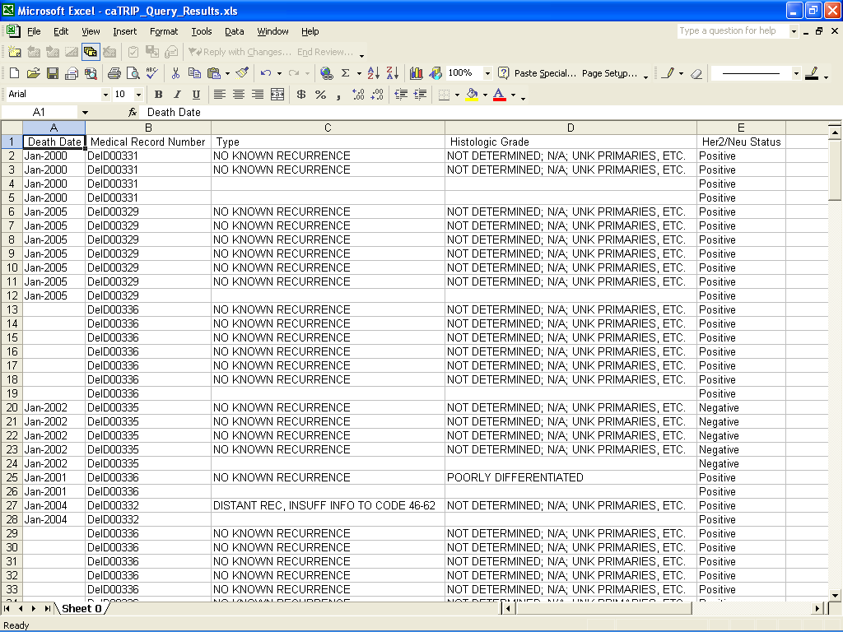
Notes:
Is there a correlation between recurrence, mortality, histologic grade, and Her2/Neu status for breast cancer patients diagnosed with lobular carcinoma?

Slide 9
Find Patients for Trials

Slide 10
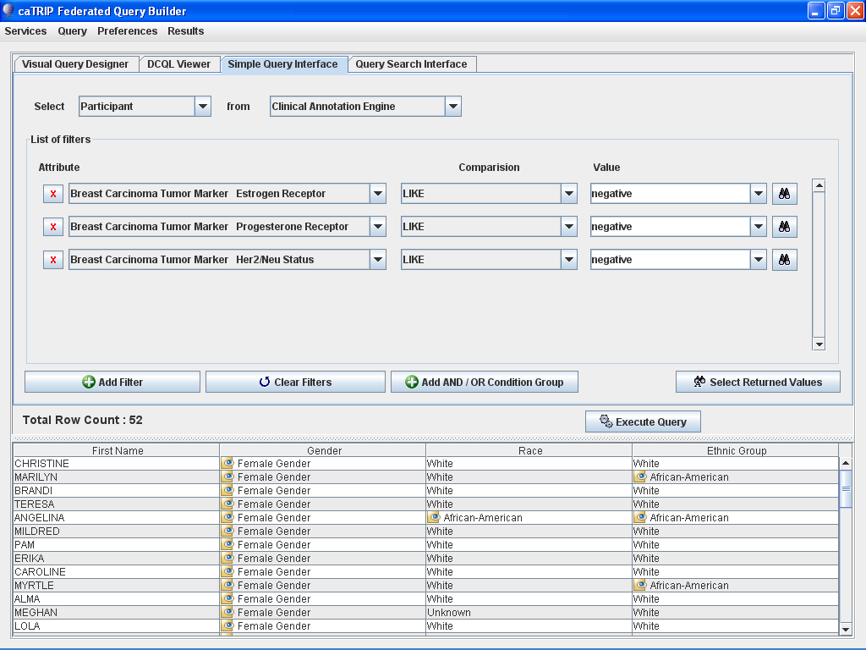
Notes:
What are all the patients that are triple negative (ER, PR, and HER2/NEU negative)?

Slide 11
Find Available Tumor Tissue

Slide 12
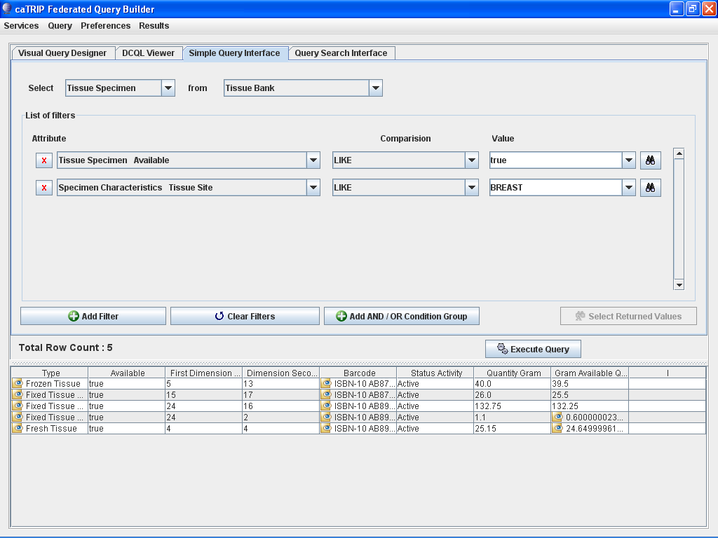
Notes:
What are all the available tissue specimens from the breast?

Slide 13
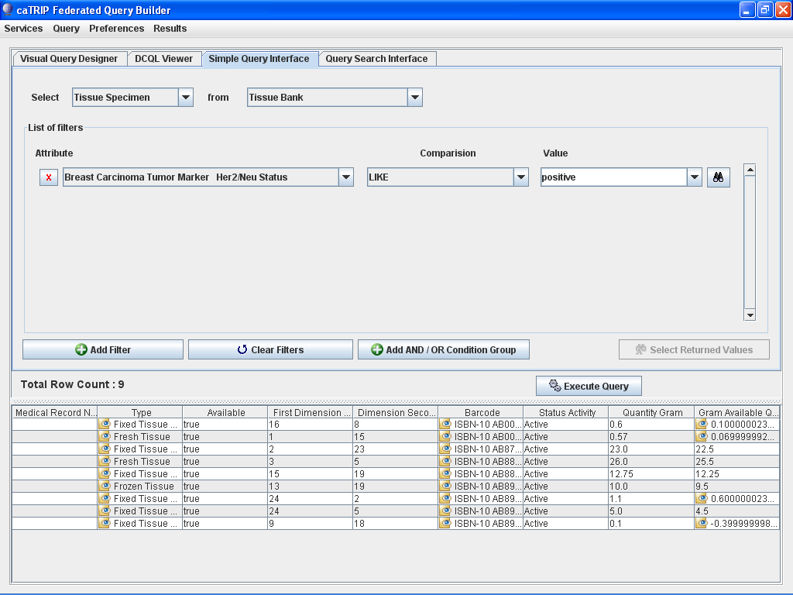
Notes:
What are all the tissue specimens from patients that have a her2/new status of positive?

Slide 14
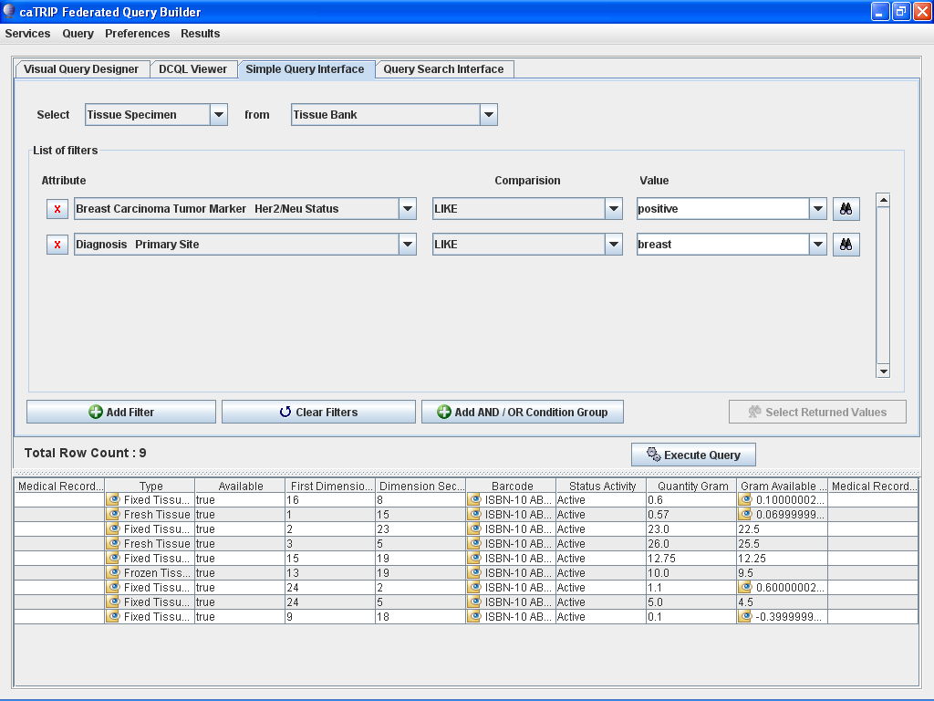
Notes:
What are all the tissue specimens from her2/neu positive patients that have a primary tumor in the breast?

Slide 15
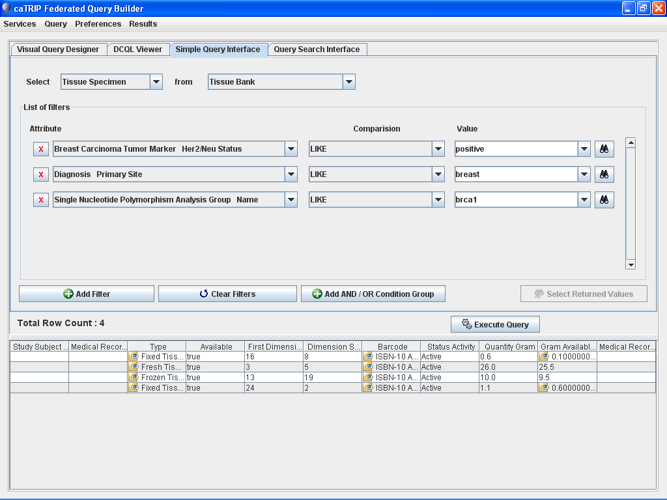
Notes:
What are all the tissue specimens from her2/neu positive patients that have a primary tumor in the breast and are BRCA1 positive?

Slide 16
Find Factors of Survival

Slide 17
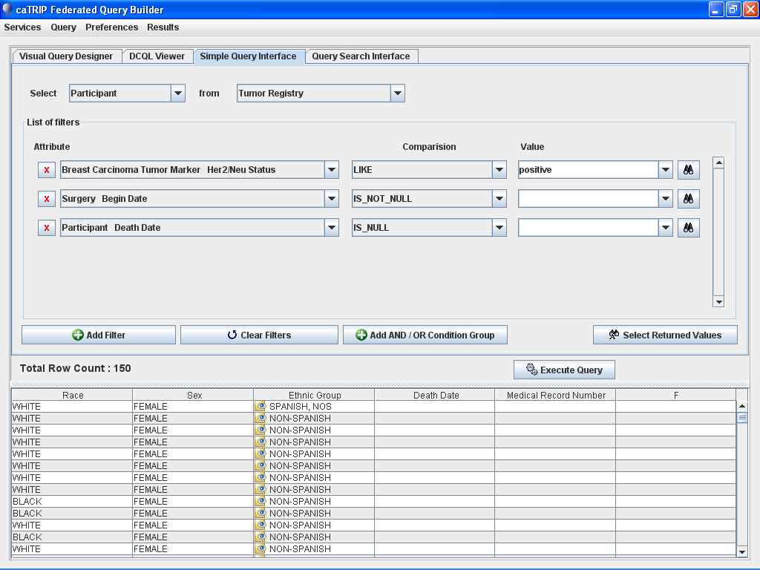
Notes:
What are all the Her2/neu positive patients that have survived breast cancer after surgery?

Slide 18
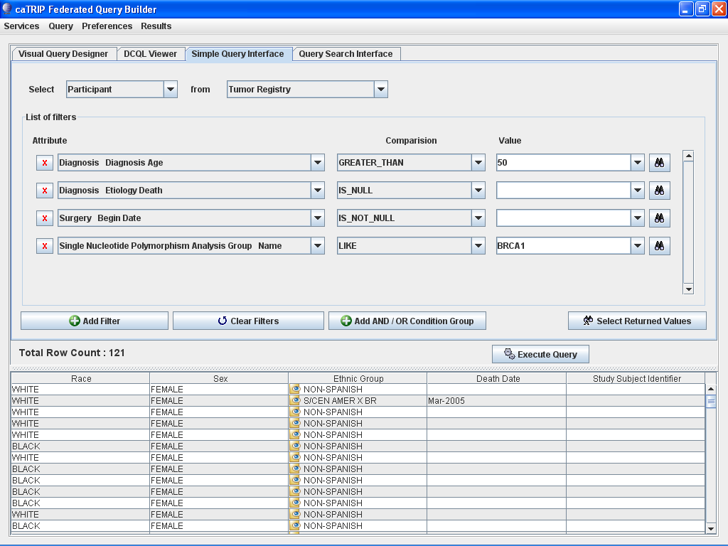
Notes:
What are all the BRCA1 positive patients over the age of 50 that have survived breast cancer after surgery?

Slide 19
Determine the Distribution of Disease Factors Over Time
Requires post-processing

Slide 20
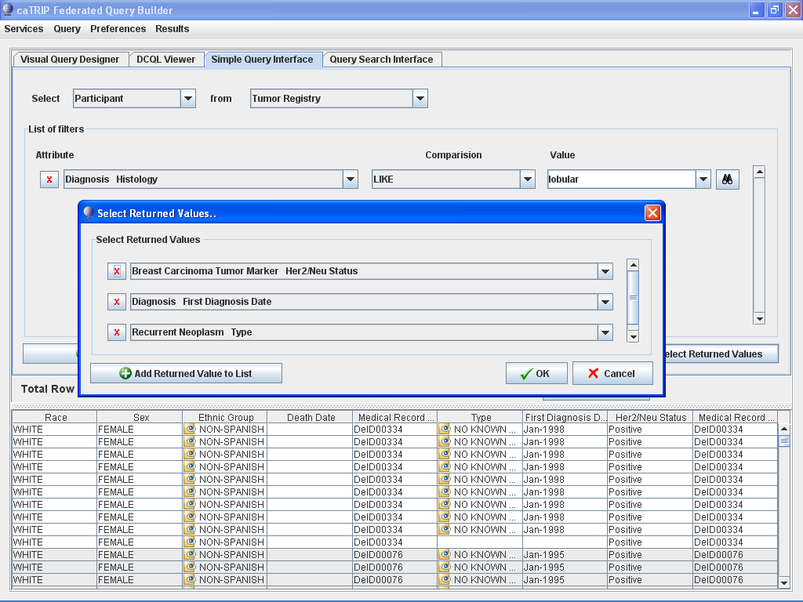
Notes:
Does a change in pathology biomarkers over time contribute to recurrence or death?

Slide 21
Determine Correlation of Factors Pre and Post Surgery
Requires post-processing

Slide 22
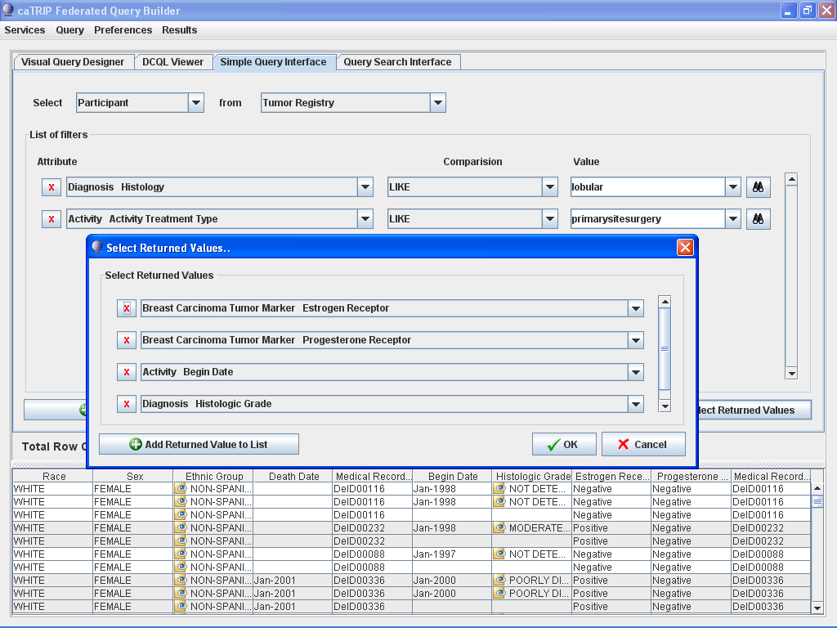
Notes:
Does a change in ER or PR status before and after surgery correlate with other factors such as histologic grade?

Slide 23
Find Pathology Reports of Interest
Pathology reports not available yet

Slide 24
Query Sharing

Slide 25
Notes:
What are all the patients that are triple negative (ER, PR, and HER2/NEU negative)?

Slide 26
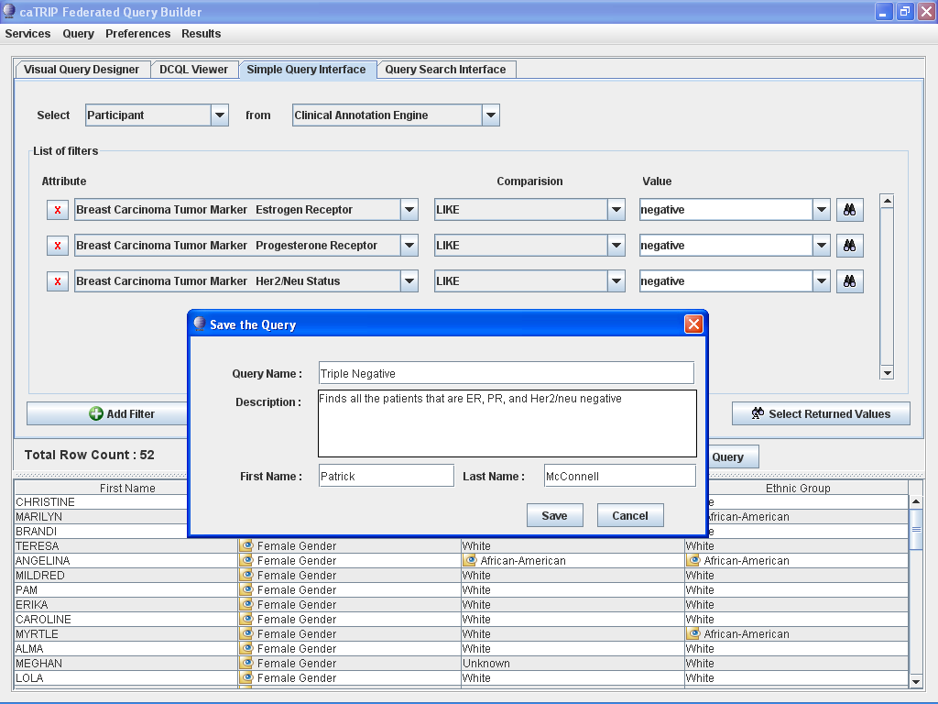
Notes:
What are all the patients that are triple negative (ER, PR, and HER2/NEU negative)?

Slide 27
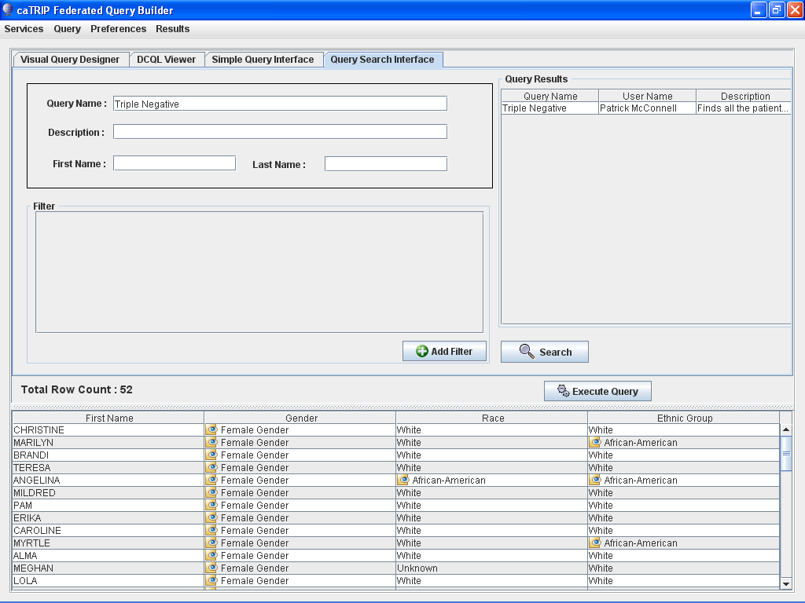
Notes:
What are all the patients that are triple negative (ER, PR, and HER2/NEU negative)?

Slide 28
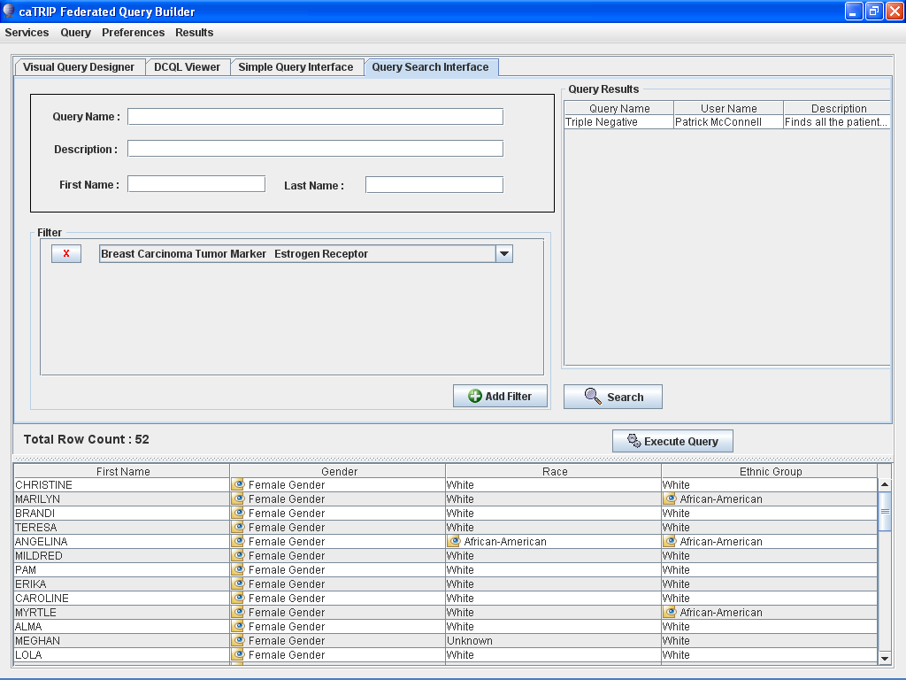
Notes:
What are all the patients that are triple negative (ER, PR, and HER2/NEU negative)?

Slide 29
Grouping

Slide 30
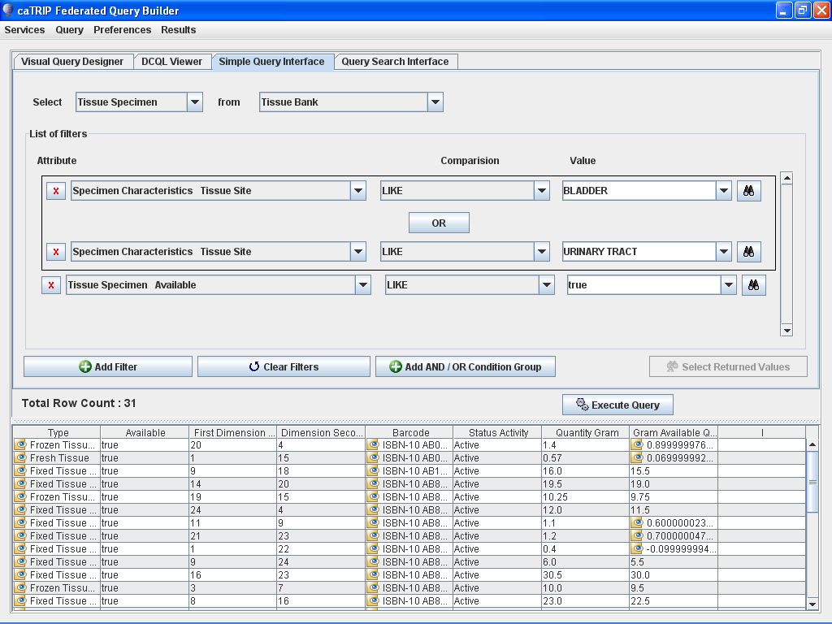
Notes:
What are all the available tissue specimens from the bladder or urinary tract?

