Slide 1
caTRIP Overview and Demo
Bob Annechiarico¹, Raj Dash¹, Ram Chilukuri²
¹Duke Comprehensive Cancer Center
²Semantic Bits, LLC

Slide 2
Who is involved
Duke Bioinformatics
  Jamie Cuticchia (PI)
  Patrick McConnell (lead architect)
Duke Information Systems
  Bob Annechiarico (PM)
  Wilma Stanley (developer)
  Mark Peedin (developer)
  Mohamad Farid (DBA)
  Jeff Allred (IT manager)
Duke Pathology
  Raj Dash (domain expert)
  Chris Hubbard (developer)
Duke Oncology
  Kelley Marcom (domain expert)
  Gretchen Kimmick (domain expert)
  Kimberly Blackwell (domain expert)
  Lee Wilke (domain expert)
Duke CALGB
  Kimberly Johnson (DataMart liaison)
Semantic Bits
  Ram Chilukuri (lead developer)
  Srini Akkala (developer)
  Sanjeev Agarwal (developer)
5 AM Solutions
  Bill Mason (developer)
3rd Millennium
  Julie Klemm (ICR WS lead)
NCI
  Carl Shaefer (NCI rep)
  Subha Madhavan
  (caIntegrator PM)
BAH
  Mehul Shah (tech support)

Slide 3
Background
Bob Annechiarico
Duke Comprehensive Cancer Center

Slide 4
Background
Translational RFP issued in Feb-March
  Duke/Semantic Bits/5AM collaboration
caTRIP: Cancer Translational Research Informatics Platform
  Awarded in May
Two 6 months phases
  Function prototype: delivered
  Production system: next six months

Slide 5
What is translational research?
Bench-to-Bedside
Wikipedia (the source of all knowledge):
Translational medicine is a branch of medical research that attempts to more directly connect basic research to patient care.
Basic research occurs in the lab
Patient care occurs in the clinic

Slide 6
Translational research extension
Also from Wikipedia:
Translational medicine can also have a much broader definition, referring to the development and application of new technologies in a patient driven environment - where the emphasis is on early patient testing and evaluation.
…facilitate the interaction between basic research clinical medicine, particularly in clinical trials.
Our focus will be on connecting existing data systems, including basic science data, to enhance patient care

Slide 7
Initial problem scenario
Outcomes analysis: using data from existing patients to inform the treatment of another patient
Leverage clinical, pathology, tissue, and basic science data
Scenario:
Patient A enters the clinic. What treatments were applied with success on other patients with similar characteristics (race, sex, symptoms, pathology results, adverse events, biomarkers).

Slide 8
Scientific use cases
Find available tumor tissue
  What are all the tissue specimens from her2/neu positive patients that have a primary tumor in the breast and are BRCA1 positive?
Find factors of survival
  What are all the ER positive patients that have survived breast cancer after radiation treatment?
Find patients for trials
  What are all the patients that are triple negative (ER, PR, and HER2/NEU negative)?
Determine the distribution of disease factors over time
Determine correlation of factors pre and post surgery
Find pathology reports of interest
Notes:
Find available tumor tissue
caTissue CORE: protocol #, pathological status, clinical diagnosis
CAE: ER, PR, Her-2/neu, EGFR status
Find factors of survival
Cohorts of patients who have survived a certain number of years following their diagnosis
Tumor registry: dates of diagnosis/treatment/death, nodal/distant metastasis status, grade of tumor
CAE: ER, PR, Her-2/neu, EGFR status
SNP: BRCA1/BRCA2 status
Determine the distribution of disease factors over time
Factors that may contribute to or reflect progression of a disease state
Tumor registry: dates of diagnosis/treatment/death, nodal/distant metastasis status, grade of tumor
CAE: ER, PR, Her-2/neu, EGFR status
Find patients for trials
Example is that of the triple negative hormone
Tumor registry: dates of diagnosis/treatment/death, nodal/distant metastasis status, grade of tumor
CAE: ER, PR, Her-2/neu, EGFR status
Determine correlation of factors pre and post surgery
Patients that have particular factors change before and after surgery
Tumor registry: dates of surgery
CAE: ER, PR, Her-2/neu, EGFR status
Find pathology reports of interest
Tumor registry: dates of diagnosis/treatment/death, nodal/distant metastasis status, grade of tumor
CAE: ER, PR, Her-2/neu, EGFR status
caTIES: pathology report
Find SNP results correlated with factors
Tumor registry: nodal/distant metastasis status, grade of tumor
CAE: ER, PR, Her-2/neu, EGFR status
SNP: BRCA1/2 status, genotype finding, gene biomarker

Slide 9
caBIG Tools
Clinical data: Tumor Registry
  Diagnosis, treatment, recurrence, followup
Clinical results: CAE
  Pathology biomarkers
Tissue bank: caTissue CORE
  Tissue specimens, location
Pathology reports: caTIES
  Free-text fields
Basic Science: caIntegrator
  SNP data

Slide 10
Data Sharing
Raj Dash
Duke Comprehensive Cancer Center

Slide 11
Duke databases
Medical Assistant on the World Wide Web (MAW3)
  Entity-centric database
  Tissue banking, pathology, and some clinical annotations
Tumor Registry
  Relational database
  Endpoint data since 1980
Decision Support Repository (DSR)
  Data warehouse
  Patient clinical data, crossing all medical specialties, lab data
Genetic Modifiers of BRCA1 and BRCA2 (GEMS)
  SNP Illumina flat-files
  Investigation to identify factors that influence the incidence of breast cancer in germline BRCA1/2 mutation carriers

Slide 12
Data sharing challenges
Sharing identifiable data
  Step 1: caTRIP gets IRB approval to build a system
  Step 2a: researcher gets IRB approval for protocol to view data
  Step 2b: researcher uses data for patient care or quality of service
Sharing deidentified data
  Traditional method: data manager deidentifies an entire dataset then throws away the key
    Centralized: not scalable
  Proposed method: trusted service provider (TSP) deidentifies discreet values
    Distributed: everyone is responsible for their own deid

Slide 13


Distributed deidentification
Secure connection
MRN3
MRN3
GHI789
Trusted Service
Provider
GHI789
Has IRB approval to see identifiable data
Has IRB approval to see identifiable data
Has IRB approval to store identifiable data
PHI | DEID
MRN1 | ABC123
MRN2 | DEF456
. . . | . . .
PHI | DEID
MRN1 | ABC123
MRN2 | DEF456
MRN3 | GHI789
. . . | . . .
Randomly generated

Slide 14
caTRIP data sharing
Current datasets are deidentified
  Performed via modified centralized mothod
  caTissue CORE, Tumor Registry
Future deidentified datasets
  CAE, SNP
Goals
  Get IRB approval at Duke for building system with identifiable data
  Modify Duke deidentification policy to allow distributed model of deidentification
  Use caTRIP as one potential model for sharing data in caBIG

Slide 15
caTRIP Demo
Duke Comprehensive Cancer Center

Slide 16
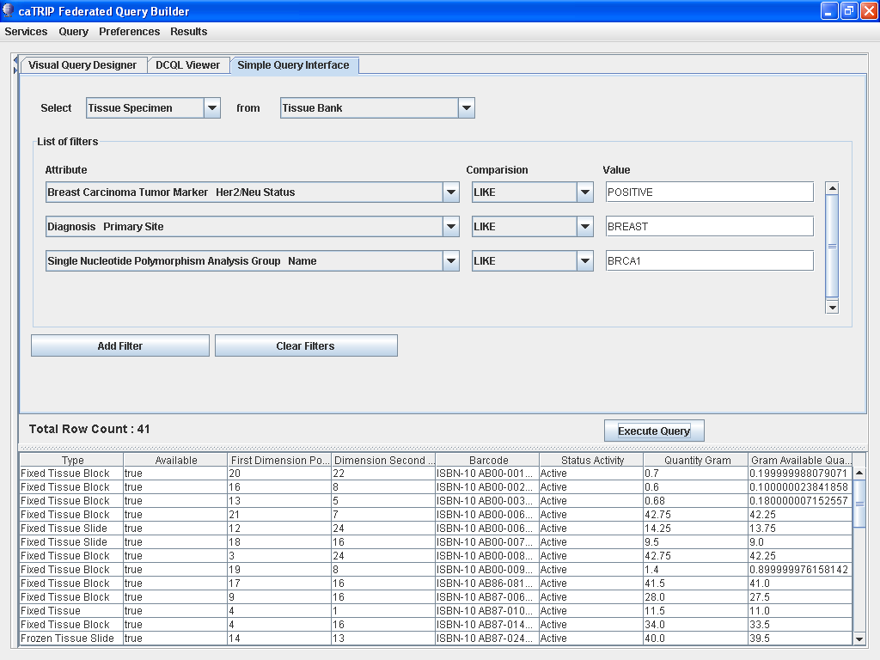
Phase 1 scientific queries
Find available tumor tissue
What are all the tissue specimens from her2/neu positive patients that have a primary tumor in the breast and are BRCA1 positive?

Slide 17
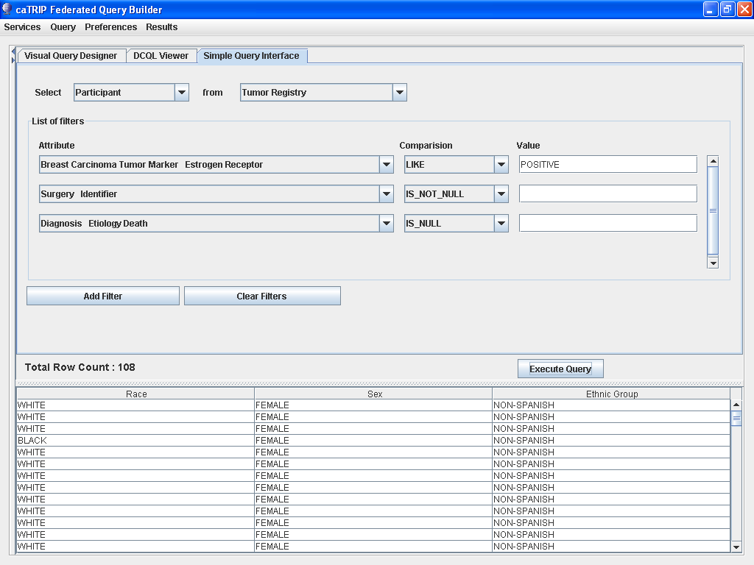
Phase 1 scientific queries
Find factors of survival
What are all the ER positive patients that have survived breast cancer after radiation treatment?

Slide 18
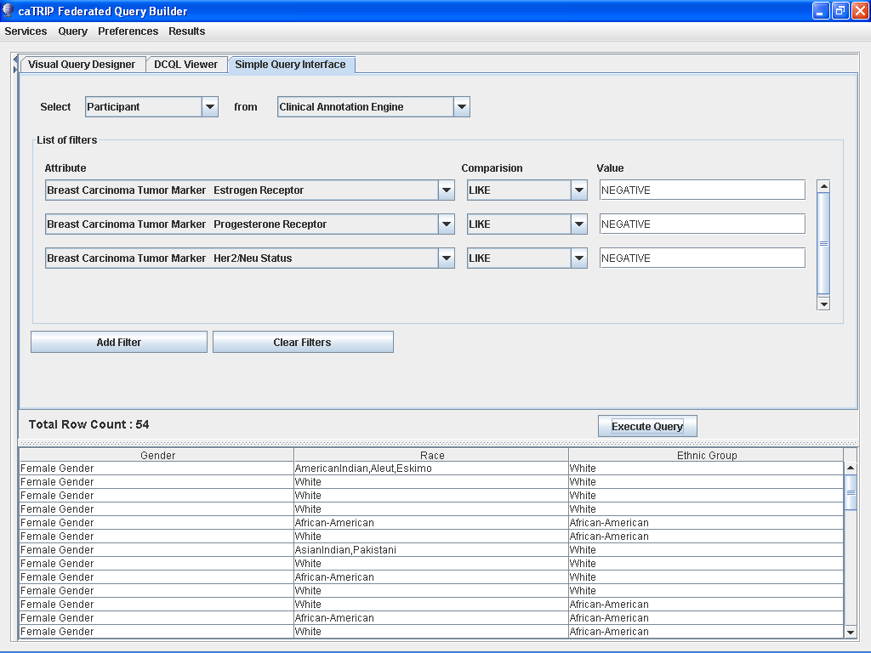
Phase 1 scientific queries
Find patients for trials
What are all the patients that are triple negative (ER, PR, and HER2/NEU negative)?

Slide 19
Architecture
Ram Chilukuri
Semantic Bits

Slide 20
Proposed Solution
Federated versus warehouse
  Leverage semantics to perform distributed queries
  Enabled by heavy use of Common Data Elements (CDEs)
Three major components
  Domain services
  Distributed query engine
  Graphical user interface
Enabled by the grid (alphabet soup)
  Advertisement/discover: Index Service
  Metadata: caDSR/EVS
  APIs: WSDL
  Transport: XML over SOAP
  Data model: XML Schema stored in the GME
  Security: Dorian layered over Duke IDP (Identity Provider)

Slide 21
caTRIP Architecture Overview
GUI
query
Distributed
Query
Engine
authenticate
discover
Core Grid Services
Domain Grid Services
IdP
Service
Index
Service
Grid
Grouper
authorize
caTissue
CORE
caTIES
CAE
TR
CGEMS
SNP
Duke
Domain
Controller
caTissue
CORE
caTIES
CAE
TR
caIntegrator
MAW3
Tumor Registry
Illumina

Slide 22
Service implementation
Index Service
advertise
advertise
Distributed
Query
Engine
caGrid Data Service
CQL Query
caCORE SDK
CQL Engine
domain
model
Object-relational
mapping
database

Slide 23
Distributed query engine overview
CQL
caGrid data
service
database
data
objects
DCQL
Distributed
Query
Engine
CQL
caGrid data
service
database
data
objects
data
objects
CQL
database
caGrid data
service
data
objects

Slide 24
Simple GUI: Configuration file Schema
Service A
Service B
TissueSpecimen
SpecimenCollectionGroup
BreastCancerBiomarkers
Target
ClinicalReport
Linking Object
Join Condition
Associated
Classes
ParticipantMedicalIdentifier
Association Direction
Filter
Object
SpecimenCharacteristics
Associated Object Tree
Foreign Association inbound Paths
Linking Object
Join Condition
Join Condition: CDE ex. MRN
Target
Association Direction
Service A
Service B
Foreign Association Outbound Path
Foreign Association

Slide 25
caTRIP Security
authorization
User Grid
Certificate
authentication
Grid
Data Service
User
Credentials
SAML
Assertion
Dorian
CSM
Trust Fabric
caGrid
Authentication Service
Grid
Grouper
backend
data
Duke
Authentication Plugin
Duke Domain Controller
NT Security

Slide 26
Next Steps
Ram Chilukuri
Semantic Bits

Slide 27
caTRIP next steps
Add functionality
  GUI, DQE
Implement query sharing
  Grid service, search/save/retrieve/delete
Implement security
  Authorization, authentication
Add audit capabilities
  Common logging component
Add datasets
  CAE, SNP, caTIES
Document/implement compliance
  Section 508 and 21 CFR part 11

Slide 28
Beyond phase 2
Invocation of analytical services
  Building workflows
  Adding data visualization
Enhanced reporting
  Automate Excel pivot table
  Data mining style results
Enhanced querying
  Asynchronous parallel querying
  Aggregate data from multiple services of the same type

Slide 29
Discussion
All

Slide 30
Backup slides

Slide 31
Tumor Registry
Created from Duke TR database
Submitted model for loading into the DSR
Duke
  Validated model
  Provided real de-identified test data
Data Loading
  Delimited data files
  Hibernate API
Available at GForge under caTRIP project

Slide 32
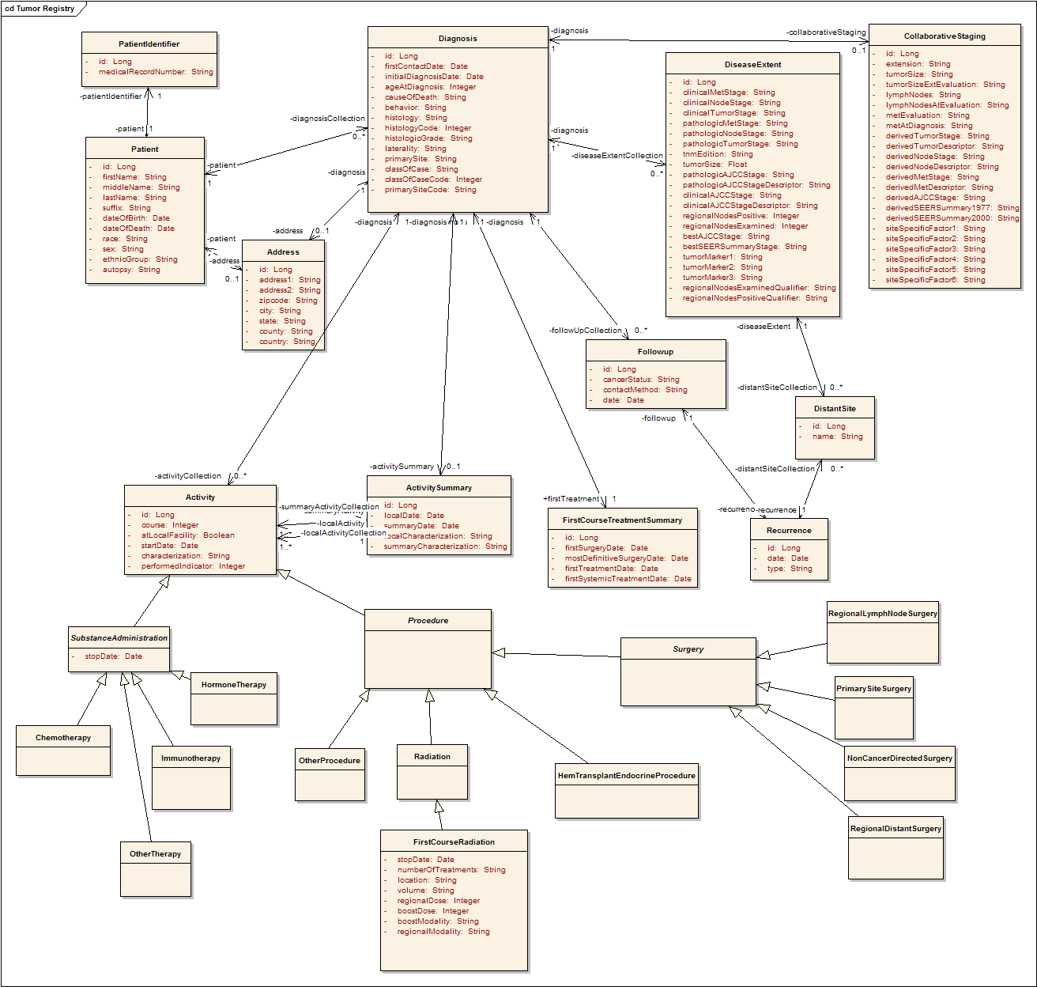
Tumor Registry Model
Participant
Diagnosis
Collaborative
Staging
Follow up and
Recurrence
Treatment

Slide 33
Loading test data
Identified sample data
  Queried various Duke databases
  Googled cancer websites
Built input files
  Text files with values that correspond to CDEs
Loaded data
  Randomly selected values from text files
  Used Hibernate APIs to load objects

Slide 34
Data loading example
Curated
Data Files
Data
Generator
Participant
randomly
select
generate
objects
Maria
Kennedy
Liles | MARY
Harris | PATRICIA
Kennedy | LINDA
Wynne | BARBARA
Lytle | ELIZABETH
Lytle | JENNIFER
Tamborella | MARIA
Chopra | SUSAN
Denny | MARGARET
. . . | . . .
Participant
DB
Linda
Liles
Participant
load via
hibernate
Susan
Wynne
Participant
Barbara
Chopra
. . .

Slide 35
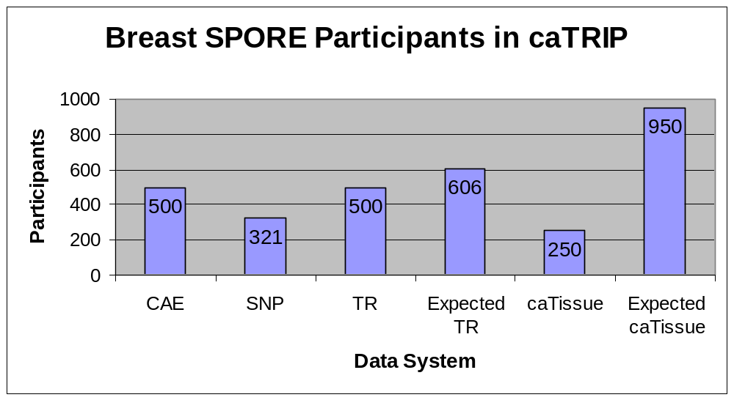
caTRIP data system statistics

Slide 36
Data sharing challenges
Sharing identifiable data
  Step 1: caTRIP gets IRB approval to build a system
  Step 2a: researcher gets IRB approval for protocol to view data
  Step 2b: clinician uses data for patient care (trickier than it sounds) or quality of service
Sharing deidentified data
  Traditional method: data manager deidentifies an entire dataset then throws away the key
    Centralized: not scalable
  Proposed method: trusted service provider (TSP) deidentifies discreet values
    Distributed: everyone is responsible for their own deid
    Very scalable

Slide 37
Phase 1 scientific queries
Find available tumor tissue
What are all the available tissue specimens from the breast?
What are all the tissue specimens from patients that have a her2/new status of positive?
What are all the tissue specimens from her2/neu positive patients that have a primary tumor in the breast?
What are all the tissue specimens from her2/neu positive patients that have a primary tumor in the breast and are BRCA1 positive?

Slide 38
Phase 1 scientific queries
Find factors of survival
What are all the ER positive patients that have survived breast cancer after radiation treatment?
What are all the BRCA1 positive patients over the age of 50 that have survived breast cancer after surgery?

Slide 39
Phase 1 scientific queries
Find patients for trials
What are all the patients that are triple negative (ER, PR, and HER2/NEU negative)?

Slide 40
GUI enhancements
Reporting
  Data-mining style reporting
Filters
  Drop-down values for enumerated value domains and distinct values
  Filter type based on data type
  Groups of ORs and ANDs
Query sharing and synchronization
  Synchronize DQCL, simple, and advanced GUI
  Share new queries, invoke existing queries

Slide 41
DQE enhancements
Service
  Grid service for DQE
  Delegation
XML-based processing
  Generalize to any grid service
DCQL enhancements
  Define return type (associated objects)
  Return distinct values or single attributes
Implementation
  Distributed joins other than equality

Slide 42
Auditing module
caGrid
Authentication Service
GUI
caLog?
caLog?
Security
Call-out
Grid Service
user
D/CQL
caLog
HQL
CSM
CQLProcessor
results
. . .
Hibernate
CLM?
Domain DB
Log DB
or
Log File

Slide 43
Compliance
Section 508
  Mostly pertain to usability for people with vision impairments.
  Examples
    Alternative keyboard navigation
    Animated displays, color and contrast settings, flash rate, and electronic forms
  Implemented by simplified GUI input form
21 CFR part 11
  Ensures the authenticity, integrity, non-repudiation and confidentiality of electronic records and signatures
  Implemented by the logging module

