Slide 1
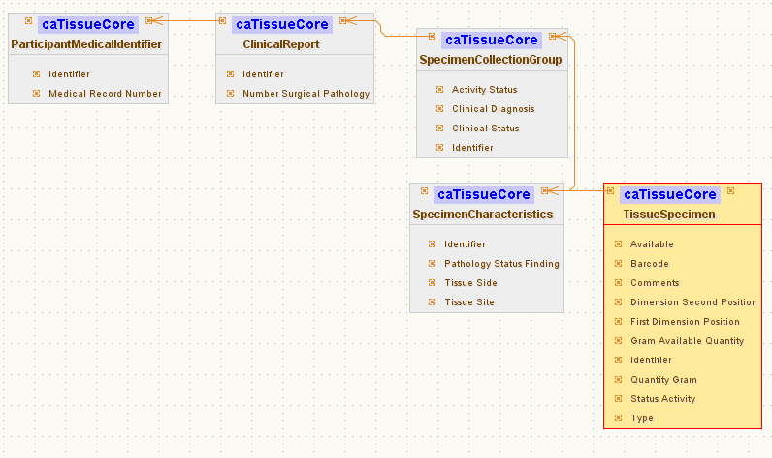
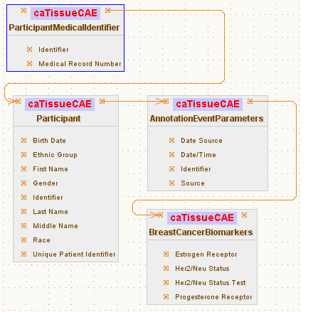
Simple GUI: Configuration file Schema
Inbound Path
ParticipantMedicalIdentifier
AnnotationEventParameters
BreastCancerBiomarkers
Outbound Path
Association path
Participant
TissueSpecimen
Foreign Association inbound Path
SpecimenCollectionGroup
ClinicalReport
caTissueCore Filter
ParticipantMedicalIdentifier
Association path
SpecimenCollectionGroup
ParticipantMedicalIdentifier
TissueSpecimen
ClinicalReport
SpecimenCharacteristics
CAE Filter
Foreign Association Outbound Path

Slide 2
Simple GUI: Configuration file Schema
Service A
Service B
TissueSpecimen
SpecimenCollectionGroup
BreastCancerBiomarkers
Target
ClinicalReport
Linking Object
Join Condition
Associated
Classes
ParticipantMedicalIdentifier
Association Direction
Filter
Object
SpecimenCharacteristics
Associated Object Tree
Foreign Association inbound Paths
Linking Object
Join Condition
Join Condition: CDE ex. MRN
Target
Association Direction
Service A
Service B
Foreign Association Outbound Path
Foreign Association

