Slide 1
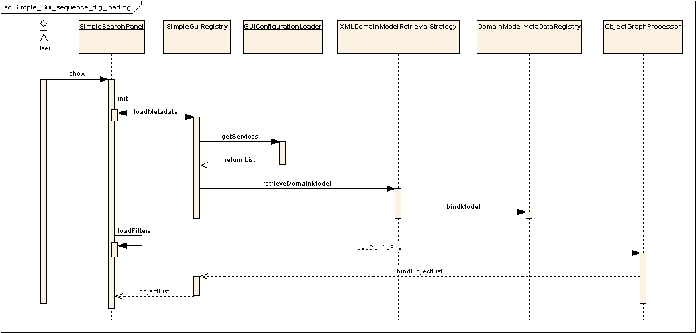
Sequence Diagram: Simple GUI
Loading of the Configuration and Domain Model Metadata Extract

Slide 2
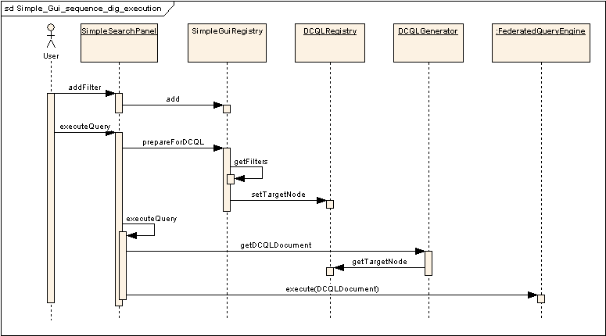
Sequence Diagram : Simple GUI
Execution of the Query

Slide 3
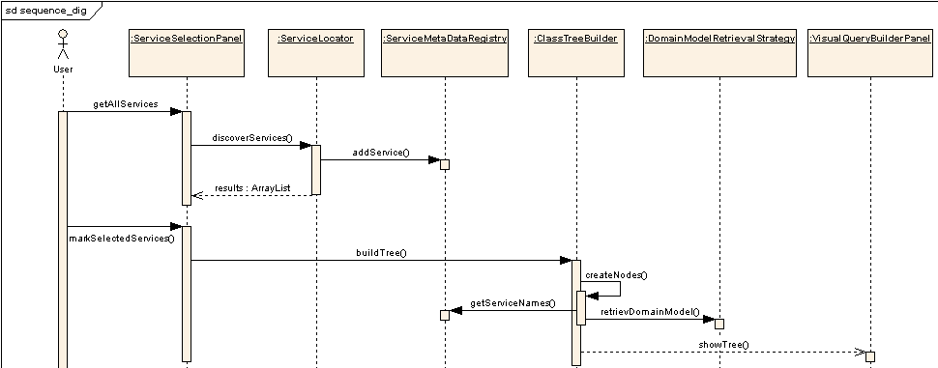
Sequence Diagram : Advance GUI
Loading and Discovery of Domain Model Metadata Extract

Slide 4
Motivation for Simple GUI
Drawbacks of advanced GUI
  Knowledge of UML Model
    Associations, Class Names, Attributes/CDEs
  Familiarity with technology
    Drag-n-Drop, Graph, Tree etc.
  Visual Query building: Freedom associated with Complexity
Simple GUI pro’s and con’s
  Pro’s
    eliminates all of above mentioned complexities
  Con’s
    Freedom to select Association Path, CDEs, Target Objects is lost
    Dynamic discovery & loading of services is not supported

Slide 5
Features of GUI : Phase-1
4 integrated grid services with Domain Model extract:
  CAE, CaTissueCORE, Tumor Registry, CGEMS.
Dynamic discovery/loading of Services via Index service.
HTML Result export facility.
Advance / Configurable Simple GUI.

Slide 6
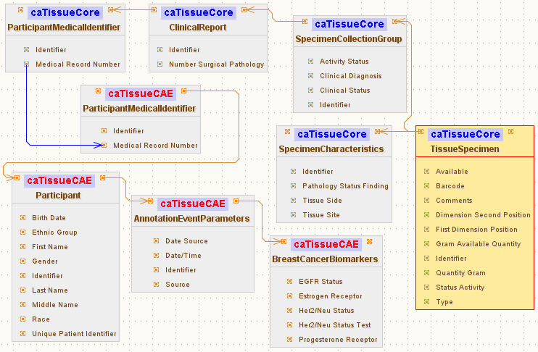
Example Query

Slide 7
Simple GUI: Configuration file Schema
Service A
Service B
Target
Linking Object
Join Condition
Associated
Classes
Association Direction
Filter
Object
Foreign Association inbound Paths
Associated Object Tree
Linking Object
Join Condition
Join Condition: CDE ex. MRN
Target
Association Direction
Service A
Service B
Foreign Association Outbound Path
Foreign Association

Slide 8
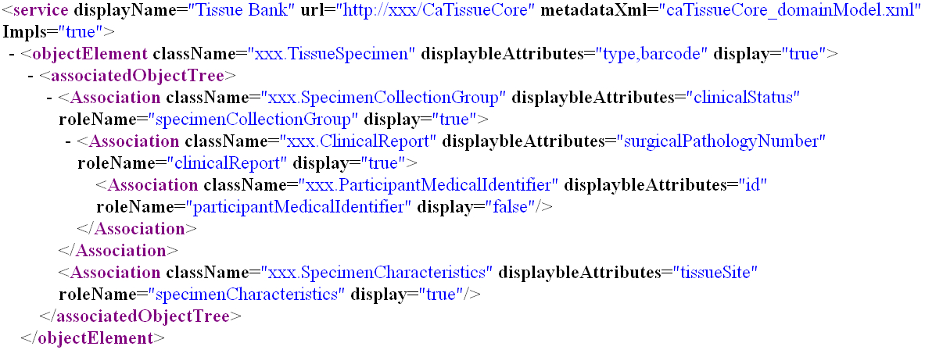
Simple GUI: Configuration file Schema
Associated Object Tree

Slide 9
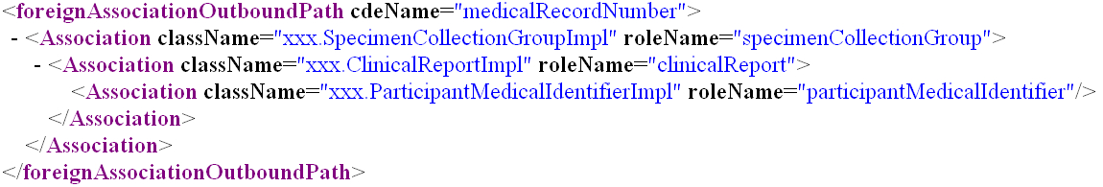
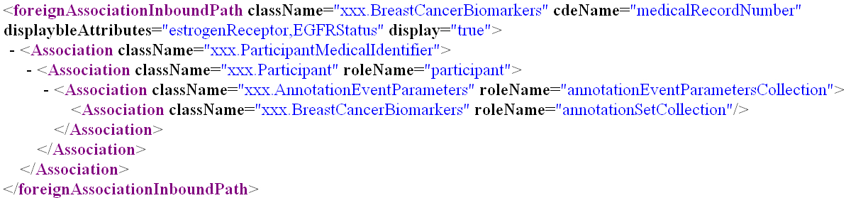
Simple GUI: Configuration file Schema
Foreign Association Outbound Path
Foreign Association inbound Path

Slide 10
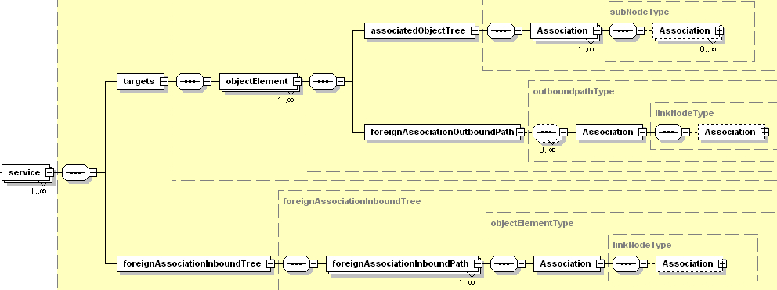
Simple GUI: Configuration file Schema
simpleQueryInterface-config.xsd

Slide 11
Performance Tuning
GUI
  Reuse Axis engine for CQLObjectResultsIterator
    Before tuning: 40/45 seconds
    After tuning: 1.2/1.3 seconds
Domain Services
  Hibernate layer tuning (Lazy loading)
    Before tuning: 70/75 seconds
    After tuning: 2/3 seconds
The above figures are for a CQL Result Set of 500 records

