Slide 1
caTRIP Beta Release
Patrick McConnell¹ and Ram Chilukuri²
¹Duke Comprehensive Cancer Center
²Semantic Bits, LLC

Slide 2
Agenda
Demo
  Overview, use cases, demo
Technical design
  Architecture overview
  Data services (overview, data loading, test data)
  Distributed query engine
  GUI (simple and advanced)
  caGrid collaboration
Next steps (phase 2 and beyond)
Phase 1 review

Slide 3
Who is involved
Duke Bioinformatics
  Jamie Cuticchia (PI)
  Patrick McConnell (lead architect)
Duke Information Systems
  Bob Annechiarico (PM)
  Wilma Stanley (developer)
  Mark Peedin (developer)
  Mohamad Farid (DBA)
  Jeff Allred (IT manager)
Duke Pathology
  Raj Dash (domain expert)
  Chris Hubbard (developer)
Duke Oncology
  Kelley Marcom (domain expert)
  Gretchen Kimmick (domain expert)
  Kimberly Blackwell (domain expert)
  Lee Wilke (domain expert)
Duke CALGB
  Kimberly Johnson (DataMart liaison)
Semantic Bits
  Ram Chilukuri (lead developer)
  Srini Akkala (developer)
  Sanjeev Agarwal (developer)
5 AM Solutions
  Bill Mason (developer)
3rd Millennium
  Julie Klemm (ICR WS lead)
NCI
  Carl Shaefer (NCI rep)
  Subha Madhavan
  (caIntegrator PM)
BAH
  Mehul Shah (tech support)

Slide 4
caTRIP Demonstration
Patrick McConnell
Duke Comprehensive Cancer Center

Slide 5
Problem scenario
Outcomes analysis: using data from existing patients to inform the treatment of another patient
Leverage clinical, pathology, tissue, and basic science data
Scenario:
Patient A enters the clinic. What treatments were applied with success on other patients with similar characteristics (race, sex, symptoms, pathology results, adverse events, biomarkers).

Slide 6

caTRIP Overview
GUI
query
Distributed
Query
Engine
authenticate
discover
Core Grid Services
Domain Grid Services
IdP
Service
Index
Service
Grid
Grouper
authorize
caTissue
CORE
caTIES
CAE
TR
CGEMS
SNP
Duke
Domain
Controller
caTissue
CORE
caTIES
CAE
TR
caIntegrator
MAW3
Tumor Registry
Illumina

Slide 7
Scientific use cases
Find available tumor tissue
Find factors of survival
Determine the distribution of disease factors over time
Find patients for trials
Determine correlation of factors pre and post surgery
Find pathology reports of interest
Notes:
Find available tumor tissue
caTissue CORE: protocol #, pathological status, clinical diagnosis
CAE: ER, PR, Her-2/neu, EGFR status
Find factors of survival
Cohorts of patients who have survived a certain number of years following their diagnosis
Tumor registry: dates of diagnosis/treatment/death, nodal/distant metastasis status, grade of tumor
CAE: ER, PR, Her-2/neu, EGFR status
SNP: BRCA1/BRCA2 status
Determine the distribution of disease factors over time
Factors that may contribute to or reflect progression of a disease state
Tumor registry: dates of diagnosis/treatment/death, nodal/distant metastasis status, grade of tumor
CAE: ER, PR, Her-2/neu, EGFR status
Find patients for trials
Example is that of the triple negative hormone
Tumor registry: dates of diagnosis/treatment/death, nodal/distant metastasis status, grade of tumor
CAE: ER, PR, Her-2/neu, EGFR status
Determine correlation of factors pre and post surgery
Patients that have particular factors change before and after surgery
Tumor registry: dates of surgery
CAE: ER, PR, Her-2/neu, EGFR status
Find pathology reports of interest
Tumor registry: dates of diagnosis/treatment/death, nodal/distant metastasis status, grade of tumor
CAE: ER, PR, Her-2/neu, EGFR status
caTIES: pathology report
Find SNP results correlated with factors
Tumor registry: nodal/distant metastasis status, grade of tumor
CAE: ER, PR, Her-2/neu, EGFR status
SNP: BRCA1/2 status, genotype finding, gene biomarker

Slide 8
Phase 1 scientific queries
Find available tumor tissue
What are all the available tissue specimens from the breast?
What are all the tissue specimens from patients that have a her2/new status of positive?
What are all the tissue specimens from her2/neu positive patients that have a primary tumor in the breast?
What are all the tissue specimens from her2/neu positive patients that have a primary tumor in the breast and are BRCA1 positive?

Slide 9
Phase 1 scientific queries
Find factors of survival
What are all the ER positive patients that have survived breast cancer after radiation treatment?
What are all the BRCA1 positive patients over the age of 50 that have survived breast cancer after surgery?

Slide 10
Phase 1 scientific queries
Find patients for trials
What are all the patients that are triple negative (ER, PR, and HER2/NEU negative)?

Slide 11
caTRIP Technical Design
Ram Chilukuri
SemanticBits, LLC

Slide 12
Tumor Registry
Created from Duke TR database
Submitted model for loading into the DSR
Duke University
  Validated model
  Provided real de-identified test data
Data Loading
  Delimited data files
  Hibernate API
Available at GForge under caTRIP project

Slide 13
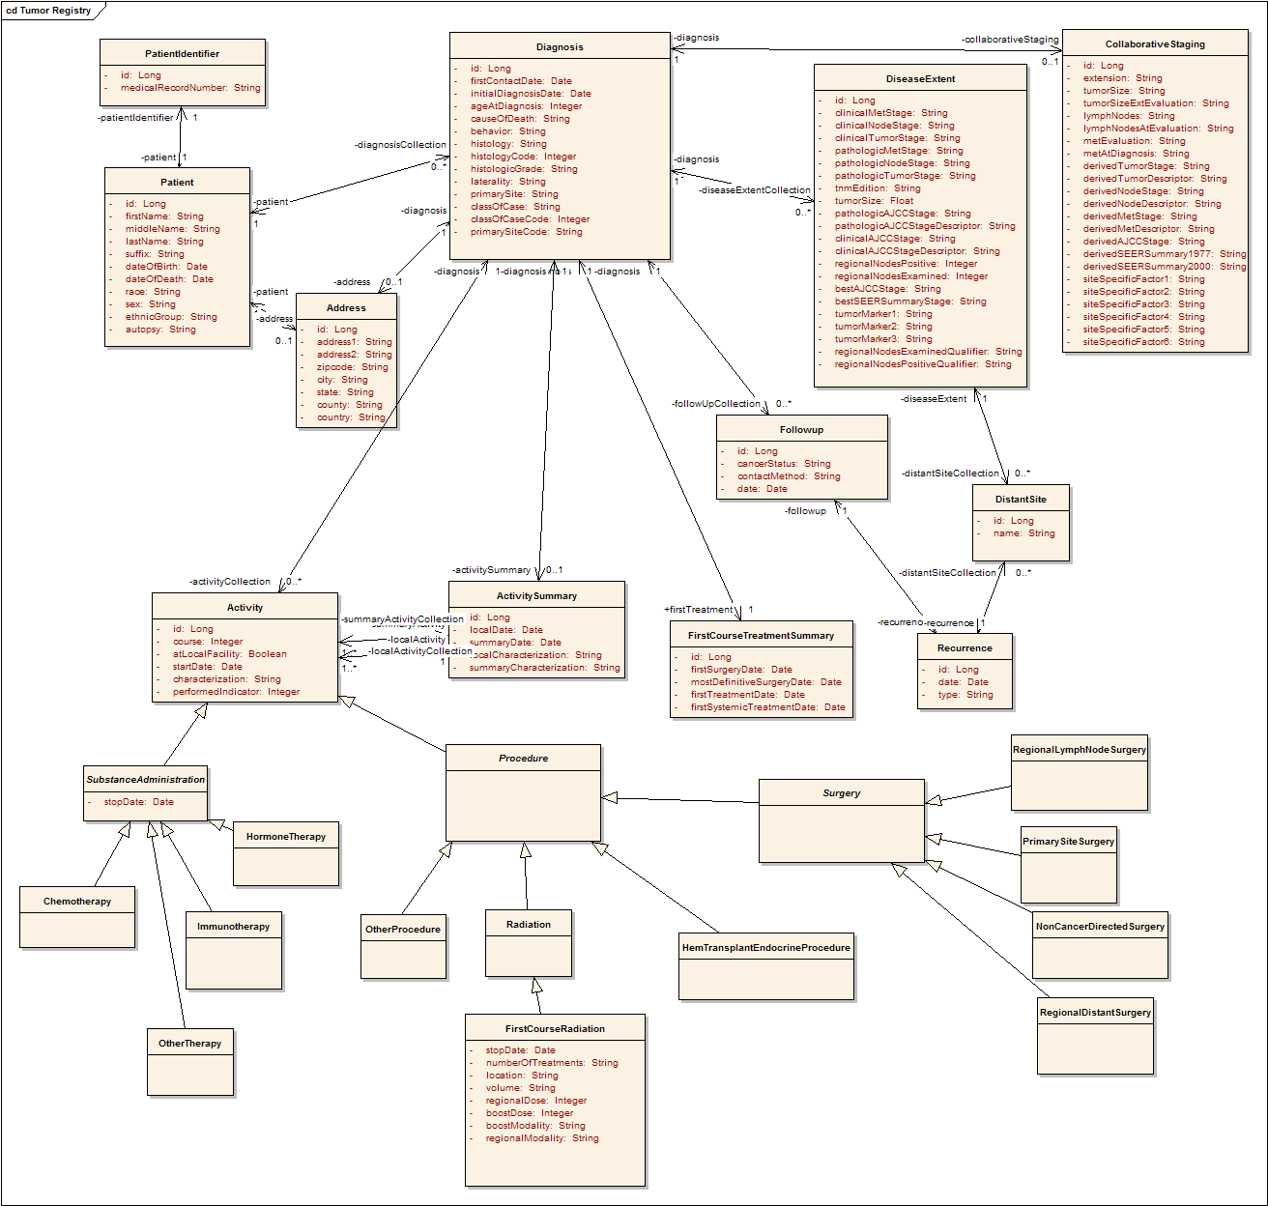
Tumor Registry Model
Participant
Diagnosis
Collaborative
Staging
Follow up and
Recurrence
Treatment

Slide 14
Collaboration with caGrid 1.0 Development Team
caTRIP use cases were a major factor in the implementation of CQL Query Processor
  Led to development and adoption of HQL-based implementation and deprecation of Criteria-based implementation
Finalize the DCQL schema
caTRIP FQE implementation is the basis for caGrid FQE
Finalize the domain model extract schema and implementation
Identified and reported a major issue in de-serialization logic that led to significant performance improvement
  Add metrics here..
Reported several defects and tested the fixes

Slide 15
caTRIP Next Steps
Patrick McConnell
Duke Comprehensive Cancer Center

Slide 16
caTRIP next steps
Add functionality
  GUI, DQE
Implement security
  Authorization, authentication
Add audit capabilities
  Common logging component
Implement compliance
  Section 508 and 21 CFR part 11
Add datasets
  CAE, SNP

Slide 17
GUI enhancements
Reporting
  Data-mining style reporting
Filters
  Drop-down values for enumerated value domains and distinct values
  Filter type based on data type
  Groups of ORs and ANDs
Query sharing and synchronization
  Synchronize DQCL, simple, and advanced GUI
  Share new queries, invoke existing queries

Slide 18
DQE enhancements
Service
  Grid service for DQE
XML-based processing
  Generalize to any grid service
DCQL enhancements
  Define return type
  Return distinct values or single attributes
Implementation
  Distributed joins other than equality

Slide 19
Security
authorization
User Grid
Certificate
authentication
Grid
Data Service
User
Credentials
SAML
Assertion
Dorian
CSM
Trust Fabric
caGrid
Authentication Service
Grid
Grouper
backend
data
Duke
Authentication Plugin
Duke Domain Controller
NT Security

Slide 20
Auditing module
caGrid
Authentication Service
GUI
caLog
caLog
Security
Call-out
Grid Service
user
D/CQL
caLog
HQL
CSM
CQLProcessor
results
. . .
Hibernate
CLM?
Domain DB
Log DB
or
File

Slide 21
Compliance
Section 508
  Mostly pertain to usability for people with vision impairments.
  Examples
    Alternative keyboard navigation
    Animated displays, color and contrast settings, flash rate, and electronic forms
  Implemented by simplified GUI input form
21 CFR part 11
  Ensures the authenticity, integrity, non-repudiation and confidentiality of electronic records and signatures
  Implemented by the logging module

Slide 22
caTRIP Phase 1 Review
Patrick McConnell
Duke Comprehensive Cancer Center

Slide 23
Technical evaluation
Number of scientific use cases identified and the percentage of high priority use cases implemented in the beta release
  50% of all use cases met
  100% high priority use cases met
Usability criteria
  End-users review
    Oncologists will start review on Nov 5th
  Installation
    Web-start is easy
  Maintainability
    Design document, modular code

Slide 24
Technical evaluation cont.
Software quality
  Followed industry standard best practices
Potential for software reuse by others as measured by modular design, remote access
  caGrid is already reusing some of our code
  All domain services are remotely accessible
Reuse
  caGrid, caCORE SDK, caDSR
  caTissue CORE, CAE, caIntegrator

Slide 25
Project management
Schedule adherence
  On time with nearly all deliverables
Cost adherence
  We can ask for more money?
  Just kidding…

Slide 26
caBIG collaboration
Silver-level compatibility of caTRIP services, with Grid-compatible APIs
  We leverage fairly recent caGrid codebase
Reuse of domain workspace systems, including domain object models
  caIntegrator CGEMS: complete reuse
  caTissue CORE: complete reuse
  CAE: just changed 2 classes
Interaction with the broader caBIG community
  Monthly presentations at translational SIG
  Presentation at latest ICR F2F
  Presentations to other groups (e.g. population sciences)

Slide 27
Discussion
Patrick McConnell
Duke Comprehensive Cancer Center

