Slide 1
Clinical Trials Managements Systems Interoperability Project (CTMSi)
DSIC issues
Patrick McConnell
Duke Comprehensive Cancer Center
patrick.mcconnell@duke.edu

Slide 2


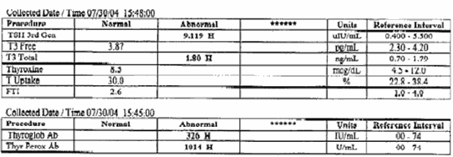

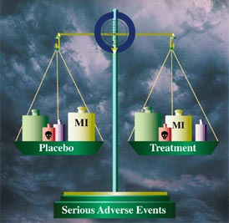

CTMSi
Background: data sharing
Integrate
Participant Registration
Lab Results
caXchange
caGrid
Patient Scheduling
Adverse Events
Clinical Trials DB

Slide 3
CTMSi
Data sharing issues
Global issue: trust of caGrid security
  Data needs to be exchanged between caBIG applications
  Data is all behind the firewall (for now…)
  Is it OK to exchange PHI between systems that use the caGrid security infrastructure?
  What about cross-institutional studies”
  Is it still OK to exchange PHI between systems that use the caGrid security infrastructure?

Slide 4
Clinical Trials Managements Systems Interoperability Project (CTMSi)
DSIC issues backup slides
Patrick McConnell
Duke Comprehensive Cancer Center
patrick.mcconnell@duke.edu

Slide 5
CTMSi
Mapping the Clinical Research Domain
Layer 1
Bench Research Domain
Clinical Research Domain
Integrated Clinical & Translational Domain
Layer 2
Study Plan
Study Set Up
Study Conduct
Study Analyze & Report
Layer 3
Manage Study
Manage Subjects
Manage Data
Quantify CRA Workload
Enroll Subjects
Load Lab data
Layer 4
AE Triggered Mod
Data for Interim
Analysis
Re-consenting Subjects
Identify Potential dose
change
…

Slide 6
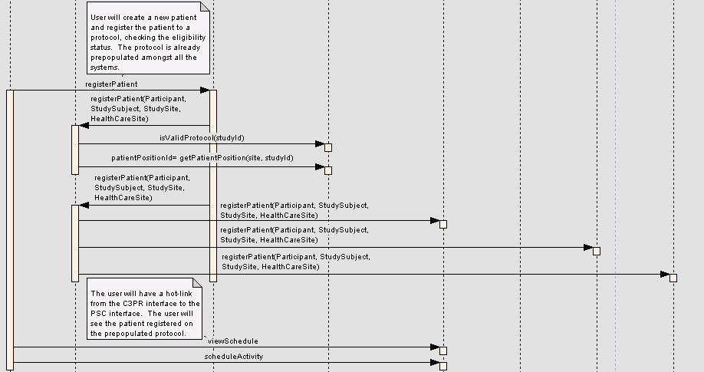
CTMSi
Enroll patient

Slide 7
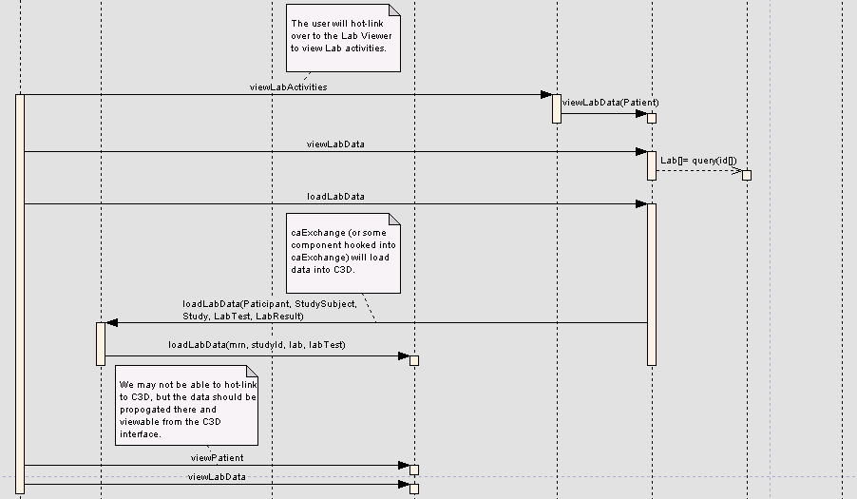
CTMSi
Load lab data

Slide 8
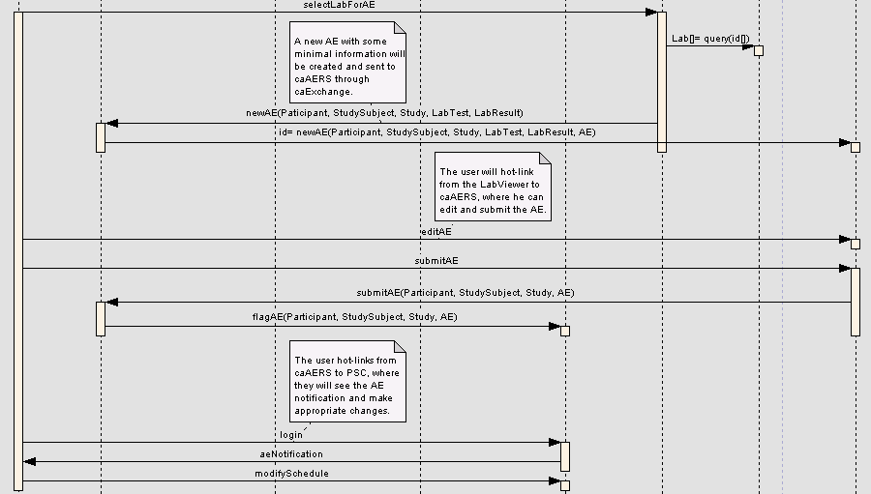
CTMSi
Adverse Event triggered modification

Slide 9





CTMSi
Architectural Overview
^{C3PR}
^{C3D}
^{PSC}
^{LabViewer/CTOM}
^{caAERS}
^{Oracle}
^{Oracle}
^{Postgre}
^{Oracle}
^{Postgre}
^{Grid Service}
^{Web Service}
^{Grid Service}
^{Grid Service}
^{Grid Service}
^{Authentication}
^{Trust}
^{Authorization}
^{Messages}
^{caXchange}
^{caGrid}
^{Enterprise Service Bus}
^{Inbound}
^{Binding}
^{Component}
^{Outbound}
^{Binding}
^{Component}
^{Routing Rules}
^{Dorian}
^{GTS}
^{Grid Grouper}

Slide 10
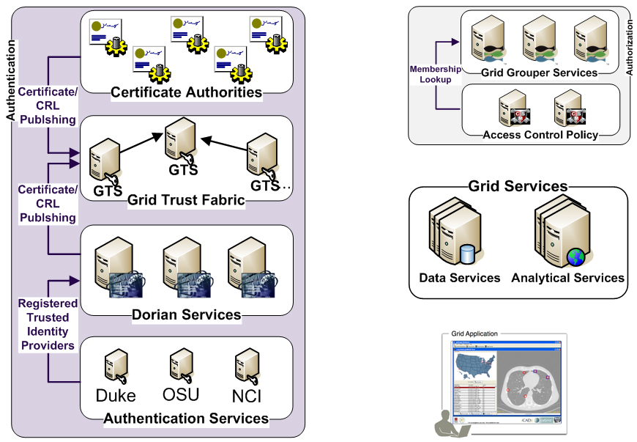
CTMSi caGrid Security
Is member of?
Should I trust the
credential signer?
Is
Authorized?
SAML Assertion
Grid
Credentials
Grid
Credentials
Authenticate with
Local Credential Provider
SAML Assertion

