Slide 1
Cancer Translational Research Informatics Platform (caTRIP)
DSIC issues
Patrick McConnell
Duke Comprehensive Cancer Center
patrick.mcconnell@duke.edu

Slide 2
caTRIP
IRB and deidentification issues
Local issues: building data-oriented systems
  Duke required IRB approval to even build a data-oriented system based upon real PHI
  We worked around by leveraging people already on IRB protocols
Global issues: data deidentification
  Data is owned by different groups across the cancer center
  Traditional deidentification: data manager deidentifies an entire dataset then throws away the key
  Distributed deidentification: trusted service provider (TSP) deidentifies discreet values
  Traditional approach is not scalable – requires a middle-man
  IRB approval required for distributed approach because it deviates from traditional deidentification (at Duke)

Slide 3
caTRIP
Grid security
Global issue: IRB submissions
  Exposing PHI on the grid is a touchy subject
  IRB’s don’t understand grid technology
  Development teams won’t necessarily understand all the intricacies of the caGrid security infrastructure
  It would be very useful to have some boiler-plate text and some write-ups for IRB proposals
Global issue: trusting the caGrid security infrastructure
  caGrid security infrastructure is very new
  caGrid security is based upon some standard technologies and some newly developed technologies
  There is a mistrust about exposing PHI through caGrid security, even though it uses some of the same technologies as a standard web application

Slide 4
caTRIP
Cross-institutional clinical querying
Global issue: caBIG vision is a world-wide-web of cancer data in the hands of oncologists and researchers
  Cross-institutional clinical querying requires data be shared
The scenario:
Envision a clinical scenario where a patient reaches an oncologist’s office for the first time with a known histologic diagnosis of breast cancer. She produces a pathology report that describes the cancer as “invasive lobular”, moderately differentiated. At this point the oncologist is comfortable explaining the various options for treatments and their associated risks. However, now imagine a scenario where that same patient has a strong family history of cancer (consider both breast cancer or non-breast cancer histories as possible scenarios). How should the risks and therefore suggested treatments change? Now add in the possibility of additional confounding data that is not well-published in the current literature. Consider that the lobular cancer over expresses the proto-oncogene Her-2/neu, a condition that almost never happens in lobular tumors. How would an oncologist even begin to calculate risks or appropriately suggest treatment options? Even taking the cohort of all patients at a single large tertiary care facility, there may not be enough data to provide the statistical strength to derive a valid conclusion. Here is a situation where a multi-institutional caGrid-enabled network of clinical, pathology, and molecular data in concert with the translational informatics system described above can help to provide the oncologist with the statistical power to provide an informed decision with regard to the best treatment options for his/her new patient.
No lack of PHI, IP, IRB, and deidentification issues

Slide 5
caTRIP
Cross-institutional research querying
Global issues: caBIG vision is a world-wide-web of cancer data in the hands of oncologists and researchers
  Cross-institutional research querying requires data be shared
The scenario:
Take the seemingly simple question of trying to determine if there is a correlation between Nottingham Score and Her2/Neu status for patients diagnosed with lobular carcinoma. Firstly, this query crosses two domains that typically are in disjoint data systems in a cancer center: clinical/pathology annotations and diagnosis histology. Secondly, in order to make a statistically valid analysis, there may not be enough data at a single cancer center. Bringing data from other institutions can increase statistical power immensely. Take a second related scenario, whereby the researcher would also like to investigate gene biomarkers that correlate with a Her2/Neu status of negative and survival. Pulling basic science data from multiple studies across different research sites provides to the fingertips of a researcher a wealth of data previously impossible. Furthermore, when tissue banking systems are hooked in, the researcher has the opportunity to determine whether tissue samples are available for further research through other experimental methods, such as immunohistochemistry.
No lack of PHI, IP, IRB, and deidentification issues

Slide 6
Cancer Translational Research Informatics Platform (caTRIP)
DSIC issues backup slides
Patrick McConnell
Duke Comprehensive Cancer Center
patrick.mcconnell@duke.edu

Slide 7



caTRIP
Distributed deidentification
Can join on GHI789, which is a deidentified ID
Distributed
Query
Engine
^{CAE}
^{caTissue}
^{CORE}
CAE
caTissue
CORE
GHI789
Trusted Service
Provider
GHI789
MRN3
MRN3
Data owners submit PHI to be deidentified by the TSP
^{Data Owner}
^{Data Owner}

Slide 8
caTRIP in-depth
Architecture
GUI
query
Distributed
Query
Engine
authenticate
discover
Core Grid Services
Domain Grid Services
IdP
Service
Index
Service
Grid
Grouper
authorize
caTissue
CORE
caTIES
CAE
TR
CGEMS
SNP
Duke
Domain
Controller
caTissue
CORE
caTIES
CAE
TR
caIntegrator
MAW3
Tumor Registry
Illumina

Slide 9
Challenges in data sharing
Security
Challenge
  Security in a distributed grid environment is a difficult problem
  The caGrid security infrastructure is still very new (caGrid 1.0 is released)
authentication
User
Credentials
SAML
Assertion
User Grid
Certificate
authorization
Grid
Data Service
caGrid
Authentication Service
Dorian
CSM
Trust Fabric
Duke
Authentication Plugin
Grid
Grouper
backend
data
Duke Domain Controller
NT Security

Slide 10
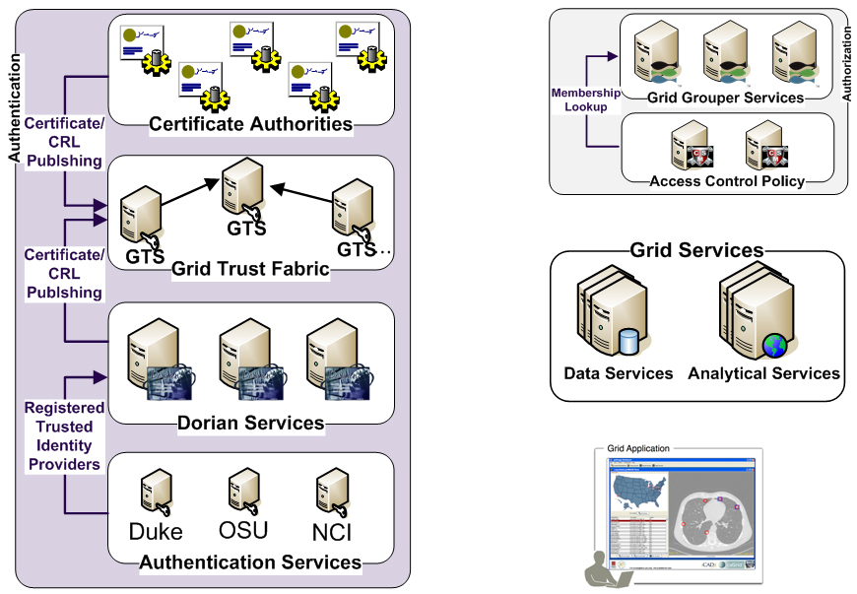
caTRIP caGrid Security
Is member of?
Should I trust the
credential signer?
Is
Authorized?
SAML Assertion
Grid
Credentials
Grid
Credentials
Authenticate with
Local Credential Provider
SAML Assertion

