Slide 1
NCICB Common Security Service
caCore Meeting
11/04/2004
Notes:
Kalpesh

Slide 2
Agenda
Introduction
Project Overview
  Overall Process, Project Management, Project Life Cycle
Work accomplished so far
  Use Case Model, SAD, Authentication Prototype & Design
Product Features
High Level Architecture
Application Integration
Future Direction and Next Steps
Notes:
Kalpesh

Slide 3
Introduction
The Team
  Kalpesh Patel (Program Manager) patelk@mail.nih.gov
  Vinay Kumar (Project lead) kumarvi@mail.nih.gov
  Brian Husted ( Co-Architect & QA) bhusted@ekagrasoft.com
  Kunal Modi (Senior Developer) modik@mail.nih.gov
  Eric Copen (Test Engineer) copene@mail.nih.gov
The Documentation Location on the net:
  http://ncicbintra.nci.nih.gov/ncicb_common/#security
Notes:
Kalpesh

Slide 4
Project Overview
To provide a Common Security Framework for Authentication and Authorization to be used by all the applications at NCICB
To provide secured and guaranteed Message transfer capability between applications
To move towards providing Single Sign-on for users
To provide HIPAA, HL7 etc. compliance for applications
To provide tool to manage user provisioning as well as configuring the authentication and authorization data for various applications
Notes:
Kalpesh

Slide 5
Overall Process
Iterative RUP Approach
Interactive with technical group
Alignment with caCORE release
Prioritize requirements into release and iterations
Define scope for each iteration
Get concurrence of the plan & iteration
Delivery and integration with application teams through iterations
Notes:
Kalpesh

Slide 6
Use cases
26 Use Cases identified so far
Planned for current release
  Authentication
  Authorization
  User Authorization Provisioning (scoped down for caCORE 3.0)
  Logging
Future requirements and technologies
  Single Sign-On
  Messaging (HL7) encryption, non-repudiation
  WS Security
  HIPPA compliance
  Mutual authentication
  Federated authentication and authorization (SAML, eAuthentication, Shiboleth etc.)
  PKI
  XACML
Notes:
Kalpesh

Slide 7
Product Features for Release I
(CaCORE 3.0)
Localized implementation of common security service
Use Cases leading to the following features have been picked for implementation for Release I
  JAAS Authentication Module
  JAAS Authorization Module
  Authentication/Authorization object/interface model
  User Authorization Provisioning Application
  Advanced Logging architecture has been planned for implementation in the Security framework
Notes:
Vinay

Slide 8
Assumptions
No external users
No self registration of users
No capability to create user credentials
No self registration of applications
Notes:
Vinay

Slide 9
High Level Architecture for Release I
Credential Providers
Application server
RDBMS
LDAP
Application XYZ
Application Specific DB mySQL
Authorized
Common
Authorization
schema
JAAS
Authenticate
Authenticate
Security module
Authorize
User
Provisioning
Web
interface
Web server
Application
server
User
Provisioning
application
Notes:
Vinay

Slide 10
TARGET ARCHITECTURE
( High level – needs refinement)
Credential providers
LDAP
RDBMS
Others..
Application specific
Authorization schema
( role to objects mapping)
authenticate
Application A
A
Application C
(using only
Web Services)
Authenticate
SOAP
Security Service
csmClient.jar
Xml Authorization Schema
XML
Common
Authorization
schema
Application B
(using
Web Services &
native calls)
B
Xml Authorization Schema
Authenticate (SOAP)
Application server
User
Provisioning
Web
interface
Web
server
User
Provisioning
application
(User to role mapping)
Notes:
Vinay

Slide 11
Work Accomplished
Established Security Working Group (SWG)
Held two meetings with the SWG to refine the requirements
Use Case model is complete
Data Model has been finalized
Object Model Design for Authentication is complete
Software Architecture Document (SAD) is near completion
Authentication has been prototyped with caMatch
Logging Application has been completed
Notes:
Vinay

Slide 12
Logging Application – Business Case
Production support staff need to rapidly identify and resolve production support issues
In many cases, production support teams and developers must traverse through several log files and thousands of debug messages
Retrieving and traversing log files in a clustered environment has proven to be both time consuming and counter productive
Notes:
Kalpesh

Slide 13
Logging Application - Features
Powerful and efficient web-based searching across clustered servers and applications
Near real-time access to production log messages
Light-weight and easily adoptable framework
Very simple installation and configuration (30 minutes)
Notes:
Kalpesh

Slide 14
Logging Application - High Level Arch.
RDBMS
  Used to store all log messages
  Non-transaction database recommended
  Oracle users should consider MySql for better performance
Custom Apache Log4J Appender (JDBCAppender)
  Packaged as a JAR file that is appended to the target application’s classpath
  Inserts the SQL statements into the database in near real time
  Using a configurable buffer to perform batch processing to maximize performance
Log Tracker
  Struts based front-end application deployed on a J2EE application container such as Tomcat
  Provides web-based access to query log messages
  Enforces user authentication
  SSL and mutual authentication may be implemented for increased security
Notes:
Vinay

Slide 15
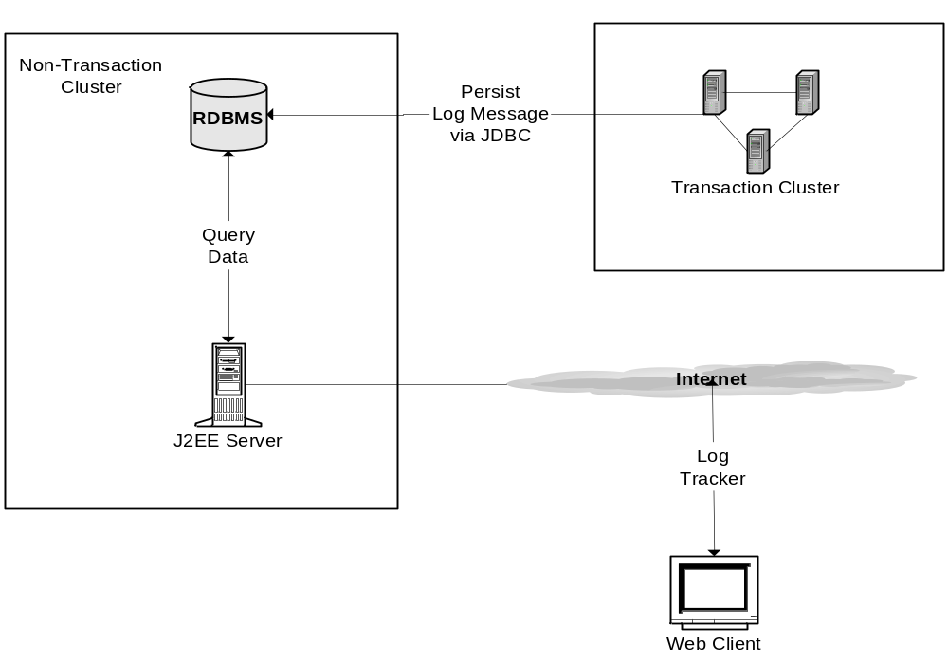
Logging Application – Arch. Diagram
Notes:
Vinay

Slide 16
Logging Application - Current Impl.
Grants.gov
caMatch
Notes:
Vinay

Slide 17
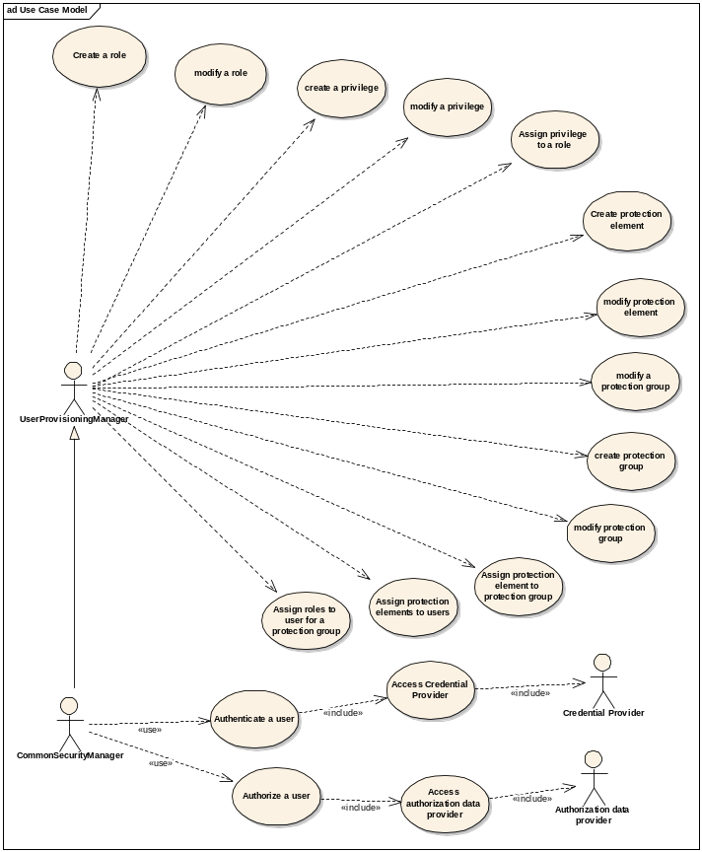
Use Case Model

Slide 18
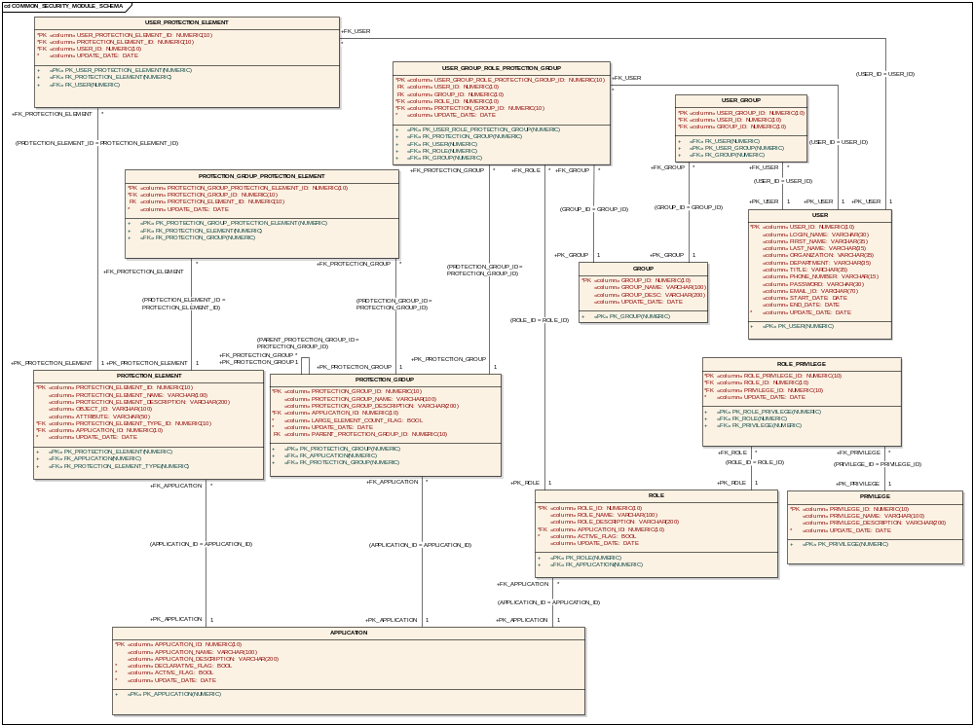
Data Model

Slide 19
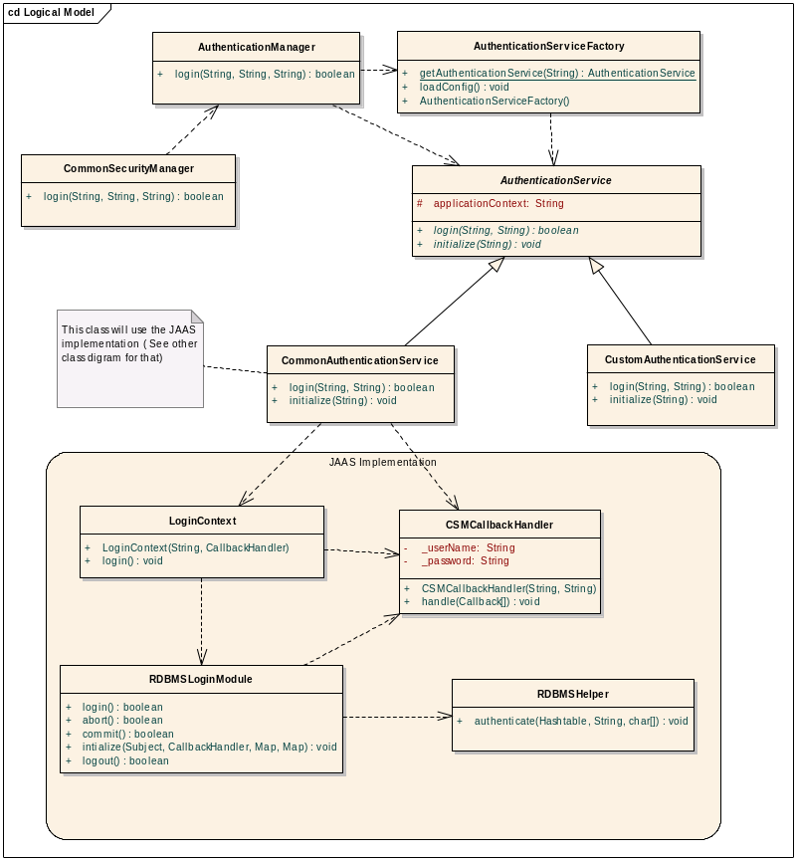
Object Model - Authentication

Slide 20
Release road map contd..
Major Milestones
  Inception
    Complete and already discussed
  Elaboration
    Iteration I - Complete
    Iteration II – 10/26/2004
  Construction
    Iteration I construction phase – 11/22/2004
    Iteration II construction phase – 12/21/2004
    Iteration III construction phase – 01/28/2005
    Iteration IV construction phase – 01/14/2005
  Transition
    Iteration I Transition phase – 02/15/2005
    Iteration II Transition phase – 02/28/2005
Notes:
Vinay

Slide 21
Application Integration
Elaboration
  Identify up to three teams for integration
Construction
  Integration at each iteration
The Effort Required
  Minor design changes related to login mechanism
  Coding effort required to integrate with the Security Module
  Configuring the Authentication and Authorization Data
  Writing of Test Cases to test the Integrated Functionality
Volunteers needed for Candidate Application
Ekagra team will work very closely to help with implementation and integration
Notes:
Kalpesh

Slide 22
Issues
Access to NCICB LDAP is not available to perform authentication testing
Late enhancements to data model requiring a some rework
Late changes to authorization requirements leading to rework for SAD
Notes:
Kalpesh

Slide 23
Future Direction
Common Security Framework to be the single source of Authentication and Authorization for all Applications
LDAP to be the preferred source of Authentication Credential Provider even though the service will be capable of supporting other industry standard credential providers
Security Framework to be available as a Web Service which can be access using client APIs or direct SOAP calls
Notes:
Kalpesh

Slide 24
Next Steps
Baseline all the documents developed so far 10/14/2004
Application Team Volunteers
  Contact
    Kalpesh
    Vinay
Peer Review volunteers
  Contact
    Vinay
    Brian
Requirements for user provisioning
SWG meeting every two week
  Review Prototype Results
  Review SAD
Questions?
Notes:
Kalpesh

