Slide 1
NCICB Common Security Service
Security Working Group Meeting
10/28/2004
Notes:
Kalpesh

Slide 2
Agenda
Introduction
Integration Milestones
Use Case Model
Proposed modifications to Common Schema
Discussion on User/Principal interface
Common User Attributes to identify a user uniquely
Notes:
Kalpesh

Slide 3
Introduction
The Documentation Location on the net:
  http://ncicbintra.nci.nih.gov/ncicb_common/#security
The module name for CVS:
  security
Notes:
Kalpesh

Slide 4
Integration Milestones
Prototype for Authentication using JAAS completed
Prototype integrated with caMatch application performing RDBMS authentication
Sample code and documentation available in CVS
Notes:
Kalpesh

Slide 5
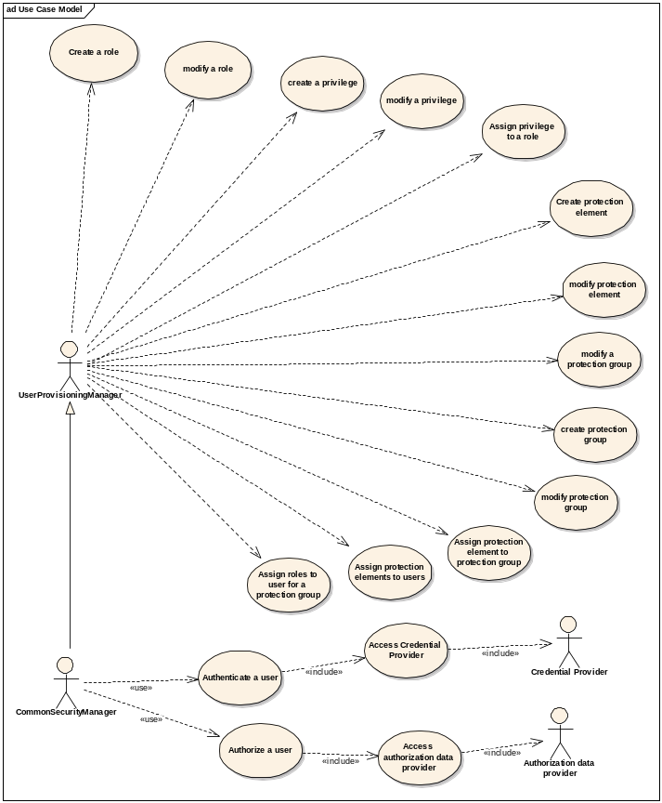
Use Case Model
Notes:
Kalpesh

Slide 6
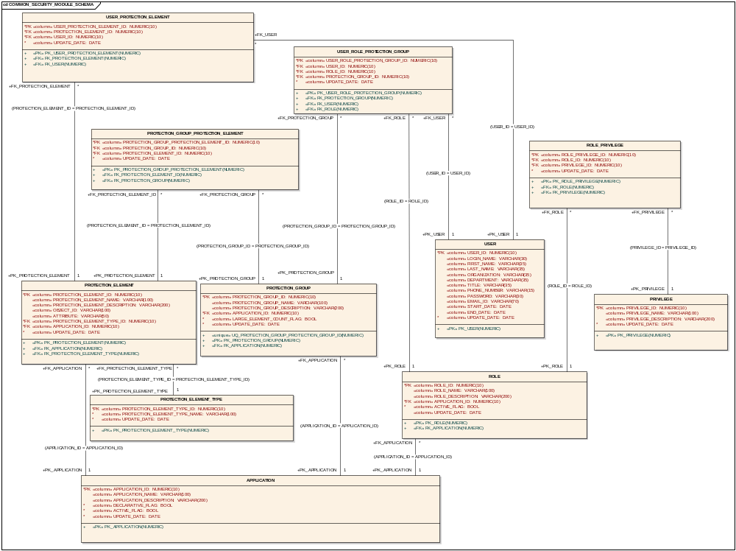
Proposed modifications to Common Schema
Notes:
Kalpesh

Slide 7
Discussion Points
Discussion on User/Principal Interface
Common User Attributes to identify a user uniquely
Others
Questions and Answers
Notes:
Kalpesh

