Slide 1
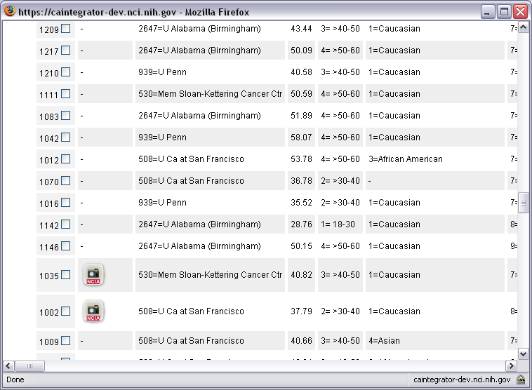
Notes:
The NCIA image links appear on the ispy clinical report page. By clicking on the images, it will take you to the ncia home page.

Slide 2
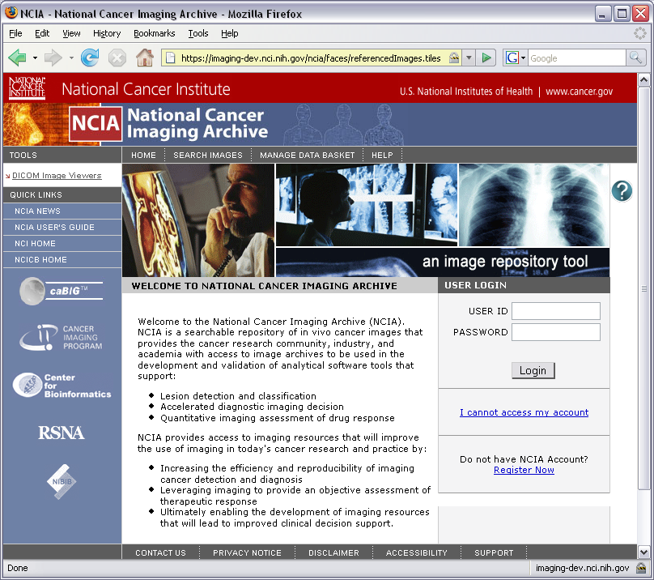

Notes:
One need to log in to view the ispy images

Slide 3
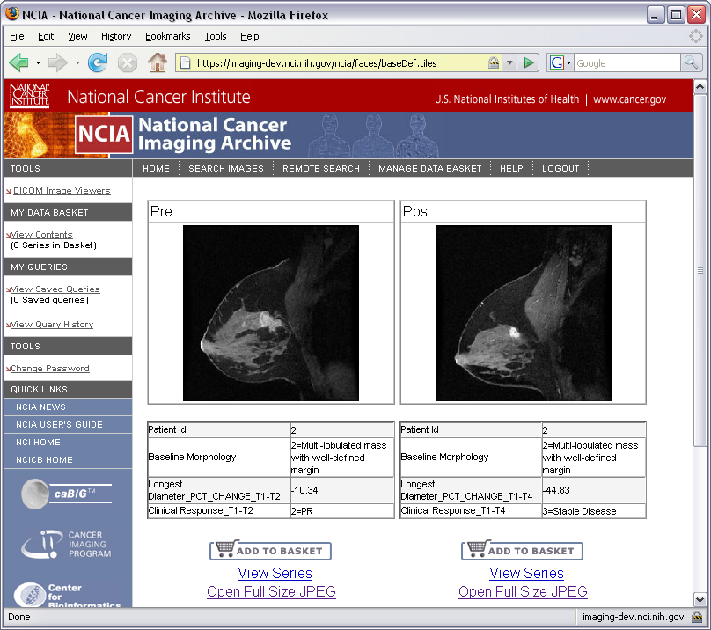
Notes:
Once logged in, the images selected from ispy will show.

Slide 4
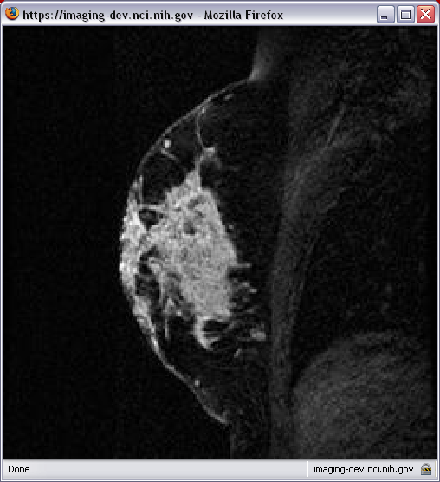
Notes:
One can view full size image by double clicking the image.

Slide 5
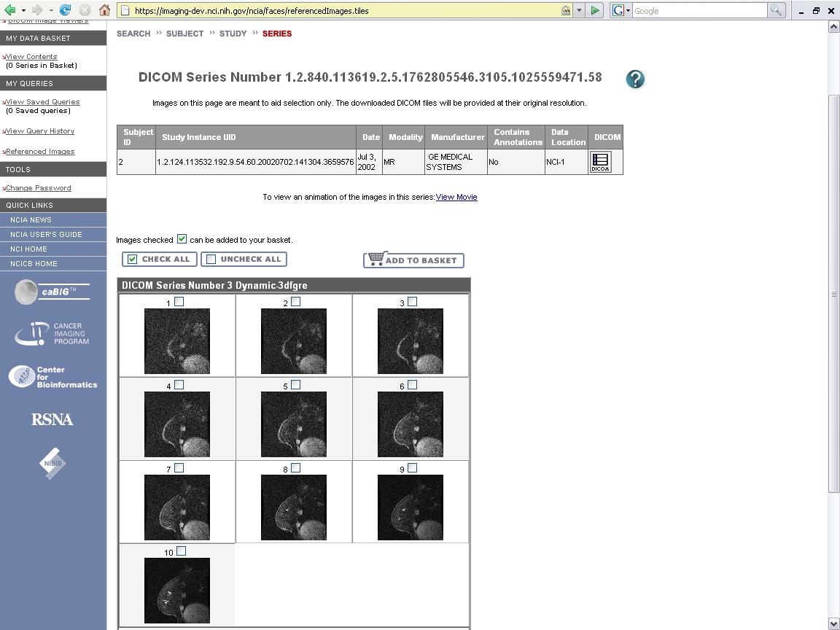
Notes:
Or one can view the whole series by clicking on the series link.

