Slide 1

caBIG® Integration Hub
MirthConnect Proof of Concept Results
Ekagra Software Technologies
September 10, 2010

Slide 2
Agenda
Background
Proof of Concept (POC) Objectives
Overview and Scope
Development Activities
Mirth Basics
High-level Architecture
Design
Demo
Conclusions

Slide 3
Background
  Indiana University Simon Cancer Center shared challenges in using iHub for their use cases and experience with MirthConnect
  iHub team completed a comparative assessment of iHub capabilities and MirthConnect features
  iHub team was asked to conduct a Proof of Concept (POC) for using MirthConnect as a platform for iHub

Slide 4
POC Objectives
Feature | iHub/ CCHC | Mirth | Comments
Administration User Interface (UI) | √ | √ | Mirth Administration UI provides a number of features iHub does not provide an Administration UI CCHC provides a UI for making configuration changes
HL7v2 | √ | √ | Mirth support includes a built-in HL7v2 parser and supports all HL7v2 messages iHub/CCHC support conversion of only Lab Results from HL7v2 to HL7v3 but can provide comprehensive support using tools such as caAdapter and HAPI
Database Integration | Χ | √ | Mirth support includes generic integration with any database that supports JDBC and provides a user interface for mapping message elements to database columns
Re-submission of messages | Χ | √ | Any message including those that failed can be re-submitted through the administration GUI
caGrid Secure services Integration | √ | Χ | iHub supports grid, non-grid and multi-grid integration iHub components enabling grid integration, can be migrated to Mirth
Suite and caTissue integration scenarios | √ | Χ | After adding custom components, Mirth can support these integration scenarios
√ = Full Support, √ = Limited Support, Χ = No Support

Slide 5
POC Objectives
Evaluate the usability of Mirth’s UI in making the routing configurations easier
Implement custom components in Mirth to support integration with secure caGrid Services
Evaluate if Mirth’s generic routing pattern can be used to address various routing requirements of iHub – Specifically, test an integration scenario from caBIG® Clinical Trials Suite
Evaluate HL7v2 to HL7v3 format transformation capability
Evaluate Mirth’s database connectors
Evaluate Mirth’s ability to recover from a failure to reliably route the messages

Slide 6
POC Overview and Scope
caBIG Clinical Trials suite’s Subject Registration scenario was selected for development activities
  Step 1 - Enroll patient in C3PR and broadcast the subject registration message to caAERS, PSC, and LabViewer.
  Scenario 1 - All three applications process the message and return success. iHub aggregates the status and returns success back to C3PR.
  Scenario 2 – One of the applications fails to process the message, iHub initiates a rollback message to all successful applications and returns an error back to C3PR
Develop Mirth components to securely invoke caGrid Credential Delegation service and then Subject Registration services for caAERS, PSC and LabViewer
Design Mirth components to convert HL7v2 to HL7v3 message formats

Slide 7
POC Development Activities
Downloaded Mirth source code using SVN client. Configured, built & ran Mirth from within Eclipse
Designed Mirth Channel Architecture for routing the caBIG Clinical Trials Suites’ Subject Registration
Designed logical model for message storage, compiled SQL DDL/ DML scripts and built the database using PostgreSQL
Created Java project and wrote/ re-factored code to securely invoke caGrid services
Wrote JavaScript code for routing the message data between channels, database and java code
Downloaded and configured Apache ActiveMQ for use as a Message Queue

Slide 8
Mirth Basics
Mirth is an open source health care integration engine that supports the creation of interfaces, or channels, that perform message filtering, transforming, and routing between disparate systems
Channels are created & configured using the Mirth Administrator UI and are deployed to the Mirth Server
An integration scenario may involve creation and/or configuration of multiple channels
Each channel must have one source (referred to as source connector) and can have one or more destinations (referred to as destination connectors)
One or more filters/ transformations can be applied to each source and/ or destination connectors

Slide 9
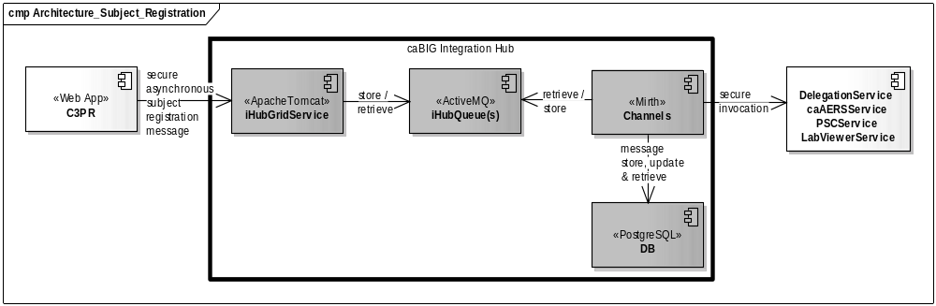
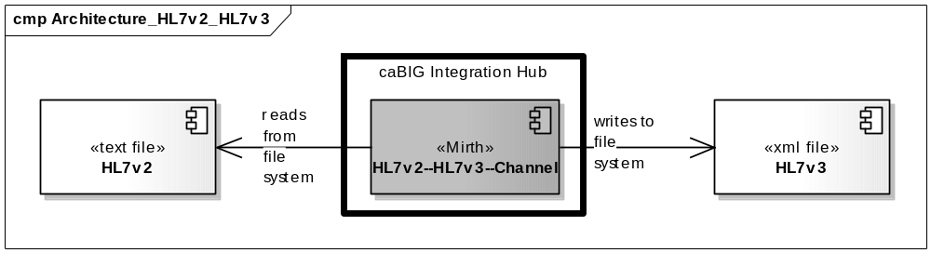
POC Architecture
Subject Registration
HL7v2 to HL7v3 Converter

Slide 10
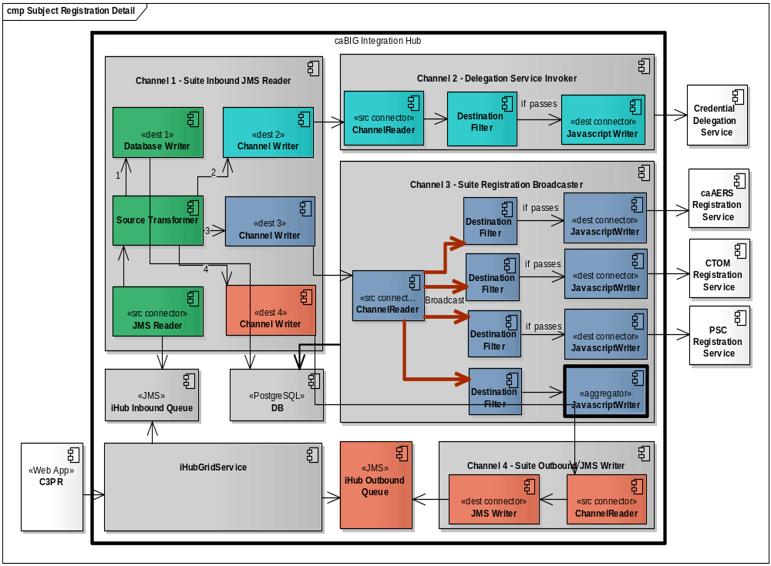
POC Subject Registration Detail

Slide 11
Demo

Slide 12
Conclusions
Current Technical Architecture, based on JBI-compliant Apache Servicemix, can be revisited since the JBI specification has not been as widely adopted by ESB (Enterprise Service Bus) products as anticipated
Mirth is an open-source, health care integration engine with several built-in features that were on iHub’s implementation roadmap
MirthConnect can be used as a platform for implementing caBIG® Integration Hub functional capabilities*
*Note: Non-functional aspects of the product such as Performance / Scalability, Failover/Clustering capability have not been assessed yet

