Slide 1
LexEVS 6.0
Value Set and Pick List Definitions
April, 2010
Notes:
Value Domain and Pick List
November,2009

Slide 2
Session Details: Value Set and Pick List Definitions
Course Outline
Overview:
  Provide the user with an overview of Value Set Definition and Pick List Definition of the LexGrid model.
  Talks about Value Set Definition and Pick List Definition Services that are available in LexEVS API.

Slide 3
Session Details: Value Set and Pick List Definitions
Course Objectives
When you complete this course, you will be able to:
Understand and define the core structure of Value Set and Pick List Definitions of the LexGrid Model.
Define all the Value Set and Pick List Definitions services in LexEVS API.

Slide 4
Session Details: LexGrid 2010 Model
Lesson Syllabus
Lesson 1: Value Set Definition
Lesson 2: Pick List Definition
Lesson 3: Value Set Definition API
Lesson 4: Pick List Definition API

Slide 5
Lesson 1: Value Set Definition
When you complete this lesson, you will be able to:
  Understand and define Value Set Definition of the LexGrid 2010 Model.

Slide 6
Lesson 1: Value Set Definition
What Is It?
The Value Set Definition of the LexGrid Model is the proposed mechanism for describing the contents of Value Sets.
The contents are concept codes defined in referencing Code System.
Value Set can contain concept codes from one or more Code Systems.

Slide 7
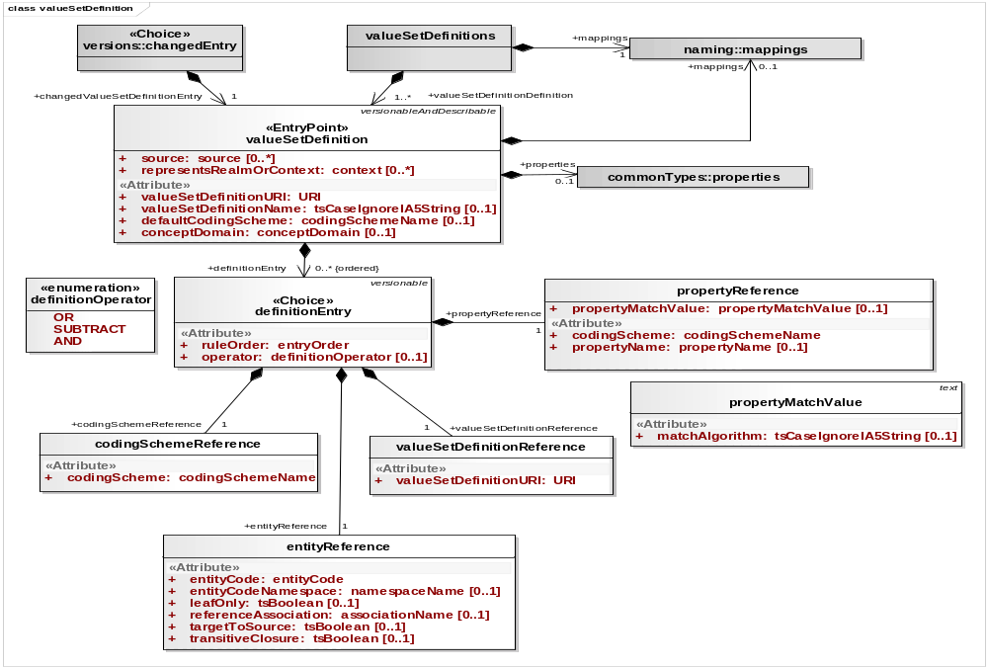
Lesson 1: Value Set Definition
Value Set Definition Model
Value Domain Definition Model
Diagram showing value domain definition of the LexGrid model.

Slide 8
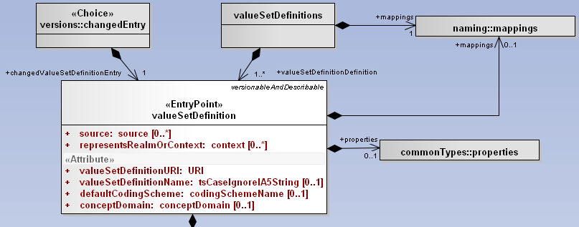
Lesson 1: Value Set Definition
Value Set Definition Model
valueSetDefinitions : Collection of Value Set Definitions
mappings : A list of all of the local identifiers and defining URI's that are used in the associated resource
changedEntry : A top level versionable entry
Properties : A collection of properties
valueSetDefinition : A definition of a given value set

Slide 9
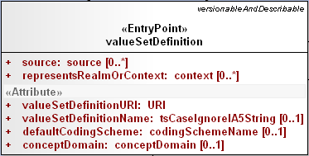
Lesson 1: Value Set Definition
Value Set Definition Class
source : The local identifiers of the source(s) of this value set definition. Must match a local id of a supportedSource in the corresponding mappings section.
representsReamsOrContext : The local identifiers of the context(s) in which this value set applies. Must match a local id of a supportedContext in the corresponding mappings section.
valueSetDefinitionURI : The URI of this value set definition
valueSetDefinitionName : The name of this value set definition, if any
defaultCodingScheme : Local name of the primary coding scheme from which the set is drawn. defaultCodingScheme must match a local id of a supportedCodingScheme in the mappings section.
conceptDomain : When present, the contents of value set definition are considered to be bonded to this specific concept domain.

Slide 10
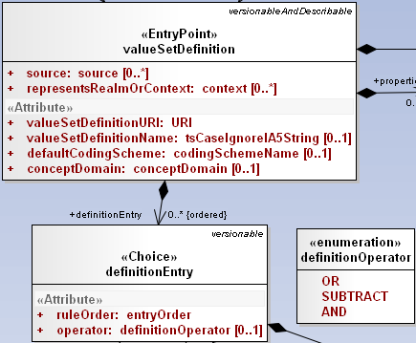
Lesson 1: Value Set Definition
DefinitionEntry Class
valueSetDefinition can have 0 or more definitionEntry.
ruleOrder : Relative order in which this entry should be applied
Operator : Defines how this entry is to be applied to the value set
  OR : Add the set of entityCodes described by the currentEntity to the value set. (logical OR)
  SUBTRACT : Subtract (remove) the set of entityCodes described by the currentEntity from the value set. (logical NAND)
  AND : Only include the entity codes that are both in the value set and the definition entry. (logical AND)

Slide 11
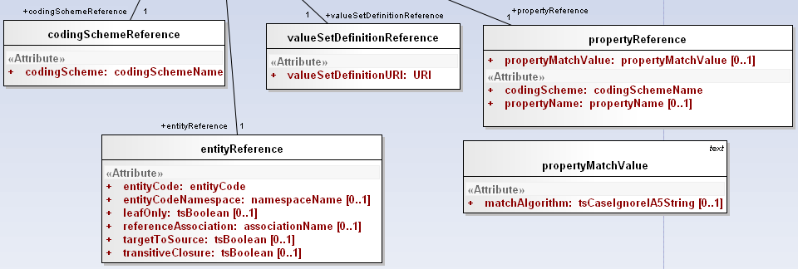
Lesson 1: Value Set Definition
DefinitionEntry Reference
Each definitionEntry can reference one of the following :
  codingSchemeReference : A reference to all of the entity codes in a given coding scheme.
  valueSetDefinitionReference : A reference to the set of codes defined in another value set definition.
  entityReference : A reference to an entityCode and/or one or more entityCodes that have a relationship to the specified entity code
  propertyReference : A reference to a propertyName or propertyValue and matchAlgoritm to use

Slide 12
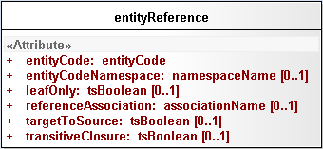
Lesson 1: Value Set Definition
DefinitionEntry entityReference
entityReference : A reference to an entityCode and/or one or more entityCodes that have a relationship to the specified entity code.
  entityCode : The entity code being referenced
  entityCodeNamespace : Local identifier of the namespace of the entityCode. Must match a local id of a supportedNamespace in the corresponding mappings section. If omitted, the URI of the defaultCodingScheme will be used as the URI of the entity code.
  leafOnly : If true and referenceAssociation is supplied and referenceAssociation is defined as transitive, include all entity codes that are "leaves" in transitive closure of referenceAssociation as applied to entity code. Default: false
  referenceAssociation : The local identifier of an association that appears in the native relations collection in the default coding scheme. This association is used to describe a set of entity codes. If absent, only the entityCode itself is included in this definition.

Slide 13
Lesson 1: Value Set Definition
DefinitionEntry entityReference
entityReference
  targetToSource : If true and referenceAssociation is supplied, navigate from entityCode as the association target to the corresponding sources. If transitiveClosure is true and the referenceAssociation is transitive, include all the ancestors in the list rather than just the direct "parents" (sources).
  transitiveClosure : If true and referenceAssociation is supplied and referenceAssociation is defined as transitive, include all entity codes that belong to transitive closure of referenceAssociation as applied to entity code. Default: false.

Slide 14
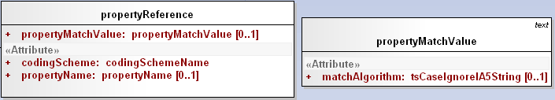
Lesson 1: Value Set Definition
DefinitionEntry propertyReference
propertyReference : A reference to a propertyName or propertyValue and matchAlgoritm to use.
  propertyMatchValue : Property match value to be used to restrict entity property. matchAlgorithm can be used in conjunction to get matching entity properties.
  codingScheme : The local identifier of the codingScheme that this propertyreference will be resolved against.
  propertyName : The local identifier to be used to restrict the entities to have property with this name.

Slide 15
Lesson 1: Value Set Definition
Value Set Definition Model
Value Domain Definition Model
Diagram showing value domain definition of the LexGrid model.

Slide 16
Lesson 1: Value Set Definition
Possible Forms
Code system – all concept codes in the referencing code system
Value Set Definition – all concept codes defined in the referencing Value Set Definition
Code system/concept code – individual code
Code system/concept code + relationship + additional rules (leaf only, targetToSource, ...)
Code System/Property Name or Value match – all concept codes in the referencing code system that matches property name or property value.
Combination of any of the above with or/and/difference operators

Slide 17
Lesson 1: Value Set Definition
Value Set Resolution
A value set definition has to be made against a specific version of a code system.
But it doesn’t have to be resolved against the same version.
Even a simple list (a, b, c, d) needs to be resolved as, at some future date, “c” might be retired.
Resolution does not create static artifact.

Slide 18
Lesson 1: Value Set Definition
Example 1
Code System : ‘Automobiles’
hasSubtype
Ford Motor Company [Ford]
hasSubtype
Jaguar [Jaguar]
hasSubtype
Domestic Auto Maker [005]
hasSubtype
hasSubtype
General Motors [GM]
Chevrolet [Chevy]
@
hasSubtype
hasSubtype
Truck [T0001]
Oldsmobile [73]
hasSubtype
Automobile[A0001]
hasSubtype
Car [C0001]
uses
Tires [Tires]
Value Set Definition to include all the concept codes in Code System ‘Automobiles’ :
valueSetDefinition
valueSetDefinitionURI : urn:VDexample1
valueSetDefinitionName : All Automobiles
defaultCodingScheme : Automobiles
definitionEntry
ruleOrder : 1
Operator : OR
codingSchemeReference
codingSchemeURI : Automobiles
Result :
hasSubtype
Ford Motor Company [Ford]
hasSubtype
Jaguar [Jaguar]
Domestic Auto Maker [005]
hasSubtype
hasSubtype
General Motors [GM]
Chevrolet [Chevy]
hasSubtype
hasSubtype
Truck [T0001]
Oldsmobile [73]
Automobile[A0001]
hasSubtype
Car [C0001]
uses
Tires [Tires]

Slide 19
Lesson 1: Value Set Definition
Example 2
Code System : ‘Automobiles’
hasSubtype
Ford Motor Company [Ford]
hasSubtype
Jaguar [Jaguar]
hasSubtype
Domestic Auto Maker [005]
hasSubtype
hasSubtype
General Motors [GM]
Chevrolet [Chevy]
@
hasSubtype
hasSubtype
Truck [T0001]
Oldsmobile [73]
hasSubtype
Automobile[A0001]
hasSubtype
Car [C0001]
uses
Tires [Tires]
Value Set Definition to include all the concept codes except ‘General Motors’ and its children in Code System ‘Automobiles’ :
definitionEntry
ruleOrder : 1
Operator : OR
codingSchemeReference
codingSchemeURI : Automobiles
valueSetDefinition
valueSetDefinitionURI : urn:VDexample2
valueSetDefinitionName : All Automobiles BUT GM
defaultCodingScheme : Automobiles
definitionEntry
ruleOrder : 2
Operator : SUBTRACT
entityReference
entityCode : GM
referenceAssociation : hasSybtype
transitiveClosure : true
Result :
hasSubtype
Ford Motor Company [Ford]
hasSubtype
Jaguar [Jaguar]
Domestic Auto Maker [005]
hasSubtype
Truck [T0001]
Automobile[A0001]
hasSubtype
Car [C0001]
uses
Tires [Tires]

Slide 20

Lesson 1: Value Set Definition
Questions?

Slide 21
Lesson 2: Pick List Definition
When you complete this lesson, you will be able to:
  Understand and define Pick List Definition of the LexGrid Model.

Slide 22
Lesson 2: Pick List Definition
What Is It?
The Pick List Definition of the LexGrid Model is the proposed mechanism for describing the contents of Pick List.
An ordered list of entity codes and corresponding presentations drawn from a resolved value set definition.

Slide 23
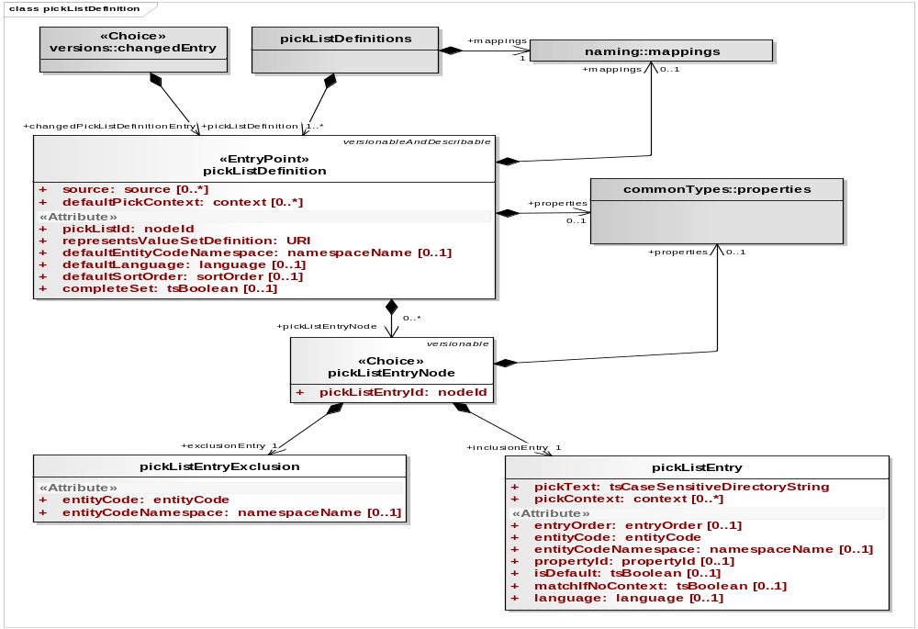
Lesson 2: Pick List Definition
Pick List Definition Model
Pick List Definition Model

Slide 24
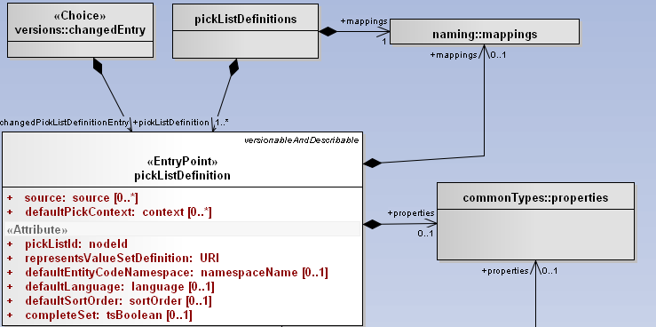
Lesson 2: Pick List Definition
Pick List Definition Model
pickListDefinition is versionable.
pickLists : Collection of Pick List Definitions
mappings : A list of all of the local identifiers and defining URI's that are used in the associated resource
changedEntry : A top level versionable entry
properties : A collection of properties
pickListDefinition : A definition of a given Pick list

Slide 25
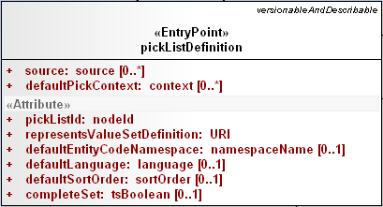
Lesson 2: Pick List Definition pickListDefinition class
source : The local identifiers of the source(s) of this pick list definition. Must match a local id of a supportedSource in the corresponding mappings section.
defaultPickContext : The local identifiers of the context used in the definition of the pick list
pickListId : An identifier that uniquely names this list within the context of the collection
representsValueSetDefinition : The URI of the value set definition that is represented by this pick list
defaultEntityCodeNamespace : Local name of the namespace to which the entry codes in this list belong. defaultEntityCodeNamespace must match a local id of a supportedNamespace in the mappings section.

Slide 26

Lesson 2: Pick List Definition pickListDefinition class
defaultLanguage : The local identifier of the language that is used to generate the text of this pick list if not otherwise specified. defaultLanguage must match a local id of a supportedLanguage in the mappings section.
defaultSortOrder : The local identifier of a sort order that is used as the default in the definition of the pick list
completeSet : True means that this pick list should represent all of the entries in the resolved value set definition. Any active entity codes that aren't in the specific pick list entries are added to the end, using the designations identified by the defaultLanguage, defaultSortOrder and defaultPickContext. Default: false

Slide 27
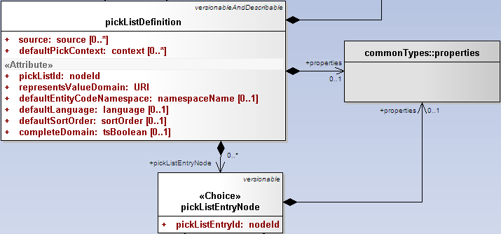
Lesson 2: Pick List Definition pickListEntryNode class
Each pickListDefinition can have 0 or more pickListEntryNode.
pickListEntryNode is versionable.
pickListEntryNode can contain properties.
pickListEntryId : Unique identifier of this node within the list

Slide 28
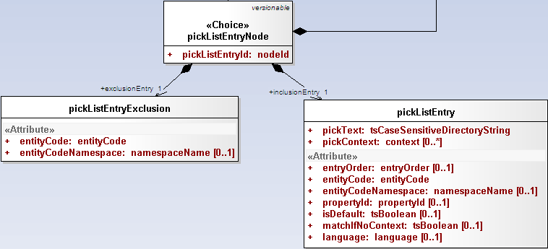
Lesson 2: Pick List Definition pickListEntryNode class
Each pickListEntryNode can either have
  pickListEntryExclusion or
  pickListEntry

Slide 29

Lesson 2: Pick List Definition pickListEntryExclusion class
An entity code that is explicitly excluded from a pick list.
entityCode : Entity code associated with this entry
entityCodeNamespace : Local identifier of the namespace of the entity code if different than the pickListDefinition defaultEntityCodeNamespace entityCodeNamespace must match a local id of a supportedNamespace in the mappings section.

Slide 30
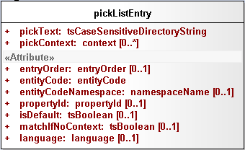
Lesson 2: Pick List Definition pickListEntry class
An entity code and corresponding textual representation.
pickText : The text that represents this node in the pick list. Some business rules may require that this string match a presentation associated with the entityCode
pickContext : The local identifiers of the context(s) in which this entry applies entryOrder : Relative order of this entry in the list
entityCode : Entity code associated with this entry
entityCodeNamespace : Local identifier of the namespace of the entity code if different than the pickListDefinition defaultEntityCodeNamespace

Slide 31
Lesson 2: Pick List Definition pickListEntry class
propertyId : The property identifier associated with the entityCode and entityCodeNamespace that the pickText was derived from. If absent, the pick text can be anything. Some terminologies may have business rules requiring this attribute to be present.
isDefault : True means that this is the default entry for the supplied language and context
matchIfNoContext : True means that this entry can be used if no contexts are supplied, even though pickContext is present
Language : The local name of the language to be used when the application/user supplies a selection language matches. If absent, this matches all languages. language must match a local id od of a supportedLanguage in the mappings section.

Slide 32
Lesson 2: Pick List Definition
Pick List Definition Model
Pick List Definition Model

Slide 33
Lesson 2: Pick List Definition
Possible Forms
Value Set Definition – all concept codes resolved from the value set definition
  completeSet = true
Code system/concept code – individual code (inclusion and exclusion)
And/or combination of both

Slide 34
Lesson 2: Pick List Definition
Pick List Resolution
A Pick List definition has to be made against a specific value set definition.
Even a simple list (a, b, c, d) needs to be resolved as, at some future date, “c” might be retired.
Resolution does not create static artifact.

Slide 35
Lesson 2: Pick List Definition
Example 1
Pick List Definition to include all the preferred designations from valueSetDefinitionURI : urn:VDexample1 (Value Set Definition ‘urn:VDexample1’ includes all the concept codes in code system ‘Automobiles’) :
pickListDefinition
pickListId : PLexample1
representsValueSetDefinition : urn:VDexample1
completeSet : true

Slide 36
Lesson 2: Pick List Definition
Example 2
Pick List Definition to include all the preferred designations from valueSetDefinitionURI : urn:VDexample1 (Value Set Definition ‘urn:VDexample1’ includes all the concept codes in code system ‘Automobiles’) but exclude code ‘Tires’:
pickListDefinition
pickListId : PLexample2
representsValueSetDefinition : urn:VDexample1
completeSet : true
pickListEntryNode
pickListEntryId : PLE1
pickListEntryExclusion
entityCode : Tires
entityCodeNamespace : Automobiles

Slide 37
Lesson 2: Pick List Definition
Questions?

Slide 38
Lesson 3: Value Set Definition API
When you complete this lesson, you will be able to:
  Understand the Value Set Definition Services available in LexEVS API.

Slide 39
Lesson 3: Value Set Definition API
What is it ?
Value Set Definition API will provide ability to load Value Set Definitions into LexGrid repository.
Provides ability to apply user restrictions.
Dynamically resolve the definitions during run time.
Author Value Set Definitions.

Slide 40
Lesson 3: Value Set Definition API
Administration functions
Ability to load Value Set Definitions into LexGrid repository.
Ability to remove Value Set Definitions from LexGrid repository.
Here are some of the admin methods available:
  loadValueSetDefinition(ValueSetDefinition vsddef, String systemReleaseURI) - Loads supplied valueSetDefinition object
  loadValueSetDefinition(InputStream inputStream, boolean failOnAllErrors) - Loads valueSetDefinitions found in inputStream
  loadValueSetDefinition(String xmlFileLocation, boolean failOnAllErrors) - Loads valueSetDefinitions found in input xml file
  removeValueSetDefinition(URI valueSetDefinitionURI) - Removes supplied value set definition from the system

Slide 41
Lesson 3: Value Set Definition API
Query functions
Ability to list all the Value Set Definitions loaded in the system.
Ability to dynamically resolve Value Set Definition with/without user supplied restrictions.
Ability to check if a concept code is part of given Value Set.
Ability to check if one Value Set is sub set of other Value Set.
Here are some of the query methods available:
  isConceptInSet(String entityCode, URI valueSetDefinitionURI) - Determine if the supplied entity code is a valid result for the supplied value set and, if it is, return the particular codingSchemeVersion that was used
  isConceptInSet(String entityCode, URI entityCodeNamespace, CodingSchemeVersionOrTag csvt, URI valueSetDefinitionURI) - Similar to previous method, this method determine if the supplied entity code and entity namespace is a valid result for the supplied value set when resolved against supplied Coding Scheme Version or Tag
  resolveValueSetDefinition(URI valueSetDefinitionURI, AbsoluteCodingSchemeVersionReferenceList csVersionList) - Resolve a value set definition using the supplied set of coding scheme versions
    ResolvedValueSetDefinition : A resolved Value Set Definition containing the Coding Scheme Version reference list that was used to resolve the Value Set and an iterator for resolved concepts

Slide 42
Lesson 3: Value Set Definition API
Query functions Cont..
  getValueSetEntitiesForTerm(String term, URI valueSetDefinitionURI, String matchAlgorithm) - Resolves the value set supplied and restricts to the term and matchAlgorithm supplied
    ResolvedValueSetCodedNodeSet : Contains the codingScheme URI and Version that was used to resolve and the CodedNodeSet. Note : the CodedNodeSet is unresolved
  isSubSet(URI childValueSetDefinitionURI, URI parentValueSetDefinitionURI) - Check whether childValueDomainURI is a child of parentValueDomainURI
  getValueSetDefinition(URI valueSetDefinitionURI) - Returns value set definition for supplied value set definition URI
  listValueSetDefinitions(String valueSetDefinitionName) - Return the URI's for the value set definition(s) for the supplied name
  getAllValueSetDefinitionsWithNoNames() - Return the URI's of all unnamed value set definition(s)
  getCodingSchemesInValueSetDefinition(URI valueSetDefinitionURI) - Returns list of coding scheme summary that is referenced by the supplied value set definition
  isSet(String entityCode, String codingSchemeName, CodingSchemeVersionOrTag csvt) - Determine if the supplied entity code is of type valueSet in supplied coding scheme and, if it is, return the true, otherwise return false

Slide 43
Lesson 3: Value Set Definition API
Authoring functions
valueSetDefinition and definitionEntry classes are versionable entities in LexGrid model. Following authoring functions can be performed on them:
  NEW : Create new Value Set Definition or add new defintionEntry to existing Value Set Definition.
  MODIFY : Modify existing attributes of Value Set Definition or definitionEntry.
  REMOVE : Ability to completely remove Value Set Definition or definitionEntry. This is not the same as deprecated, as the entity ceases to exist in future versions.

Slide 44
Lesson 3: Value Set Definition API
Questions?

Slide 45
Lesson 4: Pick List Definition API
When you complete this lesson, you will be able to:
  Understand the Pick List Definition Services available in LexEVS API.

Slide 46
Lesson 4: Pick List Definition API
What is it ?
Pick List API will provide ability to load Pick List Definitions into LexGrid repository.
Provides ability to apply user restrictions.
Dynamically resolve the definitions during run time.
Author Pick List Definitions.

Slide 47
Lesson 4: Pick List Definition API
Administration functions
Ability to load Pick List Definitions into LexGrid repository.
Ability to remove Pick List Definitions from LexGrid repository.
Here are some of the admin methods available:
  loadPickList(PickListDefinition pldef, String systemReleaseURI) - Loads supplied Pick List Definition object
  loadPickList(InputStream inputStream, boolean failOnAllErrors) - Loads Pick List Definitions found in inputStream
  loadPickList(String xmlFileLocation, boolean failOnAllErrors) - Loads Pick List Definitions found in input xml file
  removePickList(String pickListId) - Removes supplied Pick List Definition from the system

Slide 48
Lesson 4: Pick List Definition API
Query functions
Ability to list all the Pick List Definitions loaded in the system.
Ability to dynamically resolve Pick List Definition with/without user supplied restrictions.
Ability to list all the Pick List Definitions that uses given Value Set Definition URI.
Here are some of the query methods available:
  getPickListDefinitionById(String pickListId) - Returns pick list definition for supplied pickListId
  getPickListDefinitionsForValueSetDefinition(URI valueSetDefinitionURI) - Returns all the pickList definitions that represents supplied value set definition
  getPickListValueSetDefinition(String pickListId) - Returns an URI of the represented value set definition of the pick list
  listPickListIds() - Returns a list of pickListIds that are available in the system
  resolvePickList(String pickListId, boolean sortByText) - Resolves pickList definition for supplied pickListId
  resolvePickListForTerm(String pickListId, String term, String matchAlgorithm, String language, String[] context, boolean sortByText) - Resolves pickList definition by applying supplied arguments
    ResolvedPickListEntryList : Contains the list of resolved Pick List Entries. Also provides helpful features to add, remove, enumerate Pick List Entries.

Slide 49
Lesson 4: Pick List Definition API
Authoring functions
pickListDefinition and pickListEntryNode classes are versionable entities in LexGrid model. Following authoring functions can be performed on them:
  NEW : Create new Pick List Definition or add new pickListEntryNode to existing Pick List Definition.
  MODIFY : Modify existing attributes of Pick List Definition or pickListEntryNode.
  REMOVE : Ability to completely remove Pick List Definition or pickListEntryNode. This is not the same as deprecated, as the entity ceases to exist in future versions.

Slide 50
Lesson 4: Pick List Definition API
Questions?

