Slide 1
Transforming FMA into LexGrid Model
Deepak Sharma
Division of Biomedical Informatics
Mayo Clinic

Slide 2
Outline
Goals
LexGrid Model
Eclipse Modeling Framework (EMF)
Protégé + EMF
Transformation into EMF
Example

Slide 3
Goals of Transformation
Problems with terminologies
  Native form not useful
  Require custom tools
  Develop external model

Slide 4
Goals of Transformation
The LexGrid Solution
  Consistent content representation
  Open-source LexGrid tools
  Search & query terminologies
  Import, Export, Edit content
  Includes ANSI/HL7 CTS & OMG TQS Interface Implementation

Slide 5
LexGrid Model
Formal model of terminology
Explicit definition of entities & objects used in LexGrid tooling
Supports non-semantic entities (from the toolkit perspective) as name/value pair

Slide 6
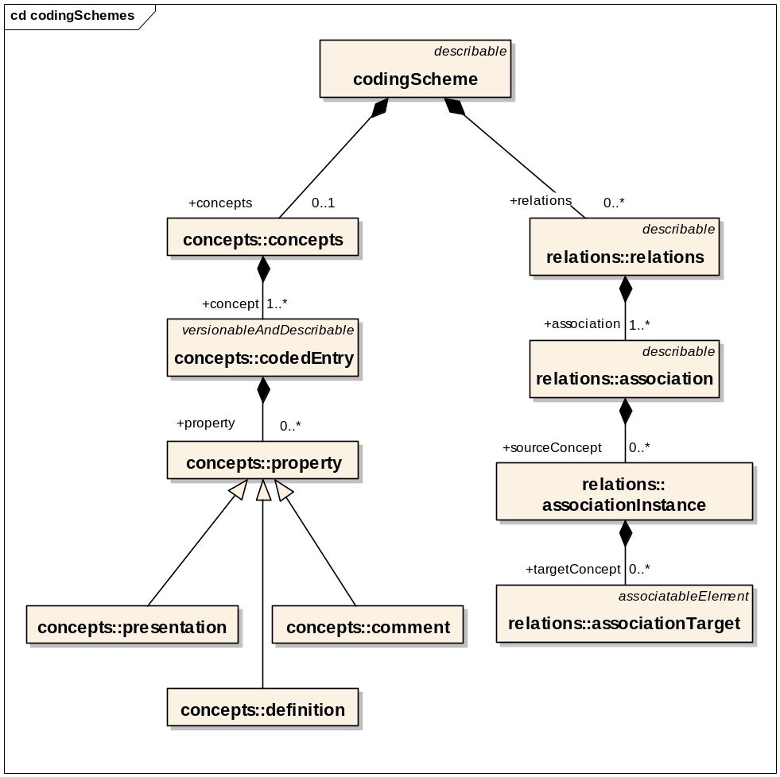
LexGrid Model
Information Model (partial)

Slide 7
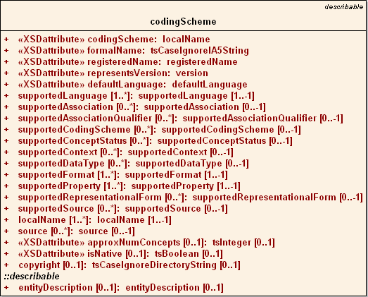
LexGrid Model
Coding Scheme Node

Slide 8
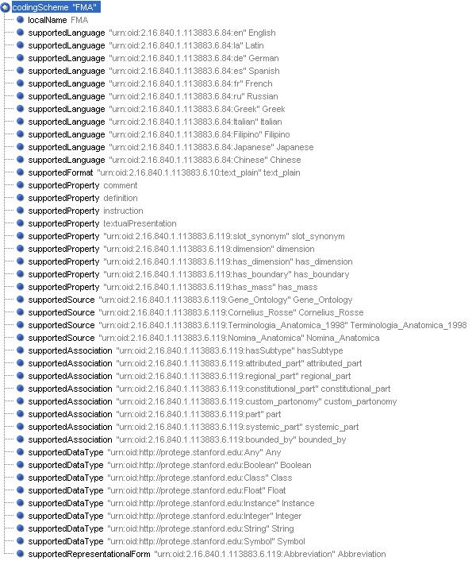
LexGrid Model
Coding Scheme Node

Slide 9
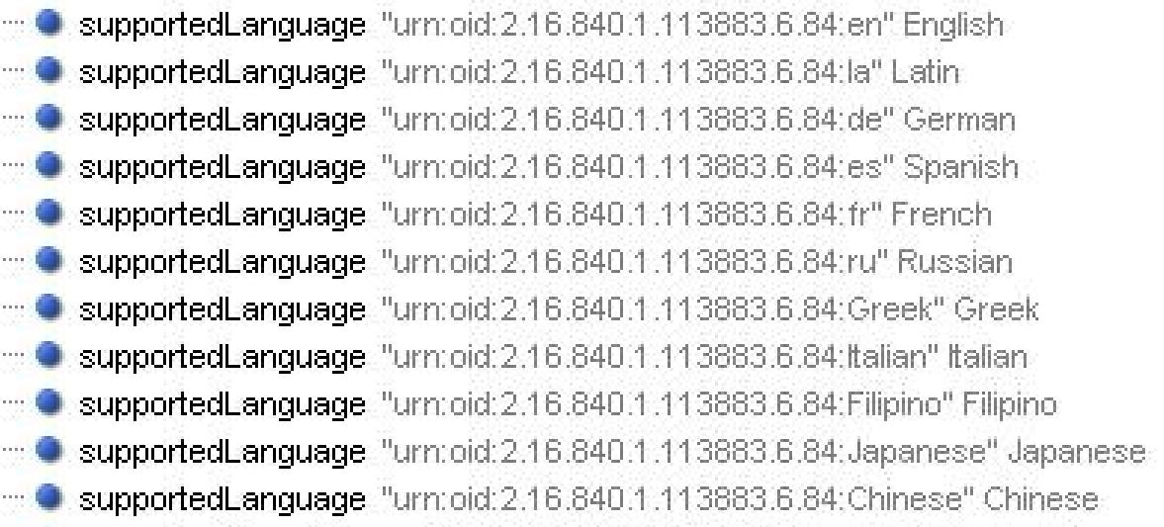
LexGrid Model
Coding Scheme Node

Slide 10
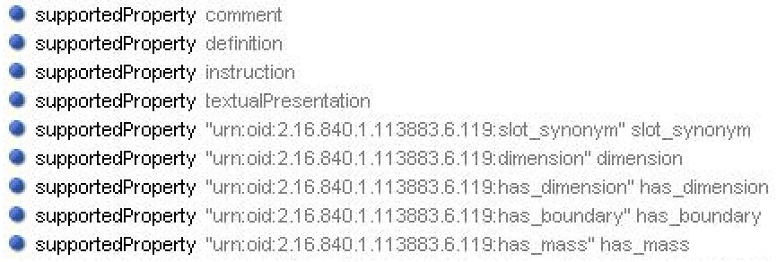
LexGrid Model
Coding Scheme Node

Slide 11
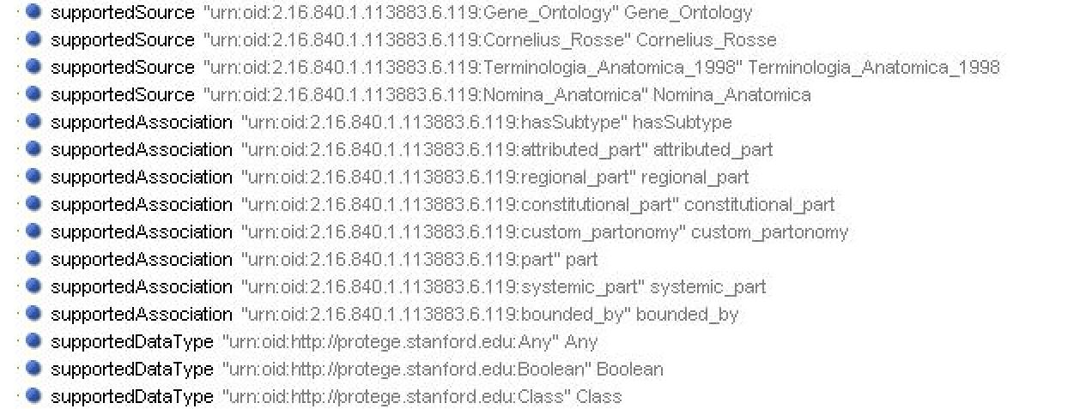
LexGrid Model
Coding Scheme Node

Slide 12
LexGrid Model
Information Model (partial)

Slide 13
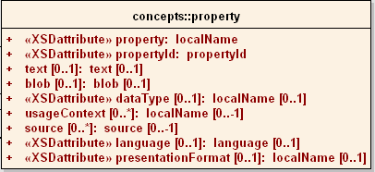
LexGrid Model
Concept Property

Slide 14
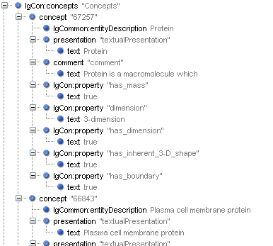
LexGrid Model
CodedEntry Node

Slide 15
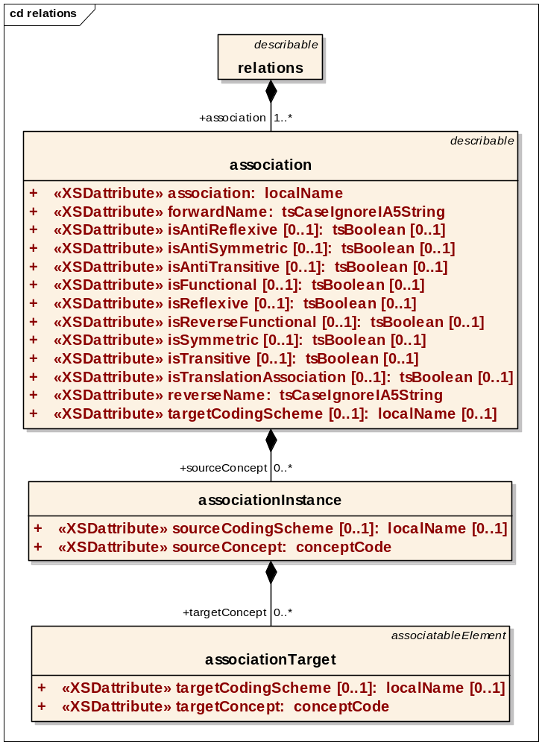
LexGrid Model
Association Node

Slide 16
LexGrid Model
Association Node
Source concept
Target
(concept / Data)

Slide 17
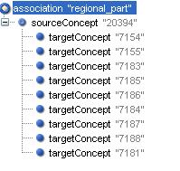
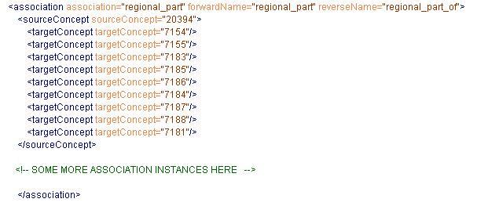
LexGrid Model
Association Node

Slide 18
LexGrid Model
Association Node
Source
Body (has regional parts)
Head
Targets
Neck
Upper limb
Right Upper limb
Left Upper limb
Lower limb
Right Lower limb
Left Lower limb
Trunk

Slide 19
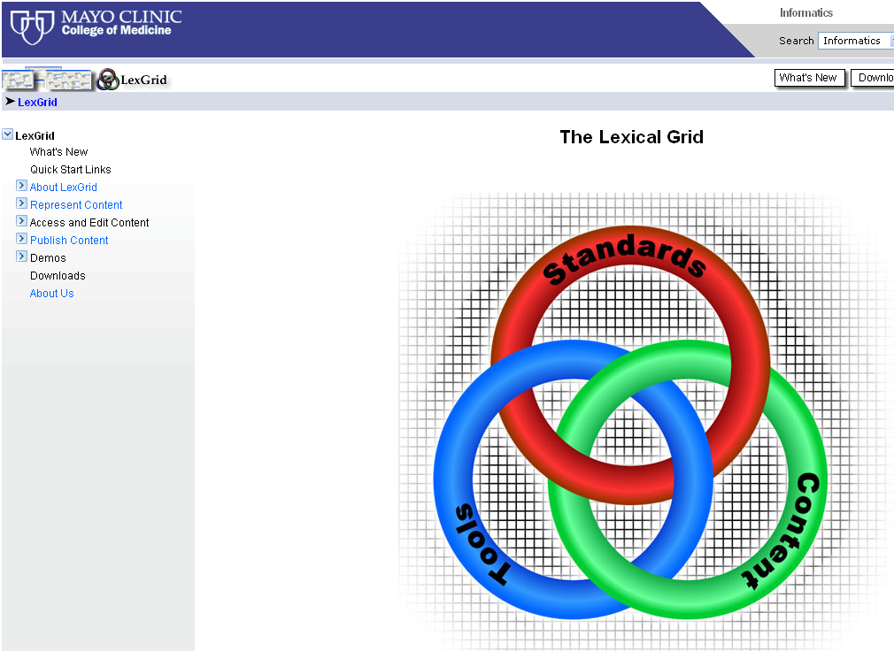
LexGrid Model http://informatics.mayo.edu

Slide 20
EMF
Framework & Code Generation
UML, XML & Java representation
LexGrid Model : XML → Java
Modeling & Programming
more http://www.eclipse.org/emf/

Slide 21
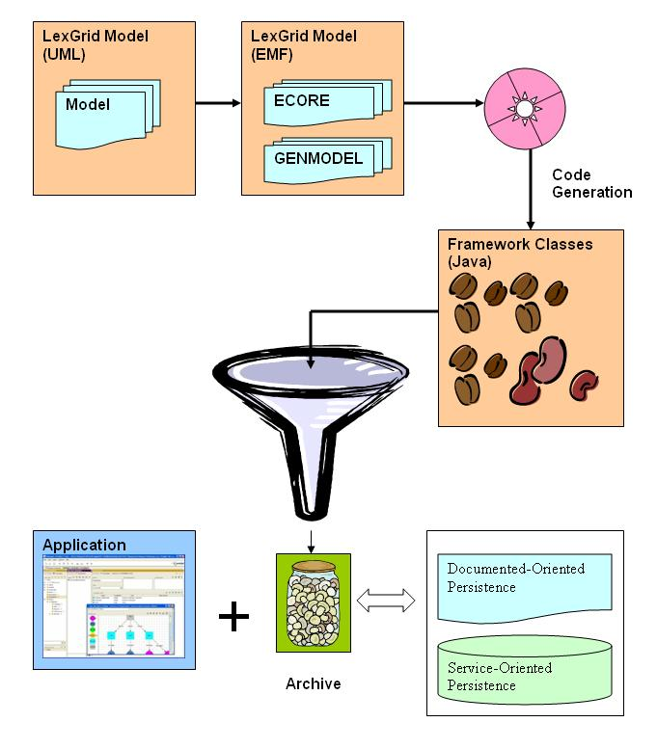
EMF

Slide 22
Transformation
FMA Protégé project Example
FMA Mapping
FMA (Protégé) → FMA (LexGrid EMF)

Slide 23
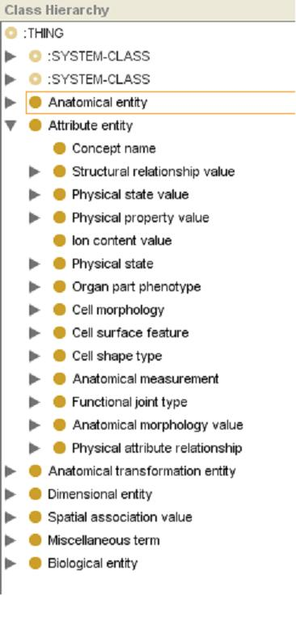
FMA (Protégé)

Slide 24
FMA (Protégé)
Top Nodes
Anatomical entity
Attribute entity
Anatomical transformation entity
Dimensional entity
Spatial association value
Miscellaneous term
Biological entity
“Concept name”

Slide 25
FMA (Protégé)
Observations
Protégé Cls or Instance → Concept
Instances of “Concept Name”:
  All Concepts Names
  Relations
Anonymous instances represent composite relationships:
fm_live_***** Instances
based on other simple relations

Slide 26
FMA Mapping
Classes and Instances as concepts in LexGrid Model except “Concept Name” Instances
Slot Type decides Category:
  “FMAID”, “Preferred name”, “name”, “Synonyms”, “Eng-Equivalent” → Presentation
  “definition” → Definition

Slide 27
FMA Mapping
Slot Type decides Category (Contd):
  :Documentation → Comment
  Protégé Cls or Instance
  → Association
  Others → Property

Slide 28
FMA Mapping
Traverse “Concept Name” instances:
  “Authority”
  “Source”
  “Language”
  “TA ID”
  “Eponym”, …
  Presentation or its attribute

Slide 29
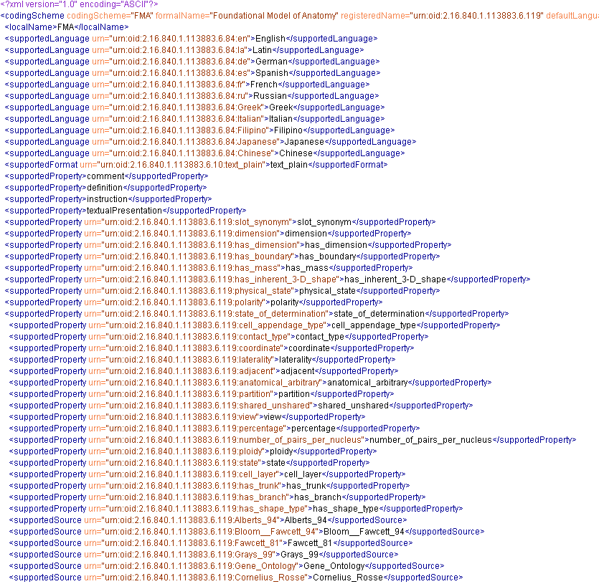
FMA (LexGrid XML Snapshot)

Slide 30
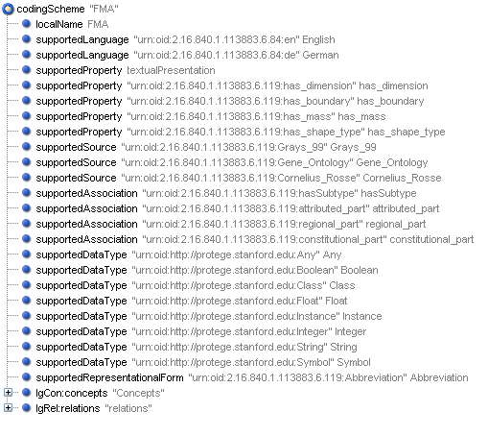
FMA (LexGrid XML Snapshot)

Slide 31
Transformation Example
Concept “Body”
LexGrid Editor tool (Mayo)
Observe Mappings:
  FMA Content with Protégé
  Transformed LexGrid content with LexGrid Editor

Slide 32
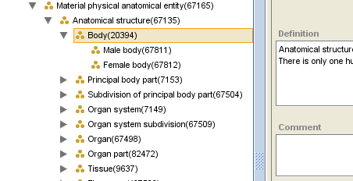
Concept “Body” (FMA)

Slide 33
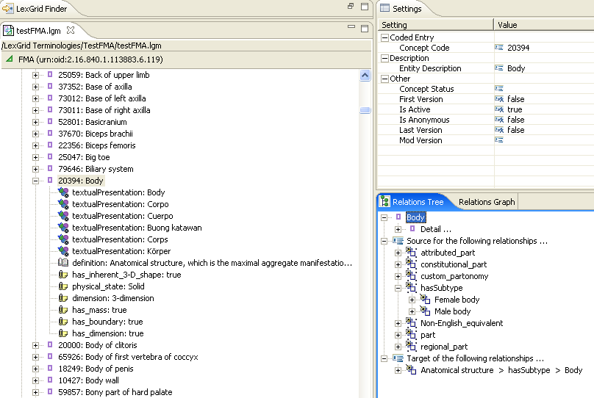
Concept “Body” (LexGrid)

Slide 34
Concept “Body” (LexGrid)
BASICS
CONCEPTS
RELATIONS

Slide 35
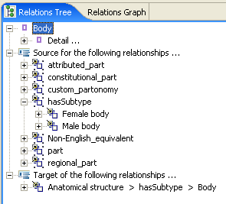
Concept “Body” (LexGrid)

Slide 36
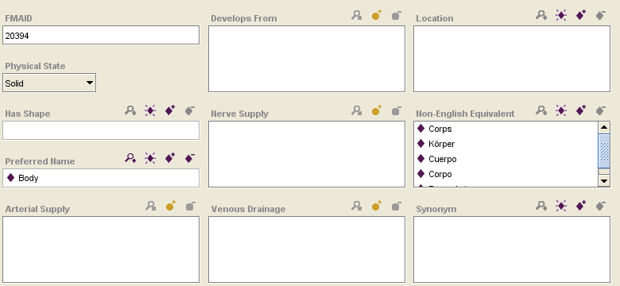
“Body” (FMA) - Attributes

Slide 37
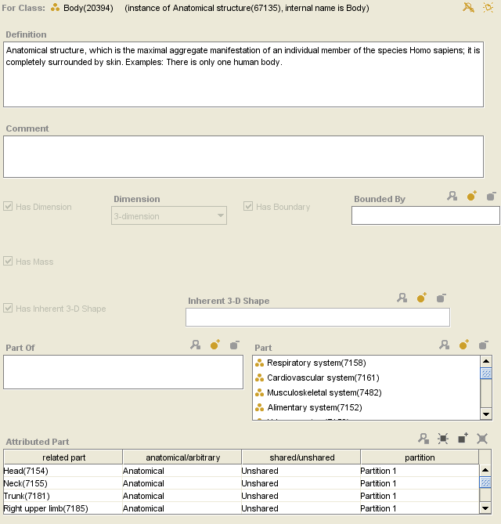
“Body” (FMA) - Attributes

Slide 38
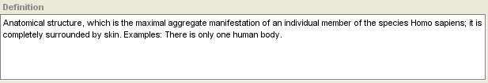
“Body” (FMA) - Attributes

Slide 39
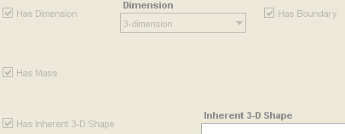
“Body” (FMA) - Attributes

Slide 40
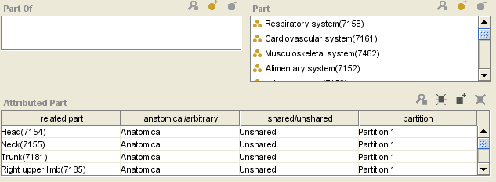
“Body” (FMA) - Attributes

Slide 41
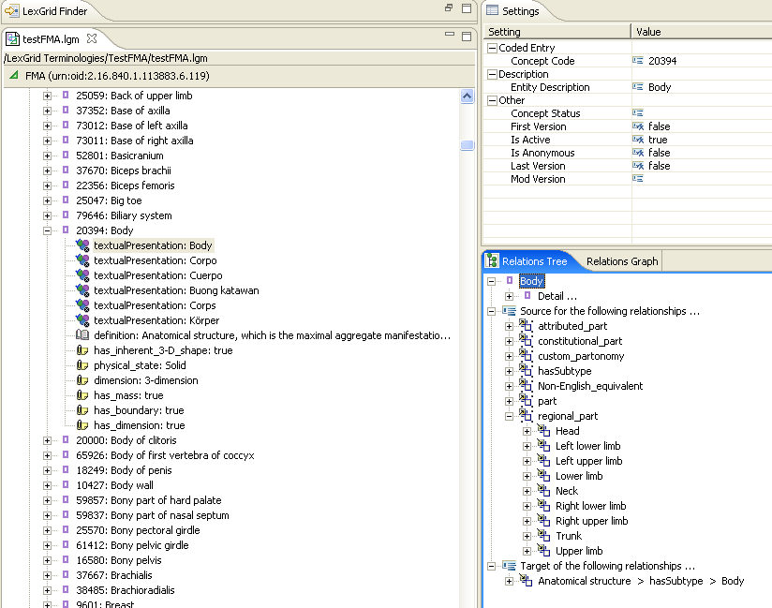
“Body” (LexGrid) - Attributes

Slide 42
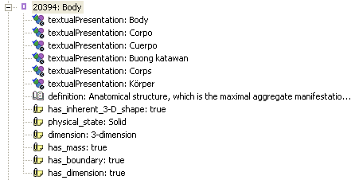
“Body” (LexGrid) - Attributes

Slide 43
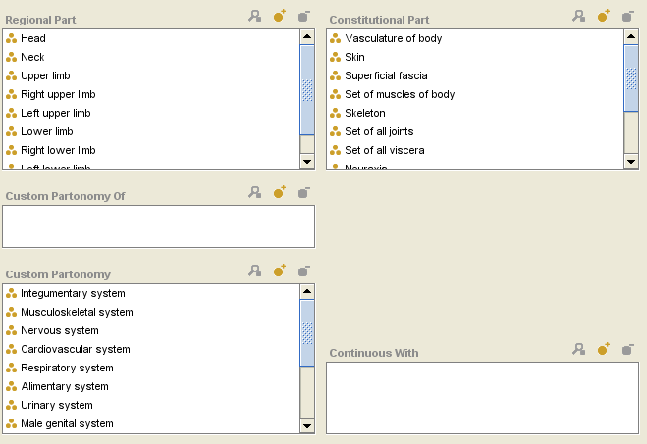
“Body” (FMA) - Relations

Slide 44
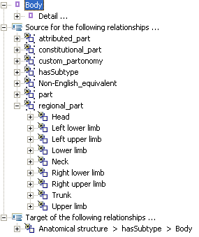
“Body” (LexGrid) - Relations

Slide 45
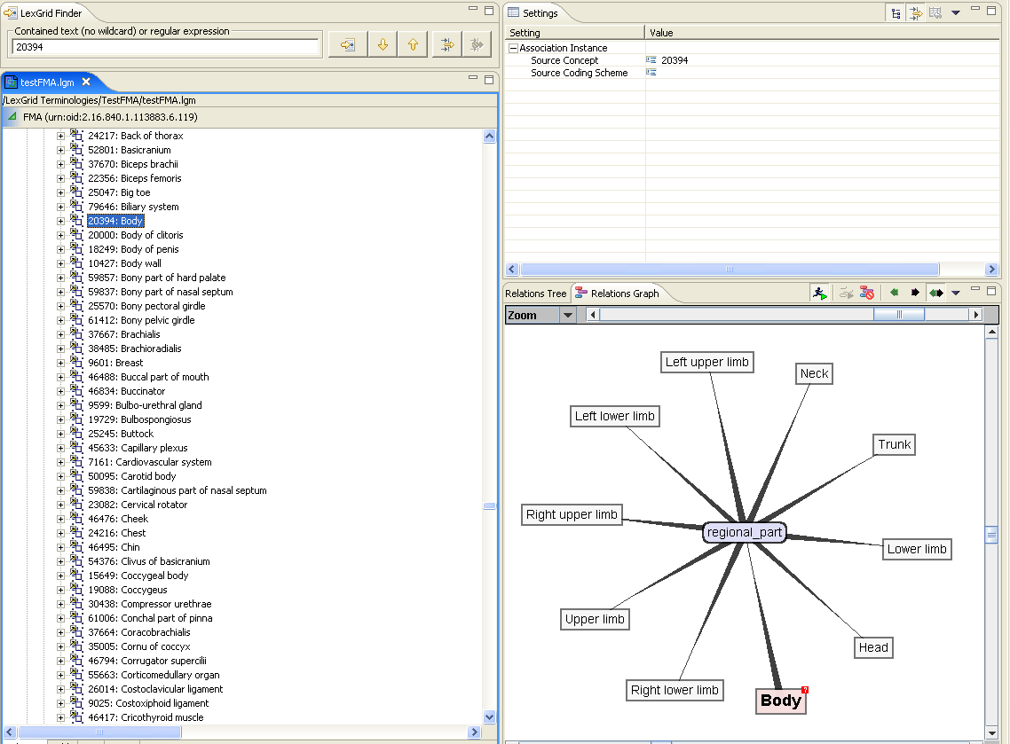
“Body” (LexGrid) - Relations

Slide 46
FMA Mapping
Anonymous Instances
  Should we treat them special ?
    Anterior branch of left anterior segmental bronchus (fm_live_04560)
    Trunk of posterior inferior segmental branch of right hepatic artery
    (fm_live_17483)

Slide 47
Current Status
Transformation Tool
Java application
  Successfully Converts FMA Protégé to LexGrid XML format using EMF
Isolate “Mapping to LexGrid Model” from EMF implementation

Slide 48
Thanks!
Harold Solbrig
Thomas Johnson
Dr. Christopher Chute
Protégé Conference Organizers

Slide 49
Questions ?
http://informatics.mayo.edu
        Deepak Sharma
        Division of Biomedical Informatics
        Mayo Clinic
        sharma.deepak2@mayo.edu

