Slide 1
Transforming FMA into LexGrid Model
Deepak Sharma
Division of Biomedical Informatics
Mayo Clinic

Slide 2
Outline
Motivation
LexGrid Model
Eclipse Modeling Framework (EMF)
Transformation to LexGrid Model
Transformation Example
Conclusion

Slide 3
Motivation
Why do a transformation?
Native form of FMA cannot be readily integrated into grid, databases and other terminologies
Need to transform content into a format and structure that is readily accessible via:
  Standard API’s
  SQL
  …
The Mayo LexGrid model is one such candidate

Slide 4
Motivation
LexGrid model
Developed by Mayo Biomedical Informatics Group
Consistent content representation
Open-source tools and API’s
Search & query terminologies
Import, Export, Edit content
Includes ANSI/HL7 CTS & OMG TQS Interface Implementation

Slide 5
LexGrid Model
Formal model of terminology
Explicit definition of entities & objects used in LexGrid tooling
Supports non-semantic entities (from the toolkit perspective) as name/value pairs

Slide 6
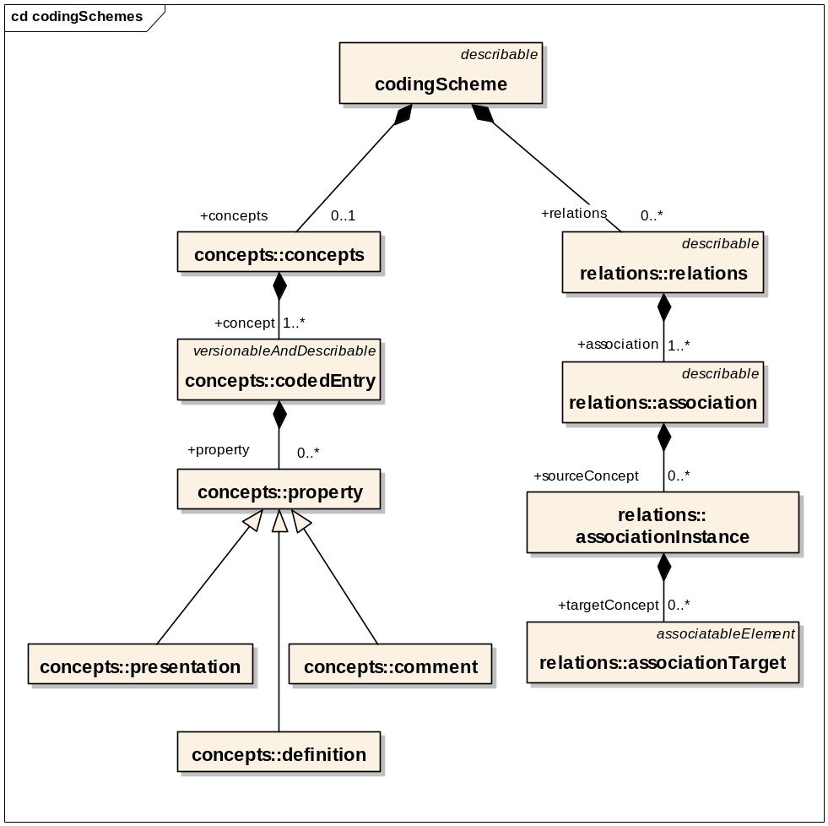
LexGrid Model
Information Model (partial)

Slide 7
LexGrid Model
Information Model (partial)
Coding Scheme
Concepts
Relations
Associations
Properties

Slide 8
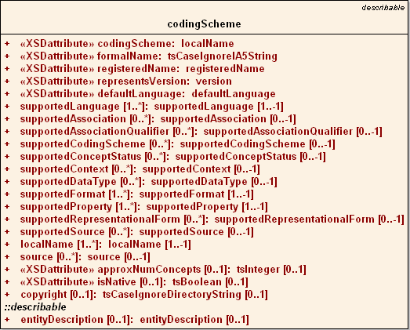
LexGrid Model
Coding Scheme

Slide 9
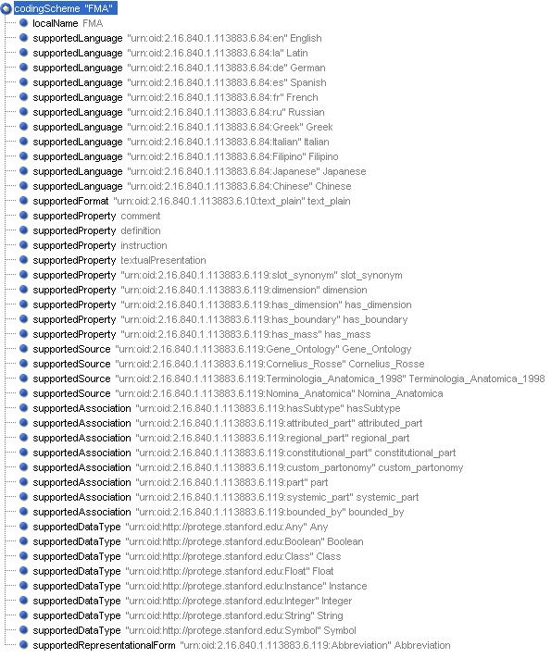
LexGrid Model
Coding Scheme

Slide 10
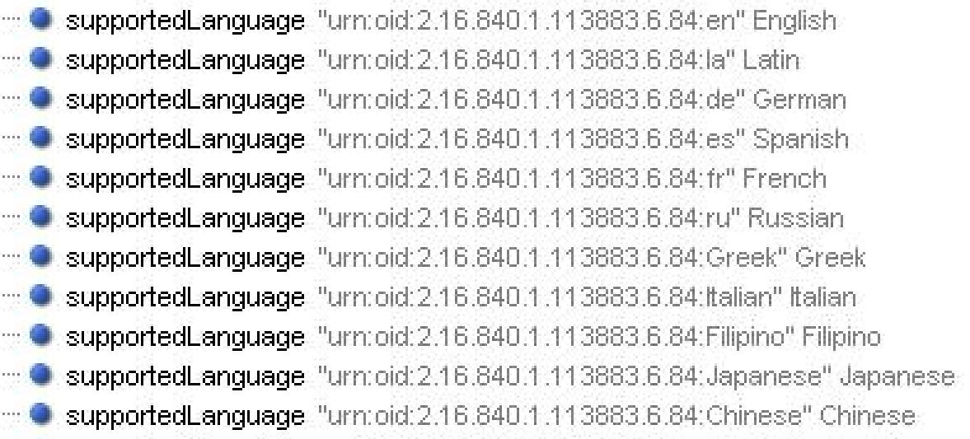
LexGrid Model
Coding Scheme

Slide 11
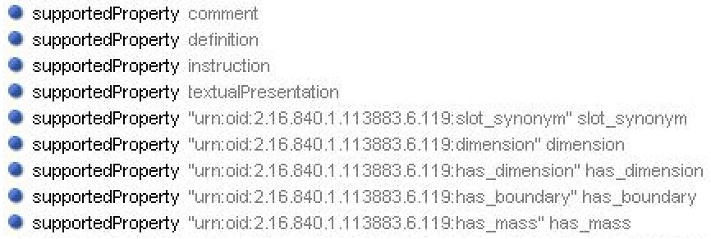
LexGrid Model
Coding Scheme

Slide 12
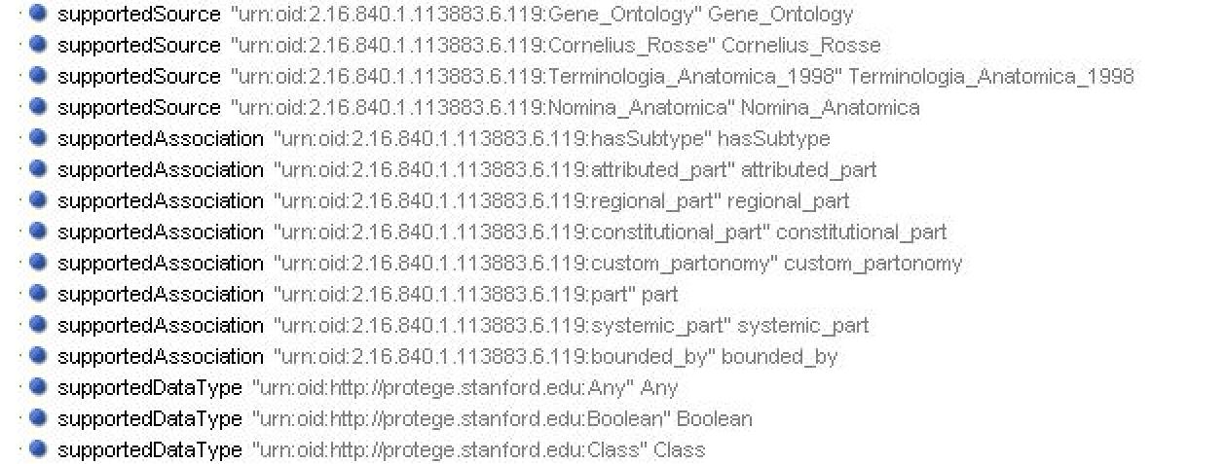
LexGrid Model
Coding Scheme

Slide 13
LexGrid Model
Information Model (partial)

Slide 14
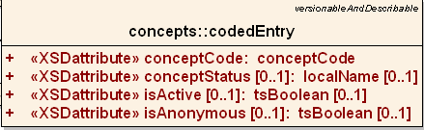
LexGrid Model
Coded Entry

Slide 15
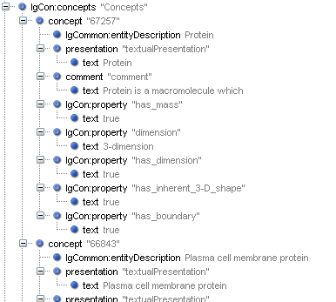
LexGrid Model
Coded Entry

Slide 16
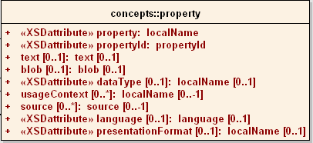
LexGrid Model
Concept Property

Slide 17
LexGrid Model
Concept Property

Slide 18
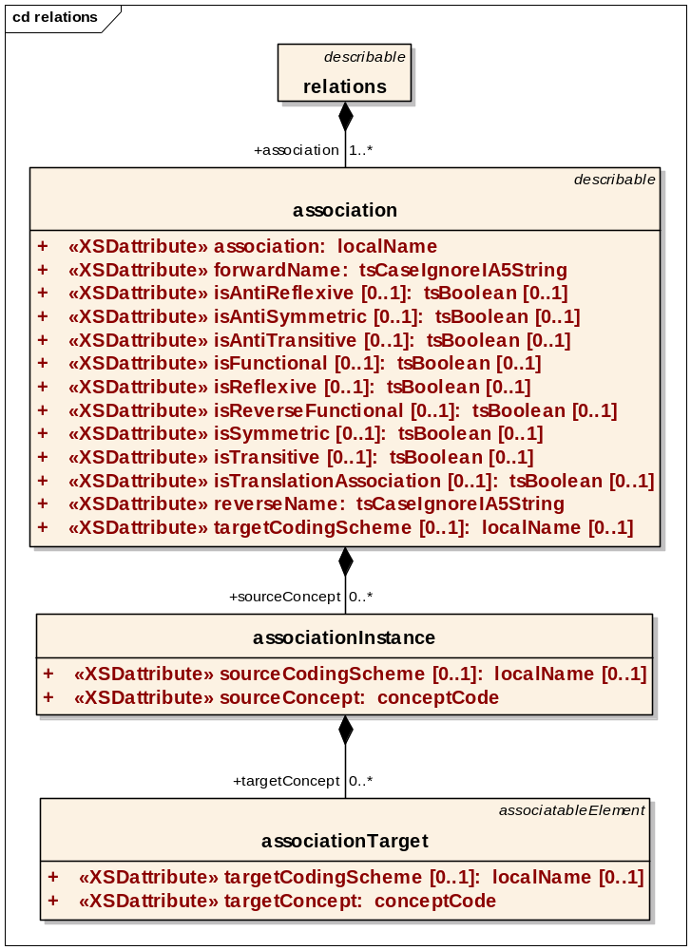
LexGrid Model
Associations

Slide 19
LexGrid Model
Associations
Source concept
Target
(concept / Data)

Slide 20
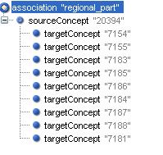
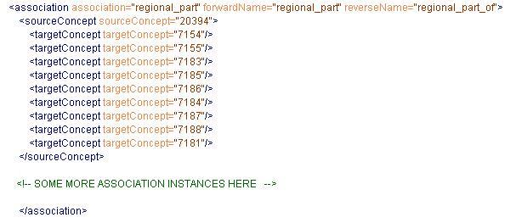
LexGrid Model
Associations

Slide 21
LexGrid Model
Associations
Source
Body (has regional parts)
Head
Targets
Neck
Upper limb
Right Upper limb
Left Upper limb
Lower limb
Right Lower limb
Left Lower limb
Trunk

Slide 22
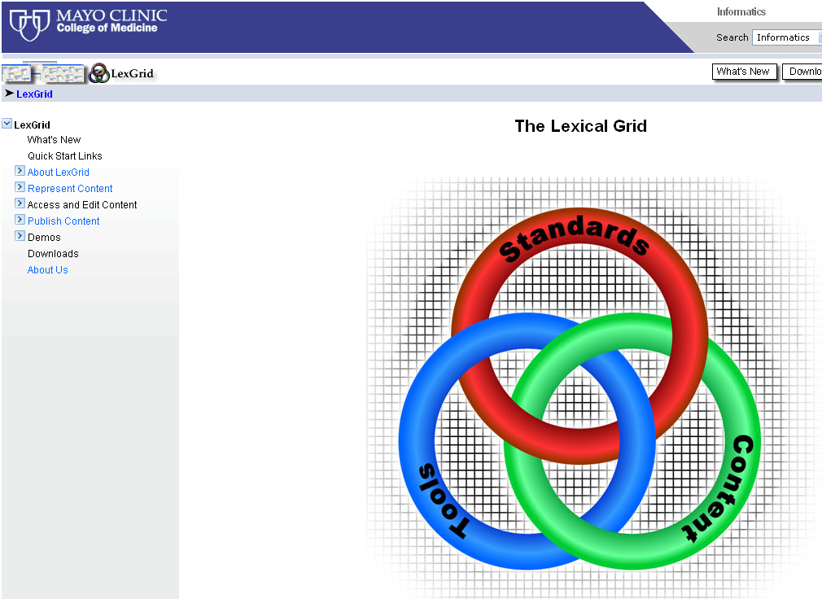
LexGrid Model http://informatics.mayo.edu

Slide 23
Eclipse Modeling Framework
  Framework & Code Generation tool
  Available with Eclipse
  Modeling ← EMF → Programming

Slide 24
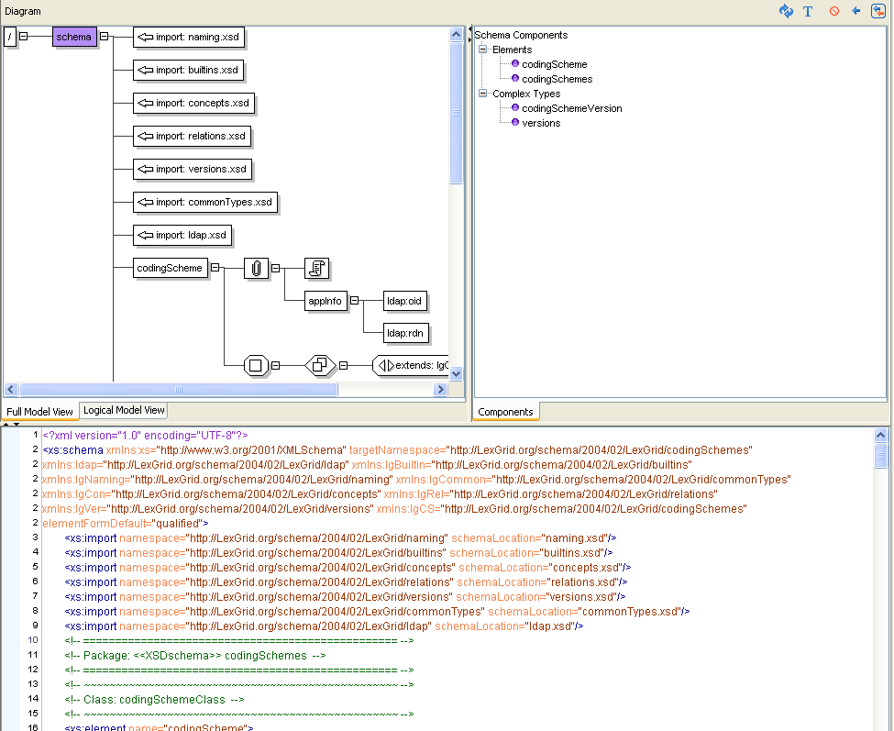
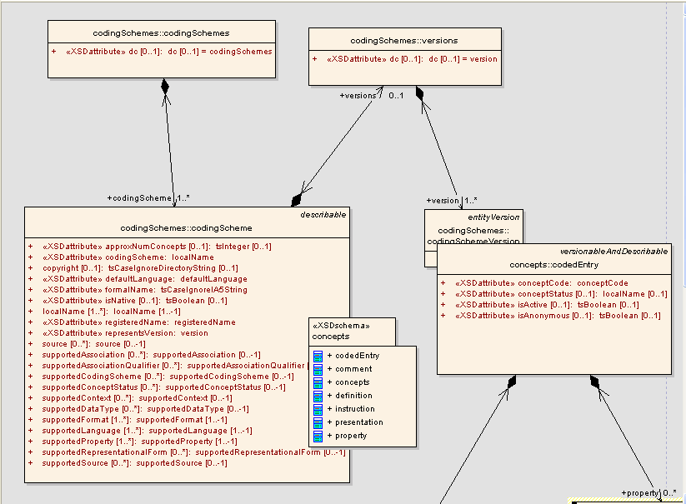
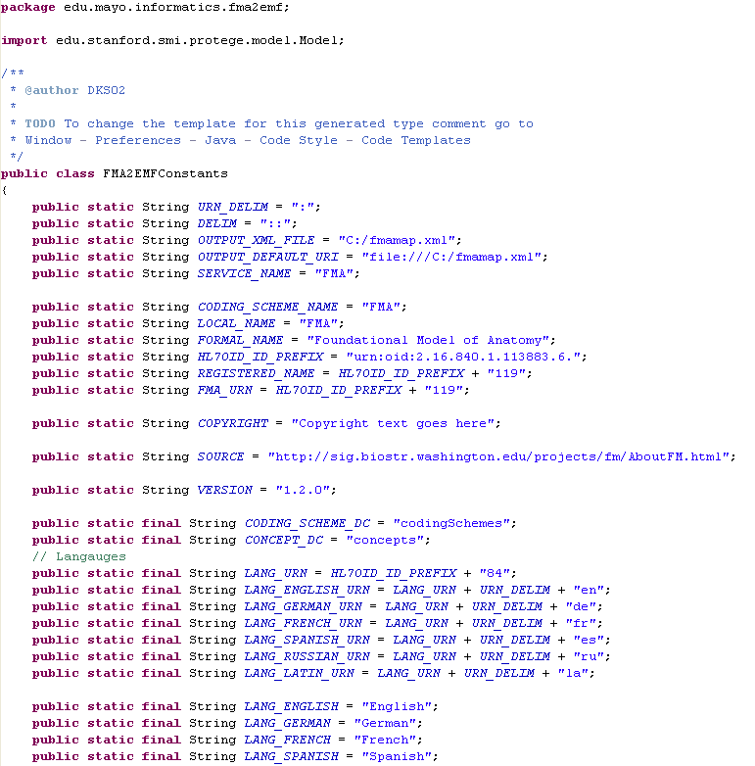
Eclipse Modeling Framework
EMF
XML Schema
Java
UML

Slide 25
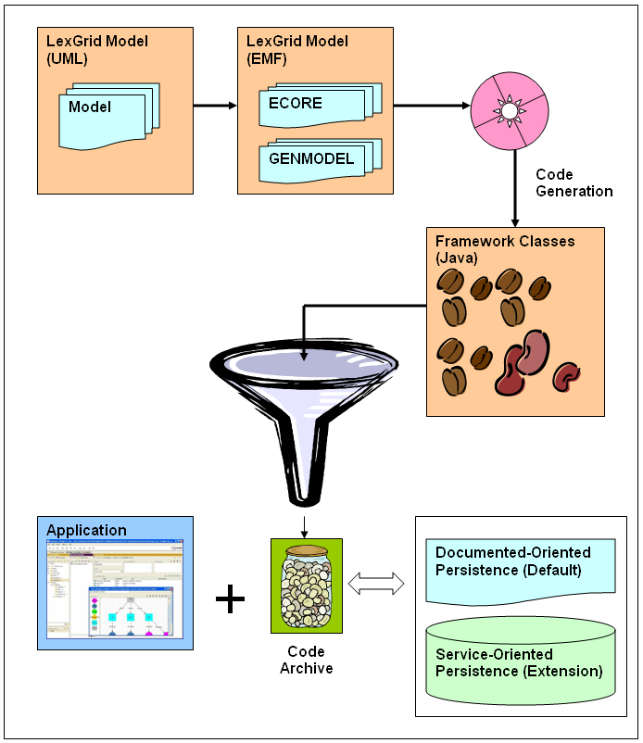
EMF

Slide 26
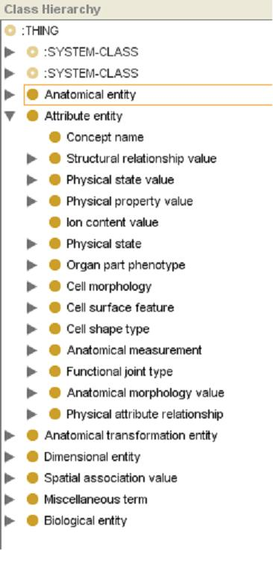
FMA (Protégé)

Slide 27
FMA (Protégé)
Root Nodes
Anatomical entity
Attribute entity
Anatomical transformation entity
Dimensional entity
Spatial association value
Miscellaneous term
Biological entity
“Concept name”

Slide 28
FMA Mapping to LexGrid
Both Protégé CLS and Protégé Instance map to LexGrid Coded Entry
  Meta-Class / CLS / Instance distinction in FMA model is pragmatic decision – not “ontological”
  Most FMA classes are both
  Exception is “Concept name”, which is strictly descriptive

Slide 29
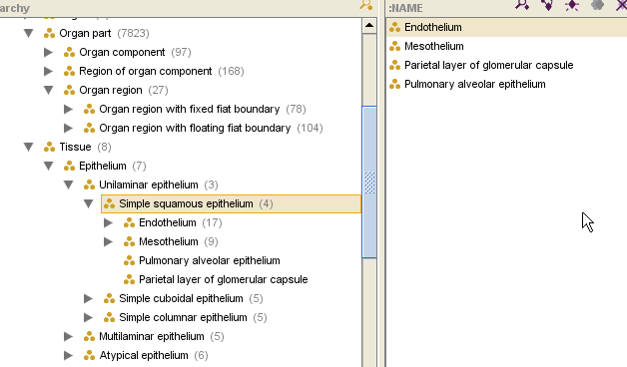
FMA Mapping
Classes and Instances

Slide 30
FMA Mapping to LexGrid
Slot Type decides Category
Slot type in FMA | LexGrid
String with values “Preferred name”, “name”, “Synonyms”, “Eng-Equivalent” | Presentation
String with other values | Property

Slide 31
FMA Mapping to LexGrid
Slot Type decides Category
Slot type in FMA | LexGrid
“definition” | Definition
:Documentation | Comment
Protégé CLS or Instance | Association
Boolean | Property {true | false}
Other | Property

Slide 32
FMA Mapping to LexGrid
Slot Type decides Category
Slot type in FMA (Instances of ‘Concept name’) | LexGrid
“Authority” “Source” “Language” “TA ID” “Eponym”, … | Presentation or its attributes

Slide 33
Transformation Example
Concept “Body”
LexGrid Editor tool (Mayo)
Observe Mappings:
  FMA Content with Protégé
  Transformed LexGrid content with LexGrid Editor

Slide 34
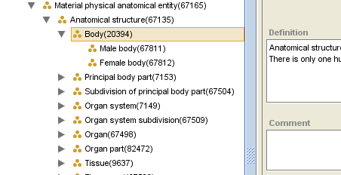
Concept “Body” (FMA)

Slide 35
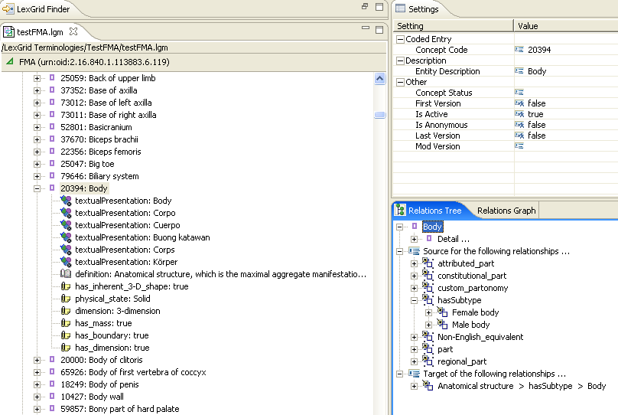
Concept “Body” (LexGrid)

Slide 36
Concept “Body” (LexGrid)
BASICS
CONCEPTS
RELATIONS

Slide 37
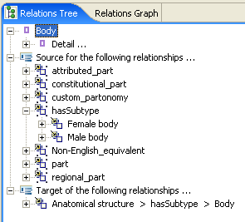
Concept “Body” (LexGrid)

Slide 38
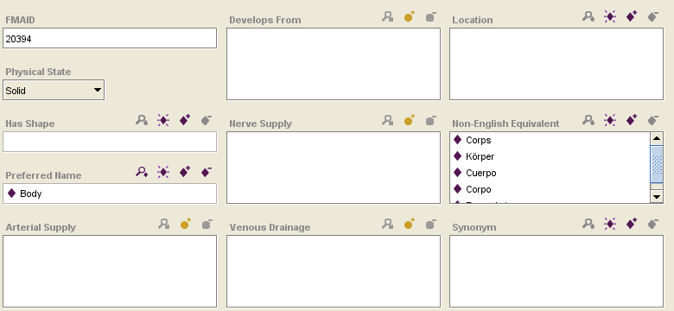
“Body” (FMA) - Attributes

Slide 39
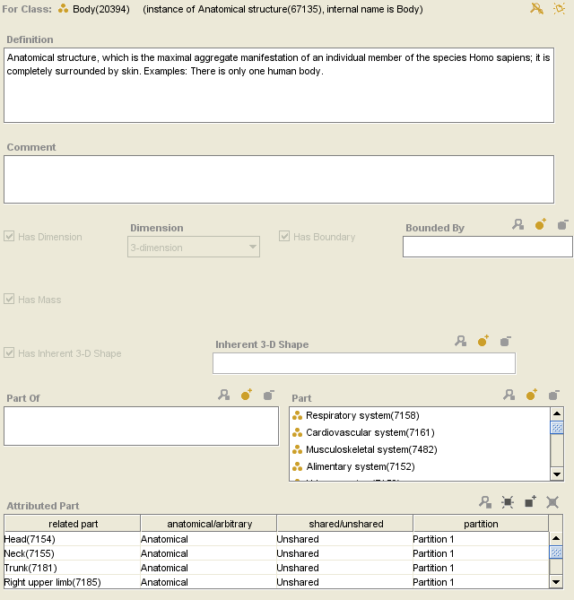
“Body” (FMA) - Attributes

Slide 40
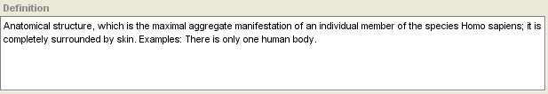
“Body” (FMA) - Attributes

Slide 41
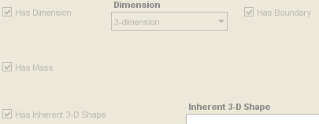
“Body” (FMA) - Attributes

Slide 42
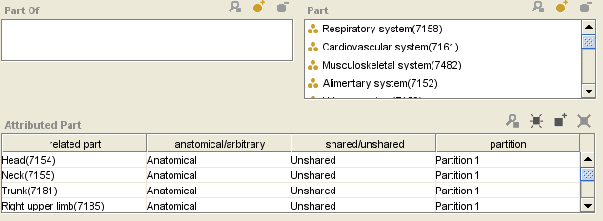
“Body” (FMA) - Attributes

Slide 43
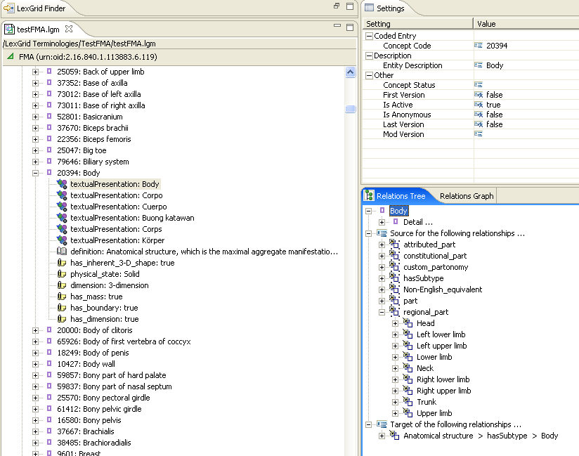
“Body” (LexGrid) - Attributes

Slide 44
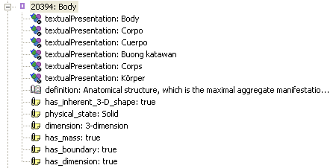
“Body” (LexGrid) - Attributes

Slide 45
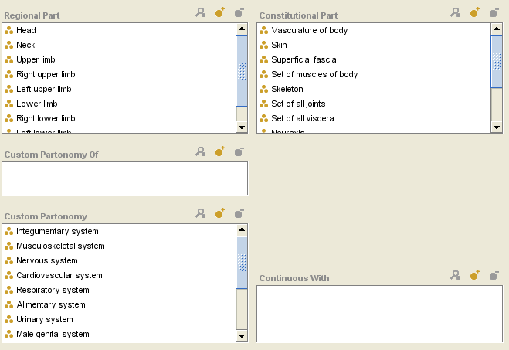
“Body” (FMA) - Relations

Slide 46
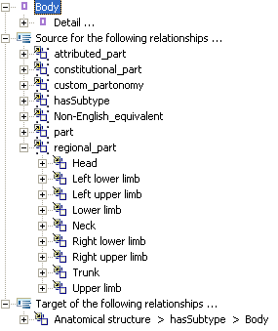
“Body” (LexGrid) - Relations

Slide 47
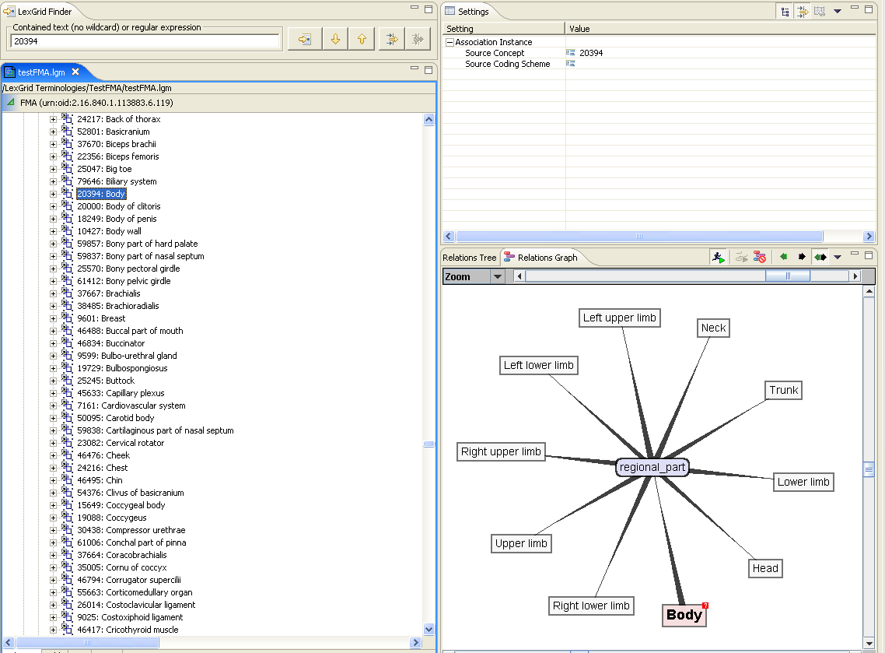
“Body” (LexGrid) - Relations

Slide 48
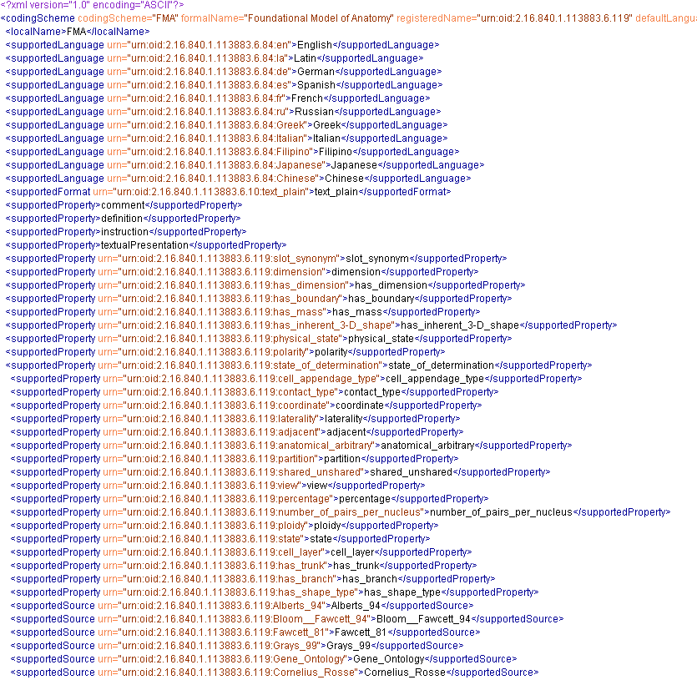
FMA (LexGrid XML Snapshot)

Slide 49
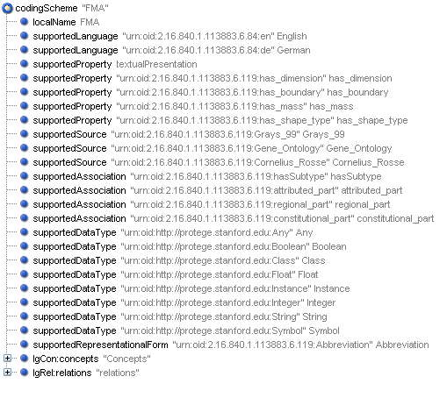
FMA (LexGrid XML Snapshot)

Slide 50
Protégé FMA
Anonymous Nodes
Anonymous nodes in FMA Version (older than 1.2.0) – Instances without FMA ID assigned
Remain anonymous in 1.2.0 even with FMA ID
Hard to understand anonymous nodes and transform them to LexGrid model

Slide 51
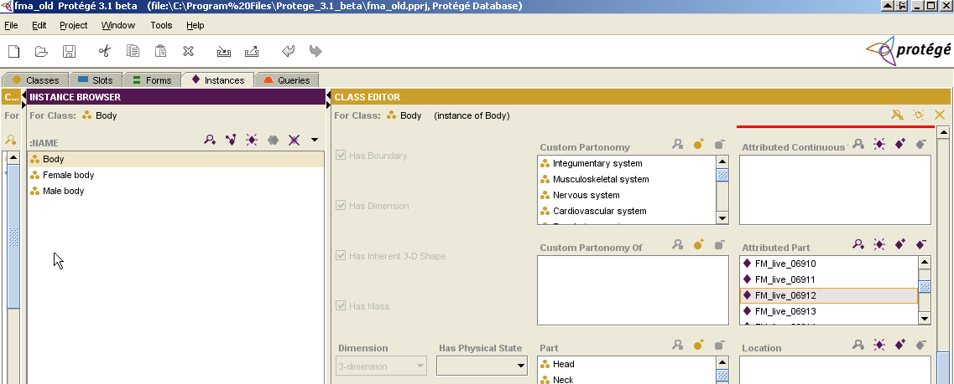
Protégé FMA
Anonymous Nodes (previous version)

Slide 52
Protégé FMA
Anonymous Nodes (previous version)
Anonymous

Slide 53
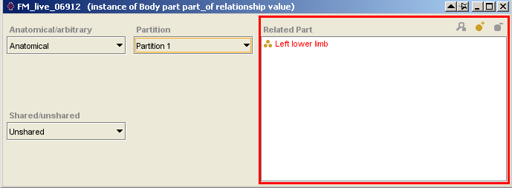
Protégé FMA
Anonymous Nodes (previous version)
No ID or concept code assigned

Slide 54
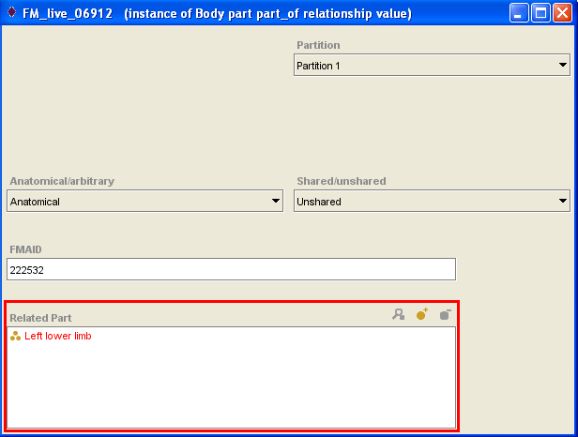
Protégé FMA
Anonymous Nodes (1.2.0)

Slide 55
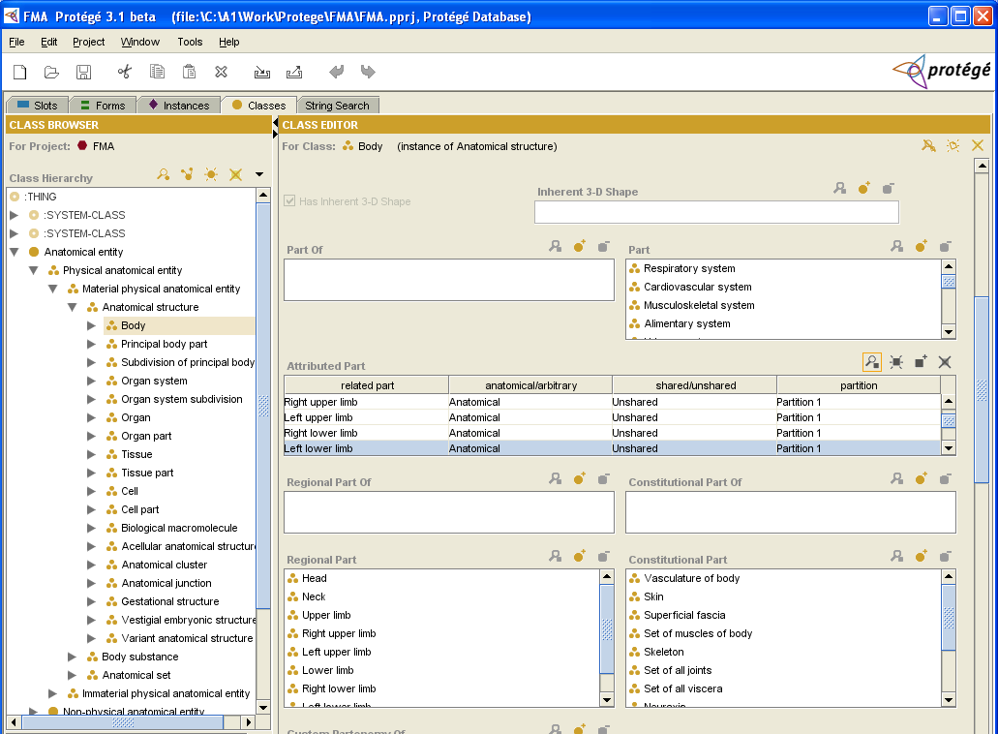
Protégé FMA
Anonymous Nodes (1.2.0)

Slide 56
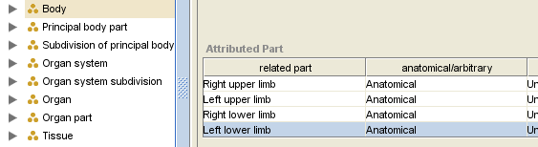
Protégé FMA
Anonymous Nodes (1.2.0)

Slide 57
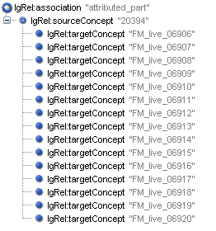
Protégé FMA
Understanding Anonymous Nodes
Body

Slide 58
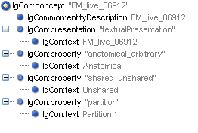
Protégé FMA
Understanding Anonymous Nodes
Instance Name
or
FMAID

Slide 59
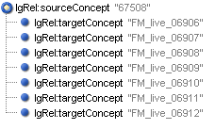
Protégé FMA
Understanding Anonymous Nodes
Body Part part-of Relationship Value
has Subtype

Slide 60

Protégé FMA
Understanding Anonymous Nodes
Left Lower Limb

Slide 61
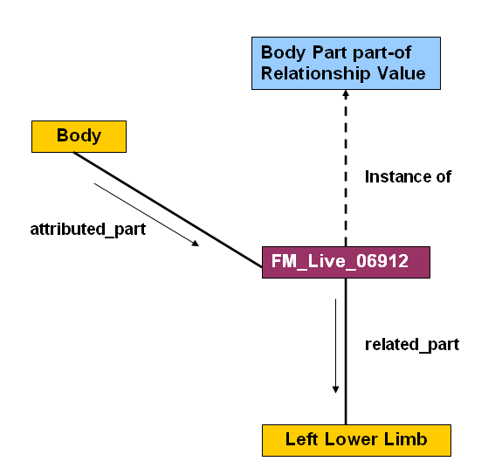
Protégé FMA
Understanding Anonymous Nodes

Slide 62
Protégé FMA
Understanding Anonymous Nodes
anonymous

Slide 63
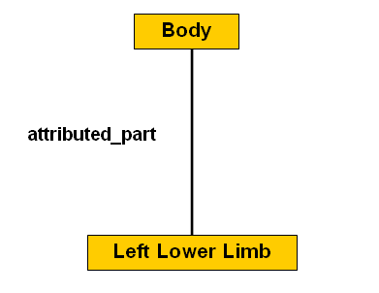
Protégé FMA
Without Anonymous Node
Need to discuss anonymous nodes
(FMA & beyond)

Slide 64
Conclusion
Successfully
  Converted FMA content to LexGrid Model
  Used EMF to create LexGrid XML output document
Need to Isolate “Mapping to LexGrid Model” from EMF implementation

Slide 65
Thanks!
Harold Solbrig
Thomas Johnson
Dr. Christopher Chute

Slide 66
Questions ?
http://informatics.mayo.edu
        Deepak Sharma
        Division of Biomedical Informatics
        Mayo Clinic
        sharma.deepak2@mayo.edu

