Slide 2
The Heart of the Lexical Grid
The LexGrid Model - a formal model of terminology that:
  Explicitly names and defines the entities and objects used in the LexGrid tooling
  Supports “non-semantic” entities (from the toolkit perspective) as name/value pairs

Slide 3
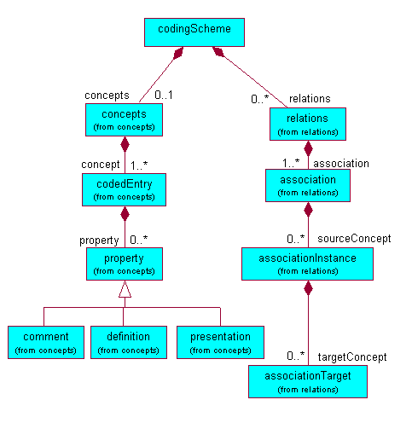
LexGrid Information Model
(partial)
property: String
text: String
Property: “comment”
Text: String

Slide 4
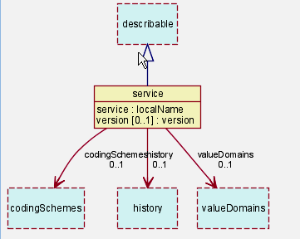
The LexGrid Model
Top Level

Slide 5
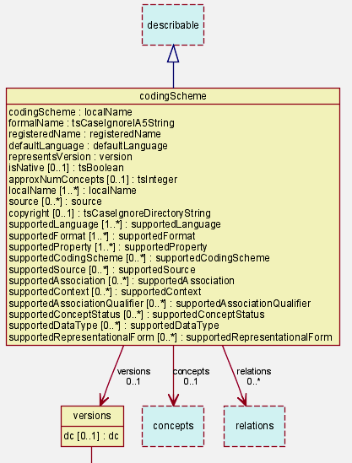
The LexGrid Model
Coding Scheme node

Slide 6
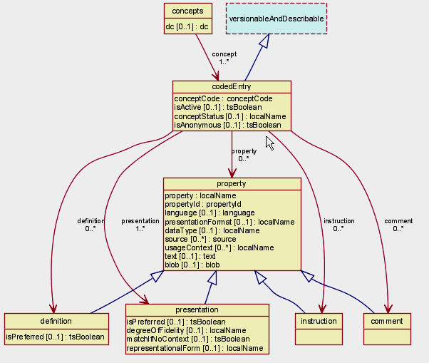
The LexGrid Model
CodedEntry node

Slide 7
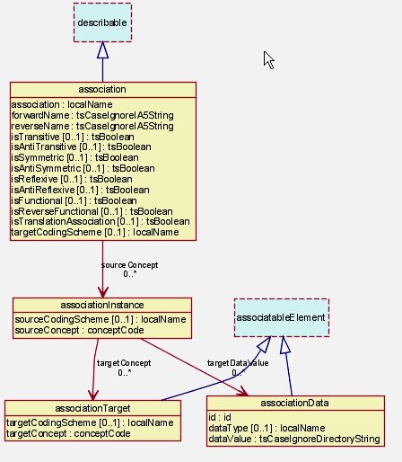
The LexGrid Model
Association Node

Slide 8
The LexGrid Model
Also includes model components:
  Revisions and Versions
  Value domains and pick lists
  URI -> local namespace maps
    <supportedLanguage uri=“2.16.840..84:en”>en</
    <supportedLanguage uri=“2.16.840..84:en”>English</
  Language, source, association, …

Slide 9
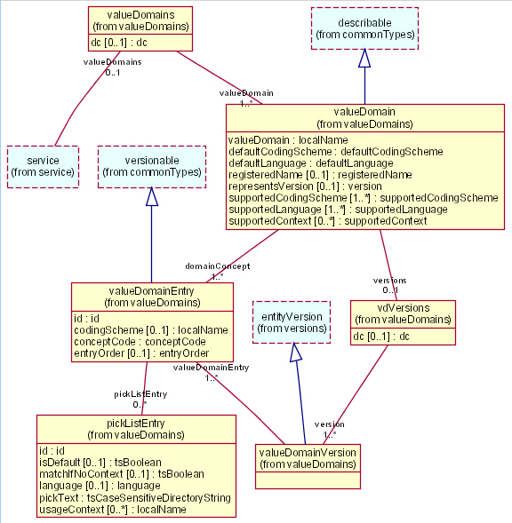
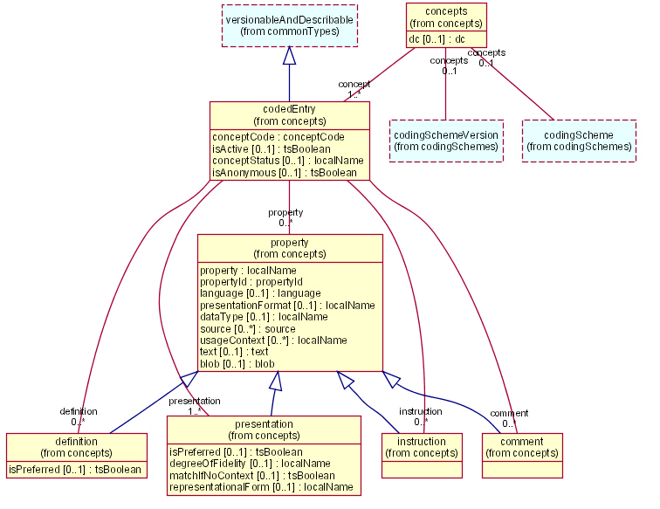
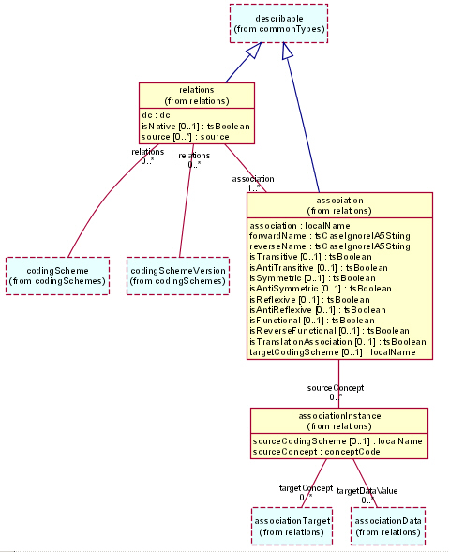
The LexGrid Node
A LexGrid Node is software and a backing data store that represents terminological information in a format semantically faithful to the LexGrid Model
LexGrid
Node
DataStore

