Slide 1
Transforming FMA into LexGrid Model
Deepak Sharma
Division of Biomedical Informatics
Mayo Clinic

Slide 2
Outline
Motivation
LexGrid Model
Eclipse Modeling Framework (EMF)
Protégé + EMF
Transformation into EMF
Example

Slide 3
Motivation
Why do a transformation?
  Native form of FMA cannot be readily integrated into grid, databases and other terminologies
  Need to transform content into a format and structure that is readily accessible via:
    Standard API’s
    SQL
    …
  The Mayo LexGrid model is one such candidate

Slide 4
Motivation
LexGrid model
  Developed by Mayo BMI group
  Consistent content representation
  Open-source tools and API’s
  Search & query terminologies
  Import, Export, Edit content
  Includes ANSI/HL7 CTS & OMG TQS Interface Implementation

Slide 5
LexGrid Model
Formal model of terminology
Explicit definition of entities & objects used in LexGrid tooling
Supports non-semantic entities (from the toolkit perspective) as name/value pairs

Slide 6
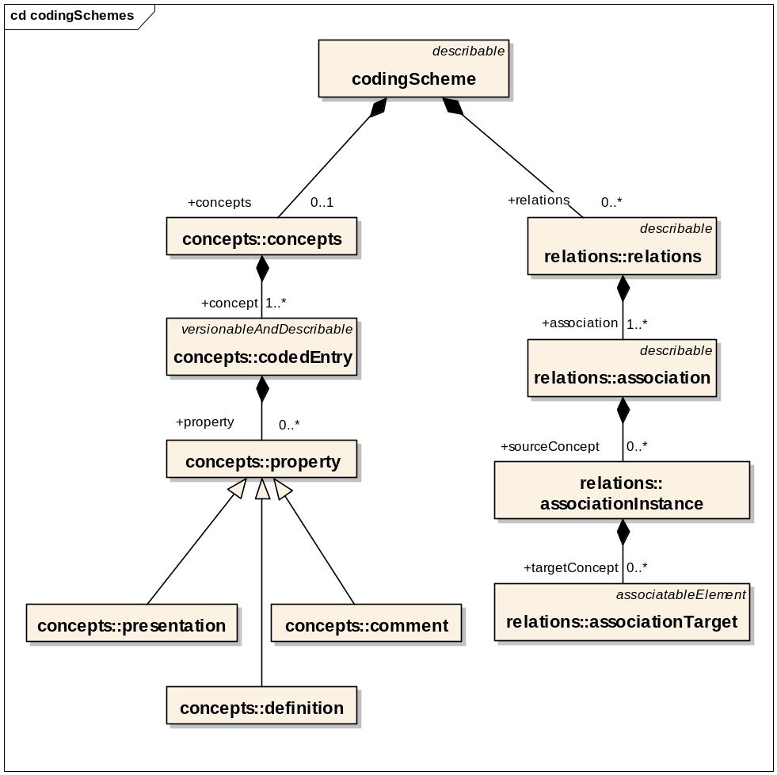
LexGrid Model
Information Model (partial)

Slide 7
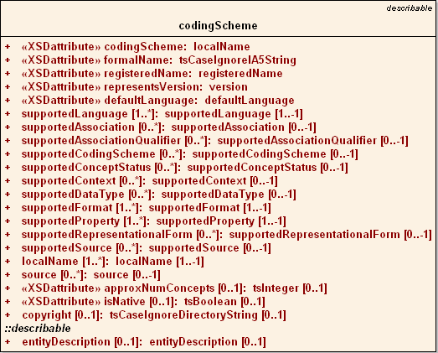
LexGrid Model
Coding Scheme Node

Slide 8
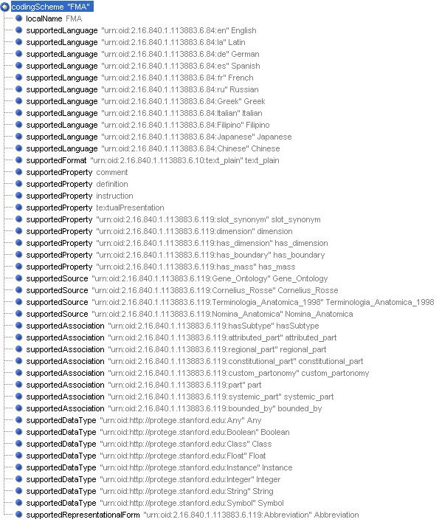
LexGrid Model
Coding Scheme Node

Slide 9
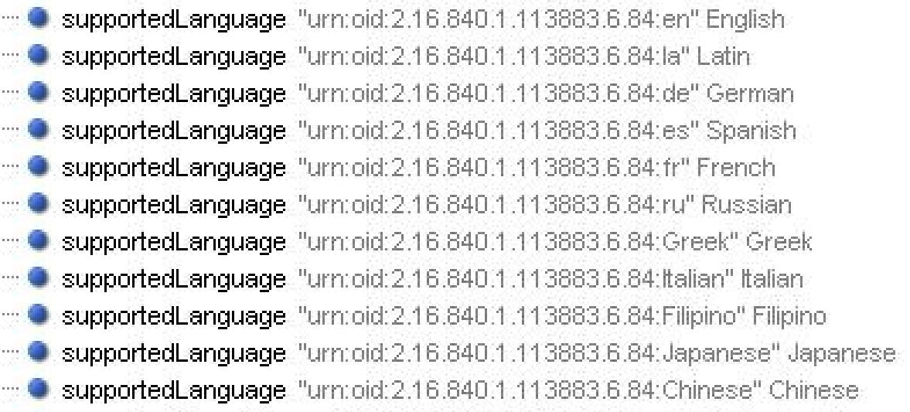
LexGrid Model
Coding Scheme Node

Slide 10
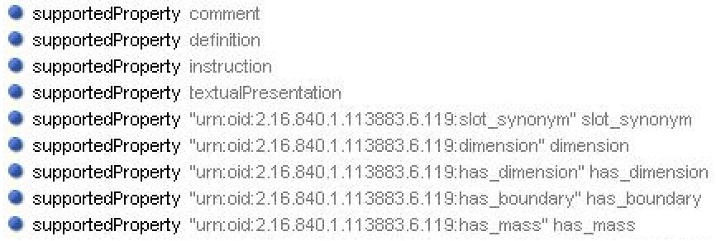
LexGrid Model
Coding Scheme Node

Slide 11
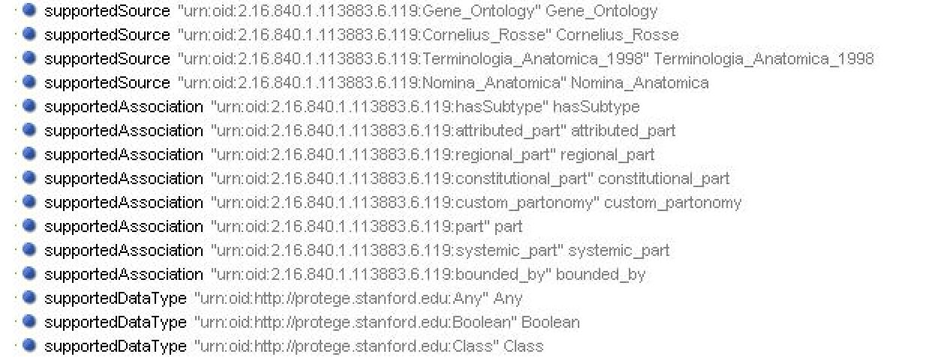
LexGrid Model
Coding Scheme Node

Slide 12
LexGrid Model
Information Model (partial)

Slide 13
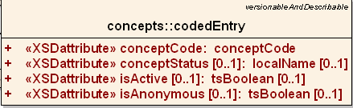
LexGrid Model
Coded Entry

Slide 14
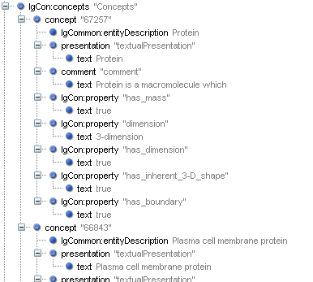
LexGrid Model
CodedEntry Node

Slide 15
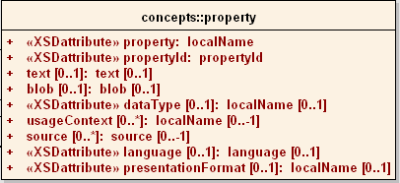
LexGrid Model
Concept Property

Slide 16
LexGrid Model
Concept Property Node

Slide 17
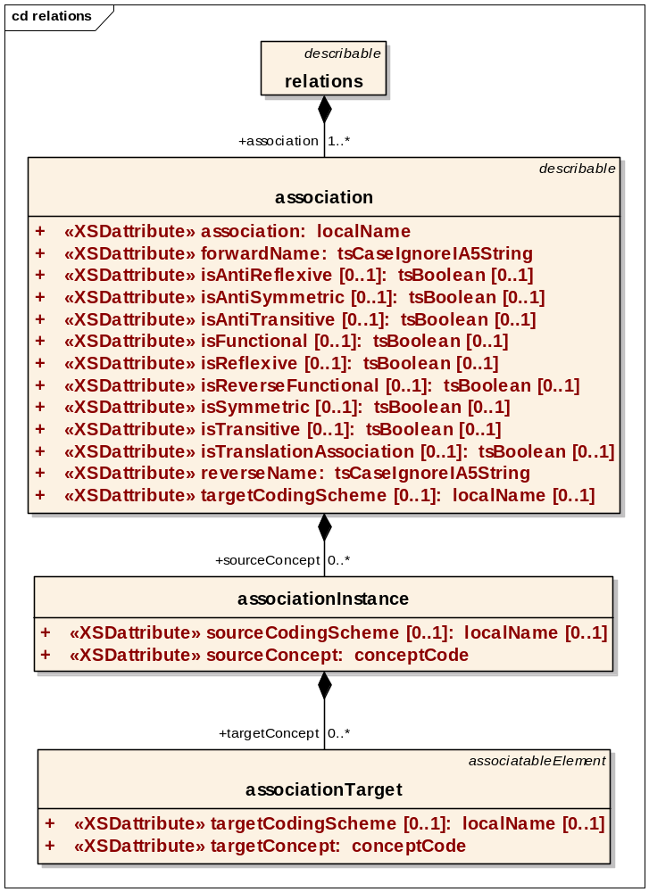
LexGrid Model
Association Node

Slide 18
LexGrid Model
Association Node
Source concept
Target
(concept / Data)

Slide 19
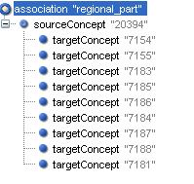
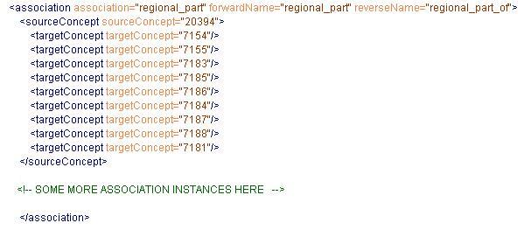
LexGrid Model
Association Node

Slide 20
LexGrid Model
Association Node
Source
Body (has regional parts)
Head
Targets
Neck
Upper limb
Right Upper limb
Left Upper limb
Lower limb
Right Lower limb
Left Lower limb
Trunk

Slide 21
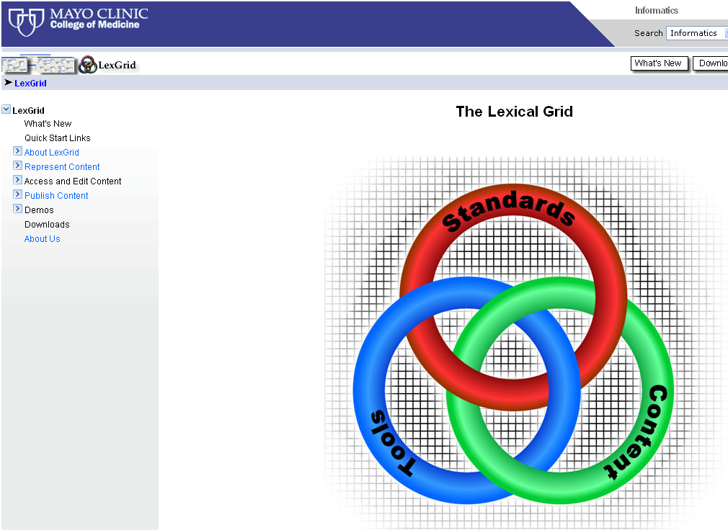
LexGrid Model http://informatics.mayo.edu

Slide 22
EMF
Framework & Code Generation
UML, XML & Java representation
LexGrid Model : XML → Java
Modeling & Programming
more http://www.eclipse.org/emf/

Slide 23
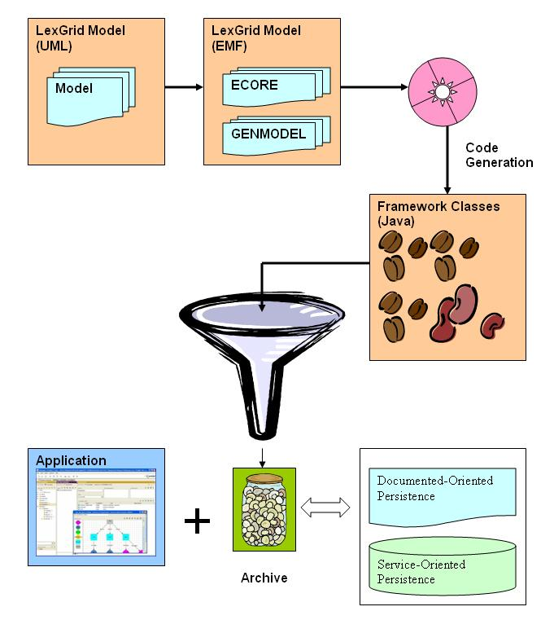
EMF

Slide 24
Transformation
FMA Protégé project Example
FMA Mapping
FMA (Protégé) → FMA (LexGrid EMF)

Slide 25
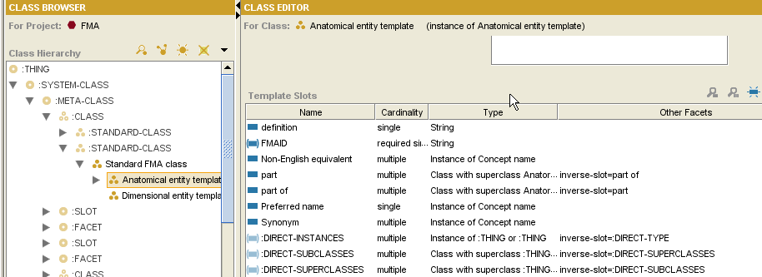
FMA (Protégé)
Meta-Classes

Slide 26
FMA (Protégé)
Meta-Classes
“definition”

Slide 27
FMA (Protégé)
Meta-Classes

Slide 28
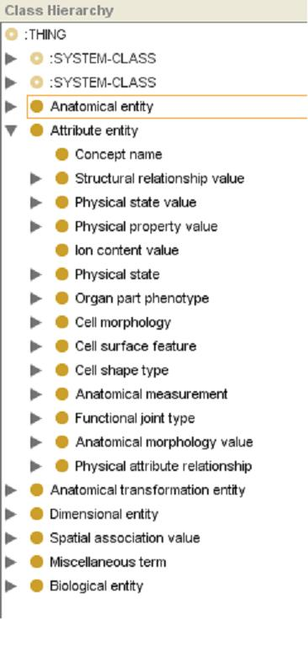
FMA (Protégé)
“Concept name”

Slide 29
FMA (Protégé)
Observations
Protégé Cls or Instance → Concept
Instances of “Concept Name”:
  All Concepts Names
  Relations
Anonymous instances represent composite relationships:
fm_live_***** Instances
based on other simple relations

Slide 30
FMA Mapping
Classes and Instances
Both Protégé CLS and Protégé Instance map to LexGrid Coded Entry
  Meta-Class / CLS / Instance distinction in FMA model is pragmatic decision – not “ontological”
  Most FMA classes are both
  Exception is “ConceptName”, which is strictly descriptive

Slide 31
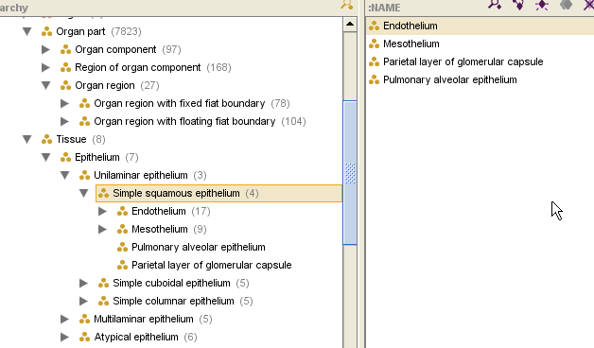
FMA Mapping
Classes and Instances

Slide 32
FMA Mapping
“Concept Name” Instances are a special case:
Slot Type decides Category:
  “Preferred name”, “name”, “Synonyms”, “Eng-Equivalent” → Presentation
  “definition” → Definition

Slide 33
FMA Mapping
Slot Type decides Category (Contd):
  :Documentation → Comment
  Protégé Cls or Instance
  → Association
  Others → Property

Slide 34
FMA Mapping
Traverse “Concept Name” instances:
  “Authority”
  “Source”
  “Language”
  “TA ID”
  “Eponym”, …
  Presentation or its attribute

Slide 35
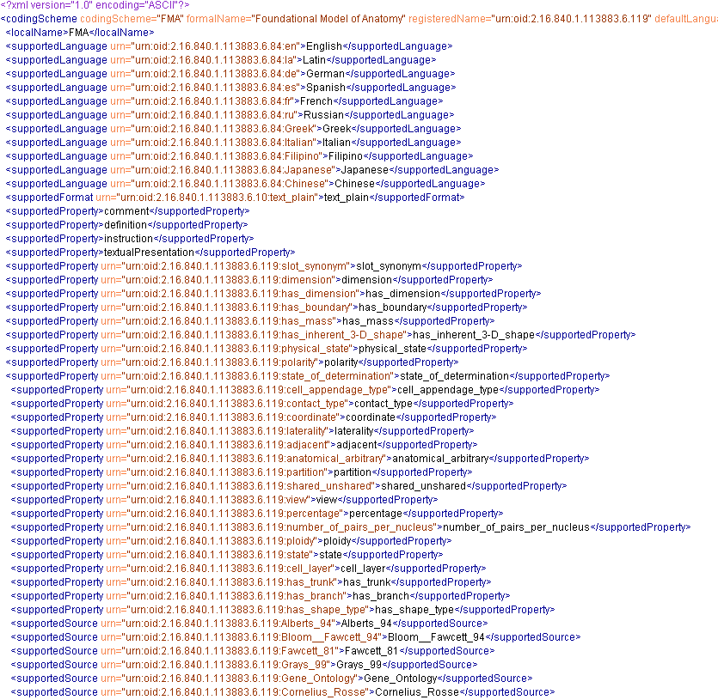
FMA (LexGrid XML Snapshot)

Slide 36
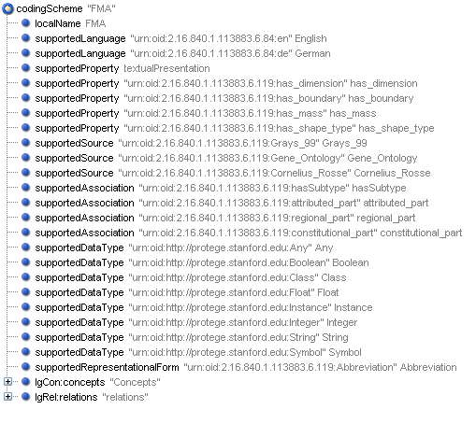
FMA (LexGrid XML Snapshot)

Slide 37
Transformation Example
Concept “Body”
LexGrid Editor tool (Mayo)
Observe Mappings:
  FMA Content with Protégé
  Transformed LexGrid content with LexGrid Editor

Slide 38
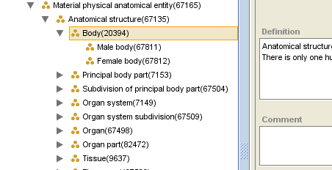
Concept “Body” (FMA)

Slide 39
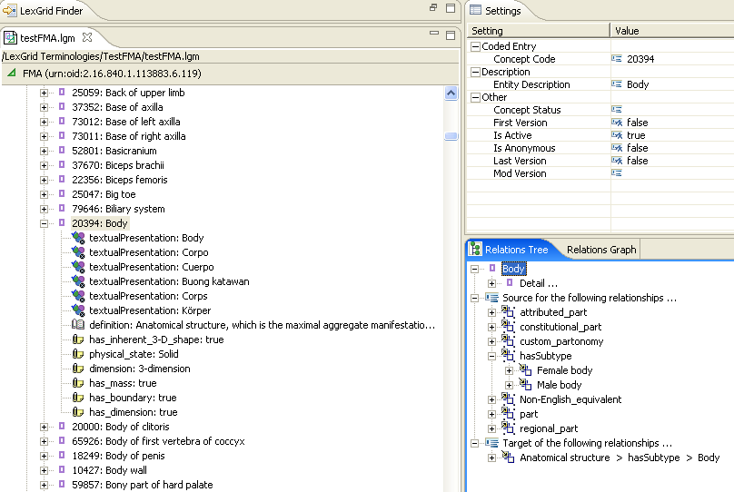
Concept “Body” (LexGrid)

Slide 40
Concept “Body” (LexGrid)
BASICS
CONCEPTS
RELATIONS

Slide 41
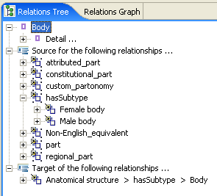
Concept “Body” (LexGrid)

Slide 42
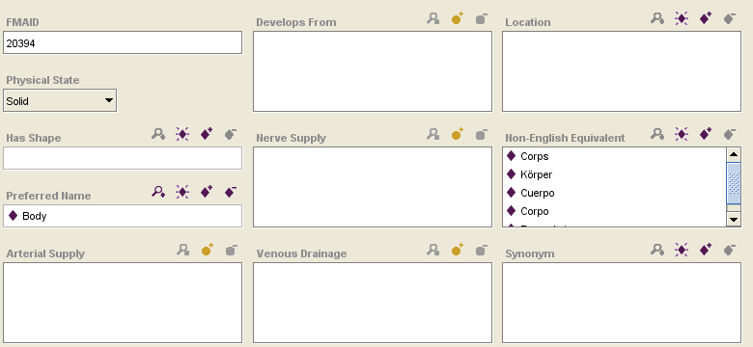
“Body” (FMA) - Attributes

Slide 43
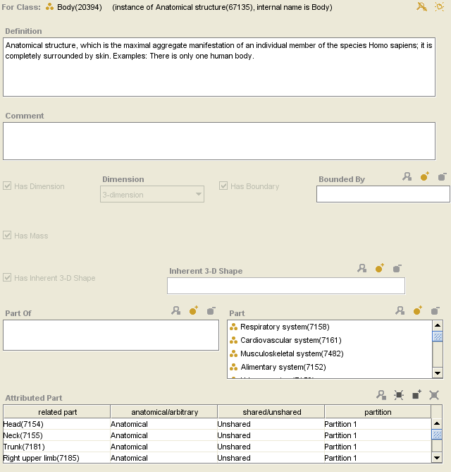
“Body” (FMA) - Attributes

Slide 44
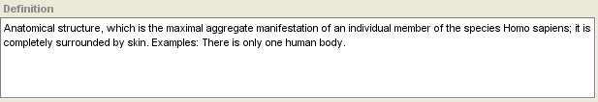
“Body” (FMA) - Attributes

Slide 45
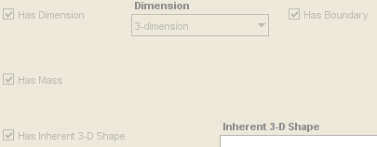
“Body” (FMA) - Attributes

Slide 46
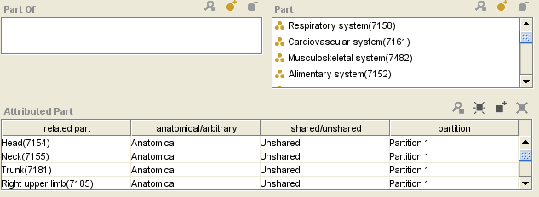
“Body” (FMA) - Attributes

Slide 47
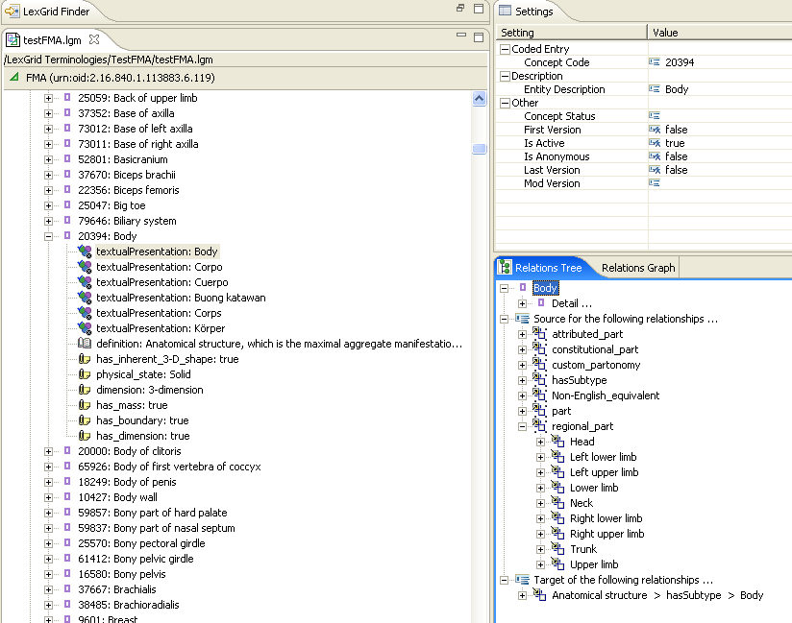
“Body” (LexGrid) - Attributes

Slide 48
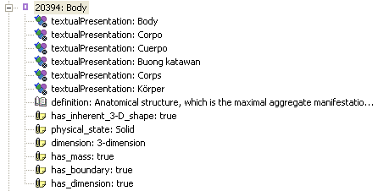
“Body” (LexGrid) - Attributes

Slide 49
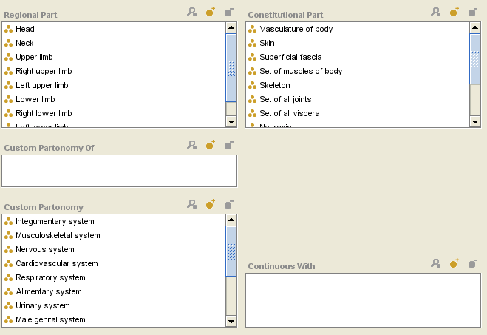
“Body” (FMA) - Relations

Slide 50
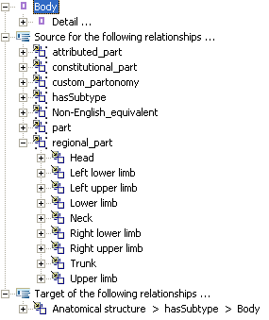
“Body” (LexGrid) - Relations

Slide 51
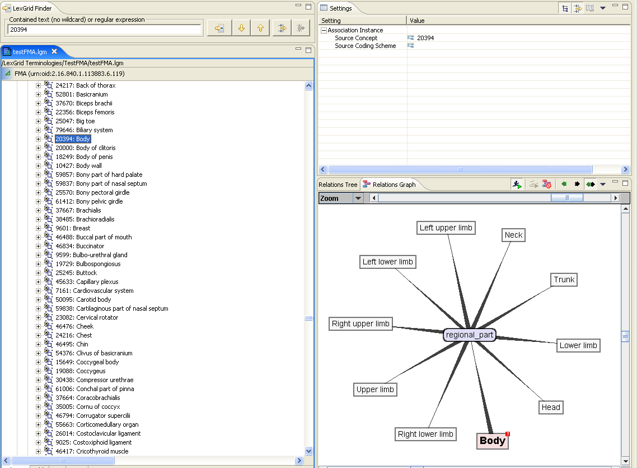
“Body” (LexGrid) - Relations

Slide 52
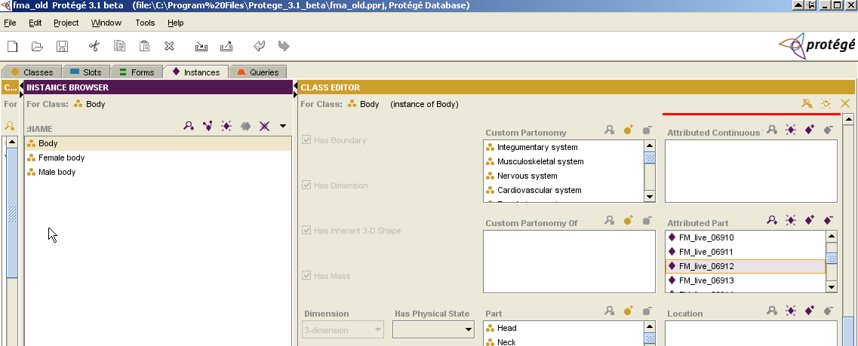

Slide 53
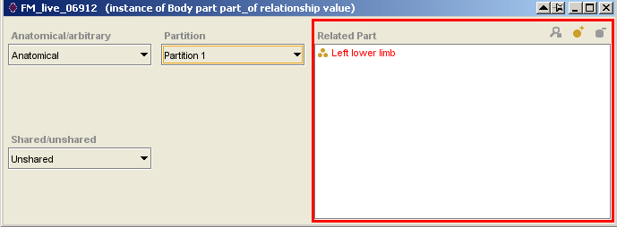

Slide 54
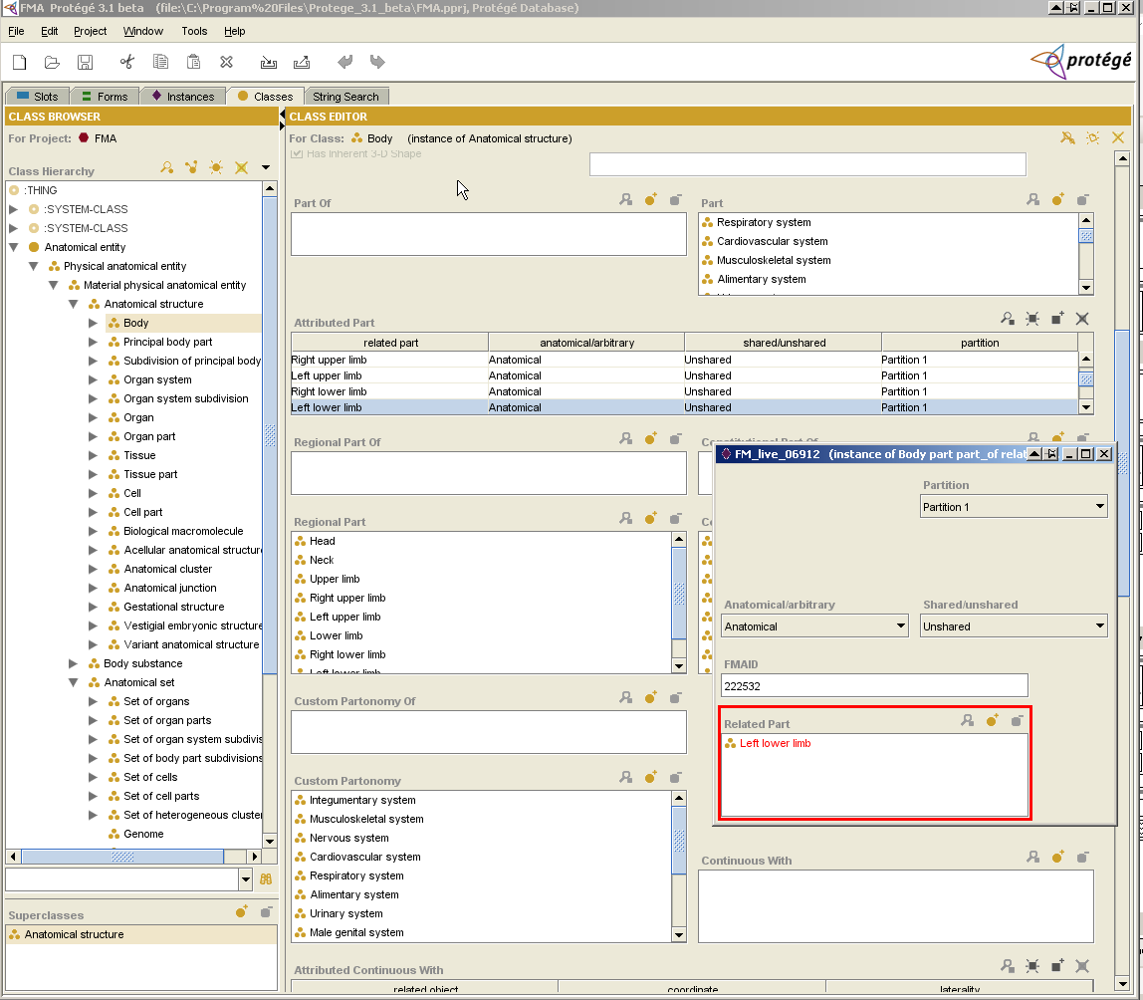

Slide 55
<lgCon:concept conceptCode="FM_live_06912">
<lgCommon:entityDescription>FM_live_06912</lgCommon:entityDescription>
<lgCon:presentation property="textualPresentation" propertyId="P4" isPreferred="false">
<lgCon:text>FM_live_06912</lgCon:text>
</lgCon:presentation>
<lgCon:property property="anatomical_arbitrary" propertyId="P1" dataType="Symbol">
<lgCon:text>Anatomical</lgCon:text>
</lgCon:property>
<lgCon:property property="shared_unshared" propertyId="P2" dataType="Symbol">
<lgCon:text>Unshared</lgCon:text>
</lgCon:property>
<lgCon:property property="partition" propertyId="P3" dataType="Symbol">
<lgCon:text>Partition 1</lgCon:text>
</lgCon:property>
</lgCon:concept>

Slide 56
<lgRel:sourceConcept sourceConcept="67508">
<lgRel:targetConcept targetConcept="FM_live_06906"/>
<lgRel:targetConcept targetConcept="FM_live_06907"/>
<lgRel:targetConcept targetConcept="FM_live_06908"/>
<lgRel:targetConcept targetConcept="FM_live_06909"/>
<lgRel:targetConcept targetConcept="FM_live_06910"/>
<lgRel:targetConcept targetConcept="FM_live_06911"/>
<lgRel:targetConcept targetConcept="FM_live_06912"/>
</lgRel:sourceConcept>
Has_subtype
Body Part part-of Relationship Value

Slide 57
<lgRel:sourceConcept sourceConcept="FM_live_06912">
<lgRel:targetConcept targetConcept="7188"/>
</lgRel:sourceConcept>
related_part
Left Lower Limb

Slide 58
<lgRel:association association="attributed_part" forwardName="attributed_part" reverseName="attributed_part_reverse">
<lgRel:sourceConcept sourceConcept="20394">
<lgRel:targetConcept targetConcept="FM_live_06906"/>
<lgRel:targetConcept targetConcept="FM_live_06907"/>
<lgRel:targetConcept targetConcept="FM_live_06908"/>
<lgRel:targetConcept targetConcept="FM_live_06909"/>
<lgRel:targetConcept targetConcept="FM_live_06910"/>
<lgRel:targetConcept targetConcept="FM_live_06911"/>
<lgRel:targetConcept targetConcept="FM_live_06912"/>
<lgRel:targetConcept targetConcept="FM_live_06913"/>
<lgRel:targetConcept targetConcept="FM_live_06914"/>
<lgRel:targetConcept targetConcept="FM_live_06915"/>
<lgRel:targetConcept targetConcept="FM_live_06916"/>
<lgRel:targetConcept targetConcept="FM_live_06917"/>
<lgRel:targetConcept targetConcept="FM_live_06918"/>
<lgRel:targetConcept targetConcept="FM_live_06919"/>
<lgRel:targetConcept targetConcept="FM_live_06920"/>
</lgRel:sourceConcept>

Slide 59
FMA Mapping
Anonymous Instances
  Should we treat them special ?
    Anterior branch of left anterior segmental bronchus (fm_live_04560)
    Trunk of posterior inferior segmental branch of right hepatic artery
    (fm_live_17483)

Slide 60
Current Status
Transformation Tool
Java application
  Successfully Converts FMA Protégé to LexGrid XML format using EMF
Isolate “Mapping to LexGrid Model” from EMF implementation

Slide 61
Thanks!
Harold Solbrig
Thomas Johnson
Dr. Christopher Chute
Protégé Conference Organizers

Slide 62
Questions ?
http://informatics.mayo.edu
        Deepak Sharma
        Division of Biomedical Informatics
        Mayo Clinic
        sharma.deepak2@mayo.edu

