Slide 1
Transformation of Protégé Ontologies into the Eclipse Modeling Framework
Deepak Sharma
Division of Biomedical Informatics
Mayo Clinic

Slide 2
Outline
LexGrid Model
Eclipse Modeling Framework (EMF)
Protégé + EMF
Transformation into EMF

Slide 3
LexGrid Model
Formal model of terminology
Explicit definition of entities & objects used in LexGrid tooling
Supports non-semantic entities (from the toolkit perspective) as name/value pair

Slide 4
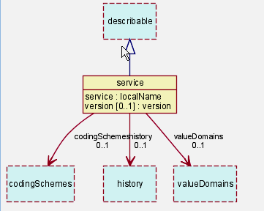
LexGrid Model
Top Level

Slide 5
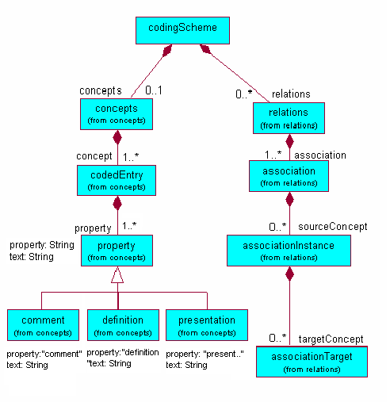
LexGrid Model
Information Model (partial)

Slide 6
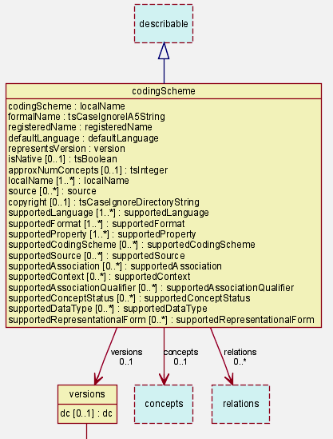
LexGrid Model
Coding Scheme Node

Slide 7
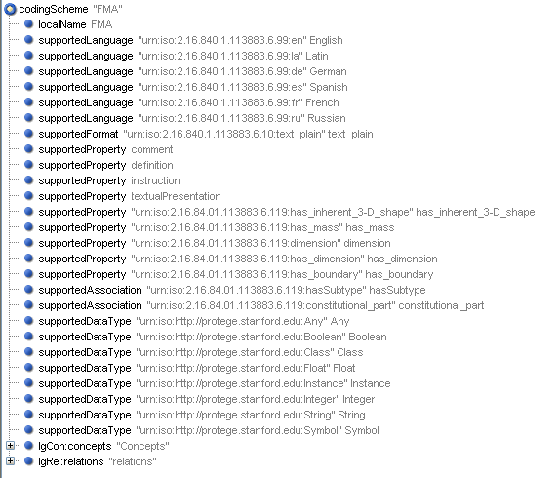
LexGrid Model
Coding Scheme Node

Slide 8
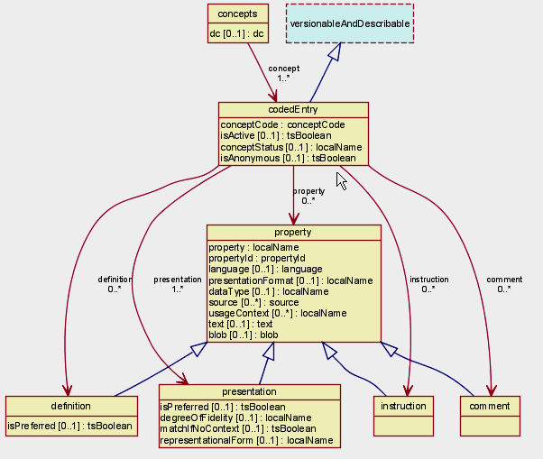
LexGrid Model
CodedEntry Node

Slide 9
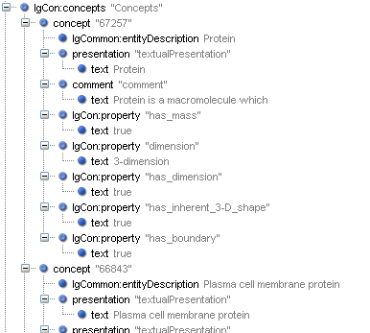
LexGrid Model
CodedEntry Node

Slide 10
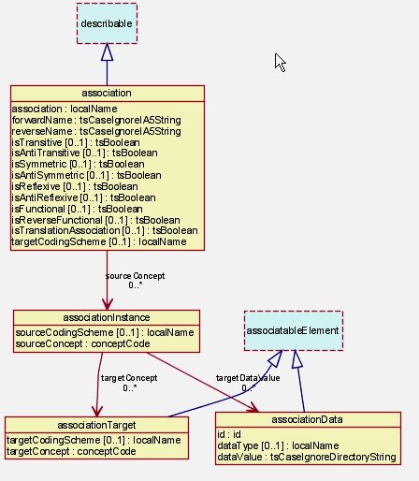
LexGrid Model
Association Node

Slide 11
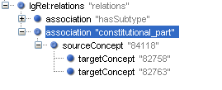

LexGrid Model
Association Node

Slide 12
LexGrid Model
Revisions & Versions
Value Domains & Pick Lists
URI → Local Namespace Maps
  <supportedLanguage urn="urn:iso:2.16.840.1.113883.6.99:en">English
  </supportedLanguage>
  <supportedLanguage urn="urn:iso:2.16.840.1.113883.6.99:en">en
  </supportedLanguage>
Language, Source, Association,…

Slide 13
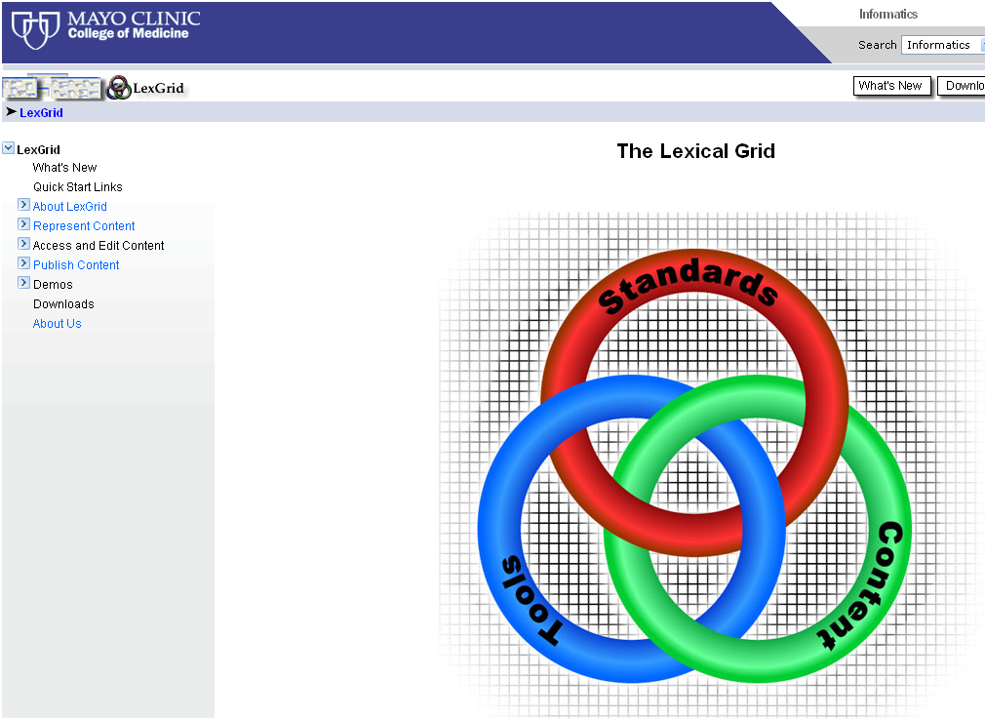
LexGrid Model http://informatics.mayo.edu

Slide 14
EMF
Framework & Code Generation
UML, XML & Java representation
LexGrid Model : XML → Java
Modeling & Programming
more http://www.eclipse.org/emf/

Slide 15
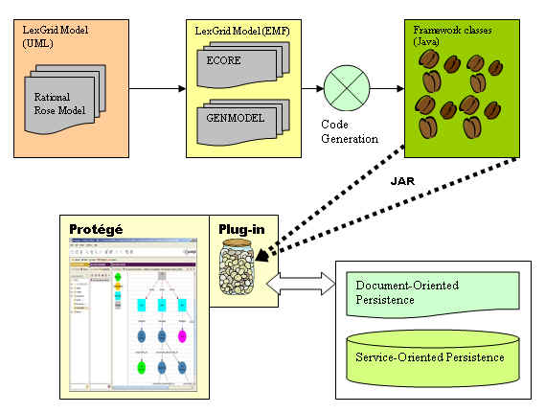
Protégé & EMF

Slide 16
Transformation
FMA Protégé project Example
FMA Mapping
FMA (Protégé) → FMA (LexGrid EMF)

Slide 17
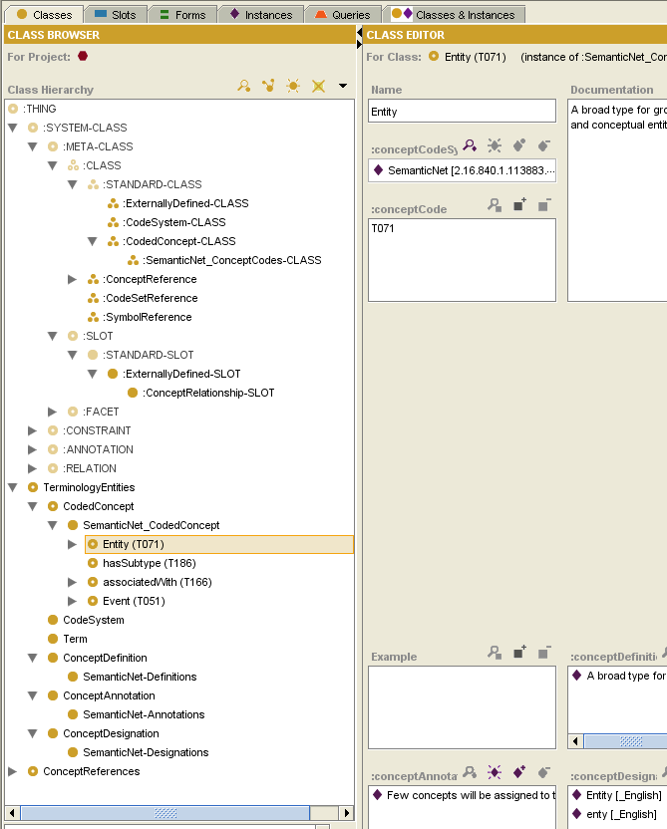
LexGrid (Protégé)

Slide 18
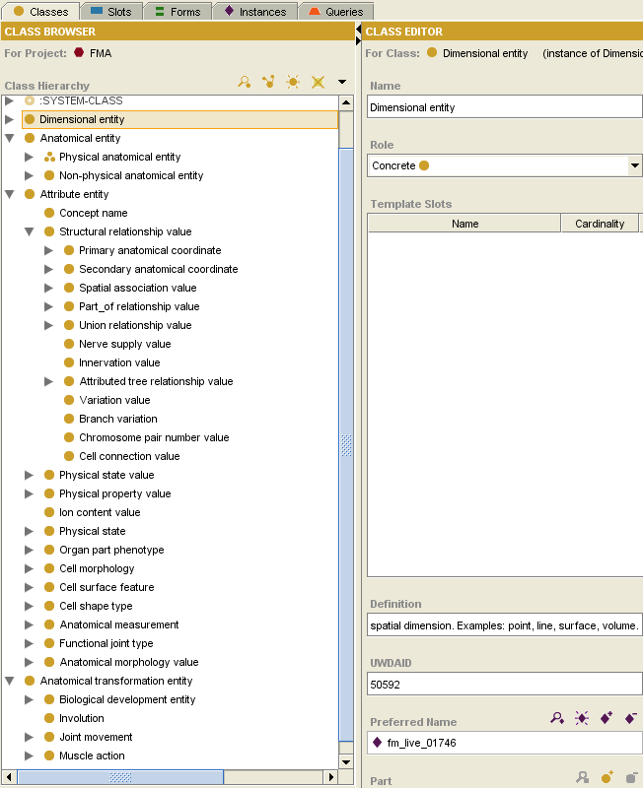
FMA (Protégé)

Slide 19
FMA (Protégé)
Observations
Protégé Cls or Instance → Concept
Instances of “Concept Name”:
  All Concepts Names
  Relations
Anonymous instances represent composite relationships:
fm_live_***** Instances
based on other simple relations

Slide 20
FMA Mapping
Classes and Instances as concepts in LexGrid Model except “Concept Name” Instances
Slot Type decides Category:
  “UWDAID”, “Preferred name”, “name”, “Synonyms”, “Eng-Equivalent” → Presentation
  “definition” → Definition

Slide 21
FMA Mapping
Slot Type decides Category (Contd):
  :Documentation → Comment
  Protégé Cls or Instance
  → Association
  Others → Property

Slide 22
FMA Mapping
Traverse “Concept Name” instances:
  “Authority”
  “Source”
  “Language”
  “TA ID”
  “Eponym”
  Presentation

Slide 23
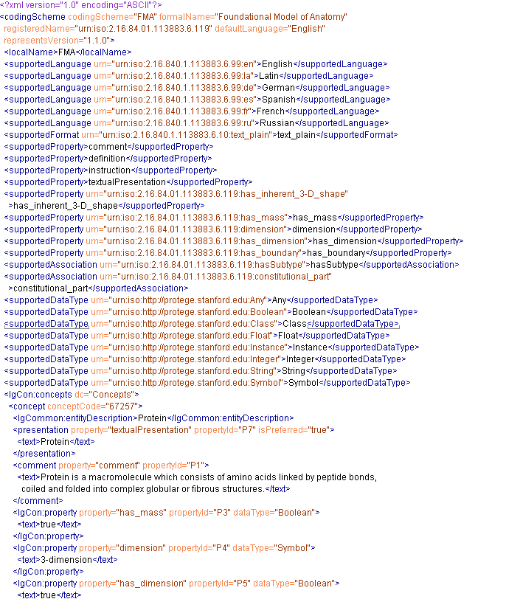
FMA (LexGrid XML Snapshot)

Slide 24
FMA Mapping
Anonymous Instances
  Should we treat them special ?
    Anterior branch of left anterior segmental bronchus (fm_live_04560)
    Trunk of posterior inferior segmental branch of right hepatic artery
    (fm_live_17483)

Slide 25
Current Status
Transformation Tool
Java application
  Successfully Converts FMA Protégé to LexGrid XML format using EMF
Isolate “Mapping to LexGrid Model” from EMF implementation

Slide 26
Thanks!
Harold Solbrig
Thomas Johnson
Dr. Christopher Chute
Protégé Conference Organizers

Slide 27
Questions ?
http://informatics.mayo.edu
        Deepak Sharma
        Division of Biomedical Informatics
        Mayo Clinic
        sharma.deepak2@mayo.edu

