Slide 1
Transformation of Protégé Ontologies into the Eclipse Modeling Framework
Deepak Sharma
Division of Biomedical Informatics
Mayo Clinic

Slide 2
Outline
Motivation
Eclipse Modeling Framework (EMF)
EMF at work
LexGrid Model & FMA Mapping
FMA Transformation Example
Conclusion

Slide 3
Motivation
Why do a transformation?
Native form of FMA cannot be readily integrated into grid, databases and other terminologies
Need to transform content into a format and structure that is readily accessible via:
    Standard API’s
    SQL
    …
The Mayo LexGrid model is one such candidate

Slide 4
Motivation
Why EMF ?
Easy & Simple to:
  Use EMF Transformation
  Integrate EMF with Protégé
  Use EMF as a hub
Successful FMA transformation

Slide 5
What is EMF ?
Eclipse Modeling Framework
  Framework & Code Generation tool
  Available with Eclipse
  Modeling ← EMF → Programming

Slide 6
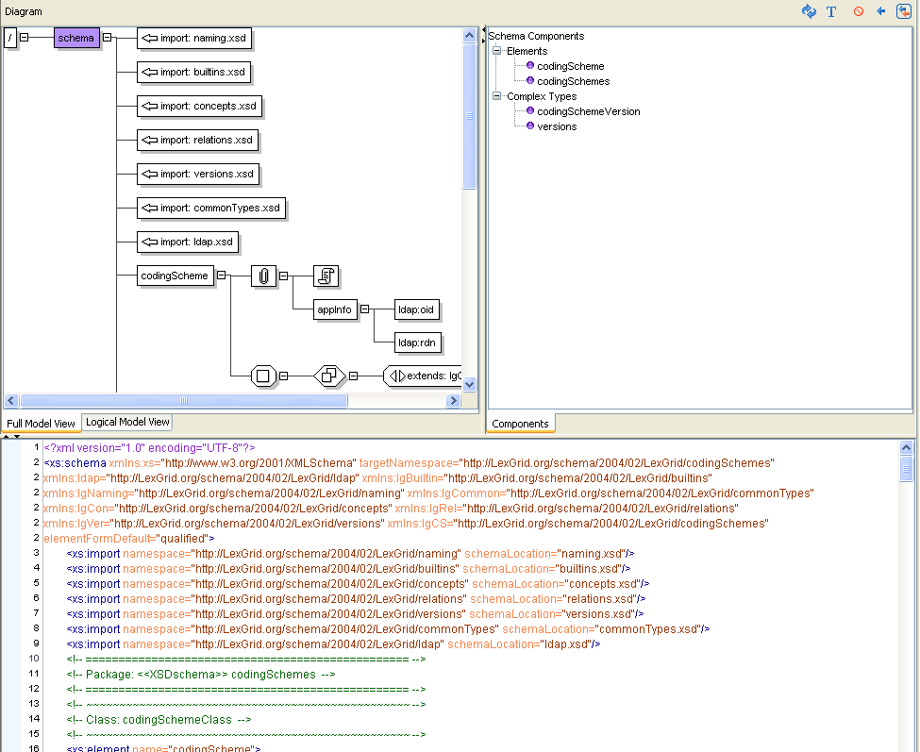
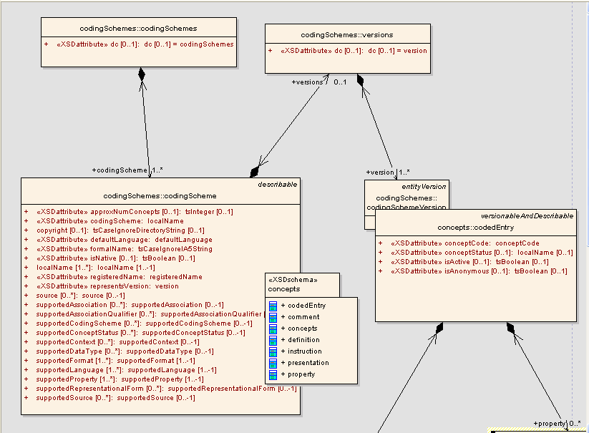
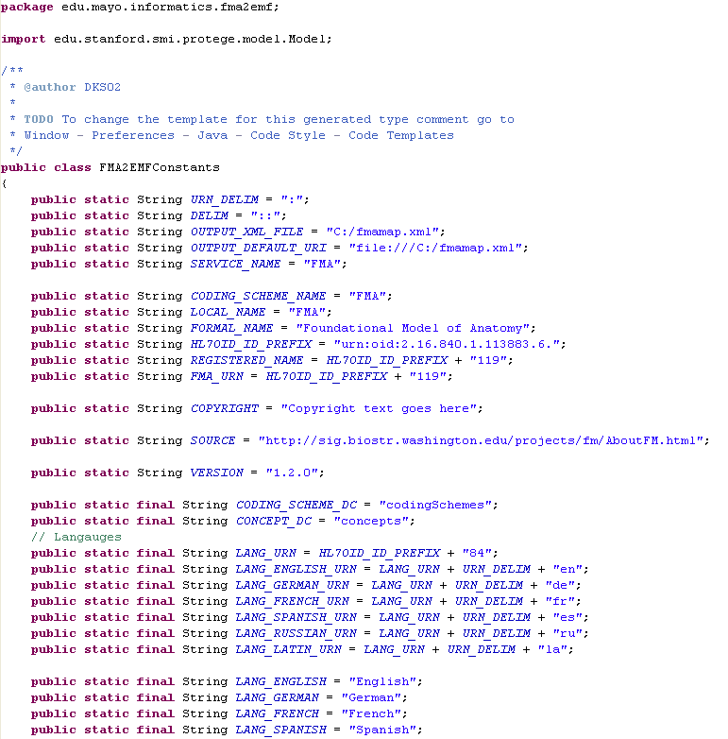
Eclipse Modeling Framework
EMF
XML Schema
Java
UML

Slide 7
Eclipse Modeling Framework
Model in XMI (XML Metadata Interchange) format
EMF Project
  ECORE
  GENMODEL
Generated Code can be customized
Easy to Update & Regenerate

Slide 8
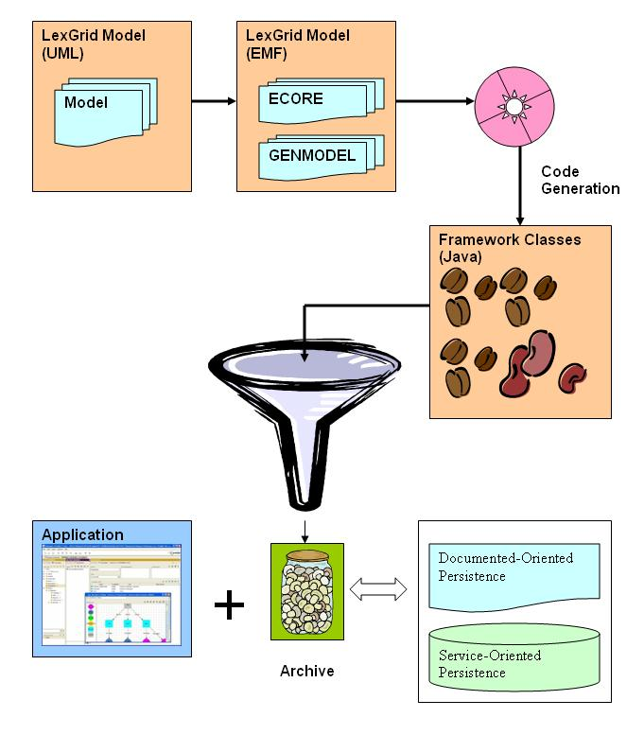
EMF

Slide 9
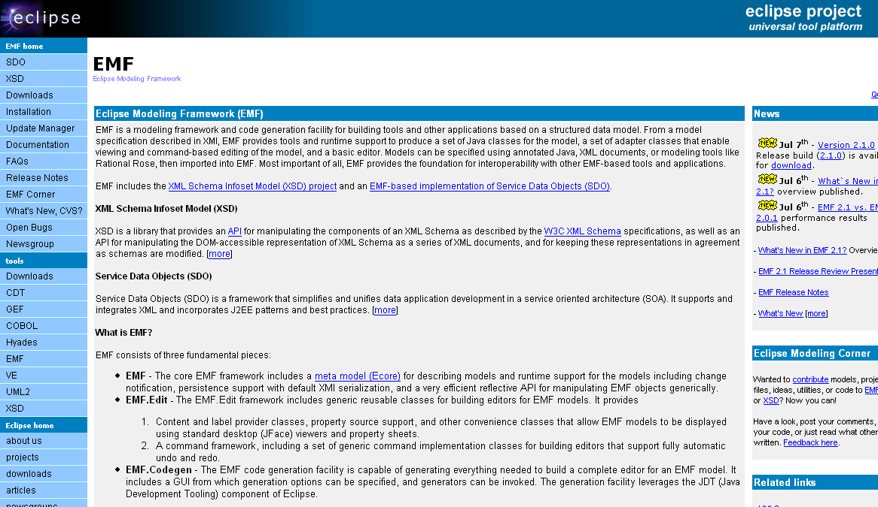
Eclipse Modeling Framework http://www.eclipse.org/emf/

Slide 10
EMF at work
Source Model & Representation
Protégé Content
Mapping
Output

Slide 11
EMF at work
Source Model & Representation | → | LexGrid Model in XML Schema
Protégé Content | → | FMA
Mapping | → | FMA to LexGrid Model
Output | → | LexGrid XML Document

Slide 12
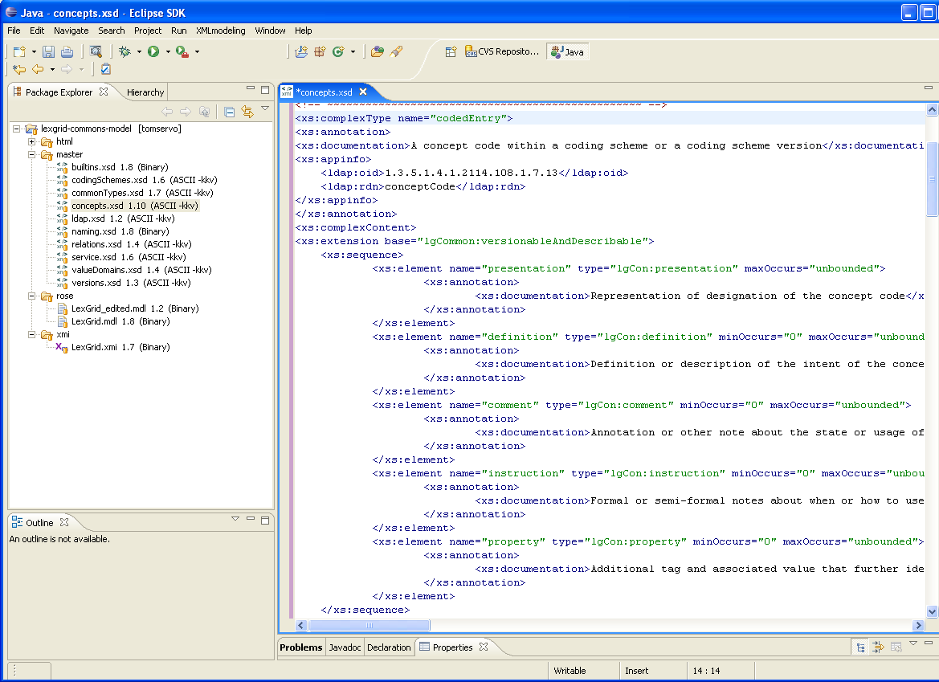
EMF at work
Model Representation

Slide 13
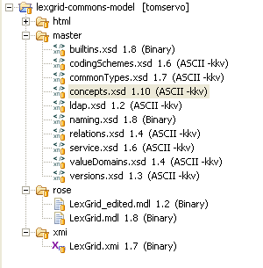
EMF at work
Model Representation
XML Schema
UML

Slide 14

EMF at work
Model Representation
XML Schema
UML

Slide 15
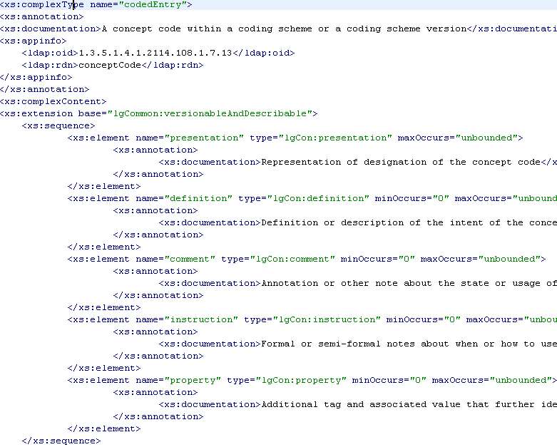
EMF at work
Model Representation (XSD)

Slide 16
EMF at work
Model Representation (XSD)

Slide 17
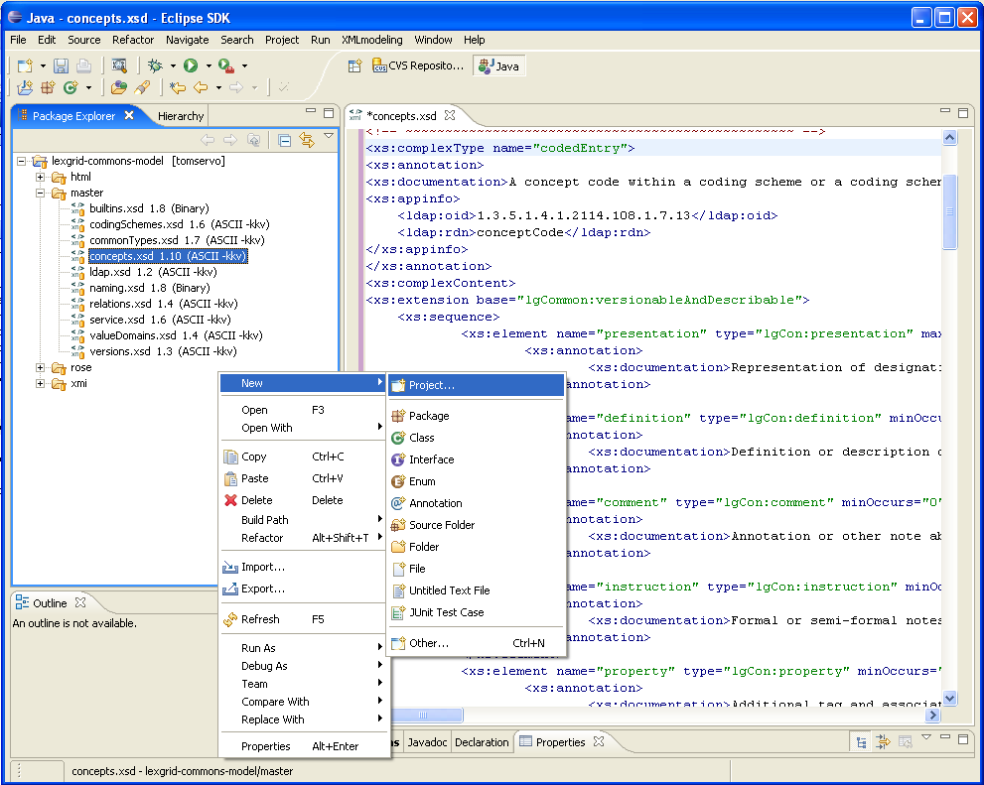
EMF at work
Create an EMF Project

Slide 18
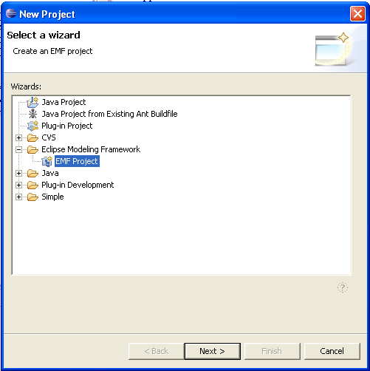
EMF at work
Create an EMF Project

Slide 19
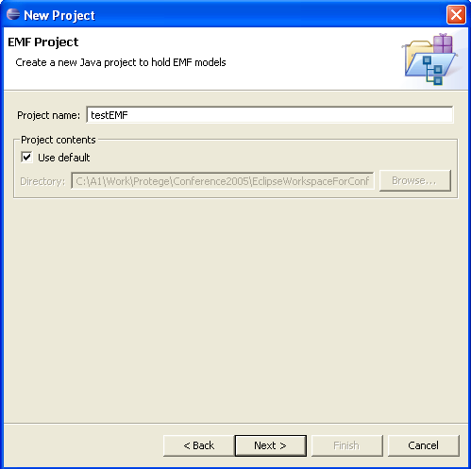
EMF at work
Create an EMF Project

Slide 20
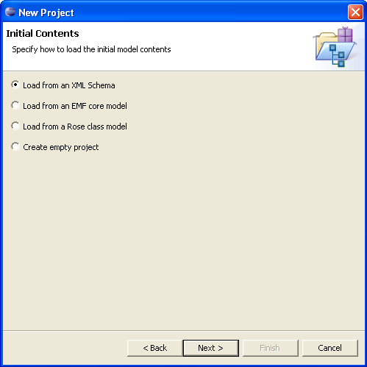
EMF at work
Create an EMF Project

Slide 21
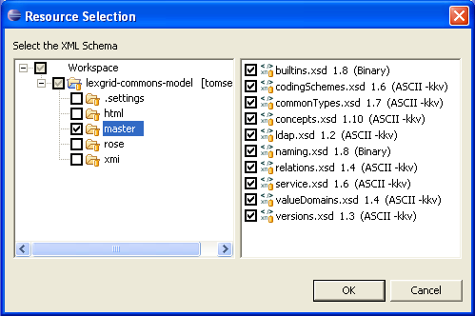
EMF at work
Create an EMF Project

Slide 22
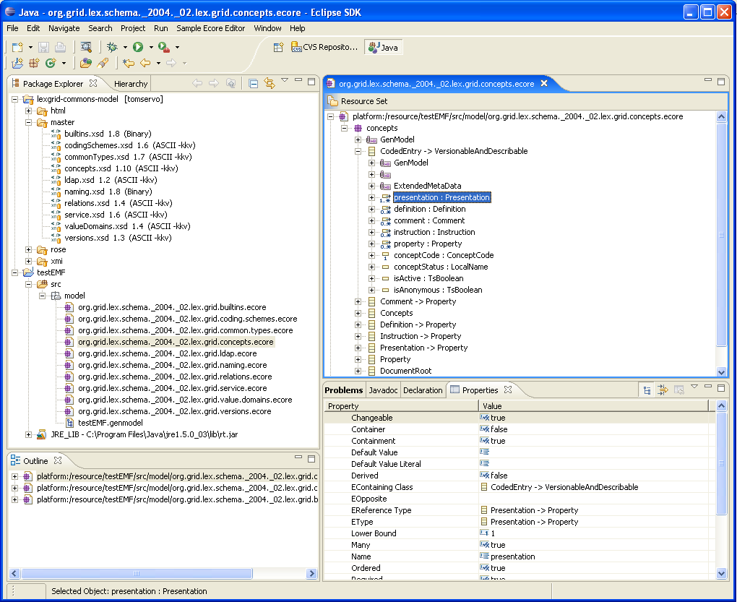
EMF at work
EMF Project Components

Slide 23
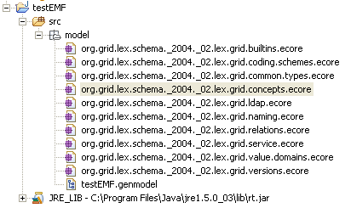
EMF at work
EMF Project Components

Slide 24
EMF at work
EMF Project Components
CORE
GENMODEL

Slide 25
EMF at work
EMF CORE Component

Slide 26
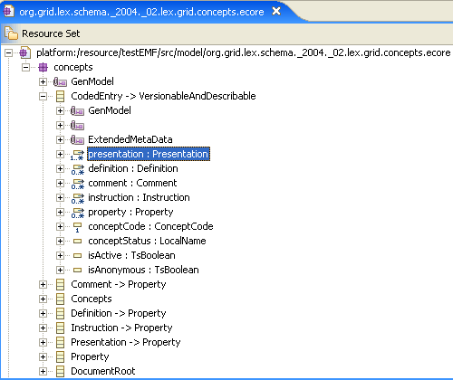
EMF at work
EMF CORE Component

Slide 27
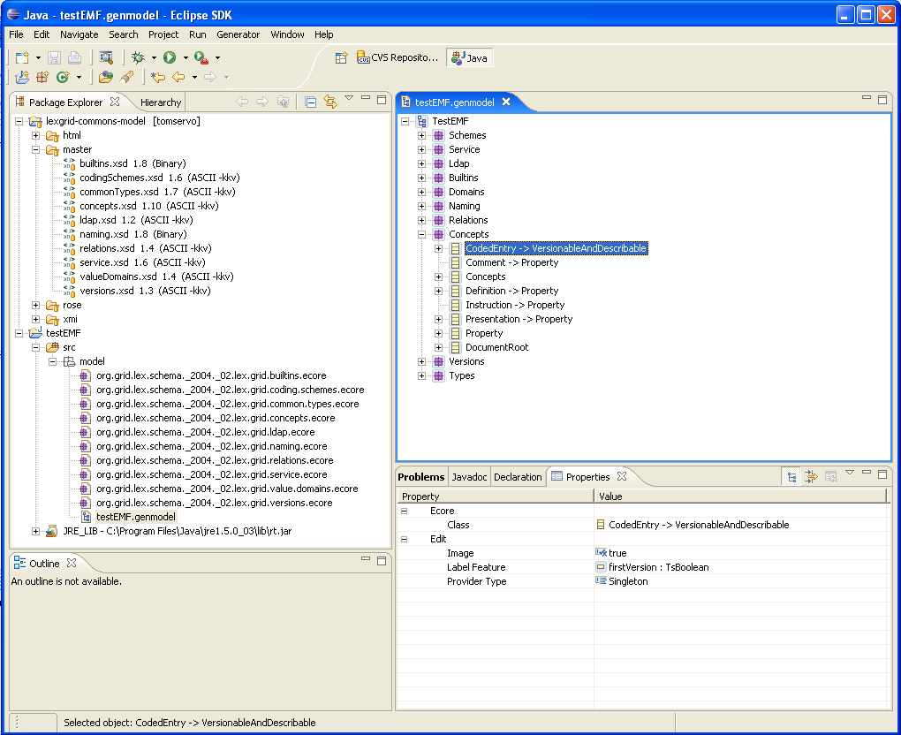
EMF at work
EMF GENMODEL Component

Slide 28
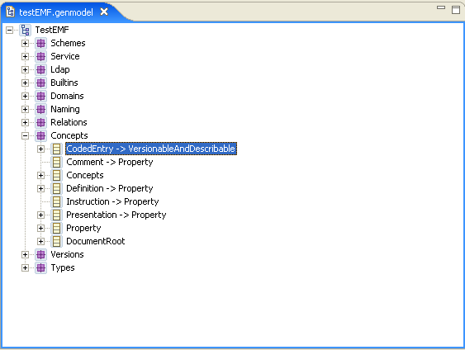
EMF at work
EMF GENMODEL Component

Slide 29
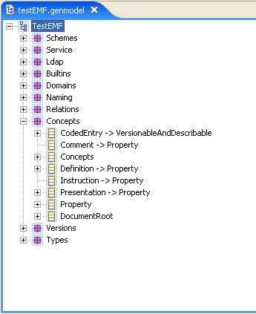
EMF at work
Generate Implementation

Slide 30
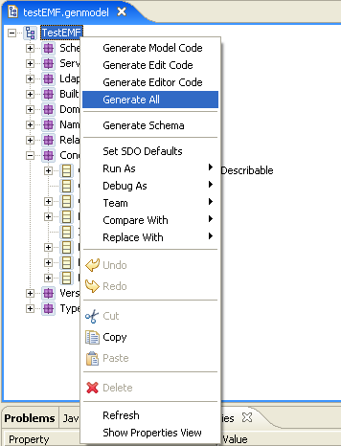
EMF at work
Generate Implementation
Generates Implementation

Slide 31
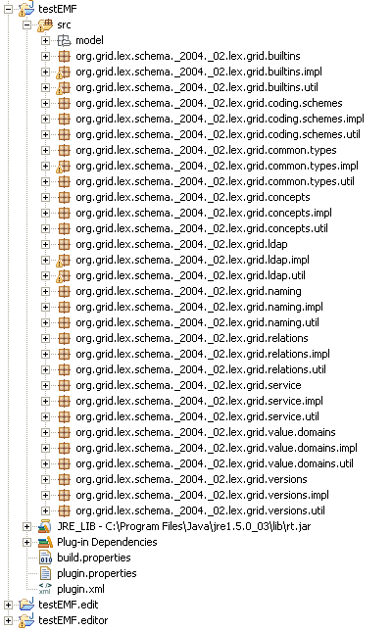
EMF at work
Implementation

Slide 32
EMF at work
Implementation
Generated
Implementation

Slide 33
EMF at work
XML Schema Snapshot

Slide 34
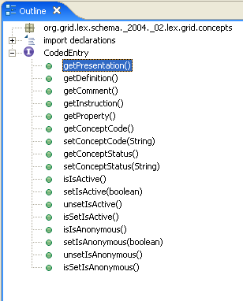
EMF at work
Generated Implementation

Slide 35
EMF at work
Customize the implementation
  Before & After Generation
Make EMF implementation available by either :
  Create and include as an Archive
  Application dependent on EMF implementation classes.

Slide 36
EMF at work
Customize the implementation
  Before & After Generation
Make EMF implementation available by either :
  Create and include as an Archive
  Application dependent on EMF implementation classes.

Slide 37
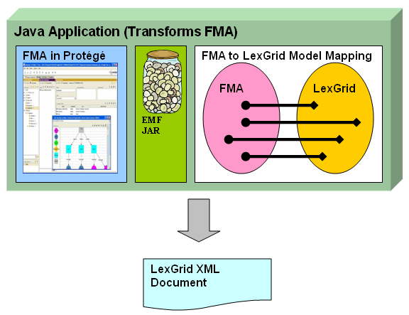
EMF at work

Slide 38
LexGrid Model
Developed by Mayo BMI Group
Formal model of terminology
Explicit definition of entities & objects used in LexGrid tooling
Supports non-semantic entities (from the toolkit perspective) as name/value pair

Slide 39
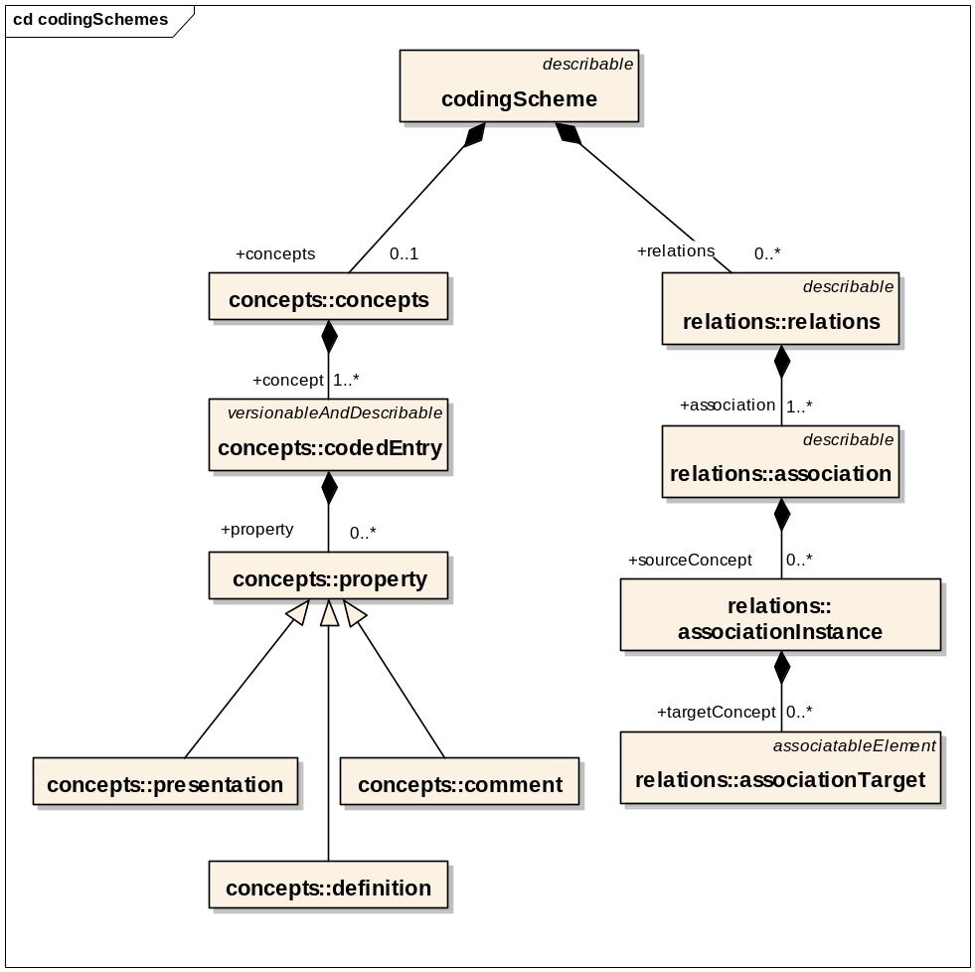
LexGrid Model
Information Model (partial)

Slide 40
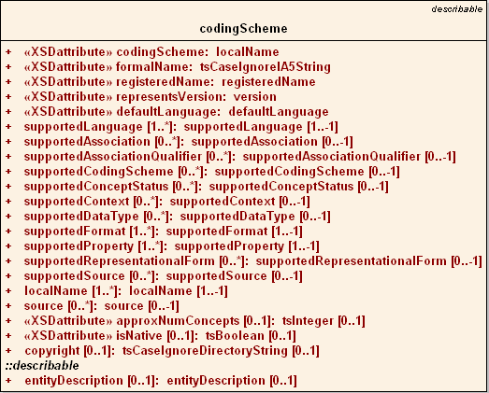
LexGrid Model
Coding Scheme Node

Slide 41
LexGrid Model
Information Model (partial)

Slide 42
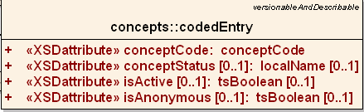
LexGrid Model
Coded Entry

Slide 43
LexGrid Model
Information Model (partial)

Slide 44
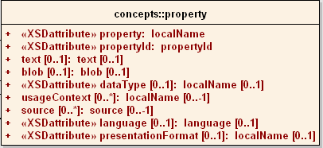
LexGrid Model
Concept Property

Slide 45
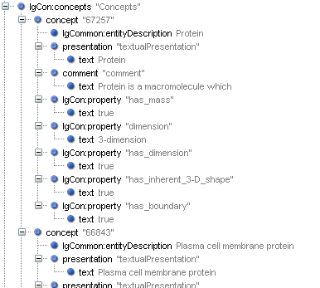
LexGrid Model
CodedEntry Node
Concept Code
Concept Name
Property Name
Property Value

Slide 46
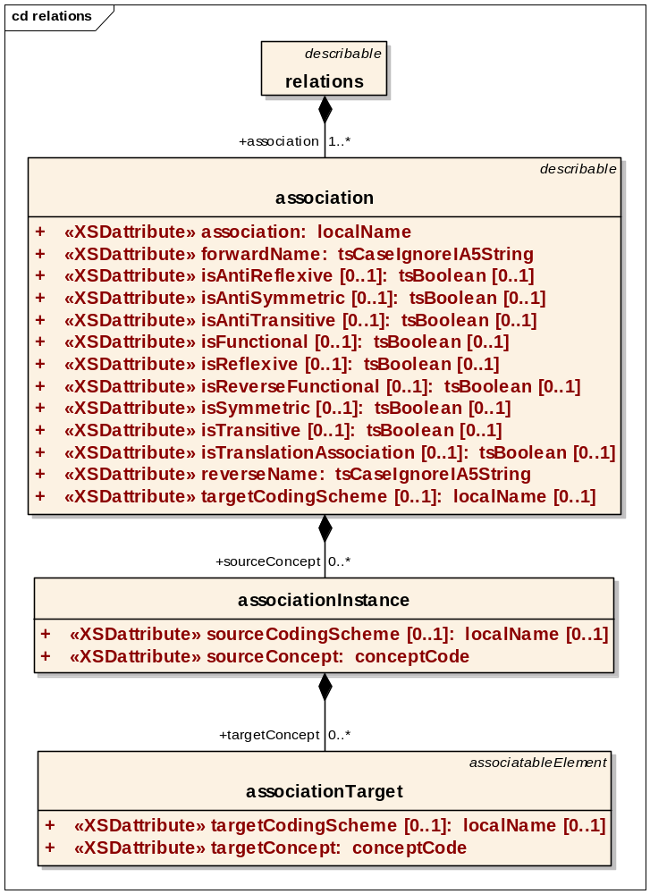
LexGrid Model
Association Node

Slide 47
LexGrid Model
Association Node
Source concept
Target
(concept / Data)

Slide 48
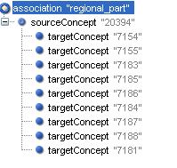
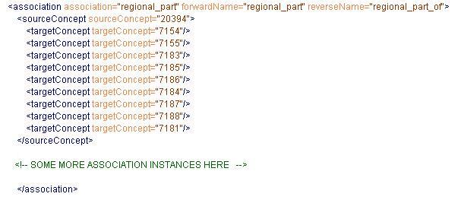
LexGrid Model
Association Node

Slide 49
LexGrid Model
Association Node
Source
Body (has regional parts)
Head
Targets
Neck
Upper limb
Right Upper limb
Left Upper limb
Lower limb
Right Lower limb
Left Lower limb
Trunk

Slide 50
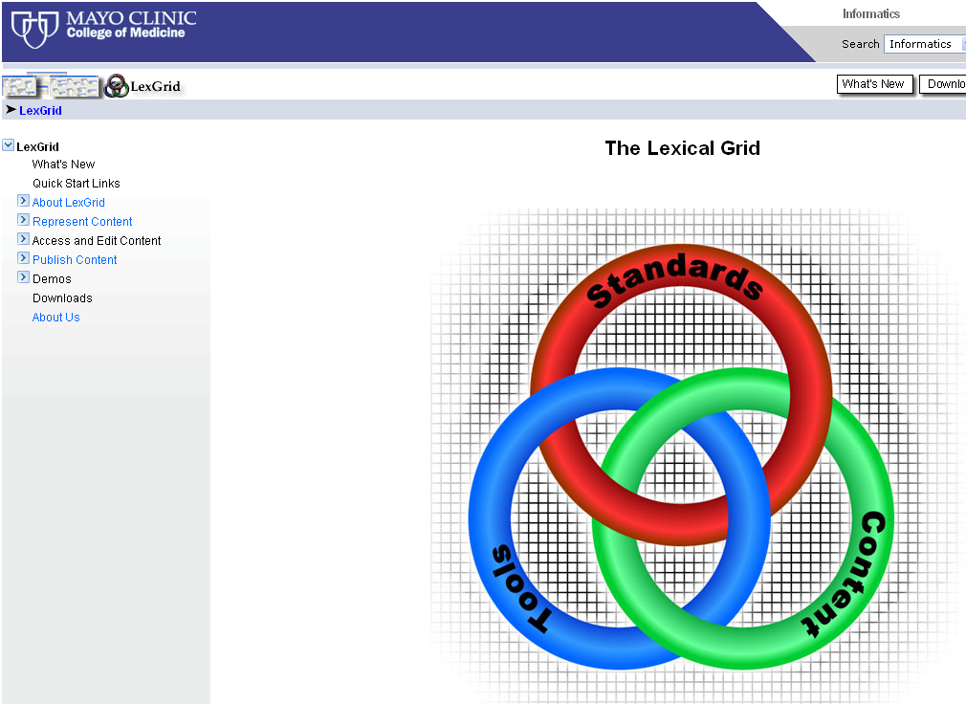
LexGrid Model http://informatics.mayo.edu

Slide 51
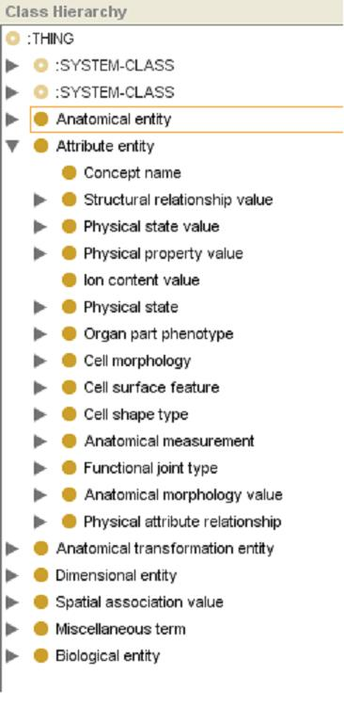
FMA (Protégé)

Slide 52
FMA (Protégé)
Root Nodes
Anatomical entity
Attribute entity
Anatomical transformation entity
Dimensional entity
Spatial association value
Miscellaneous term
Biological entity
“Concept name”

Slide 53
FMA Mapping to LexGrid
Both Protégé CLS and Protégé Instance map to LexGrid Coded Entry
  Meta-Class / CLS / Instance distinction in FMA model is pragmatic decision – not “ontological”
  Most FMA classes are both
  Exception is “Concept name”, which is strictly descriptive

Slide 54
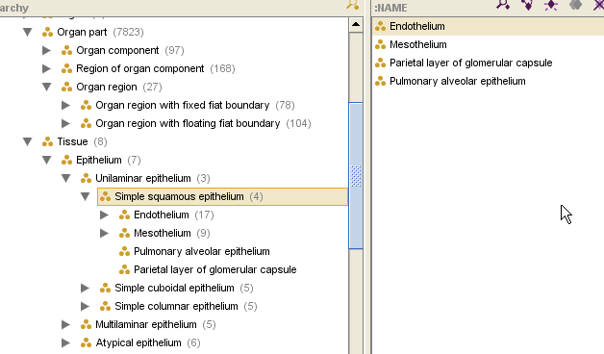
FMA Mapping
Classes and Instances

Slide 55
FMA Mapping to LexGrid
Slot Type decides Category
Slot type in FMA | LexGrid
String with values “Preferred name”, “name”, “Synonyms”, “Eng-Equivalent” | Presentation
String with other values | Property

Slide 56
FMA Mapping to LexGrid
Slot Type decides Category
Slot type in FMA | LexGrid
“definition” | Definition
:Documentation | Comment
Protégé CLS or Instance | Association
Boolean | Property {true | false}
Other | Property

Slide 57
FMA Mapping to LexGrid
Slot Type decides Category
Slot type in FMA (Instances of ‘Concept name’) | LexGrid
“Authority” “Source” “Language” “TA ID” “Eponym”, … | Presentation or it’s attributes

Slide 58
EMF at work

Slide 59
Transformation Example
Concept “Body”
LexGrid Editor tool (Mayo)
Observe Mappings:
  FMA Content with Protégé
  Transformed LexGrid content with LexGrid Editor

Slide 60
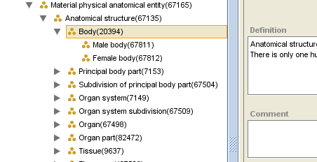
Concept “Body” (FMA)

Slide 61
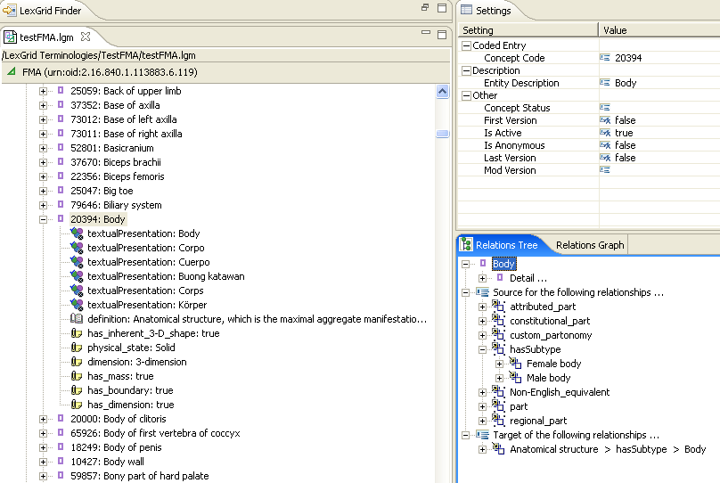
Concept “Body” (LexGrid)

Slide 62
Concept “Body” (LexGrid)
BASICS
CONCEPTS
RELATIONS

Slide 63
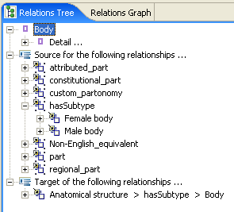
Concept “Body” (LexGrid)

Slide 64
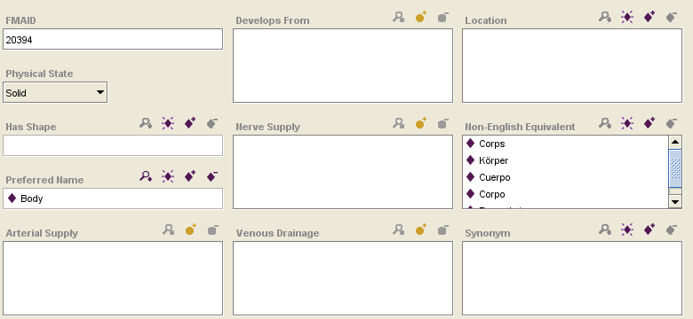
“Body” (FMA) - Attributes

Slide 65
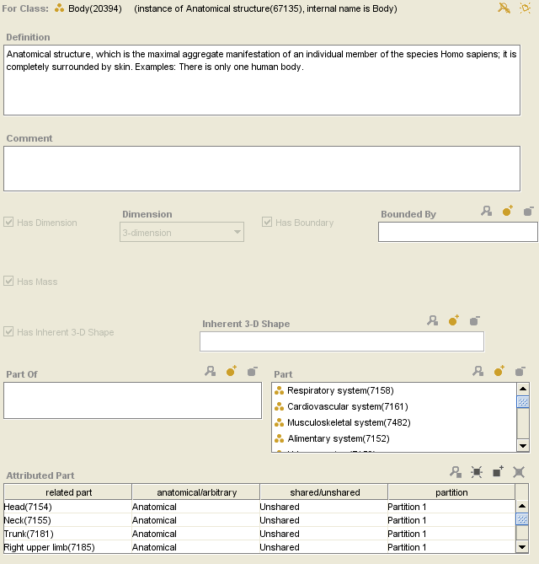
“Body” (FMA) - Attributes

Slide 66
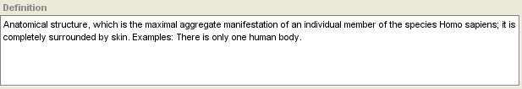
“Body” (FMA) - Attributes

Slide 67
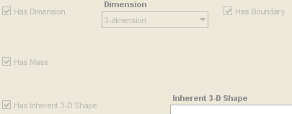
“Body” (FMA) - Attributes

Slide 68
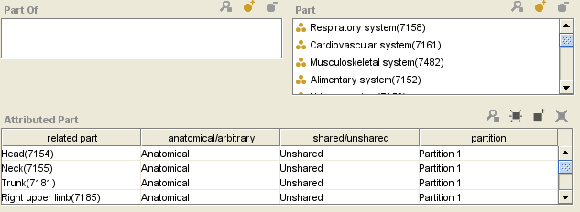
“Body” (FMA) - Attributes

Slide 69
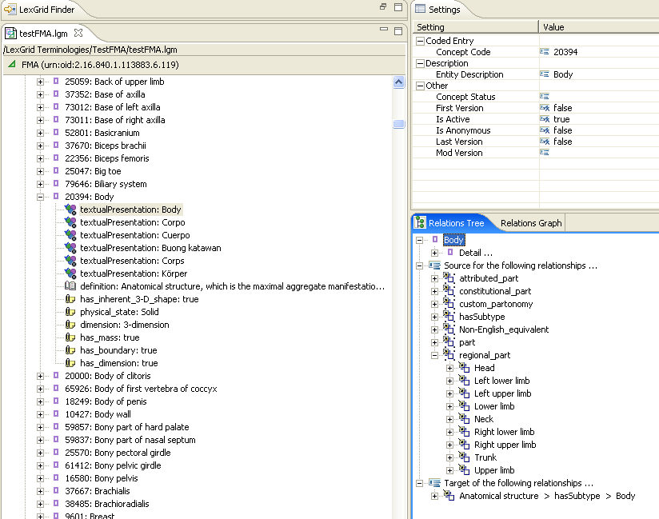
“Body” (LexGrid) - Attributes

Slide 70
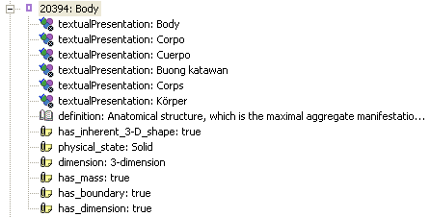
“Body” (LexGrid) - Attributes

Slide 71
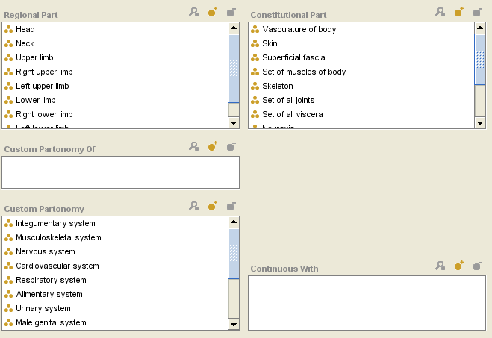
“Body” (FMA) - Relations

Slide 72
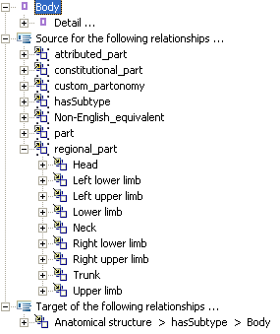
“Body” (LexGrid) - Relations

Slide 73
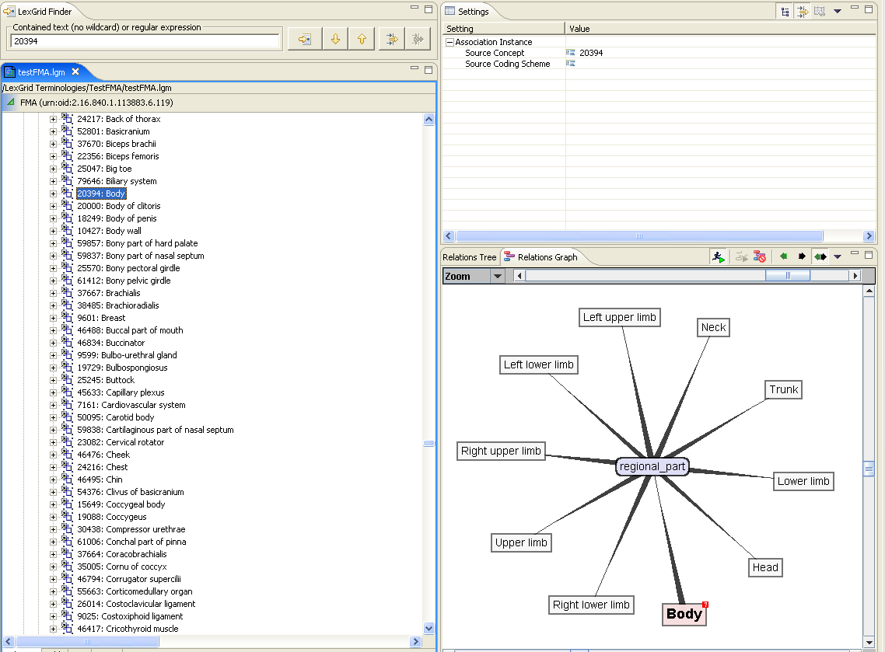
“Body” (LexGrid) - Relations

Slide 74
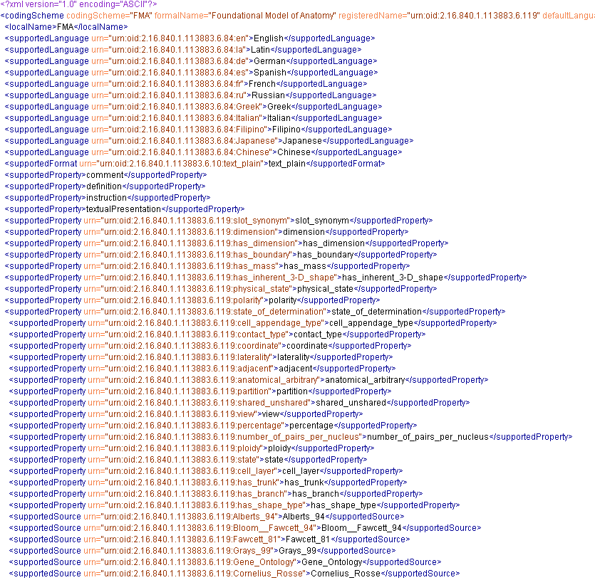
FMA (LexGrid XML Snapshot)

Slide 75
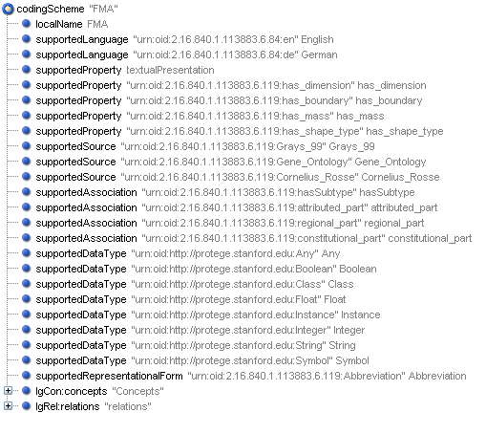
FMA (LexGrid XML Snapshot)

Slide 76
Current Status
Transformation tool is a Java application
Possible to make a Protégé plug-in
Need to Isolate “Mapping to LexGrid Model” from EMF implementation

Slide 77
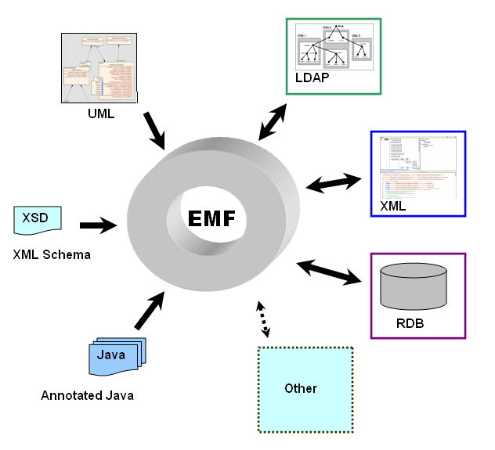
Current Status
EMF as a Hub
Available at
http://informatics.mayo.edu

Slide 78
Conclusion
Easily used EMF to work with user model and generate code
Successfully
  Converted FMA content to LexGrid Model
  Used EMF to create LexGrid XML output document
EMF as a hub

Slide 79
Thanks!
Harold Solbrig
Thomas Johnson
Dr. Christopher Chute

Slide 80
Thanks!
Protégé Conference Organizers

Slide 81
Questions ?
http://informatics.mayo.edu
        Deepak Sharma
        Division of Biomedical Informatics
        Mayo Clinic
        sharma.deepak2@mayo.edu

