Slide 2
The Heart of the Lexical Grid
The LexGrid Model - a formal model of terminology that:
  Explicitly names and defines the entities and objects used in the LexGrid tooling
  Supports “non-semantic” entities (from the toolkit perspective) as name/value pairs

Slide 3
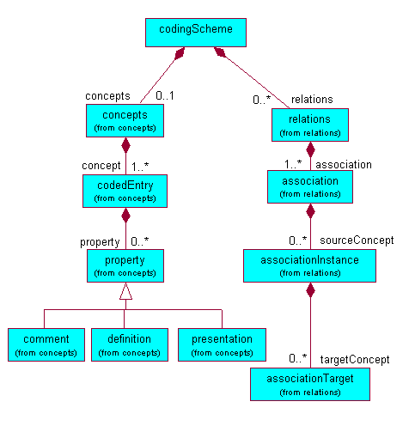
LexGrid Information Model
(partial)

Slide 4
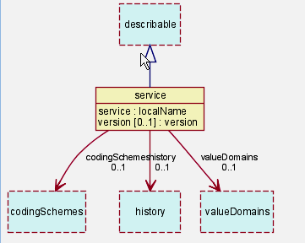
The LexGrid Model
Top Level

Slide 5
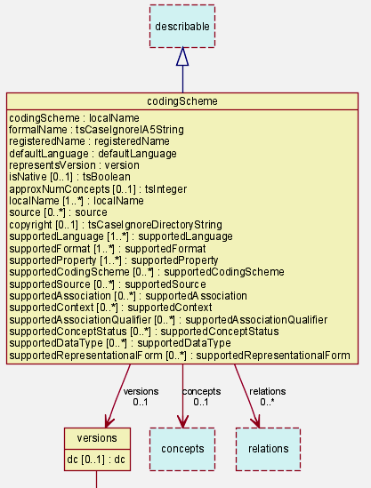
The LexGrid Model
Coding Scheme node

Slide 6
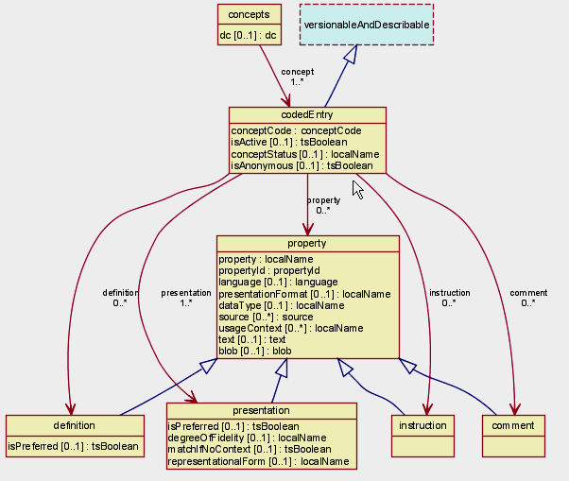
The LexGrid Model
CodedEntry node

Slide 7
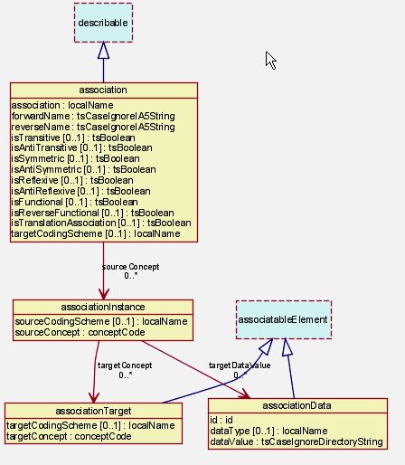
The LexGrid Model
Association Node

Slide 8
The LexGrid Model
Also includes model components:
  Revisions and Versions
  Value domains and pick lists
  URI -> local namespace maps

Slide 9
The LexGrid Model
Source is maintained in XML Schema
(Semi) automatic transformations available to
  Unified Modeling Language (UML)
  XML Model Interchange (XMI)
  Eclipse Modeling Framework (EMF)
  Java
  LDAP Schema

Slide 10
The LexGrid Model
Model also available in two flavors of SQL
  Complete SQL model
  SQL ‘Lite’

Slide 11
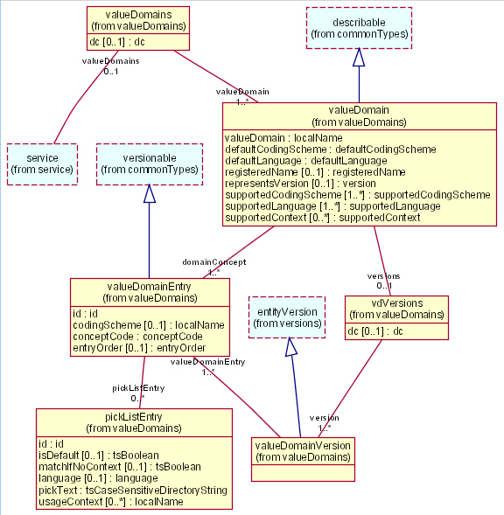
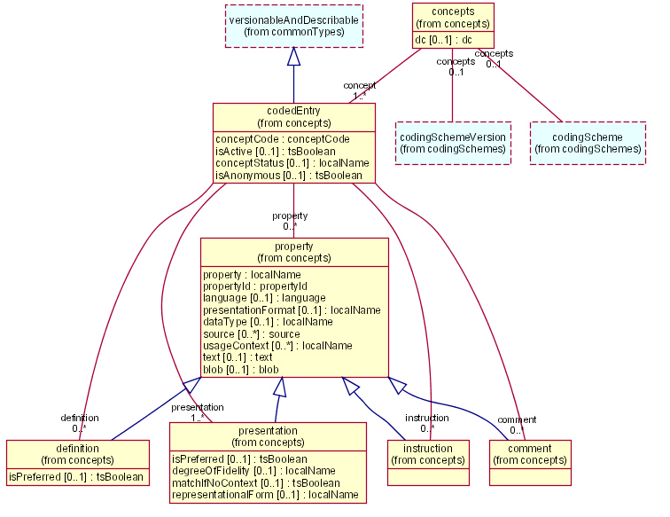
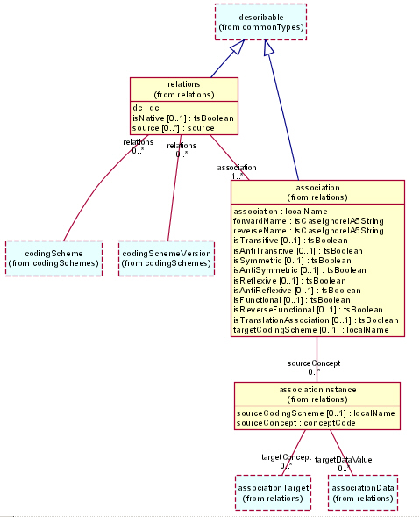
The LexGrid Node
A LexGrid Node is software and a backing data store that represents terminological information in a format semantically faithful to the LexGrid Model
LexGrid
Node
DataStore

