Slide 1
NCIA
Build and Deployment Automation
May 2008

Slide 2
Build and Deployment Process
DEV Writes Code
QA Tests Code
Systems Promotes Tested Code
Systems/QA/Dev Verify STAGE/PROD
All Build Code
  Build every time from source
  Ability to build from a Subversion tag

Slide 3
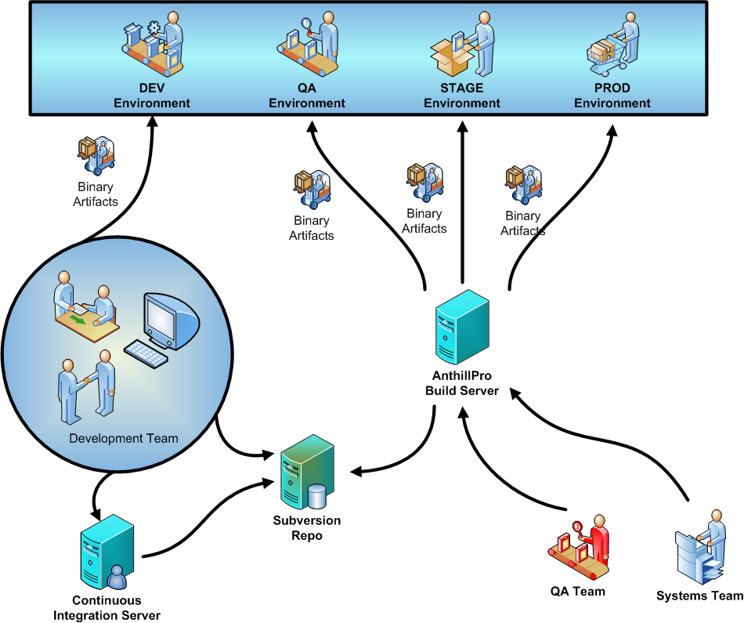

Slide 4
Build and Deployment Contexts
Local Install (Developer Workstation/CI)
Local Upgrade (Developer Workstation/CI)
Remote Install (NCI/AnthillPro)
Remote Upgrade (NCI/AnthillPro)
Installer Install (…sounds off) (Cancer Centers)
Installer Upgrade (Cancer Centers)

Slide 5
Tutorials
Local Install
Remote Upgrade (DEV)
Installer Install (..still off)
SVN/TortoiseSVN Quick Intro
Build from a tag

