Slide 1
Silver Level Compatibility
Robert Freimuth (VCDE) and Tahsin Kurc (Arch)

Slide 2
Acknowledgements
Guides to Mentors
  Robert Freimuth (XIP VCDE Mentor)
  Lewis Frey
  Tahsin Kurc (XIP Arch Mentor)
  Patrick McConnell
  Salvatore Mungal
Architecture Workspace
  Workspace participants
  Avinash Shanbhag
  Arumani Manisundaram
  Michael Keller
VCDE Workspace
  Workspace participants
  George Komatsoulis
  Brian Davis
  Michael Keller

Slide 3
Interoperability
The ability of a system to access and use
the parts of another system
Syntactic
Interoperability
Semantic
Interoperability
Notes:
Interoperability is a relatively new concept, centered on the idea that one system can use parts of another.
If you focus on computer interoperability, the IEEE definition includes two concepts.
Functional interoperability – the ability to exchange information – and semantic interoperability – the ability to use the information that has been exchanged.
As an aside, standards are frequently thought of as focusing primarily on functional interoperability, whereas the critical sine qua non for health care is semantic interoperability - if you don’t know exactly what the information you received means, having received it is useless, or worse, maybe even dangerous!

Slide 4
caBIG Compatibility Guidelines
Four Areas of Interoperability
Information Models
  Object-oriented model of the system
  Details associations and relationships between objects
  Human- and machine-readable representations
Common Data Elements
  Metadata descriptions that define and describe data
  Tagged with concepts from accepted vocabularies
  Data from different models can be joined if the same CDEs are used
Vocabularies and Ontologies
  Contain agreed-upon concepts, terms, and definitions
  Used to define metadata (e.g., CDEs) and data (e.g., Permissible Values)
Programming and Messaging Interfaces
  Allow systems to access resources from other systems
  Syntax of interfaces are defined by agreed-upon standards
Notes:
The four areas of the caBIG compatibility guidelines:
Information Models - Individual types of data are rarely collected or presented in isolation. Rather, they are assembled into a contextual environment that includes closely and more distantly associated data and information. These associations and relationships can be presented in the form of an information model. These models convey both a human and a machine readable representation of the contextual environment of data in an information resource, and are important for achieving the highest degree semantic interoperability.
CDEs - Data that is collected on a given study or trial must be defined and described such that remote users of that data can understand what it means. These metadata descriptions are referred to as data elements. When many groups use the same [common] data elements (CDEs), then larger-scale studies can be conceived, since consistency and comparability of across sites, studies, and time becomes possible. CDEs are therefore critical constructs for semantic interoperability.
Vocabularies and Ontologies - Biomedical information includes a substantial body of specialized concepts that are represented by terms. Agreement upon the basic concepts, terms and definitions that are inherent in all biomedical information is essential for achieving semantic interoperability. Terminology development systems that use description logic are helpful tools for managing these concepts.
Programming and Messaging Interfaces - Computer programs and the people who write them are able to access resources from other programs through programming and messaging interfaces. Each of these interfaces responds to a particular syntax for its communications. Agreement upon standards for these interfaces is necessary to overcome barriers to syntactic interoperability.

Slide 5
VCDE
Vocabularies and Ontologies
Vocabularies and Ontologies
  Contain agreed-upon concepts, terms, and definitions
  Used to define metadata (e.g., CDEs) and data (e.g., Permissible Values)
  Agreement upon the basic concepts, terms and definitions that are inherent in all biomedical information is essential for achieving semantic interoperability.
Main Points
  Controlled Terminology used where appropriate
  Standard Vocabularies used where appropriate
  Followed vocabulary best practices
    Ensure vocabularies follow VCDE guidelines
    Determine if additional controlled vocabularies are appropriate
CDEs
APIs
Vocabularies
Information Models

Slide 6
VCDE
Information Model
Information Models
  Object-oriented model of the system
  Details associations and relationships between objects
Main Points
  Classes sufficiently distinct for appropriate semantic annotation
  Semantic annotation conforms to described data
  Follow UML modeling best practices
    Naming conventions, etc
CDEs
APIs
Vocabularies
Information Models

Slide 7
VCDE
Common Data Elements
Common Data Elements
  Metadata descriptions that define and describe data
  Tagged with concepts from accepted vocabularies
  Data from different models can be joined if the same CDEs are used
Main Points
  All attributes correctly annotated and loaded into the caDSR as CDEs
  Ensure the semantics of the CDEs are sufficient
  Curated value domains where appropriate
  Standard Data Elements used where appropriate
    CDE reuse and non-reuse
  Followed ISO11179 best practices
CDEs
APIs
Vocabularies
Information Models

Slide 8
VCDE Review
CDEs and Information Models
Review Semantic Consistency
  Verify that the UML descriptions and the CDE annotations are consistent
  Suggest improvements to the semantic annotations if necessary
  Ensure the semantics are consistent with the UML object model
CDEs
APIs
Vocabularies
Information Models

Slide 9
Recap of Main Points - VCDE
Vocabularies and Ontologies
  Controlled vocabularies (enumerated value domains) and approved terminologies are used where appropriate
Information Models
  UML modeling best practices are followed
  UML model elements are sufficiently distinct for semantic annotation
Common Data Elements
  UML model is accurately loaded into the caDSR
  CDEs (including VDs) are appropriately curated
  Semantics (assigned concepts) are accurate and sufficient
  CDEs are reused where possible (standard or non-standard)
Semantic Consistency
  UML descriptions and CDE annotations are consistent
  Semantics are consistent with the UML object model

Slide 10
Architecture
Programming and Messaging Interfaces
Programming and Messaging Interfaces
  The means for third parties (developers, users) to access the functionality of the system
  A system should provide public APIs so that its functionality can be accessed from within client programs
Well-defined and object-oriented
  A Silver Level compatible Interface must return objects described by a Domain Object model that is semantically annotated and registered in the caDSR (metadata repository).
Main Points
  API exists
  API is well-described and documented
  API parameters are objects defined by CDEs
CDEs
APIs
Vocabularies
Information Models

Slide 11

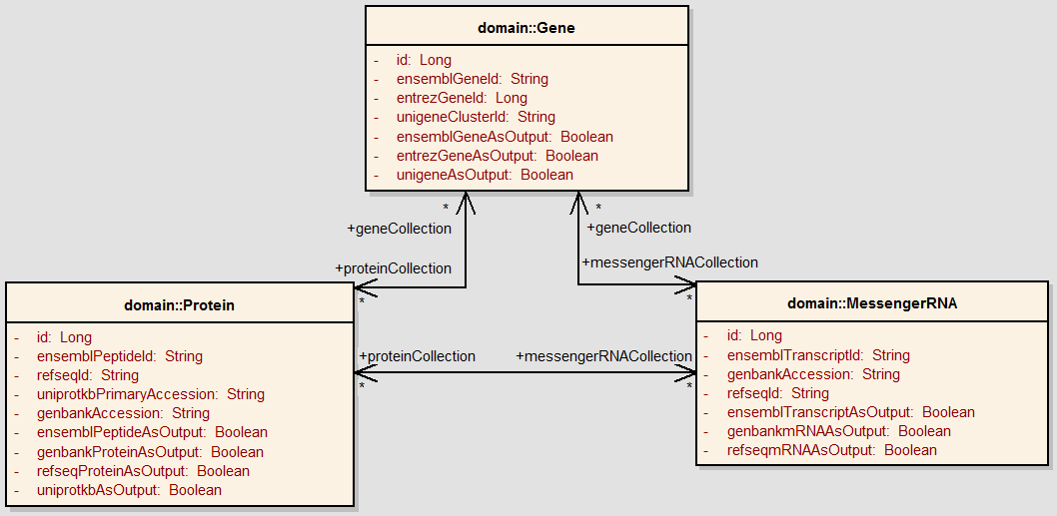

Architecture
Messaging
Interfaces/
API
Interface
Common
Data
Elements
Info Model
Vocabularies

Slide 12
Types of Interfaces
Client APIs
  Exposed directly to users through a programming language
Messaging
  Expose a standard messaging protocol
  Open to any client – language agnostic
  Preferred approach is to wrap messaging into a client API
  Electronic format for message payloads should be well-defined

Slide 13
Types of systems
Data service (Data oriented system)
  Exposes a published Information Model
  Provides query method
  Query any class, attribute, or association in the model
  Query is an object
  Associations of objects returned should be “traversable” (from the returned objects or via further queries)
Analytical services
  Algorithmic manipulation of input
  All needed associations of the input/output objects should be materialized and no query needed

Slide 14
Types of systems
Analytical tools
  Consume data registered in the caDSR via silver API or data source (e.g. file)
  Don’t need to produce data
Hybrid services
  Have characteristics of both data and analytical services
Command-line programs
  Should be wrapped into a client API

Slide 15
What does this mean for XIP
XIP as a hybrid system?
XIP has three types of actors
  Application developer using XIP to develop client workstation applications
  Library/module developer providing reusable modules in XIP that can be used to build applications
  Resource developer implementing platforms that provide services to applications developed using XIP

Slide 16
Potential Public Interfaces
XIP Applications
  What API shall I use to access XIP functionality
  API for searching for and browsing libraries and modules available in a XIP instance?
  API for creating applications that access individual modules?
  API for creating applications implemented as a network of interacting modules (e.g., workflow)

Slide 17
Potential Public Interfaces
XIP Modules/Libraries
  APIs for individual libraries and modules
  Some common API?
    What API shall I use to expose my methods functionality as an XIP module
    What API shall I use to interact with other modules: Send/Receive data
  API for registering and managing modules and libraries in XIP?

Slide 18
Potential Public Interfaces
XIP Hosts
  APIs for various XIP hosts that can be used by XIP application developers and XIP module developers
  Common API?
    What API shall I use to expose my resource to XIP
    What API shall I use to interact with XIP environment so that I can manage my resource efficiently
  API for registering and managing hosts/resources in XIP?

Slide 19
Recap of Main Points - Architecture
API should be documented
API should represent an object-oriented view to the user
API should operate on registered objects
API for data oriented parts
  Expose an information model
  Provide a query method and query objects
  Associations in the information model should be traversable

Slide 20
Submission Package
Artifacts for a Silver Level Compatibility Review
Required for VCDE:
UML Model – represents the domain model; best practices
Annotated XMI file – used to verify semantic consistency between the UML and CDE definitions; must have clean SIW error log
UML Loader Checklist - for registration in caDSR: gives information about the model and constituent packages
Value Domain Report – data types and permissible values
Vocabulary Report – lists the controlled vocabularies used
Standard CDE Report – lists the standard CDEs used and reasons for why other standards CDEs could not be used
CDE Report – export of all CDEs loaded into the caDSR

Slide 21
Submission Package
Artifacts for a Silver Level Compatibility Review
Required for Architecture:
UML Model – class diagrams for the API
API Documentation – documents methods, parameters, messaging interfaces, etc (e.g. JavaDocs)
Test Scripts - establishes existence of API, tests APIs and objects
Test Log – from API test scripts, establishes existence

Slide 22
Submission Package
Artifacts for a Silver Level Compatibility Review
Artifacts Required for Background and Context:
Presentations to the VCDE and Architecture Workspaces – brief description of the model, system, and design
Use Case Document – provides context and background
Requirements/Specification Document – provides context and background, assists classification of the system
Design Document – provides context and background, assists classification of the system
Test Approach Document – assists classification of the system

Slide 23
Summary
Silver level compatibility to ensure applications meet the caBIG requirements for interoperability
  Semantic (VCDE)
    Information Models
    Common Data Elements
    Vocabularies and Ontologies
  Syntactic (Architecture)
    Programming and Messaging Interfaces
Resources exist to help developers achieve compatibility
  caCORE SDK
  caDSR Tooling (SIW, CDE Browser, UML Model Browser)
  Architecture and VCDE Workspace Mentors

Slide 24
Resources
Compatibility Guidelines, Revision 2
  https://cabig.nci.nih.gov/guidelines_documentation
Arch-VCDE Compatibility Reviews
  http://gforge.nci.nih.gov/projects/compat-rev/
Silver Level Criteria Small Group
  http://gforge.nci.nih.gov/projects/silver-criteria/
CDE Standards
  http://gforge.nci.nih.gov/projects/cdestandards/
Architecture Mentors
  https://gforge.nci.nih.gov/projects/arch-mentors/
VCDE Mentors
  http://gforge.nci.nih.gov/projects/vcde-mentors/

