Slide 1
What is NCIA?
National Cancer Imaging Archive
Searchable repository of in vivo cancer images in DICOM format
Publicly available at no cost over the Internet
Open source (Java J2EE based)
In addition to images, NCIA contains:
  Non-image files (PDF, image markup)
  Annotation data provided by a curator
Notes:
Developed by National Cancer Institute Center for Bioinformatics (NCICB) and the Cancer Imaging Program (CIP)
Compatible with Cancer Biomedical Informatics Grid (caBIG)
Examples of non-image files are PDFs (radiologist reports, pathology reports, optical videos), and image markup
ADD IMAGE,

Slide 2
Goals of NCIA
Provide a resource for sharing image sets and related information
Enable collaboration during clinical trials involving imaging
Support research and development of imaging biomarkers
Create an environment for distributed image reads
Education
Support Computer Aided Detection (CAD) algorithm testing and development
Facilitate partnerships among organizations (Cooperative Groups)
Standardization and Interoperability
Notes:
Break down barriers that prevent sharing of images between organizations
NCIA assists CAD developers by providing images to assist in the creation and validation of the algorithms
Partnership organizations: ACRIN, PBTC, CIP
Reduce or eliminate cost of obtaining quality image sets for educational or algorithm development purposes

Slide 3
Image Submission
Medical Imaging Resource Center (MIRC)
  MIRC Field Center and MIRC Server solution addresses two barriers to image sharing across the Internet
    DICOM protocol typically blocked at firewalls
    Removal of Protected Health Information (PHI) through a configurable de-identification process at submitting site
MIRC Field Center is installed both at NCI and at partner institutions
  Images submitted via HTTPS by MIRC Field Center
  Images sent to NCI via FTP
NCI provides Tier 1 and Tier 2 support for institutions submitting images to the NCIA instance at the NCI
  Email and Telephone support available

Slide 4
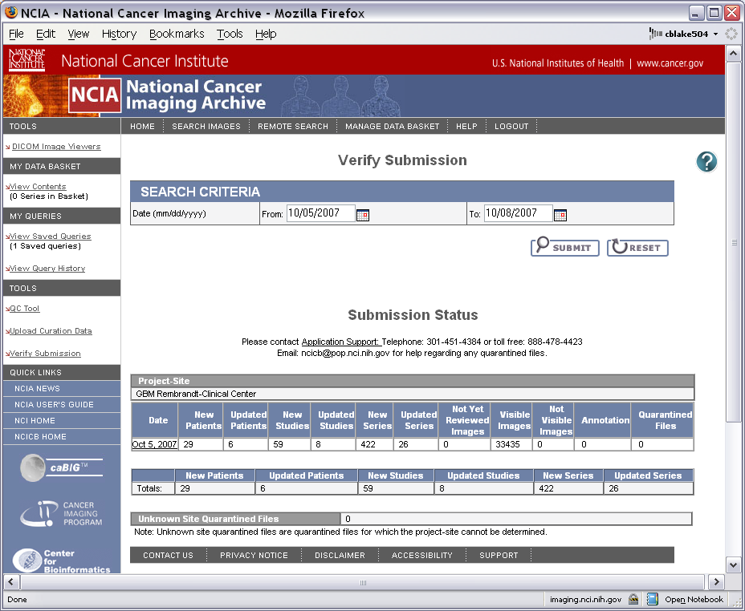
Image Submission (continued)
External organizations can verify a successful image submission to the NCIA using the Verify Submission Tool

Slide 5
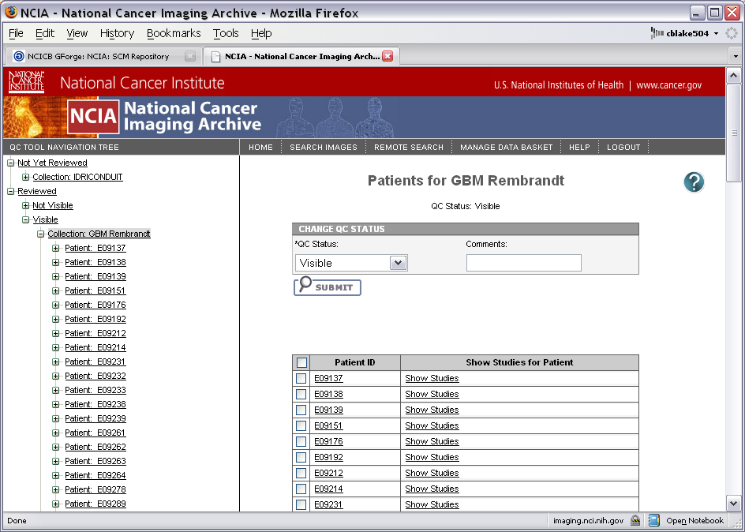
Image Submission (continued)
Images are checked for quality using the online NCIA QC Tool, available to administrative users

Slide 6
Image Repository
Archive currently contains over 2 million DICOM images plus annotation files and curation data
Data Access
  Web portal available for accessing repository
  caGrid access
  caCORE generated toolkit API
  Cedara visualization and markup
  Node-to-Node communication
Online searching for cases/images based on criteria such as Image Modality, Slice Thickness, Collection, curation data, etc.
Users can download DICOM data bundled with annotation files and curation data.
  Web portal system operates based on “shopping cart” feature
Federated searches and image downloads enabled via the implementation of the NCIA data service

Slide 7
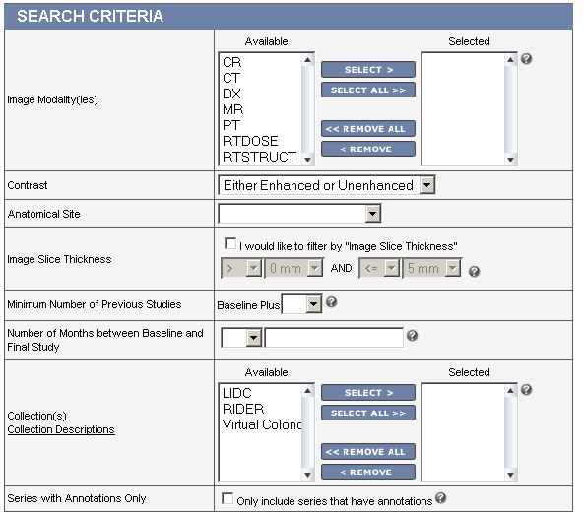
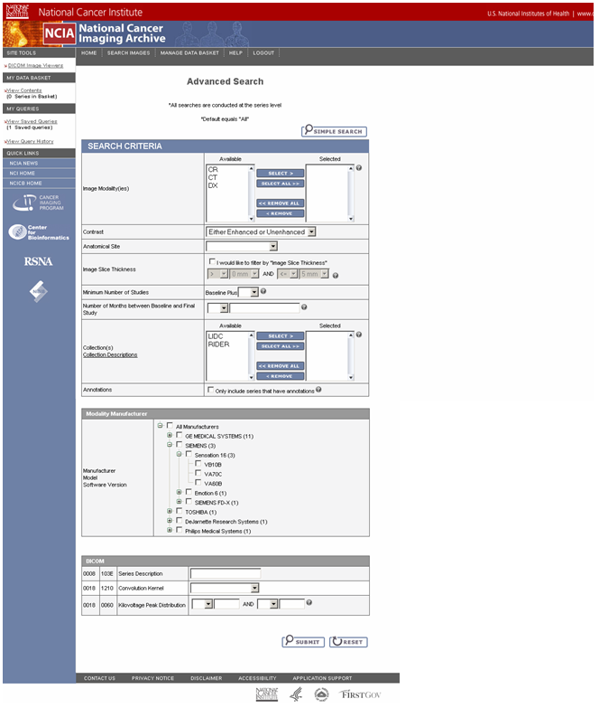
Search for Images
Search for Images
Basic Search Functionality
User can select Modality, Slice Thickness, Collections, etc.
Notes:
Search fields:
Modality
Presence of Contrast Agent
Anatomical Site
Slice Thickness
Minimum Number of Previous Studies
Number of Months between Baseline and Final Study
Collections
Presence of Annotations

Slide 8
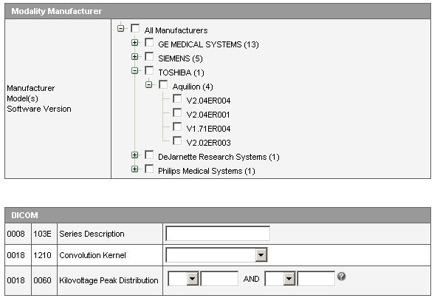
Advanced Search Options
Notes:
Search fields:
Manufacturer / Model / Software Version
Series Description
Convolution Kernel
KVP

Slide 9
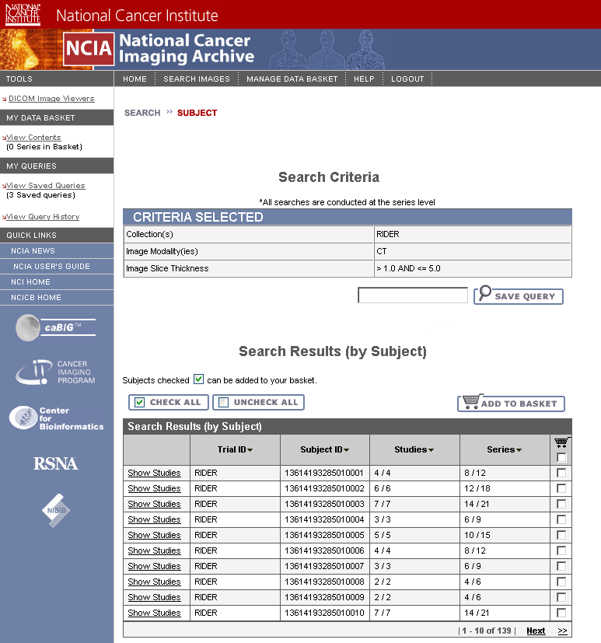
Search Results – Patient List
Search Results
Search criteria shown above
Search results shown below, organized by Subject
Notes:
Search results are initially presented as list of patients
Data is added to data basket for download

Slide 10
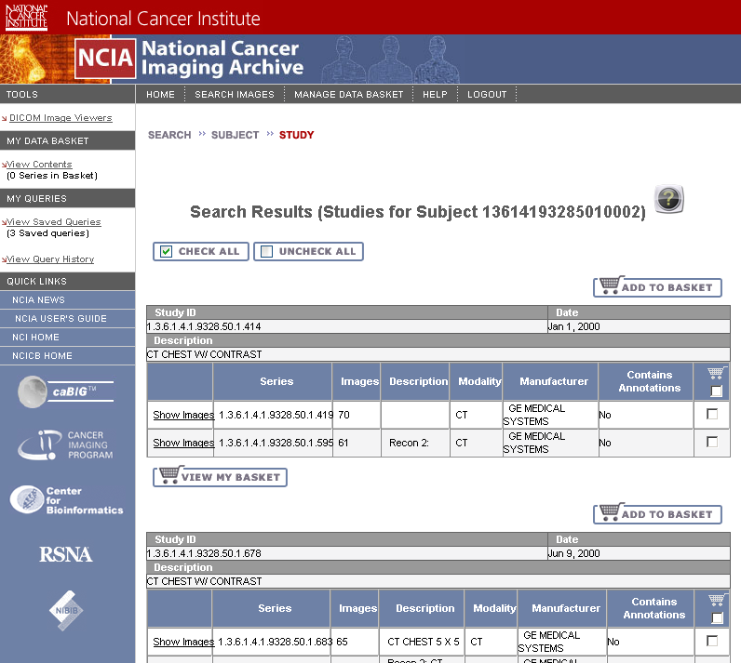
Search Results – Studies for Patient
Studies
Studies shown below, organized by de-identified Study ID
Notes:
Users can drill down to view studies for each patient

Slide 11
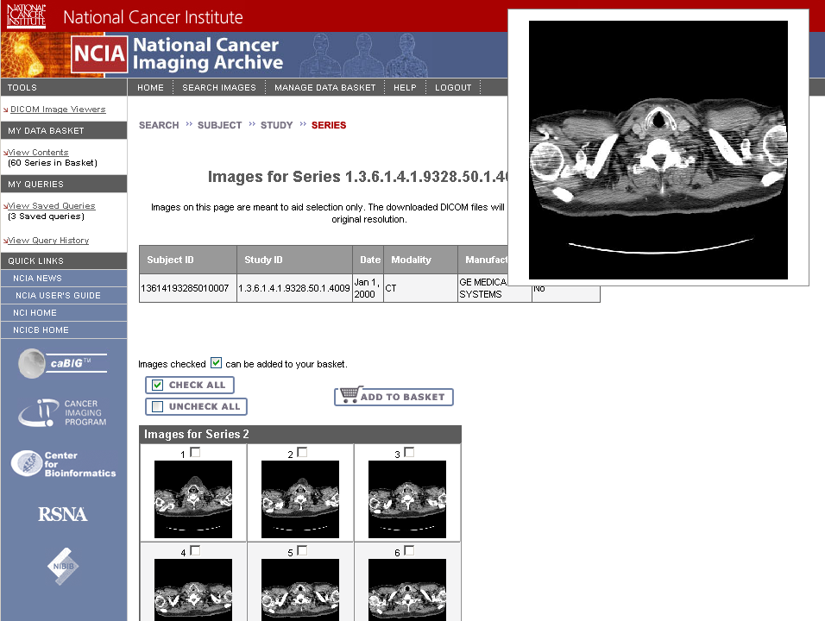
Search Results
DICOM Image Thumbnails
Image Thumbnails viewable for each series
Any individual images can be added to the data basket for download
Notes:
View image thumbnails (JPEG) for each series

Slide 12
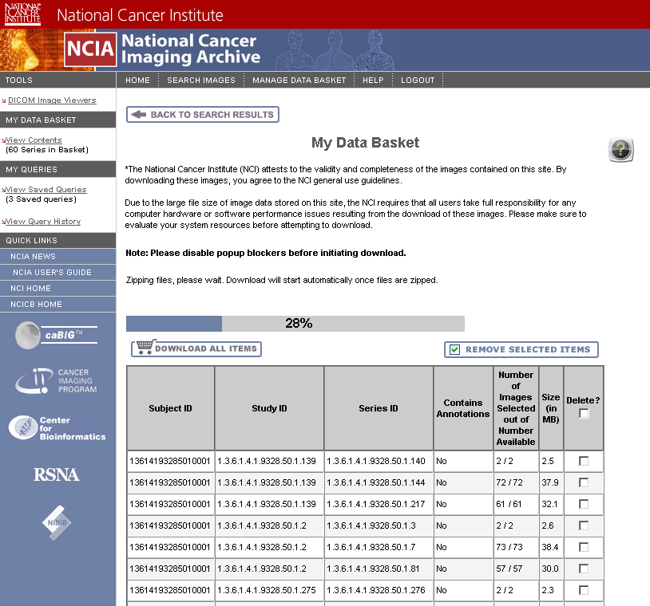
Download Images
Data Download
Downloading DICOM files in Data Basket
Notes:
Downloaded as zip file with directories for patient, study, series
Small (<3GB) result sets are downloaded in the browser while the user waits
Larger downloads (>GB) are done via FTP. User receives an email when ready

Slide 13
Image Visualization Third Party Tool
A third party tool was needed to demonstrate the following capabilities:
  Image visualization
  Image markup persistence
  Support for central reads
Stop gap solution until an XIP based application is operational
Cedara software was chosen
  Delivered a customized version of I-Response that operates in conjunction with the Cedara ISG Server.
  Communication with the I-Response and ISG is done over HTTP.
Notes:
Image markup persistence will be available in NCIA release 3.0.

Slide 14
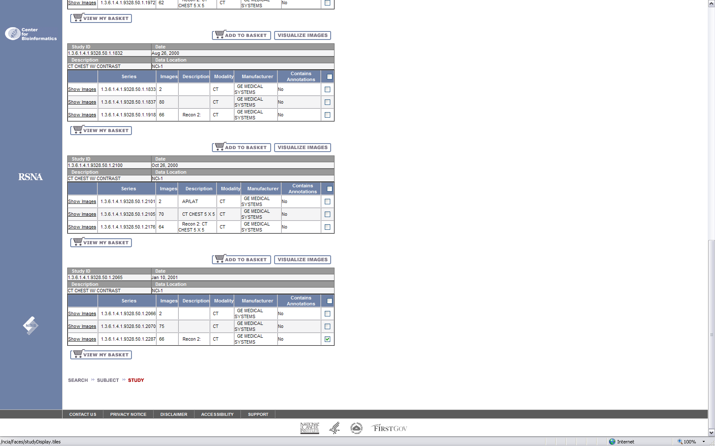
Image Visualization Controls

Slide 15
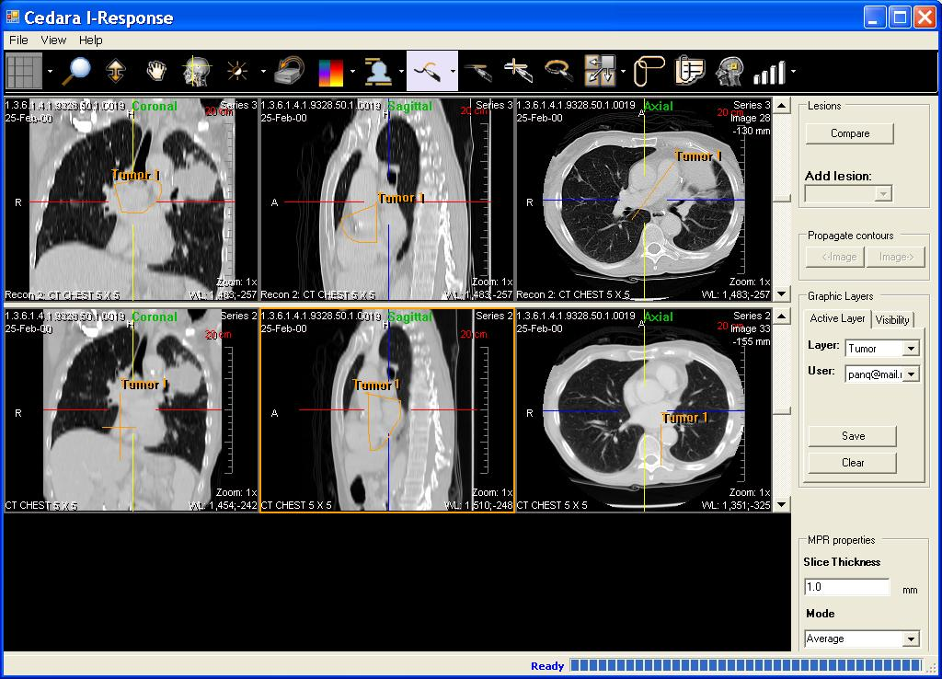
I-Response Workstation
Notes:
SPREAD OF CANCER THROUGH LYMPHATIC SYSTEM

Slide 16
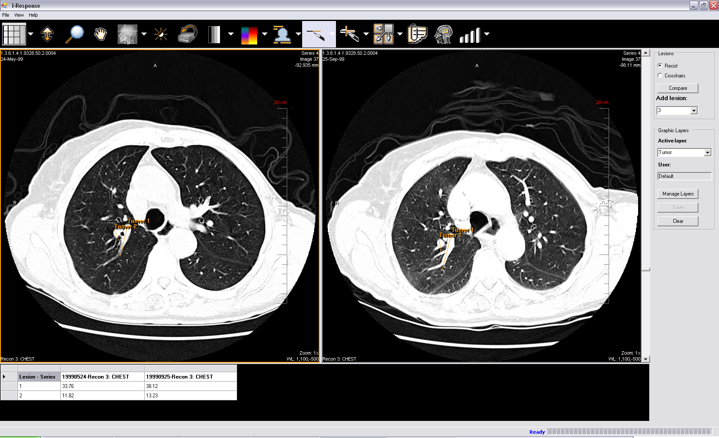
I-Response Workstation

Slide 17
Object Model

Slide 18
Object Model
Object model based on DICOM standard
Basic Hierarchy
  TrialDataProvenance – site that collected images for a collection
  Patient – Person being imaged
  Study – Grouping of one or more Series taken at one visit
  Series – Grouping of images
  Image – A digital in vivo image
  Annotation – A non-image file associated with a series

Slide 19
Object Model
Object model run through Semantic Integration Workbench (SIW) and also annotated
caBIG Silver compatibility review:
  Completed Kickoff meeting for the VCDE, Oct. 4th
  Kickoff meeting for the VCDE Architecture Workspace, Oct. 12th
Object model in Production caDSR by Oct. 19th
Project | Total DE Identified to Date | Total CDEs to date | New DE | % DE reuse | DEC Reuse | % DEC Reuse | VD Reuse | % VD Reuse
NCIA Data Model DICOM CDEs | 86 | 86 | 0 | 100% | 10 | 12% | 74 | 86%
NCIA Data Model Non-DICOM CDEs | 21 | 21 | 21 | 0% | 0 | 0% | 0 | 0%
NCIA Total CDEs | 107 | 107 | 21 | 80% | 10 | 9% | 74 | 69%
Notes:
Talk through caBIG standards.

Slide 20
Architecture

Slide 21



Image Submission and Federated Search (2.4)
Query Portal
Retrieval
Java Server Faces (JSF)
HTTPS, FTP
Verify Submission Tool
QC Tool
Online Search
MDB
(Image zipping, Curation Data Upload)
Cancer Centers /
Academia /
Industry
Processors
Query, Result set, User Registration, Lookup Manager, CSM, Export
Data
Access
Layer
NCIA Grid
Services
Data Manager
Data Manager
Generic Grid
Services
NCIA caCORE API
CSM API
Grid Client
NCIA Nodes
Hibernate
Hibernate
Hibernate
Image Submission
MIRC (Tomcat)
caGrid Clients
Cedara ISG Server
MIRC
Field
Center
* … 1
MIRC Storage Service
Database
De-ID
Firewall
Firewall
MIRC DICOM Service
DICOMHTTP
HTTPS
Cedara
I-Response client
MIRC Database Service (Adapter)
(Researchers)
Notes:
-Field Centers at Remote Clinical Sites
-BEFORE AFTER SLIDES SHOWING WHAT HAS BEEN ADDED WITH BLANKS

Slide 22
Image Submission and Federated Search (3.0)
Query Portal
Retrieval
Java Server Faces (JSF)
HTTPS, FTP
Verify Submission Tool
QC Tool
Online Search
MDB
(Image zipping,
Curation Data Upload)
Cancer Centers /
Academia /
Industry
Processors
Query, Result set, User Registration, Lookup Manager, CSM, Export
Data
Access
Layer
NCIA Grid
Services
Data Manager
Data Manager
NCIA Grid Broker
Generic Grid
Services
NCIA caCORE API
CSM API
BDT
NCIA Nodes
Grid Client
Hibernate
Hibernate
Hibernate
Grid Security
Image Submission
MIRC (Tomcat)
caGrid Clients
Cedara ISG Server
MIRC
Field
Center
* … 1
MIRC Storage Service
Database
De-ID
Firewall
Firewall
MIRC DICOM Service
DICOMHTTP
HTTPS
Cedara
I-Response client
MIRC Database Service (Adapter)
(Researchers)
Notes:
-Field Centers at Remote Clinical Sites
-BEFORE AFTER SLIDES SHOWING WHAT HAS BEEN ADDED WITH BLANKS

Slide 23
caGrid Services
What does a grid-enabled NCIA mean to you?
  Other caGrid enabled applications have the ability to pull down metadata and images from NCIA nodes using Bulk Data Transport
  Those institutions with NCIA nodes will be able to provide search and download capabilities to other applications connected to the caGrid
Sample CQL Query
  Find Patient with Patient Name = “John Doe” AND Patient ID = “12345”
<Target name="gov.nih.nci.ncia.domain.Patient">
<Group logicRelation="AND">
<Attribute name=”patientName” predicate="EQUAL_TO” value=”John Doe”/>
<Attribute name=”patientId” predicate="EQUAL_TO” value=”12345”/>
</Group>
</Target>

Slide 24
NCIA Installation
To install your own NCIA
  Download the NCIA download bundle from the NCICB Download Center, http://ncicb.nci.nih.gov/download/#NTools
  Follow the installation guide and setup instructions available on the NCIA GForge site, https://gforge.nci.nih.gov/plugins/scmcvs/cvsweb.php/ncia-docs/install%20guides/?cvsroot=ncia
  Hardware requirements are documented and are available from GForge, https://gforge.nci.nih.gov/plugins/scmcvs/cvsweb.php/ncia-docs/NCIA%20Hardware%20Requirements/?cvsroot=ncia
The NCICB will soon be offering installation and configuration assistance to those institutions installing a local grid-enabled NCIA
Image markup storage and retrieval requires server license
  A separate ISG server license is required from Cedara to operate and integrate the image markup storage and retrieval functionality.

