Slide 1
Automated Build and Deployment
NCIA Project Kickoff
March 19, 2008

Slide 2
Goals
“Build and deployment at the click of a button”
What: Speed up delivery by decreasing manual steps
  Integrate configuration into the build process rather than requiring manual intervention
How: Convert attributes (currently maintained in Word documents) into files that are machine-readable (an automated system)
Why: Enable NCIA to adapt to changes and deliver software faster with fewer deployment errors

Slide 3
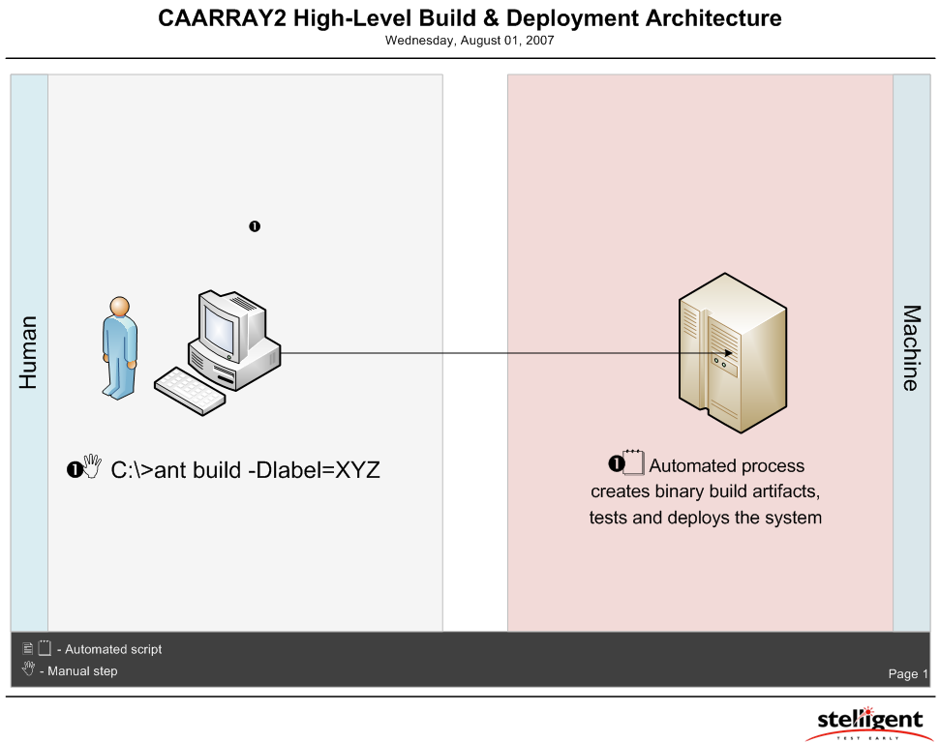
User Actions

Slide 4
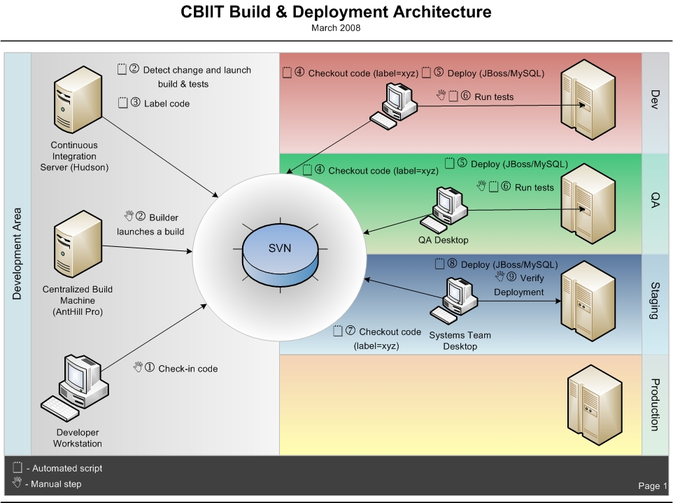
Proposed Build and Deployment Architecture

Slide 5
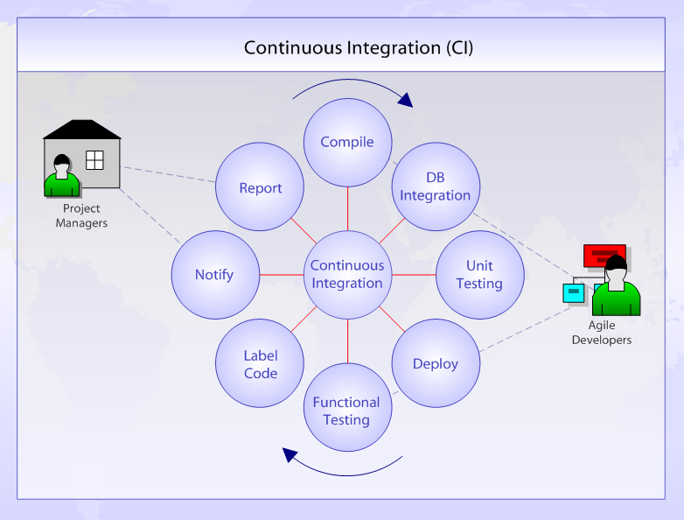
Continuous Integration

Slide 6
High-Level Build and Deployment Steps
Developer checks-in code to SVN
A machine running a continuous integration server (Hudson, etc.) detects the change and launches an integration build
Developer launches a build through a centrally managed build server (AntHill Pro, etc.) based on a tag or the latest from trunk
If the build is successful, the build server checks the EAR into SVN for later promotions and labels the code and the EAR
QA uses the same centralized build server to deploy to QA. The build process checks-out the packaged EAR file from SVN
  The deployment process deploys the EAR, configures the application servers, database servers and grid services
  The deployment process runs a suite of automated tests. The QA team performs a suite of manual tests as necessary

Slide 7
Deliverables
Analysis report of current build and deployment process
System requests converted from Word files to HTML and checked into private SCM repository
Automated build scripts and supporting property files and common build system artifacts containing compilation, packaging, database integration, test execution, code inspections (as necessary), remote deployment, installation and automated feedback checked into SVN
Continuous Integration system(s) with support for multiple projects
Build management for DEV, QA and STAGE environments established in AntHill Pro server
Build and deployment guide

Slide 8
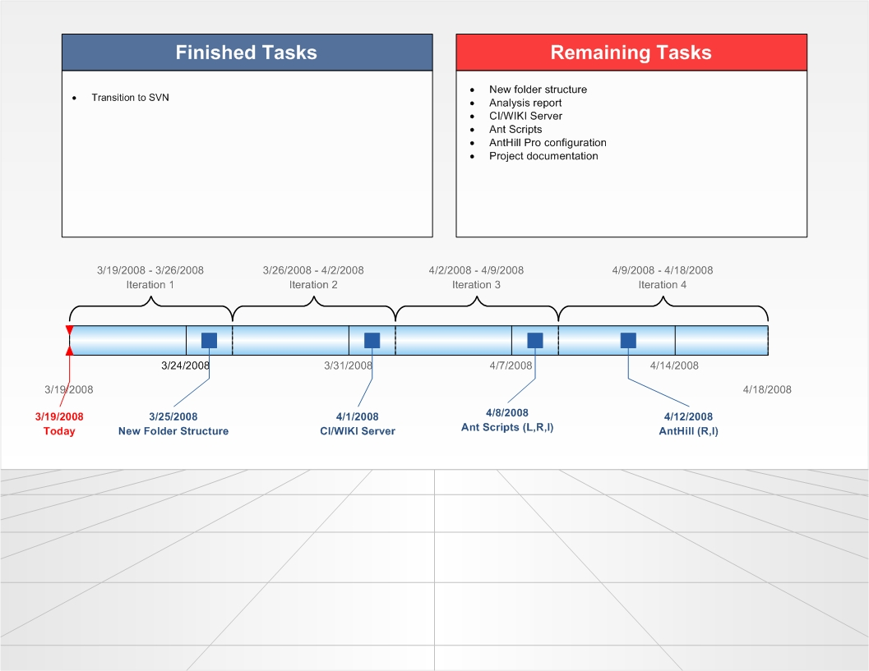
Timeline

