Slide 1
protExpress Team Meeting - 08/31/2007
Notes from Last week’s meetings
Development Activities
UI Wireframes

Slide 2
Meeting Notes
Last Team Meeting – Unresolved issues were:
  Need for a centralized contact management.
  Re-use of Protocols – How?
Meeting with Liming over the last two weeks
  Centralized Contact Management
  Re-use of Protocols
  Supported proteomics file formats
  Discussed issues surrounding user management
    LDAP
    Database Authentication

Slide 3
Meeting Notes – Contact Management
No re-use of contact information
Contacts will be private to each protocol and/or experiment
Reasons
  Contact Information is not required.
  Only limited fields (if specified) are exported to the XAR format.
  If desired, we can modify the functionality in a future release.

Slide 4
Meeting Notes – Protocol Re-use
Yes and No
Yes - to users of the system
  Protocols will exist as an independent entity.
  Users will still be able to create, edit, delete and copy protocols (subject to access rights)
  When applying a protocol (Protocol Application) to an Experiment Run (instance of an experiment), users will still select the Protocol to be applied.
No – manner in which it will be handled internally by the system
  Initial design
    When applying a protocol (Protocol Application), the Protocol Application will reference the underlying Protocol.
    Will lead to problems discussed before – Example, what happens if the owner deletes the protocol?
  New Design
    Instead of referencing the Protocol, copy over the desired information to the Protocol Application.
    Cons
      Duplication of Information – Not necessarily a problem (Name, Description, Software, Instrument..)
    Pros
      Removes lot of potential issues/problems
      A Protocol Application is a snapshot of the protocol as it exists (or existed). Thus, experiments are more self contained.
      An experiment will contain the same information over a period of time
        Exporting experiment information to XAR formatted files at different times will result in the same xar.xml file
    Protocol Search Results
      No duplicate protocols in search results.

Slide 5
Meeting Notes – Proteomic File Formats
Initially Support
  XAR xml format
  Pride XML Format
No need for a custom xml format
  Need for a custom xml format arose due to lack of a database.
CSV/Tab delimited format
  Not required.
  This is different from exporting the experiment information to a CSV file (to provide experiment overview/summary)

Slide 6
Meeting Notes – User Management
Will use CSM
LDAP and/or Database Authentication?

Slide 7
Development Activities
Dev Server URL - http://protexpress-dev.nci.nih.gov/protExpress/
Provides the basic structure in terms of look and feel
Protocols & Experiments
  Search
  List Search Results
  Add New protocol and/or experiment
  Edit
  Delete
  Basic validation incorporated for now.

Slide 8
Development Activities continued
Continuous Integration setup
  Automated build from source repository (Subversion)
  Automated unit tests run as part of the build process.
    One test fails, build fails.
  Automated deployment of webapp every night.
    Only if build is successful.

Slide 9
Development Activities continued
In the process of setting up the Bug Tracker
  https://gforge.nci.nih.gov/tracker/?atid=1316&group_id=327&func=browse
  Initially, will be used by the Dev Team to keep track of task list.
  In future, will be used for tracking task list as well as bugs/defects.
  Bugs should be entered only if found on the QA system.

Slide 10
UI Wireframes
Matt Rehfuss is the team member working on the UI.
Provided initial set of wireframes
Will be providing us the HTML files soon
  Allows Dev Team to start integrating the look and feel into the application.

Slide 11
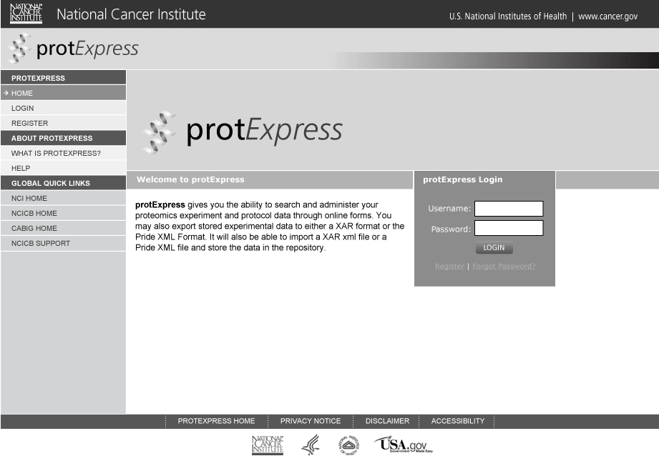
Login Page

Slide 12
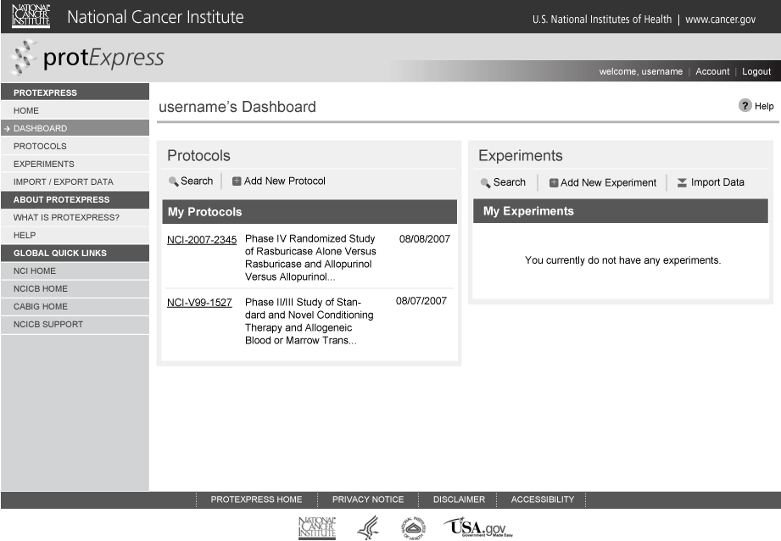
Dashboard/Welcome Page

Slide 13
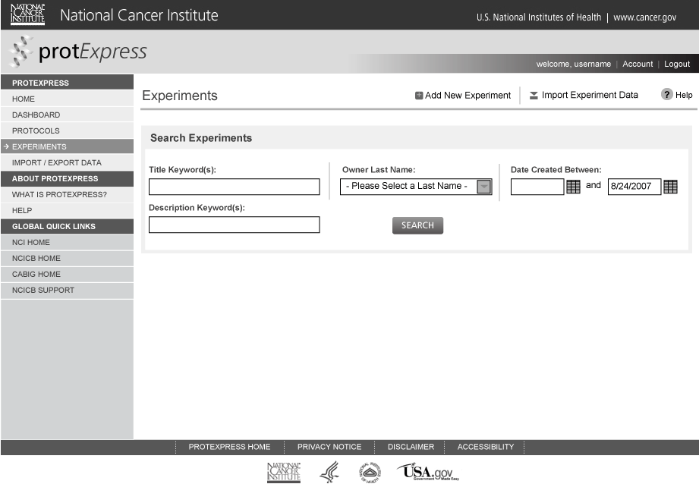
Experiment Search Page

Slide 14
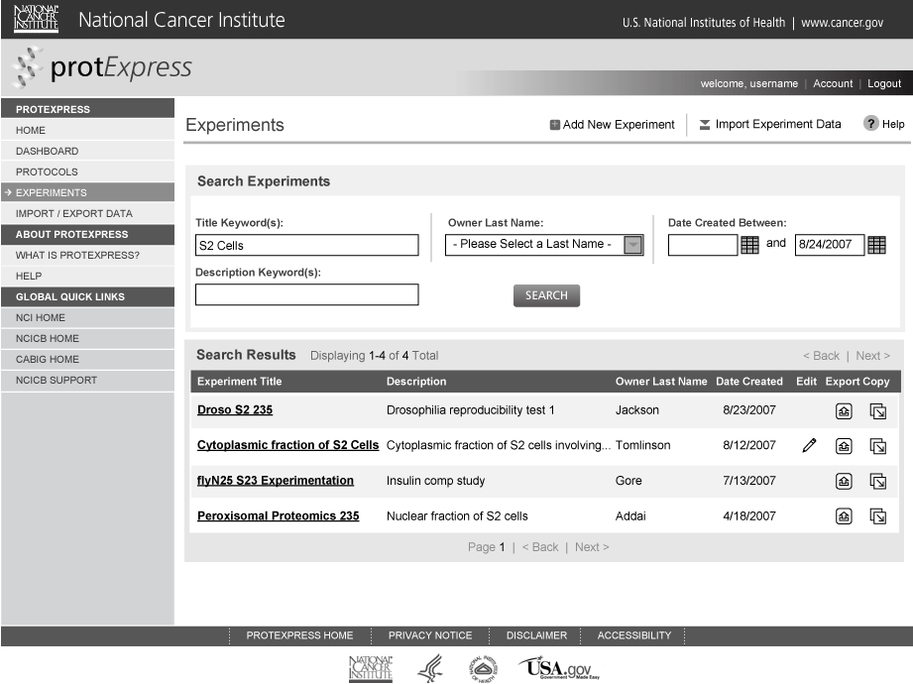
Experiment Search Results Page

Slide 15
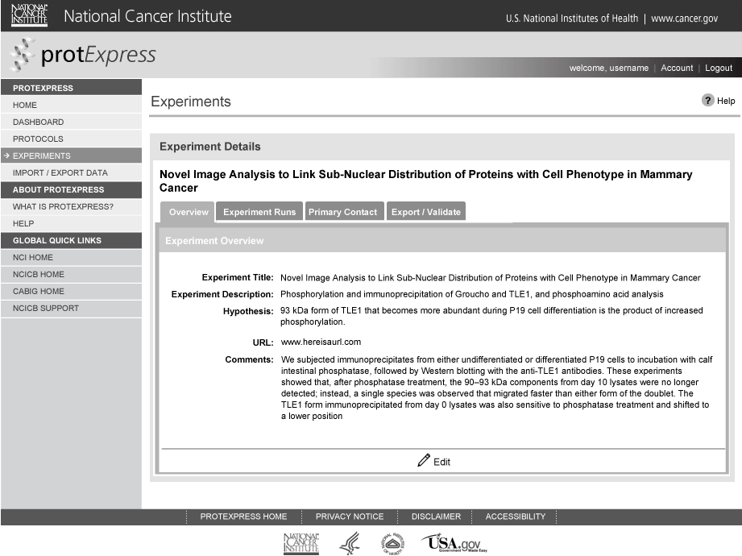
Experiment Details Page - overview

Slide 16
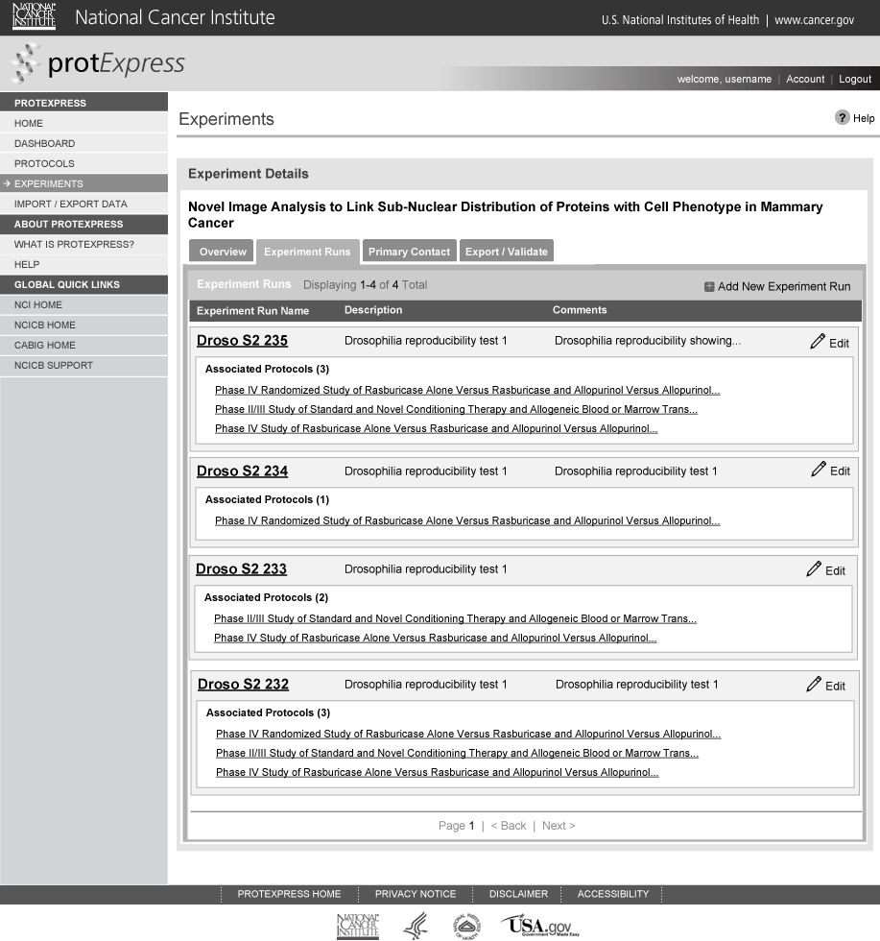
Experiment Details – experiment runs

Slide 17
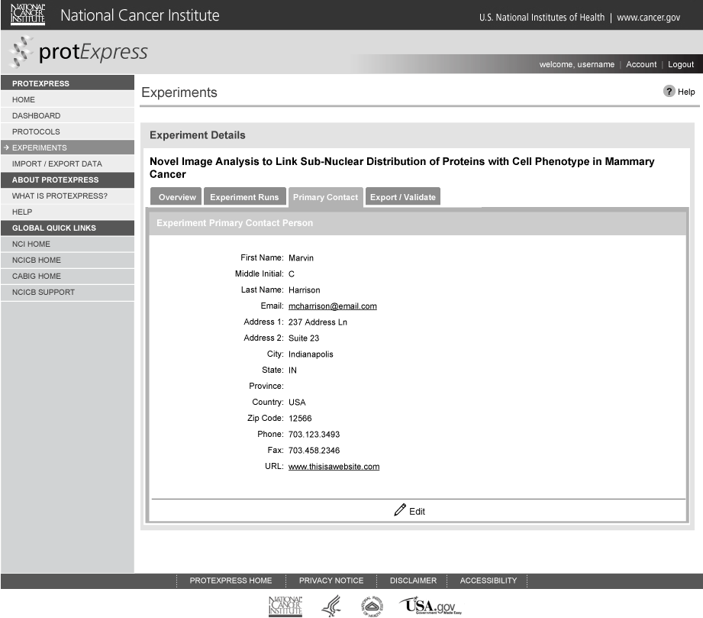
Experiment Details Page - contacts

Slide 18
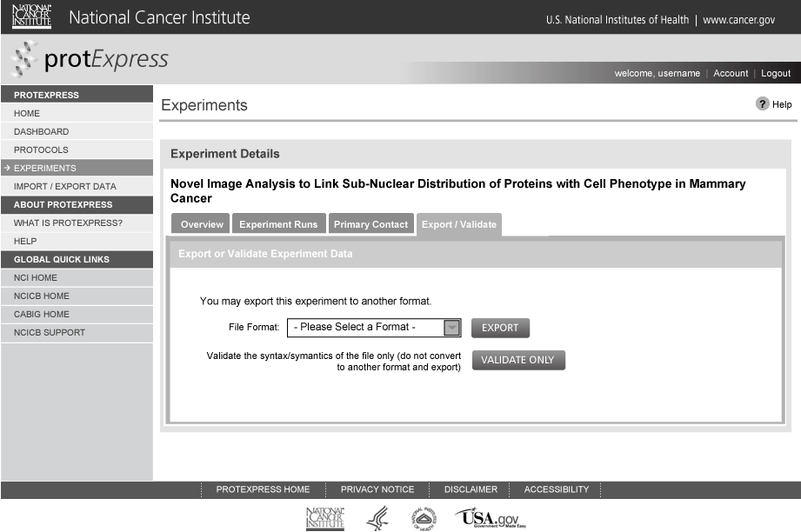
Experiment Details Page – export

