Slide 1
protExpress Team Meeting - 02/15/2008
Discuss the new User Interface
  Overview of the discussion between Liming, Matt, Xiaopeng and I.
  Walkthrough the demo available on Matt’s website
  URL: http://www.nsdev.us/5am/protexpress/home.htm
Additional updates.

Slide 2
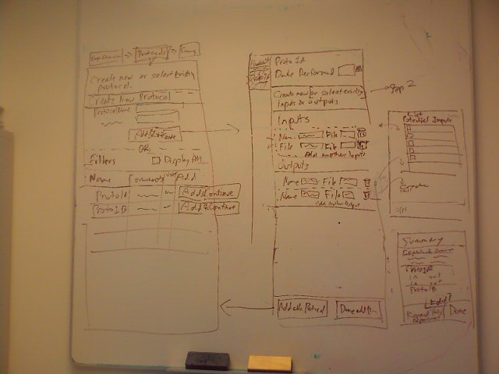
UI Discussion with Matt

Slide 3
Additional Updates
Development
  Integrating the UI from Matt into the application.
Systems
  protExpress QA/STAGE/PRODUCTION tiers to be shared with CPAS-QA, CPAS-STAGE and CPAS-PROD.
    protExpress Dev Team & CPAS-Dev Team installed protExpress on the CPAS-DEV server.
    Verified that both applications co-exist on a shared VM without any problems.

Slide 4
Additional Updates
  Request made to Systems to create DNS mappings for:
    http://protExpress-stage.nci.nih.gov – STAGE tier
    http://protExpress.nci.nih.gov – PROD tier
    QA team needs to make a similar request for QA tier.

