Slide 1
protExpress 1.0 Overview
A web-based annotation tool to input and format experiment and protocol information for proteomics research.
Carl Schaefer1, Liming Yang1, Xiaopeng Bian1 , Bill Mason2, Krishna Kanchinadam2, Scott Miller2, Matt Rehfuss2, Tom Boal3, Nonna Rabinovich3
1 The NCI Center for Biomedical Informatics and Information Technology (CBIIT), National Cancer Institute, Rockville, MD
2 5AM Solutions, Inc., Reston, VA
3 NARTech Inc., Bethesda, MD

Slide 2
Objectives
The aim of this presentation is to:
  Describe the protExpress application and its use.
  Explain how to request a protExpress user account.
  Log in and navigate through the protExpress application.
  Walk through the steps of creating a new Experiment.
  Demonstrate how to search, view and edit data.
  Identify sources of application help.

Slide 3
protExpress 1.0
Introduction to protExpress
Requesting a user account
Creating a new Experiment
  Export experiment annotation information to a supported format (currently only the XAR format is supported)
Sources of help

Slide 4
Introduction to protExpress:
What is protExpress
What is protExpress?
  protExpress is a web-based annotation tool for capturing proteomics experimental information.
  It provides a framework for describing experimental procedures and steps in an intuitive web based interface that allows the researchers to specify a series of protocols with specific inputs and outputs.
  The software exports experiment information into the XAR format used by CPAS. The architecture of protExpress allows for additional annotation formats in the future.
Technical strengths
  Simplified domain model and API
  Focus on usability
Targeted user community
  Bench scientists describing proteomics experiment information and annotation
  Users of CPAS.

Slide 5
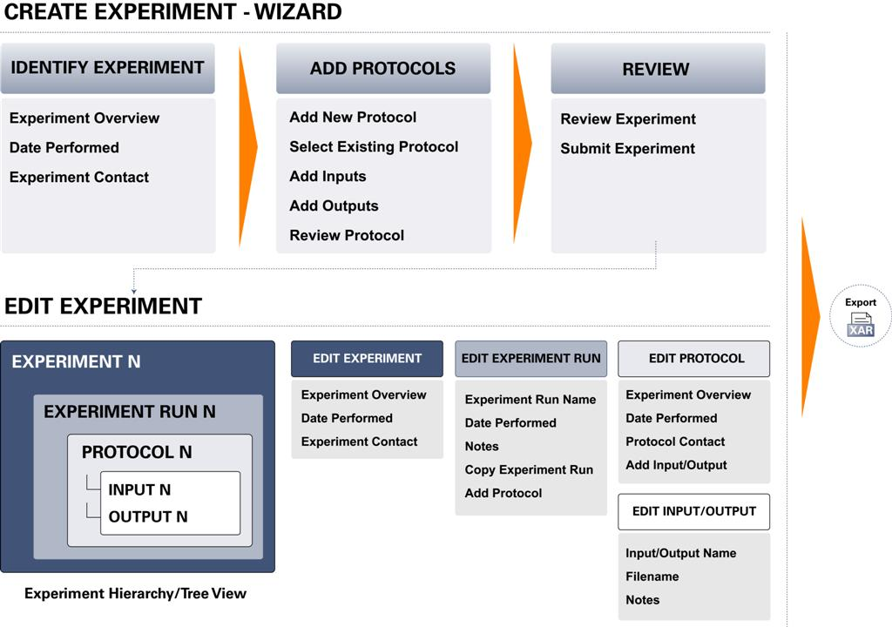
Introduction to protExpress:
Workflow

Slide 6
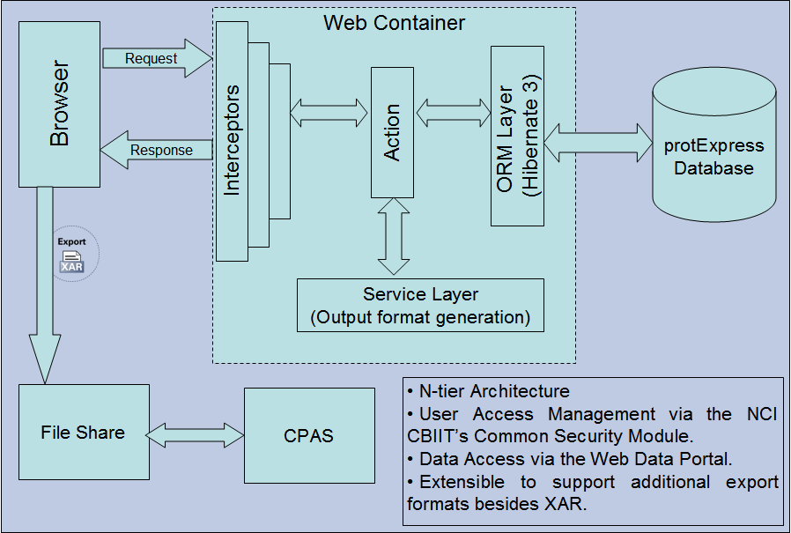
Architectural Overview

Slide 7
Introduction to protExpress:
Main Features of protExpress
Web Based User Interface:
  Submit protocol data and annotations. The protocols are reusable entities that can be applied to multiple experiments.
  Submit proteomics experimental information and annotation. An experiment consists of multiple protocols applied in a given sequence, each with its own set of inputs and outputs.
  Browse and Search through the repository for protocols and experiments of interest. The search mechanisms lead to actionable results that are clear to the end user and incorporate their specific rights for the experiments.
  Export the experiment information and annotations as a XAR formatted XML file. XAR (eXperimental ARchive) format is used in CPAS.
  You need a User Account to submit and export data.
Java API and Grid Service Interface
  Browse, Search and View the protocols and experiments in the repository.

Slide 8
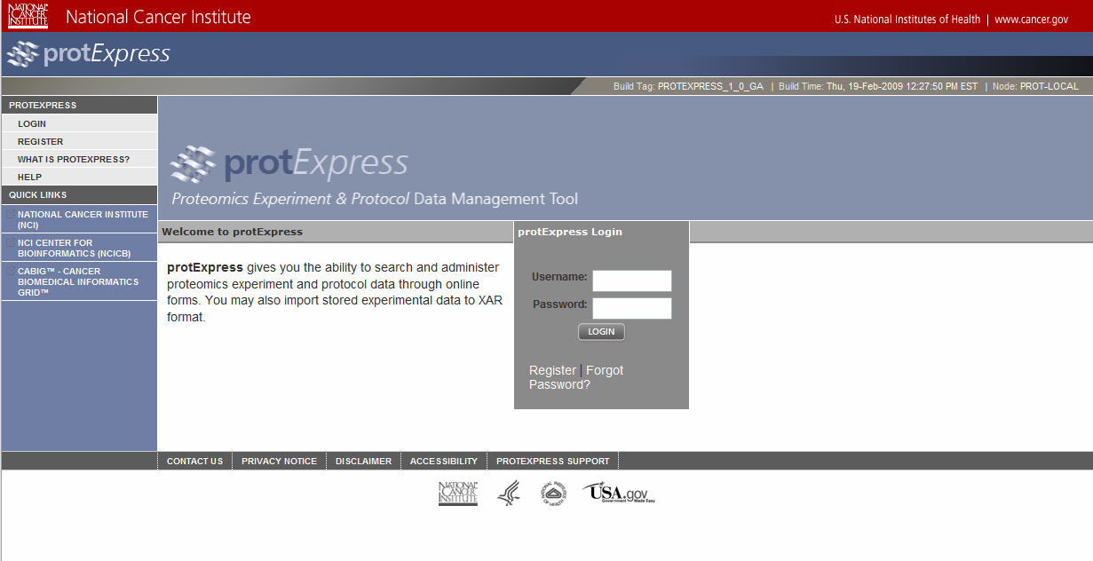
Introduction to protExpress:
Requesting a User Account
Click here to register.

Slide 9
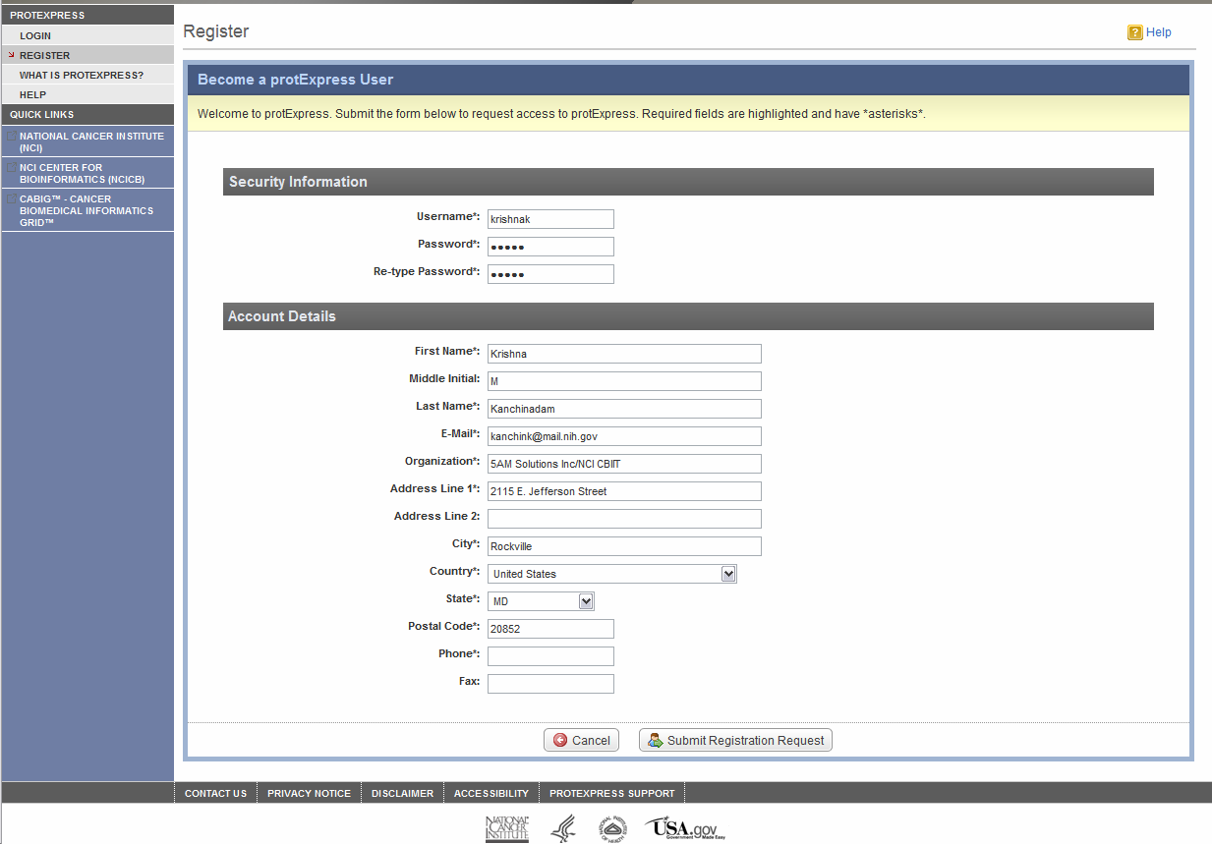
Introduction to protExpress:
Requesting a User Account
Fill in information, then submit.

Slide 10
Introduction to protExpress:
Requesting a User Account
The turnaround time for a protExpress account is typically 72 hours.
You will be assigned an NIH User ID and Password.
  If you are an existing NIH User, your account will be granted appropriate privileges to use protExpress.
The password needs to be updated/changed every three months, or as per the current NIH policy.
  You will receive a general NIH email reminding you to change your password when it gets close to expiring.
  IMPORTANT: This general purpose notification email will NOT this account as your protExpress account.
Attempting to login with an expired password?
  You will NOT be able to do so.
To Reset/Update/Change your password:
  Do it yourself at: http://password.nci.nih.gov
  Contact NCICB Application Support (ncicb@pop.nci.nih.gov) for assistance.

Slide 11
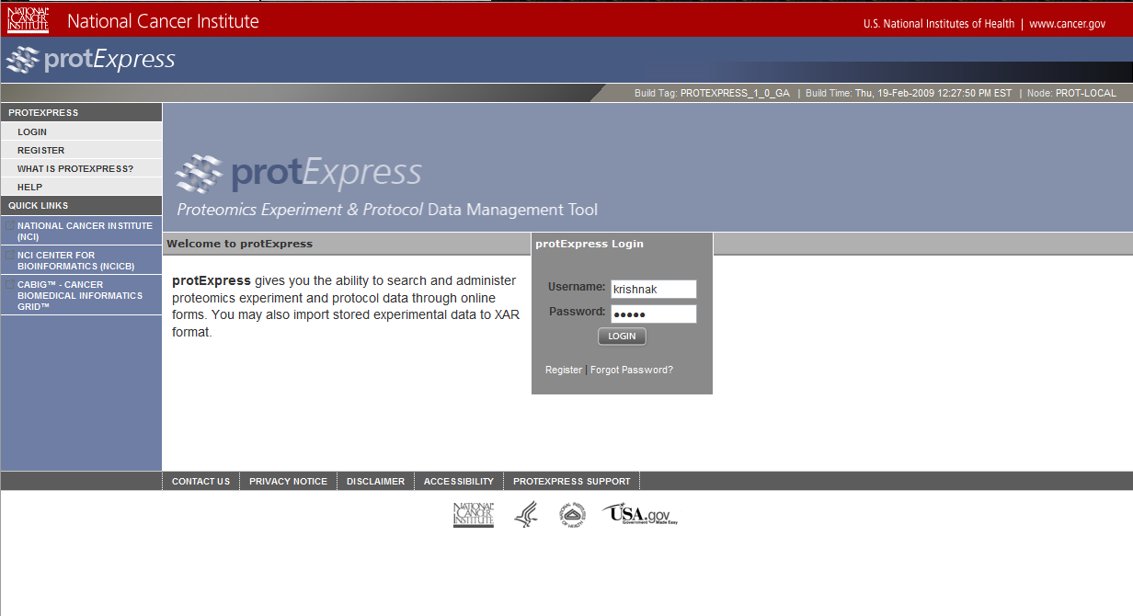
Introduction to protExpress:
Logging into protExpress
Enter your Username and Password

Slide 12
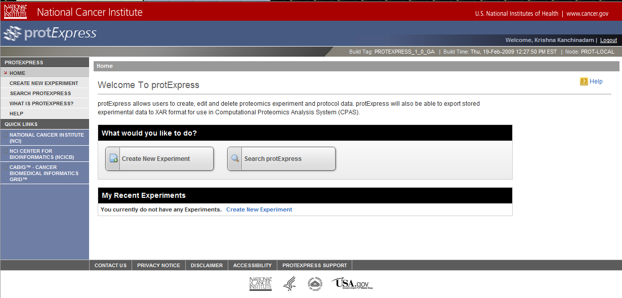
Introduction to protExpress: protExpress Homepage

Slide 13
Introduction to protExpress: protExpress Homepage
Personal Dashboard/Workspace
  Lists the 3 most recent experiments worked on.
  Options to Create a New Experiment or Search Existing Experiments and Protocols.
Left Navigation Bar
  Create New Experiment
  Search protExpress
  protExpress Overview on caBIG Tools Website
  Online Help
  Important Quick Links
Context Sensitive Help
  Available via the icon.

Slide 14
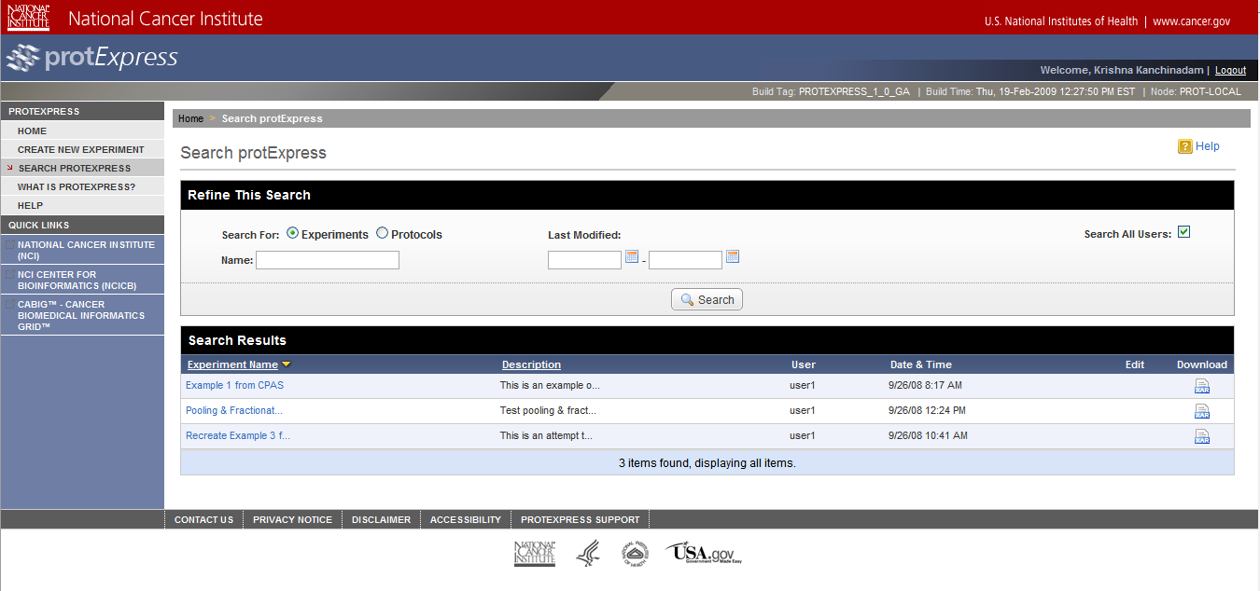
Introduction to protExpress:
Search protExpress
Defaults to Search Experiments for the currently logged in user.
Option to search Experiments or Protocols.
Ability to search for Experiments or Protocols for all users.
Ability to download experiment data as a XAR formatted xml file.
Experiment Name hyperlinked to the View Experiment Detail screen.
Option to Edit Experiment Details - Only available for experiments owned by the currently logged in user.

Slide 15
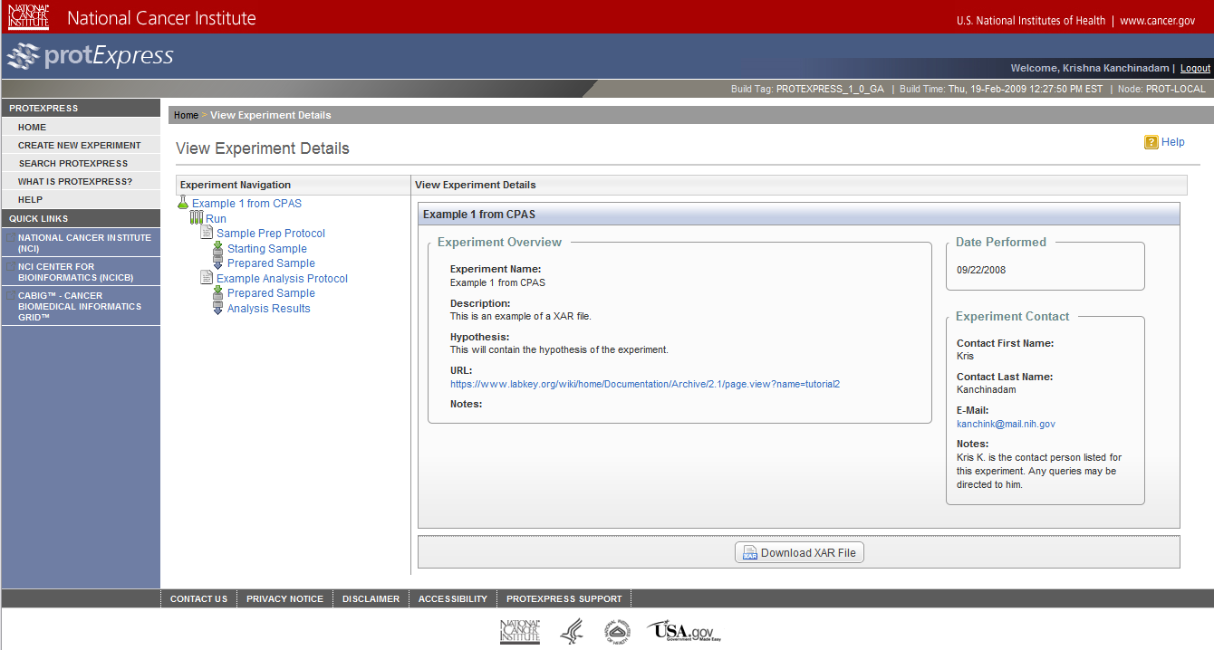
Introduction to protExpress:
View Experiment Details
A Tree based User Interface:
  Lists the Experiment as the root element.
  Lists the different “Runs” for an experiment.
  Lists all Protocol Applications for a run, with their Inputs and Outputs
 | Experiment
 | Experiment Run
 | Protocol Application
 | Protocol Application Input
 | Protocol Application Output

Slide 16
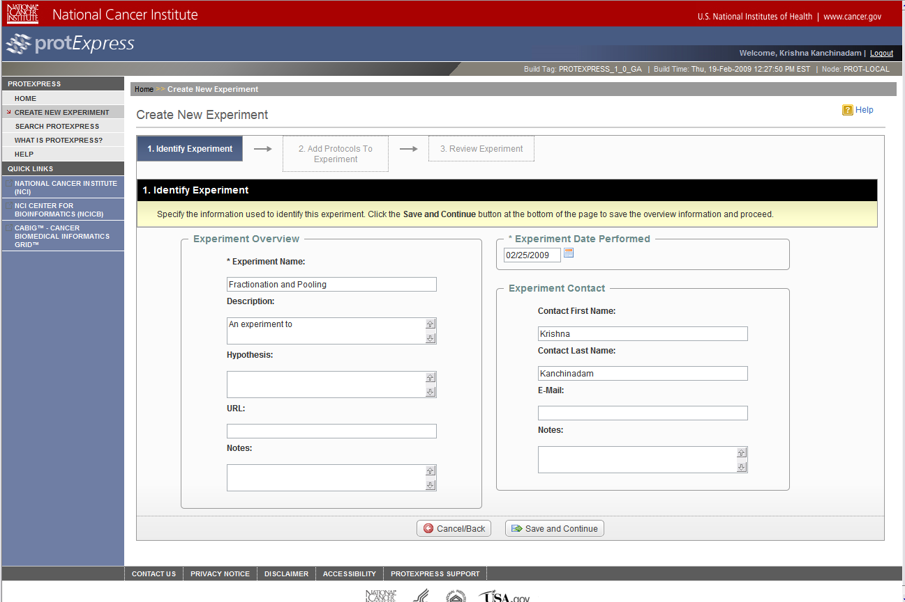
Introduction to protExpress:
Create New Experiment
Wizard-like interface.
Ability to provide basic Experiment information.
Ability to add multiple existing and/or new protocols to the experiment.

Slide 17
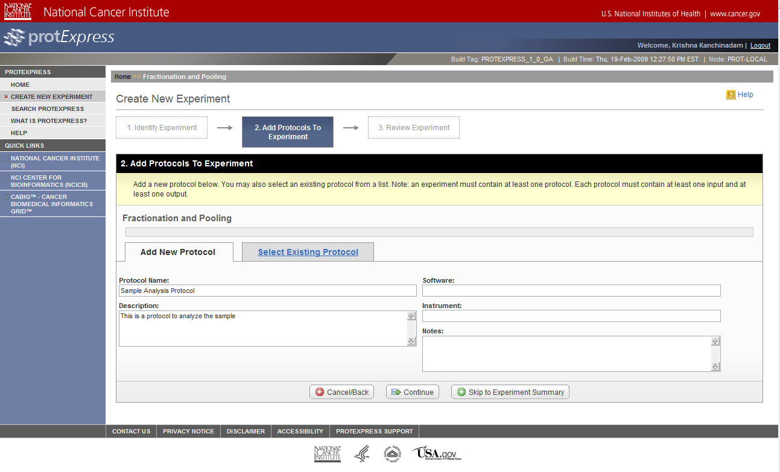
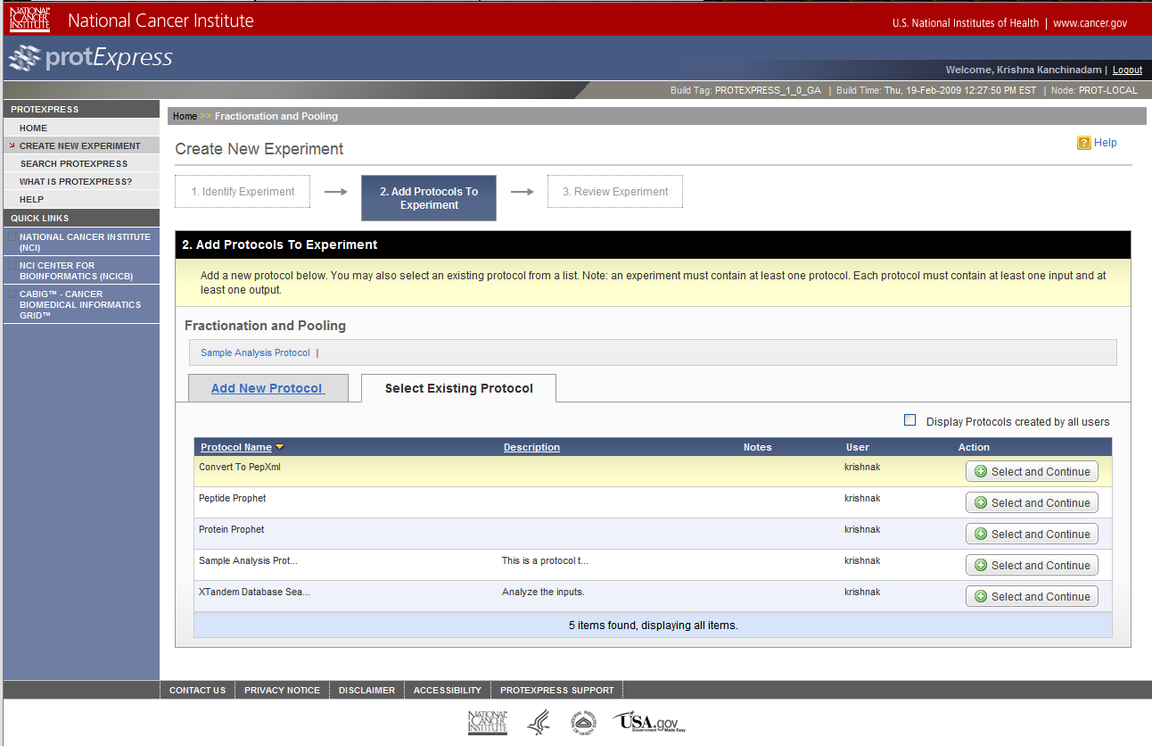
Introduction to protExpress:
Add Protocols to Experiment
Add multiple protocols to an experiment.
Ability to create new protocols to be added to the experiment.
Ability to select existing protocols to be applied.

Slide 18
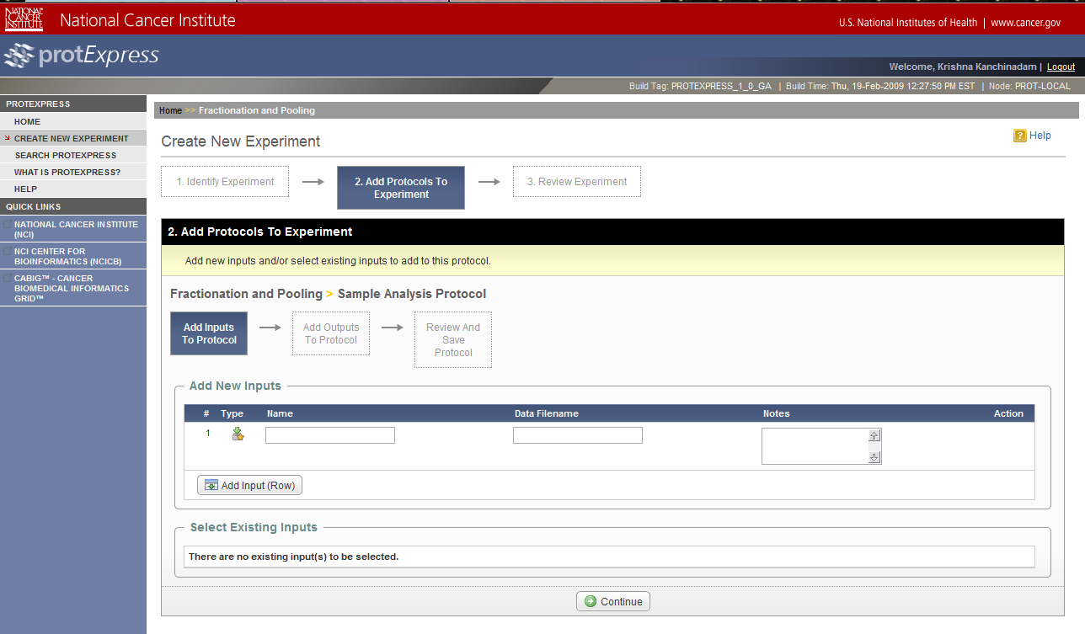
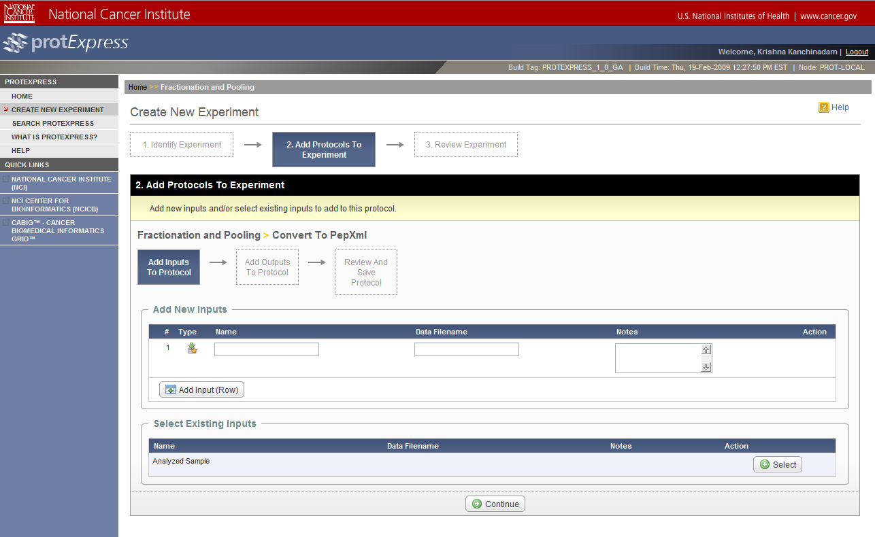
Introduction to protExpress:
Provide Inputs to the Protocol
Specify inputs to the protocol being applied.
Ability to specify new inputs or existing inputs (outputs from a previous protocol step).

Slide 19
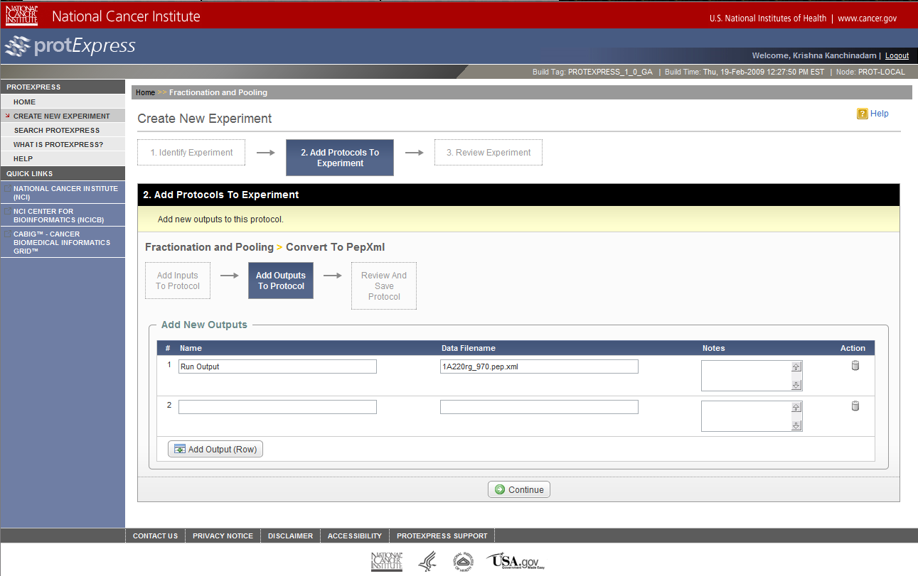
Introduction to protExpress:
Specify Protocol Outputs
Specify multiple outputs from a protocol application.

Slide 20
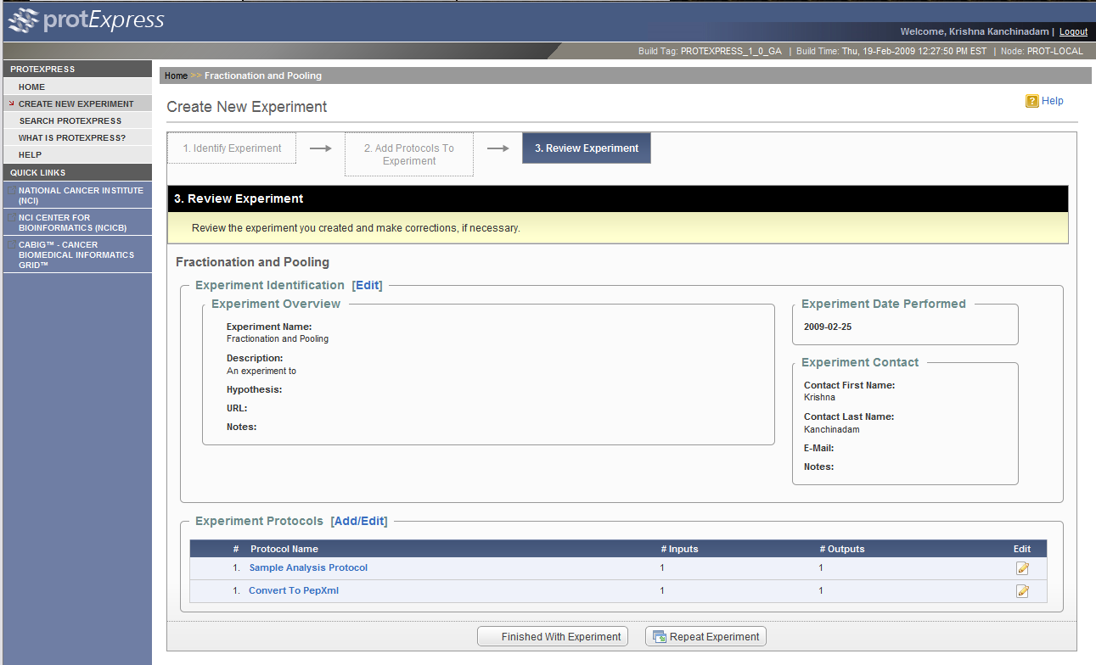
Introduction to protExpress:
Review Experiment
Functionality to review the experiment.
Add/Update/Delete new and/or existing protocols to the experiment.
Add/Update/Delete new and/or existing protocol inputs and outputs.
Ability to repeat the experiment – to create another “run” of the experiment procedure.

Slide 21
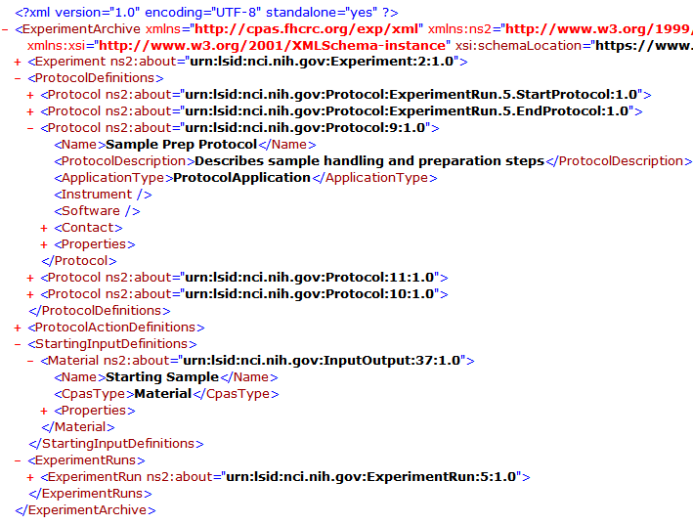
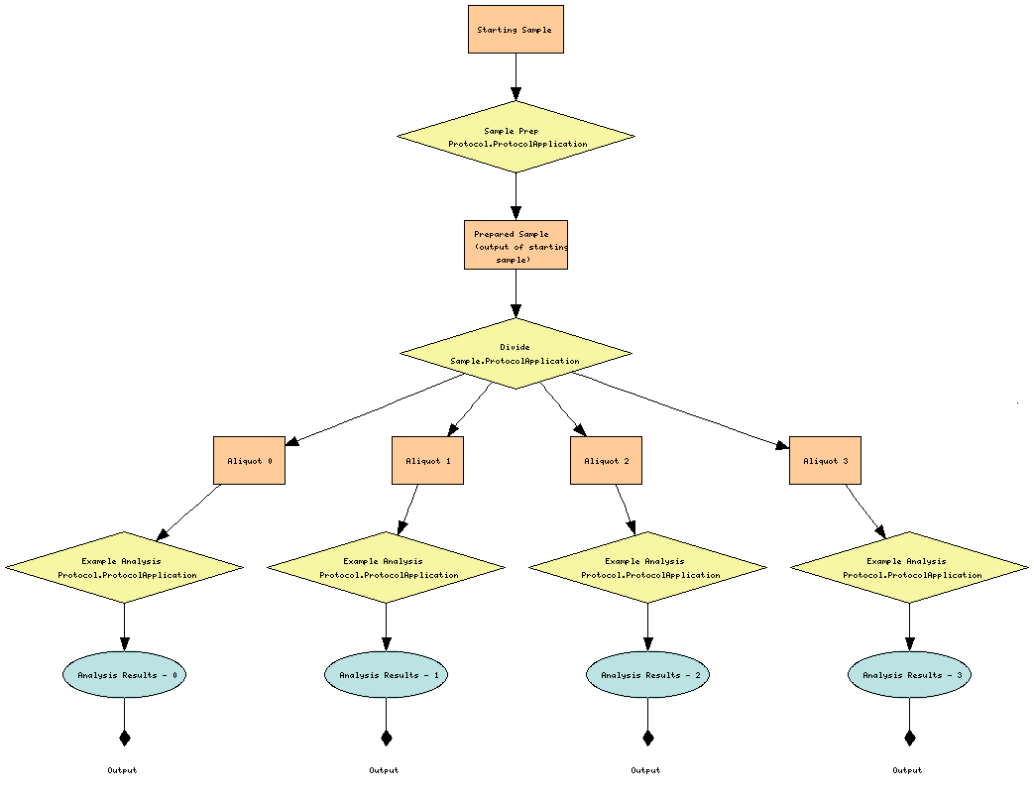
Introduction to protExpress:
Export to XAR

Slide 22
Introduction to protExpress:
Project Status & Sources of Help
Available online at https://protexpress.nci.nih.gov
Available on GForge https://gforge.nci.nih.gov/projects/gpsxar
Source and documentation available via Subversion
https://gforge.nci.nih.gov/svnroot/gpsxar
Sources of help:
  NCICB Application Support Site at http://ncicb.nci.nih.gov/NCICB/support
  NCICB Application Support – ncicb@pop.nci.nih.gov

