Slide 1

GPS-XAR: protExpress?

Slide 2
Agenda
Overview of the Use Cases
Use Case Details and Flow of Events
Q & A

Slide 3
GPS-XAR
Open source J2EE web application, based on the Model-View-Controller design pattern.
  Apache Tomcat 5.5.20
  PostgreSql 8.1.x
File location shared between GPS-XAR and CPAS, to facilitate storage and sharing of experiment information files.

Slide 4
GPS-XAR: Environment
Development Server
  Request has been made. Should be ready in a couple of days
Development Database
  PostgreSql 8.1.x
  Servername: cbiodb590.nci.nih.gov
QA Database
  Wait for a few more days before QA sends in a request?

Slide 5
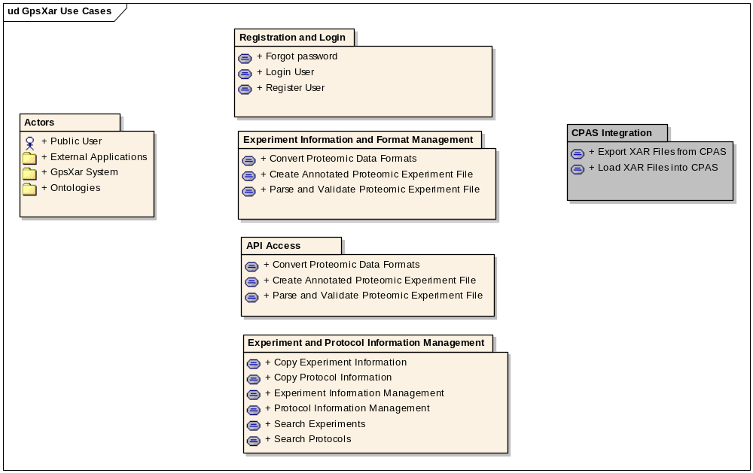
GPS-XAR: Overview of Use Cases

Slide 6
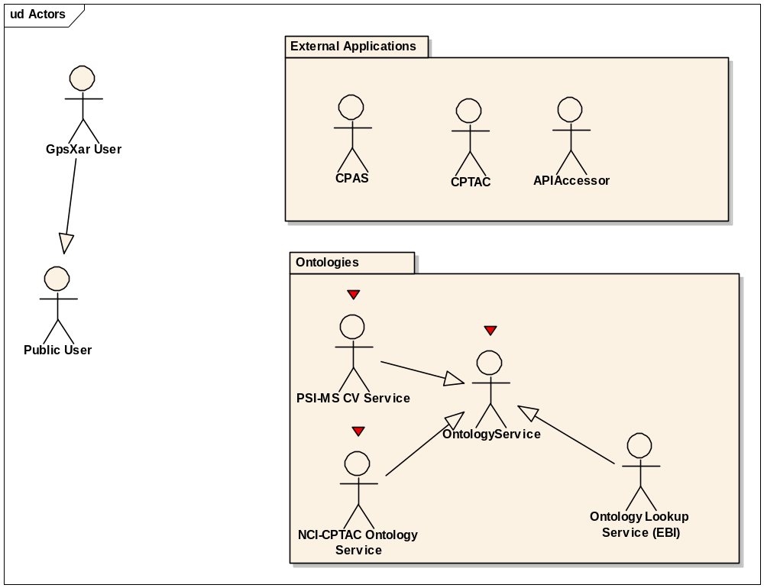
GPS-XAR: Actors

Slide 7
GPS-XAR: Actors
Public User
GpsXar User – Registered with the system.
External Applications
  CPAS
  CPTAC
  APIAccessor – Anyone who accesses the Webservice API
OntologyService
  NCI-CPTAC Ontology Service (when available)
  PSI-MS CV
  Probably better…..Ontology Lookup Service, EBI- Provides a centralized query interface to multiple ontology and Controlled vocabularies, including PSI-MS CV and Pride CV

Slide 8
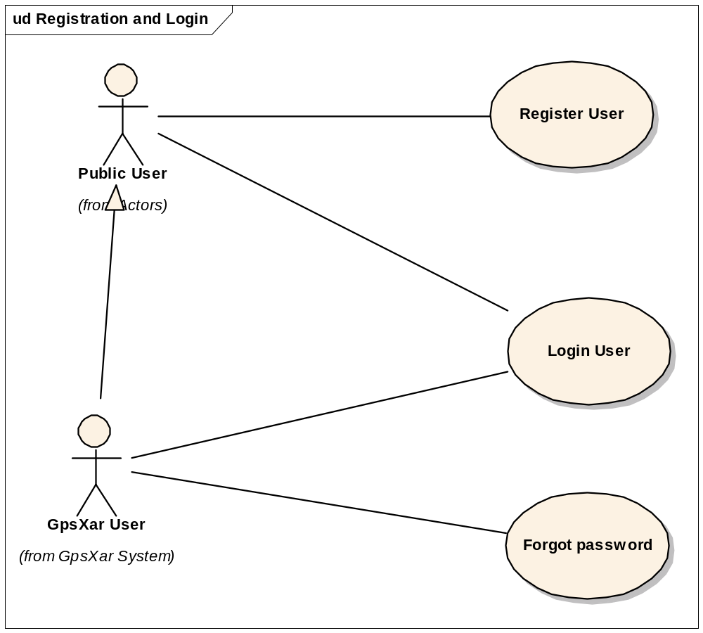
GPS-XAR: Registration and Login

Slide 9
GPS-XAR: Registration and Login
Site has public and non-public components
Register User
  Required for access to non-public areas/functions of the system. User will be provided a “Register” link wherein they can enter the desired information and register to access non-public information.
  E-Mail Id, First Name, Last Name, Organization/Group
Login User
Forgot Password: E-Mailed a new password generated automatically by the system.

Slide 10
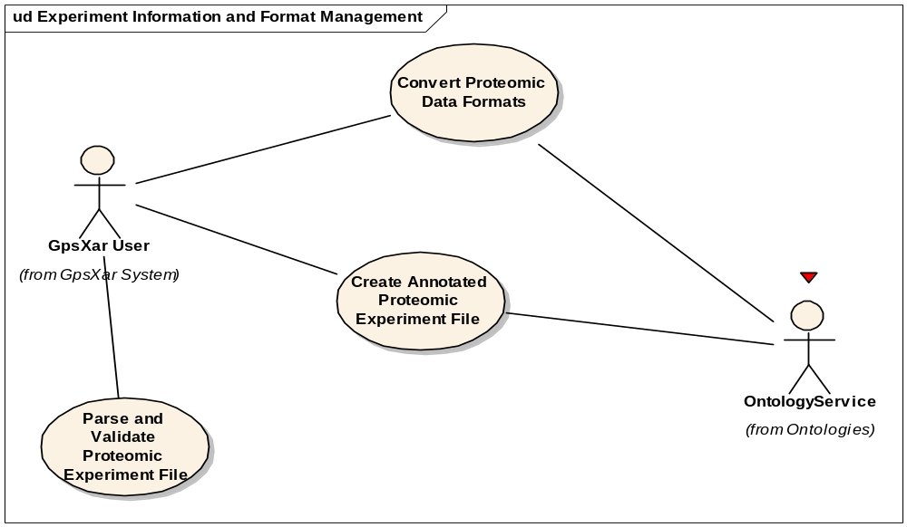
GPS-XAR: Experiment Format Management

Slide 11
GPS-XAR: Experiment Format Management
Convert Proteomic Data Formats
  Xar.xml, Pride xml format from EBI, Fuge-ML, Tab-delimited
  Represented in a custom format:
    Instead of tab-delimited, I would prefer an XML Format that could serve dual purpose.
  Publicly accessible
  Need to login to save the experiment and protocol information to the database.
Create Annotated Proteomic Experiment File
  Publicly accessible to generate any of the supported formats
  Need to login to save the experiment and protocol information to the db.
Parse and validate
  Publicly accessible- Input is a file to be parsed and validated.

Slide 12
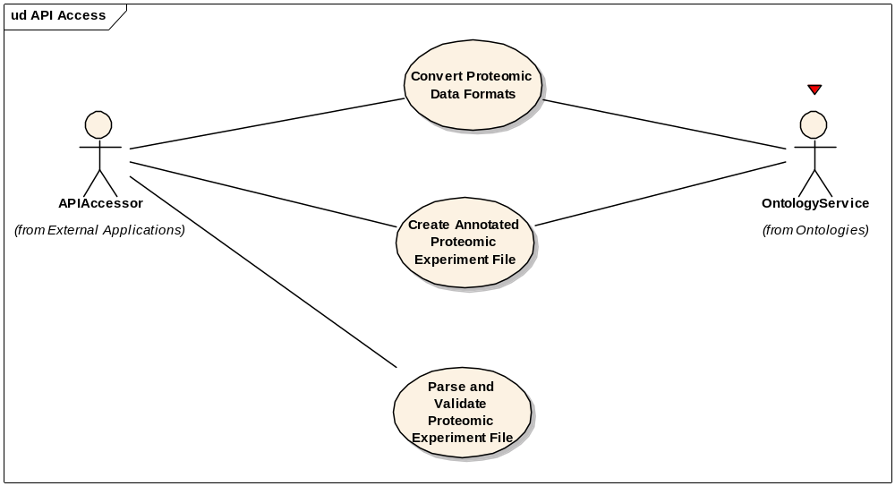
GPS-XAR: API Access

Slide 13
GPS-XAR: API Access
Convert Proteomic Data Formats
Create Annotated Proteomic Experiment File
Parse and validate
  Publicly accessible as a service.
  No login required, hence no ability to save information to the database.

Slide 14
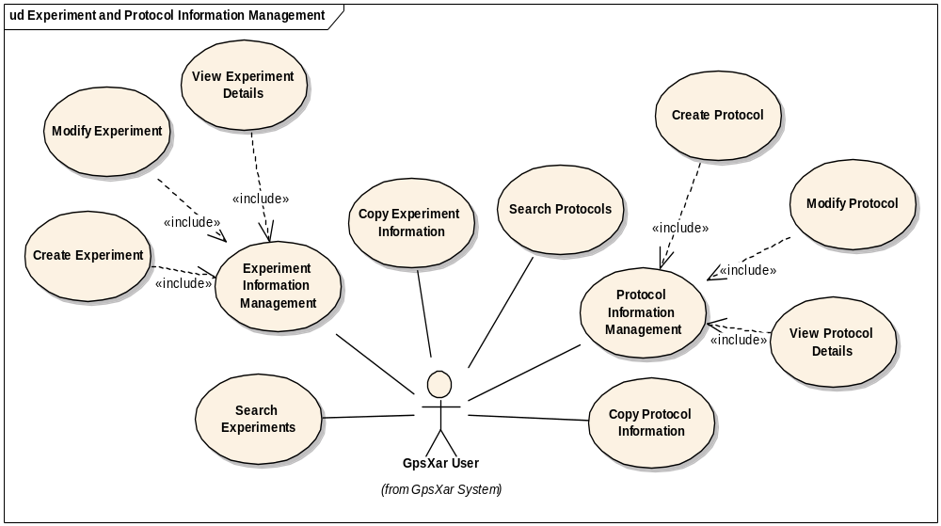
GPS-XAR: Experiment and Protocol Information Management

Slide 15
GPS-XAR: Experiment and Protocol Information Management
Search Experiments
  Search Fields- Experiment Name, Owner
  Search Results – Experiment Name, owner/created by, other information TBD, and following icons:
    View: To view details
    Delete: Only if logged in user is the owner of the experiment
    Clone/Copy: Create a copy of the experiment in the database.
Copy Experiment Information- Create a replica with new id.
Experiment Information Management
  Create, View, Modify
  When viewing details, option to Delete (owners-only), Modify (owners-only) and Clone

Slide 16
GPS-XAR: Experiment Information Management
Create Experiment
  via User Interface
  Upload a file (checkbox?) that contains experiment information – Will generate/build UI based on the information
  Option to save the information to database is present only if the user is logged in.
  If user is not logged in, option to login will be present (to allow user to save the information to database).
Modify Experiment
  No “Upload file” option.
  Only logged in users will be able to modify experiments (owners-only)

Slide 17
GPS-XAR: Experiment and Protocol Information Management
Search Protocols
  Search Fields- Protocol Name, Owner
  Search Results – Protocol Name, owner/created by, other information TBD, and following icons:
    View: To view details
    Delete: Only if logged in user is the owner of the Protocol
    Clone/Copy: Create a copy of the Protocol in the database.
Protocol Information Management
  Create, View, Modify
  When viewing details, option to Delete (owners-only), Modify (owners-only) and Clone
Copy Protocol Information- Create a replica with new id.

Slide 18
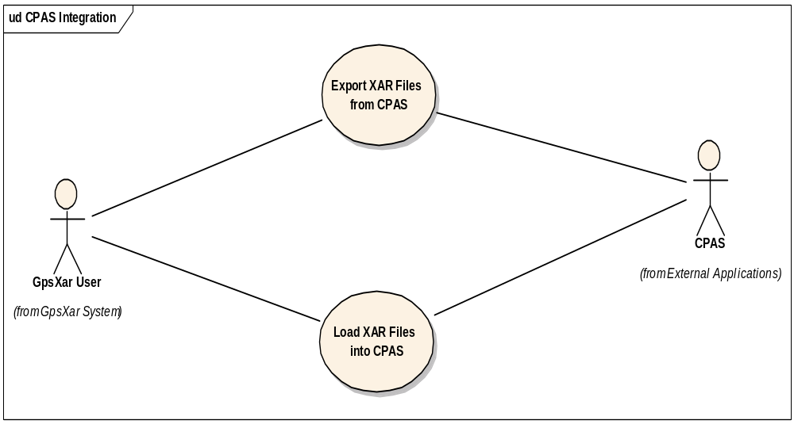
GPS-XAR: CPAS Integration

Slide 19
GPS-XAR: CPAS Integration
Need to evaluate and see what CPAS offers.
Possibility that we may not have to do anything, rather CPAS invokes the web services to manage xar.xml files (create, validate…)

Slide 20
GPS-XAR : Very very basic arch. diagram
Java Web Application
Web Server (Tomcat)
Database Server
(PostgreSQL 8.1.x)
Shared
Disk
CPAS

Slide 21
GPS-XAR: Issues to Consider
Availability of CPTAC ontology
Fuge-ML release – Late summer/Fall 2007

Slide 22
Questions so far?????

Slide 23
Data Formats
Xar.xml
Pride XML
Fuge-ML (Late summer 2007)
  Xar.xml is a subset of Fuge-ML. Expected that the final Fuge-ML format will be at least similar to Fuge-ML.
Tab Delimited and/or Custom Xml Format.

Slide 24
Pride XML Format –v 2.1
Root element is an ExperimentCollection element that acts as a holder for multiple experiments (Experiment elements)
Experiment element - 9 conceptually distinct parts
  Experiment Accession Number – assigned after successful submission of the experiment and provides a unique pointer to all associated data.
  Title element definitions
  Reference – Links to any literature citations for which the experiment provides supporting evidence
  Short label
  Protocol Information
    Protocol Name
    Protocol Steps – Ordered sequence of elements that define this protocol
      Each step contains a step description

Slide 25
Pride XML Format - Continued
9 conceptually distinct parts
  mzData- use of a MS, generated data, peak lists, initial processing of the data.
  Identifications obtained from data in #5 above. Split into 2 different types:
    GelFreeIdentification – Hold details of identifications arisen from techniques besides Gel Electrophoresis
    TwoDimensionalIdentification – represents identifications based upon 2-D Gel Electrophoresis- Gel, location of spot, pI, molecular weight…
  Additional – other information about the experiment, additional parameters etc….

Slide 26
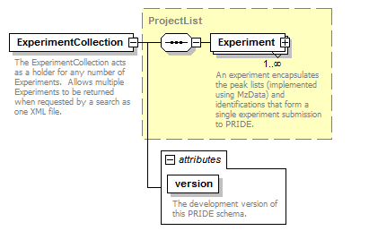

Slide 27
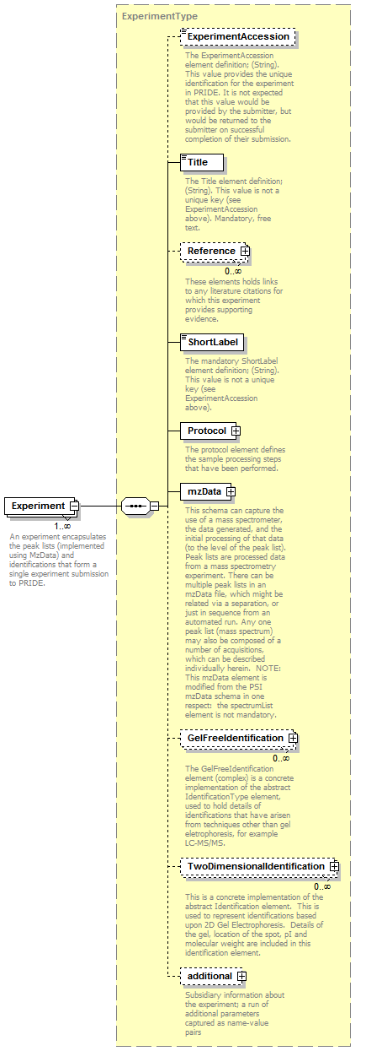

Slide 28
XAR.XML v 1.7 (CPAS 2.0)
Root element is an ExperimentArchive node – specifices namespaces and a schema file for validation.
Experiment Section – Describes One experiment associated with multiple runs described in the xml file.
Protocol Definitions

