Slide 1
protExpress Silver Compatibility Review
Carl Schaefer
William Mason
Krishna Kanchinadam
NCI CBIIT
January, 2009

Slide 2
Agenda
Project overview
  What is protExpress?
  protExpress Workflow
Domain Model
  Overall approach
  Imported classes
Architecture and APIs
  Architectural overview
  API description
  Remote Java API tests and Grid Service tests
Project status
  Available online at http://protexpress.nci.nih.gov
  Silver submission package ready for review.

Slide 3
Project Overview: What is protExpress?
Product Description: protExpress is a web-based annotation tool for capturing proteomics experimental information. It provides a framework for describing experimental procedures and steps in an intuitive web based interface that allows the researchers to specify a series of protocols with specific inputs and outputs. The software exports experiment information into the XAR format used by CPAS. The architecture of protExpress allows for additional annotation formats in the future.
Technical strengths
  Simplified domain model and API
  Focus on usability
Targeted user community
  Bench scientists describing proteomics experiment information and annotation
  Users of CPAS.

Slide 4
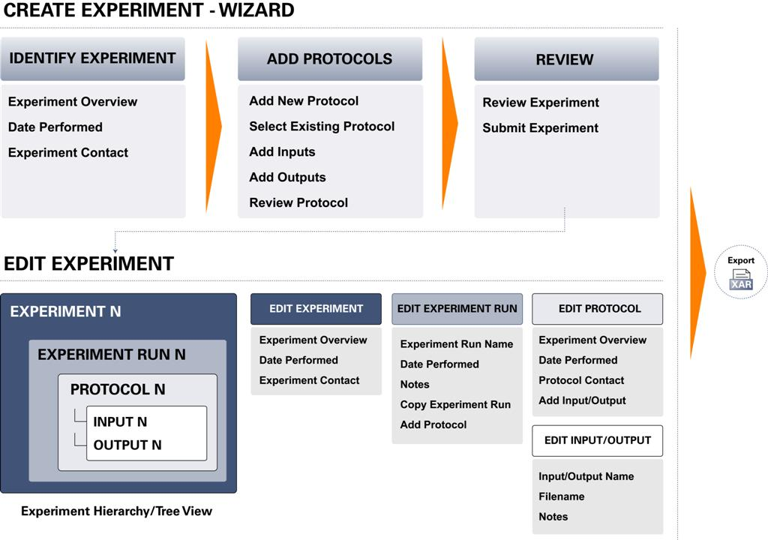
Project Overview: protExpress Workflow

Slide 5
Project Overview: Features
User Interface:
  Submit protocol data and annotations. The protocols are reusable entities that can be applied to multiple experiments.
  Submit proteomics experimental information and annotation. An experiment consists of multiple protocols applied in a given sequence, each with its own set of inputs and outputs.
  Browse and Search through the repository for protocols and experiments of interest. The search mechanisms lead to actionable results that are clear to the end user and incorporate their specific rights for the experiments.
  Export the experiment information and annotations as a XAR formatted XML file. XAR (eXperimental ARchive) format is used in CPAS.
Java API and Grid Service Interface
  Browse, Search and View the protocols and experiments in the repository.

Slide 6
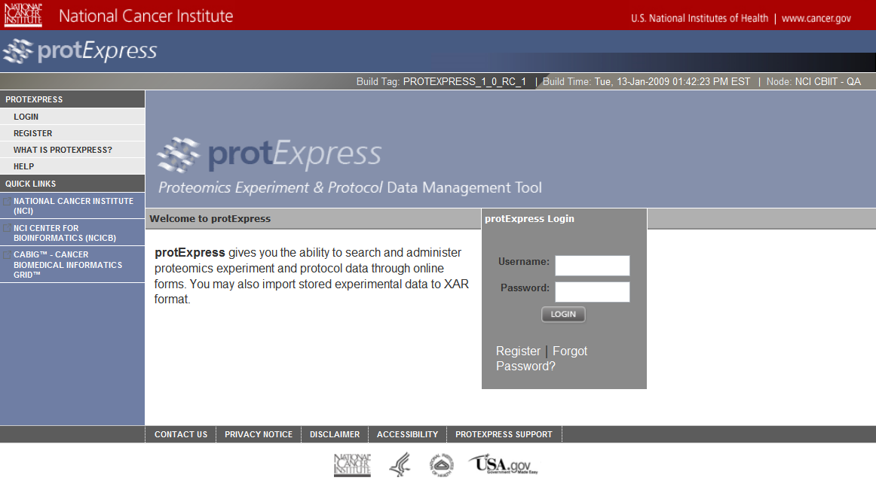
Project Overview: User Interface

Slide 7
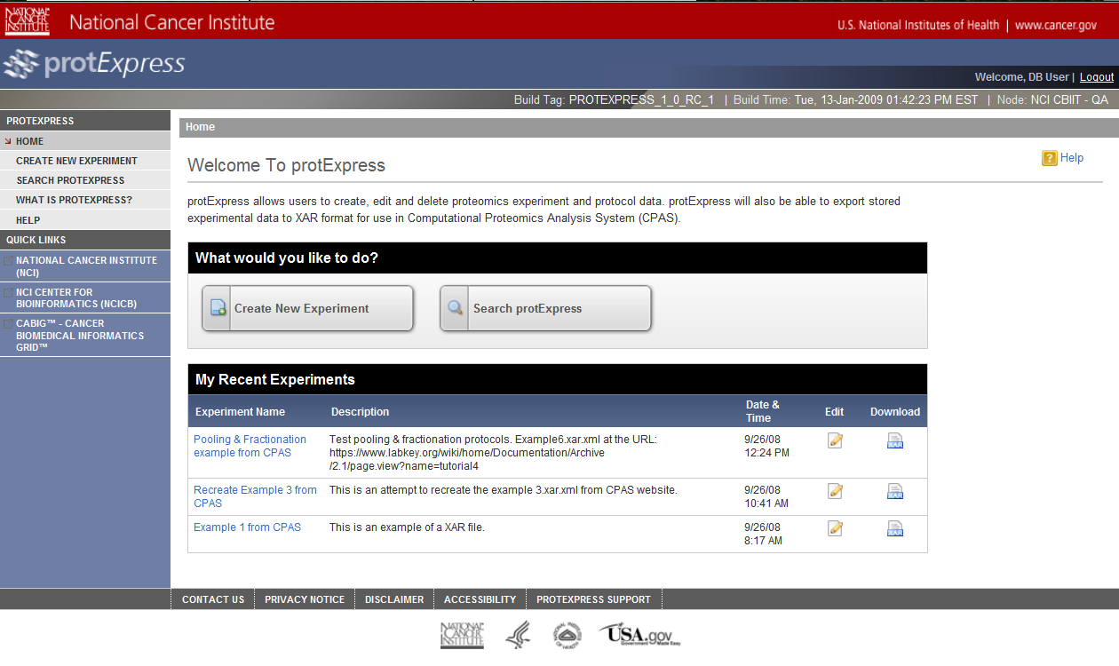
Project Overview: User Interface

Slide 8
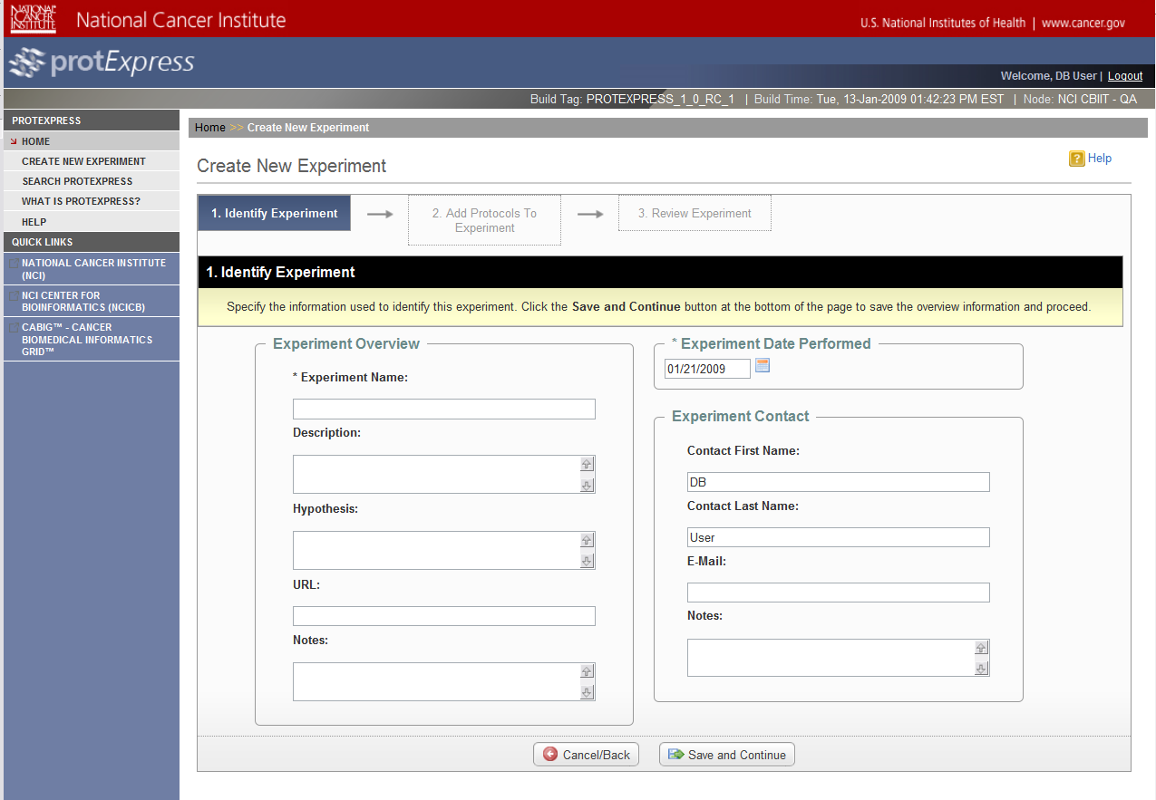
Project Overview: User Interface

Slide 9
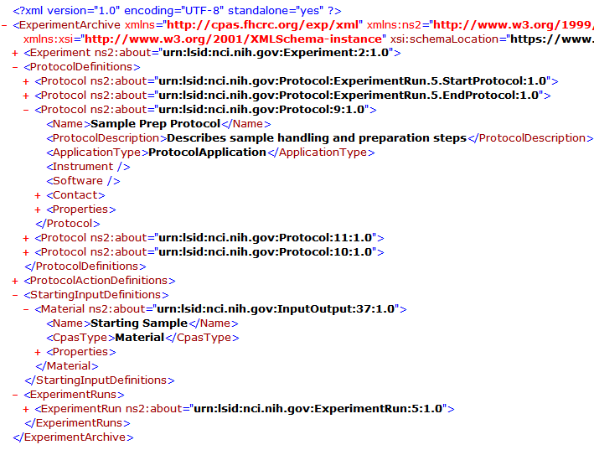
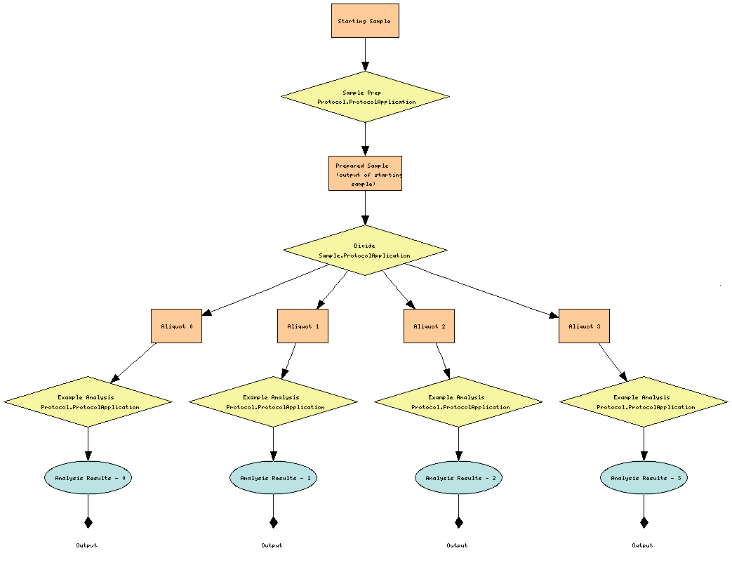
Project Overview: Export to XAR

Slide 10
External Technologies and Standards Used by protExpress 1.0
caGrid 1.2: The Introduce Toolkit provided by caGrid was used to generate the protExpress grid service
Common Security Module (CSM): used to supply authentication, authorization and user provisioning for protExpress 1.0.

Slide 11
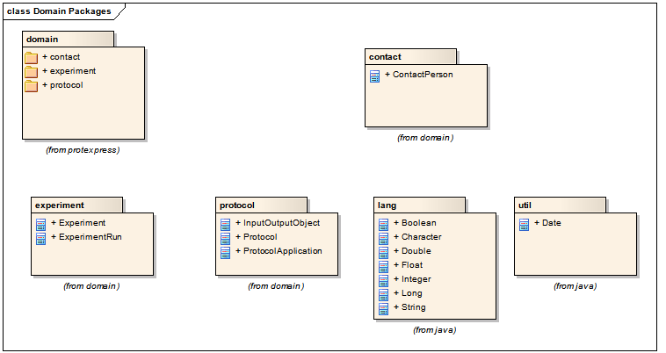
Domain Model: Packages

Slide 12
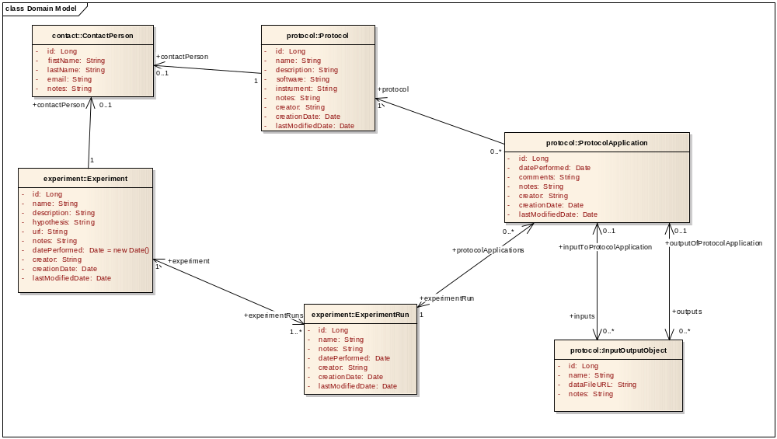
Domain Model: Class Diagram

Slide 13
Architectural Overview
protExpress 1.0 is:
  A J2EE application that uses the following major technologies
    Hibernate 3.2.x
    Struts 2.0.11
    PostgreSql 8.3.x
  Accessible via a web-based User Interface.
  Programmatic access is provided by caGrid interfaces.
  A Data Service

Slide 14
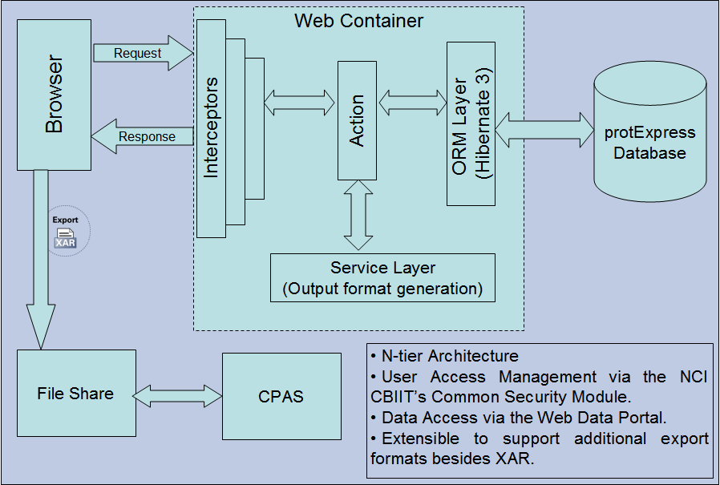
Architectural Overview

Slide 15
API Overview: Java API Class Diagram

Slide 16
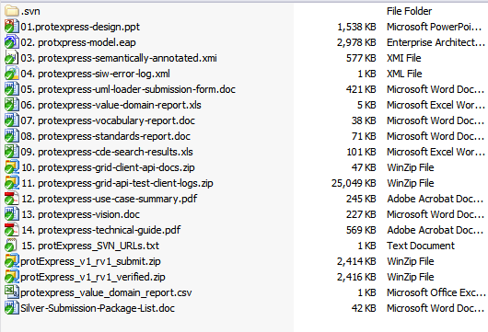
Project status
Available online at http://protexpress.nci.nih.gov
Available on GForge https://gforge.nci.nih.gov/projects/gpsxar
Source and documentation available via Subversion
https://gforge.nci.nih.gov/svnroot/gpsxar
Silver compatibility package available
  https://gforge.nci.nih.gov/svnroot/gpsxar/trunk/docs/silver_compatibility_review/v1.0

