Slide 1
protExpress Team Meeting – 11/07/2008
Grid Service Status update.
  Updates to the application.
Briefly discuss AppScan results.
Deploying application to STAGE.
New servers/hosts for QA/STAGE/PROD tiers.

Slide 2
Grid Service Update
Created a grid service, deployed and tested successfully on the local system.
  Involved modifications to the domain model.
  Subsequent changes to the database schema:
    Example – Contact person information was stored in the ContactPerson class. The actual data was previously stored in the same record as the Experiment and Protocol records. However, now the contact information is persisted in its own table, with foreign key mappings to the Experiment/Protocol tables.
    Involves changes to the application – Not implemented fully. Not tested as yet.
    Estimated to be rolled out along with the next build of the app.
Brief discussion with BDA team to incorporate deployment of the grid service into the AHP project.

Slide 3
Grid Service Update
Currently involved in deploying the grid service manually to the DEV tier.

Slide 4
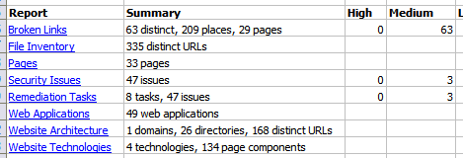
AppScan Results
SVN location : https://gforge.nci.nih.gov/svnroot/gpsxar/trunk/docs/appscan_reports

Slide 5
Update from Systems
Deploying application to STAGE
  Received an update from Systems that they are scheduling the request for this week. No more updates.
New servers/hosts for the QA/STAGE/PROD tiers – In Process.

