Slide 1
Patient Study Calendar (PSC) phase II
Data Loaded into Final Application
So, the short version is time is an extremely valuable commodity to patients, nearly more valuable than gold.
– Virginia Hetrick, patient advocate
Northwestern University
February 29, 2008

Slide 2
About this presentation
  This presentation will show data show data loaded into the final 2.0 release of PSC
  The names of Subjects, Studies, and Coordinators have been modified to ensure confidentiality

Slide 3
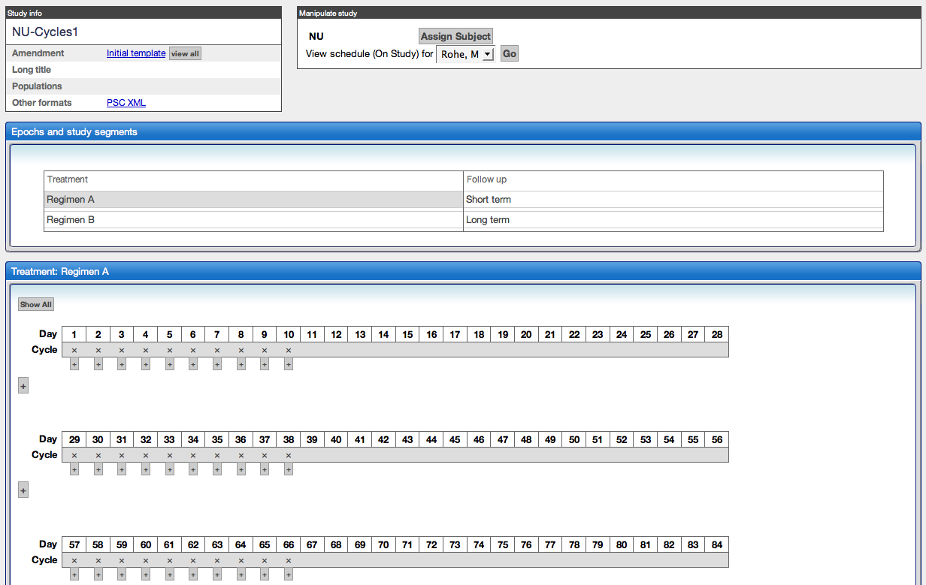
Study template for cycle-based intervention

Slide 4
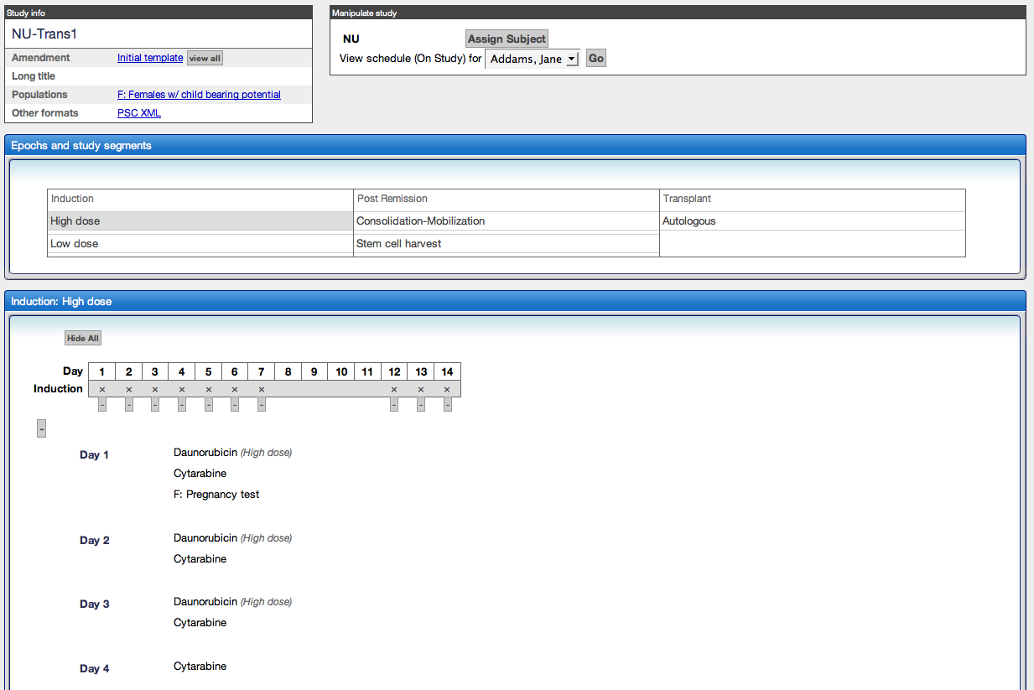
Study template for transplant study

Slide 5
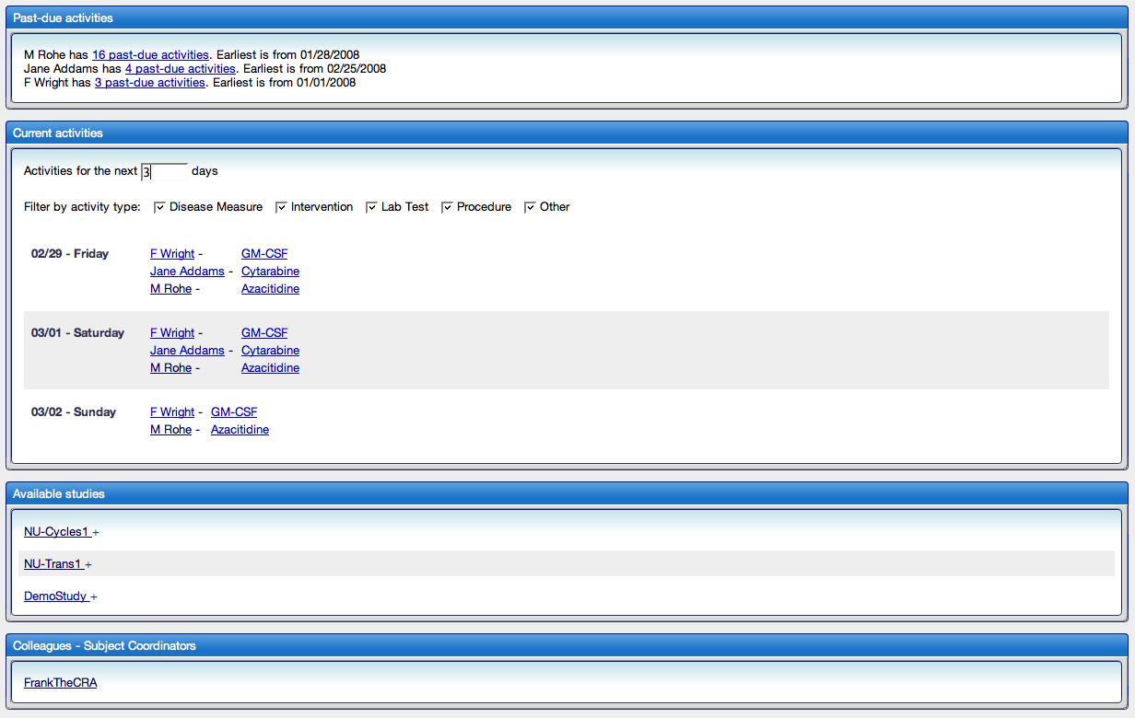
Aggregate schedule for a Subject Coordinator

Slide 6
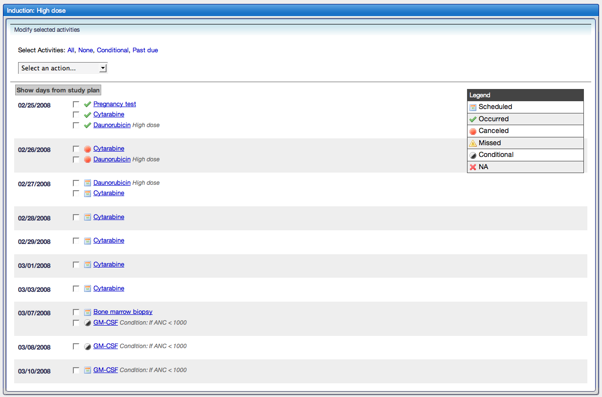
Subject calendar

Slide 7
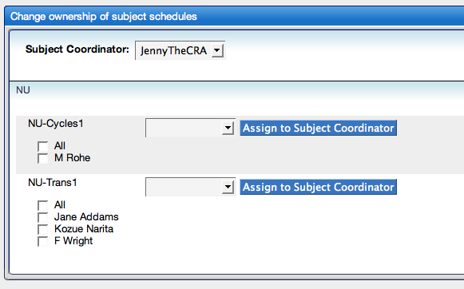
Workload of Subject Coordinator

