Slide 1
Patient Study Calendar (PSC) phase II
Overview
Session Creation: 2/11/2008
Session Length: 30 minutes
Target Audience: Anyone interested in learning about PSC
Notes:
Note about this template:
The Training WS developed this template to support the development of training for the caBIG program.
We assume that template users have a basic understanding of PowerPoint, including the use of this notes section, how to insert and move slides, and how to perform basic formatting steps.
This is a template only – you should modify to meet your specific needs.
Once you are done creating your training, be sure to delete the template guide notes in this notes section and in the text boxes on the main screen.

Slide 2
Session Details
Topic: Patient Study Calendar (PSC) Overview
Target Audience: Clinical research and technical staff
Prerequisites: Basic knowledge of clinical trials management

Slide 3
PSC Overview:
Session Goals
By the end of this presentation, you will:
  Understand the benefit of using PSC
  Know the history and features of PSC
  Know the next steps to adopting PSC
Notes:
Notes: Using SMART objectives Specific, Measurable, Attainable, Relevant, Testable objectives are important to the success of any training program especially ones designed for adult learners. Some of the verbs used in writing SMART objectives are:
Compute
Cover
Demonstrate
Describe
Determine
Distinguish
Enter
Establish
Explain
List
Locate
Practice
Prepare
Present
Provide
Show
Use
Locate
Practice
Prepare

Slide 4
PSC Overview:
Overview Content
This presentation will explain:
  The purpose of PSC
  Target users and roles
  Brief history of PSC development
  Key dependencies for using PSC
  Summary of caBIG compatibility
  Overview of key functionality
  Instructions for getting and installing PSC
  Contact and additional information

Slide 5
PSC Overview:
Purpose
The purpose of PSC is to provide an organization that manages clinical trials with:
  consistent protocol interpretation across the organization
  shared protocol templates across organizations such as cooperative groups
  easily generated and updated patient calendars from screening through follow-up
  automatic updates to calendars due to protocol amendments
  controlled data access across a multi-site environment
  management of coordinator workload
Notes:
Lessons are groupings of 3-6 learning objectives that address similar topics. Use the “Training Outline and Objectives” template available on the Training Portal to develop your lesson plan. Each lesson should last between 10-15 minutes, so a one-hour training session includes about 4 lessons, plus intro and review.

Slide 6
PSC Overview:
Target users and roles
PSC is designed to be used by
  clinical research staff that manage subjects on clinical trials (although PSC has been designed primarily with specifications from cancer centers, it should accommodate any type of clinical trial)
  managers of clinical research staff
  clinical research staff that are knowledgeable in protocol design
These users will be assigned to the appropriate roles within PSC as determined by each organization that adopts PSC
Notes:
Describe what you plan to cover in the Introduction Lesson.
Introduction lessons tend to be basic back ground and navigation type discussions.

Slide 7
PSC Overview:
Target users and roles, continued
Roles within PSC:
System Administrator |  Creates user accounts  Grants users to role(s) and site(s) within the application  Configures the application
Study Administrator | ● Reviews completed study templates and approves them  Imports and exports study templates  Makes studies available to each site
Study Coordinator | ● Creates new study templates  Marks templates as being ready for review by Study Administrator
Site Coordinator | ● Determines which study templates are accessible by each Subject Coordinator  Reassigns subject calendars to appropriate Subject Coordinator
Subject Coordinator | ● Assigns subjects to studies  Generates and manages calendars for subjects
Notes:
Describe what you plan to cover in the Introduction Lesson.
Introduction lessons tend to be basic back ground and navigation type discussions.

Slide 8
PSC Overview:
Brief history of PSC
Study Calendar Special Interest Group (SIG)
  May 2005 through February 2007
  Described need and defined requirements for a study calendar application
PSC Phase 1
  July through December of 2006
  Developed by Northwestern University, Semantic Bits and Akaza Research
PSC Phase 2
  June 2007 through February 2008
  Developed by Northwestern University and Semantic Bits
  Fully integrated into Northwestern’s CTMS February 2008
Study Conduct SIG
  Since August 2007, PSC has reported its progress to this SIG

Slide 9
PSC Overview:
Brief history of PSC, continued
The development of PSC has been possible only with significant contributions from a large number of organizations including:
  Akaza Research
  BAH
  BRIDG THC
  caBIG VCDE and ARCH mentors
  Dartmouth University
  ECOG
  Mayo Clinic
  NCICB
  Northwestern University
  Patient Advocates
  Siouxland HOA
  Thomas Jefferson University
  UCLA
  University of Arkansas
  University of Virginia
  Wake Forest University
Notes:
Trainer should reiterate the objectives stated in the beginning of the lesson.
This slide should touch on all of the important topics/concepts that were covered in this lesson.

Slide 10
PSC Overview:
Key dependencies of PSC
Each institution will host its own instance of PSC, though several sites may use a single instance, if desired
PSC is an open source, browser-based application that requires only a web browser (Firefox 1.5 or 2.0, or Internet Explorer 7) to be accessed by the end user
From the server perspective PSC requires:
  Database (tested on both PostgreSQL and Oracle)
  Tomcat 5.5.17 or higher
  JDK 5
For more information, please see the PSC Installation Guide: http://gforge.nci.nih.gov/plugins/scmcvs/cvsweb.php/studycalendar/PhaseII/Construction/Iteration4/PSC_Install_Guide.doc?cvsroot=studycalendar
Notes:
The trainer should reiterate the objectives stated in the beginning of the lesson.
This slide should touch on all of the important topics/concepts that were covered in this lesson.

Slide 11
PSC Overview:
Summary of caBIG™ compatibility
caBIG™ Silver Level Compatibility
  https://cabig.nci.nih.gov/guidelines_documentation/Silver_Review/
Harmonized with the BRIDG model
  http://www.bridgproject.org/
Model loaded into caDSR
  http://ncicb.nci.nih.gov/NCICB/infrastructure/cacore_overview/cadsr
Part of caBIG™ Clinical Trials Suite (CCTS) 1.0
  http://gforge.nci.nih.gov/projects/ccts/
Notes:
The trainer should reiterate the objectives stated in the beginning of the lesson.
This slide should touch on all of the important topics/concepts that were covered in this lesson.

Slide 12
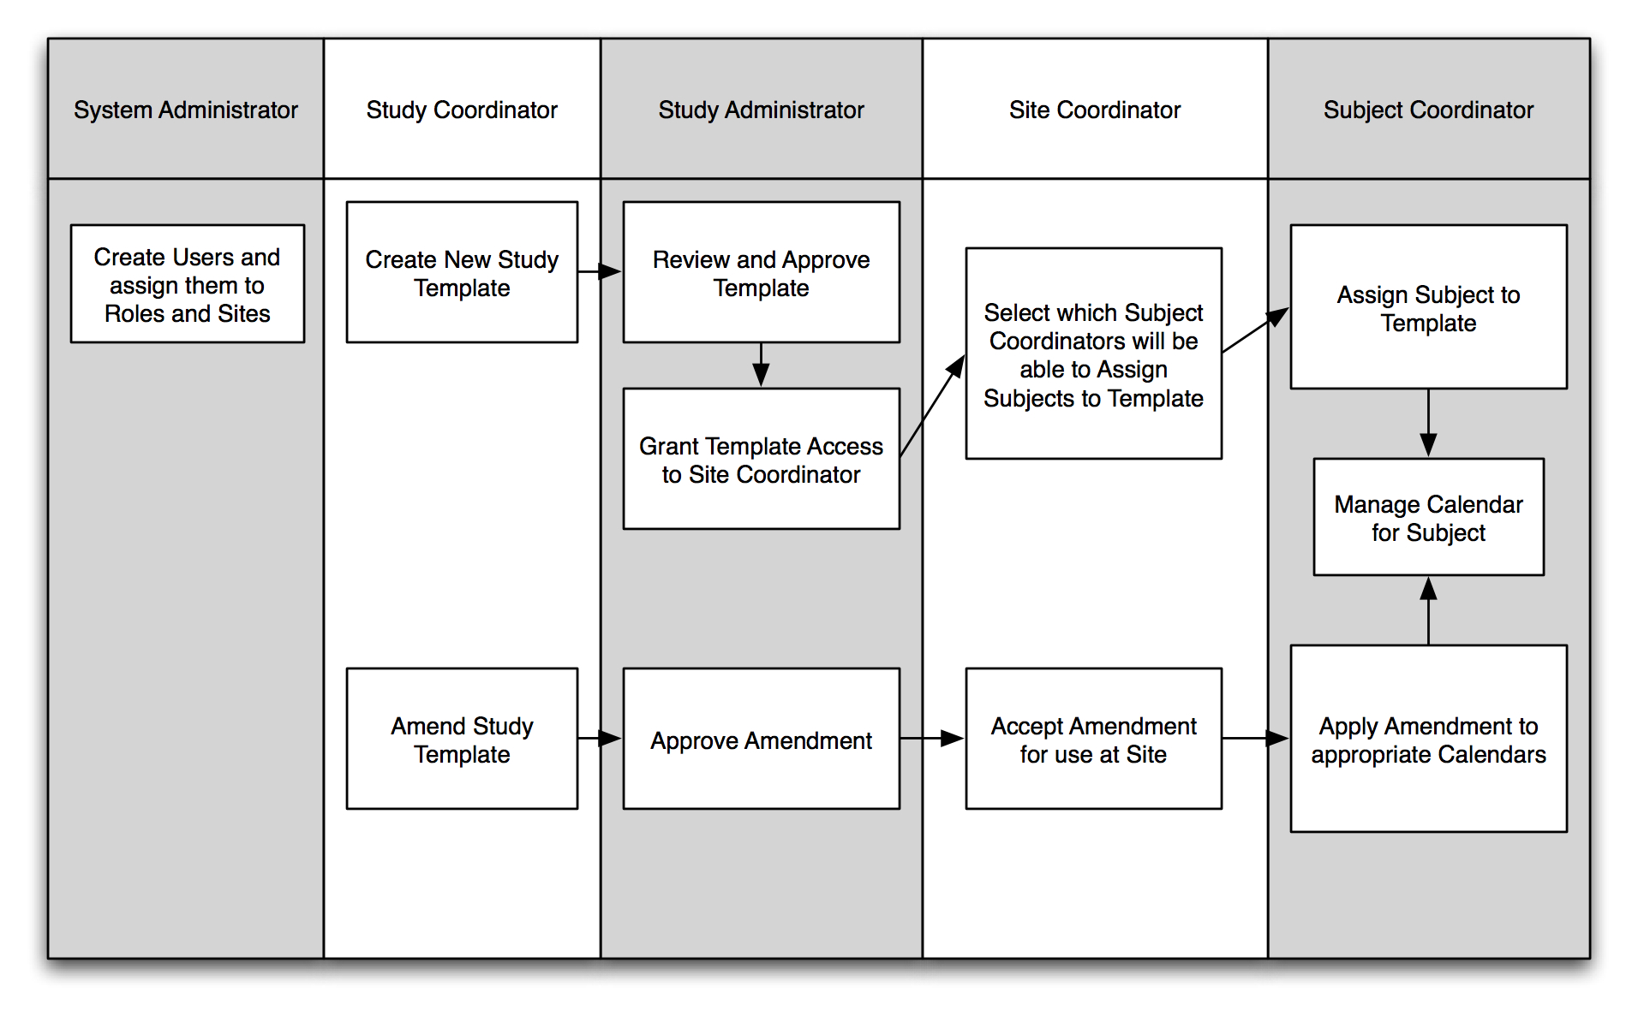
PSC Overview:
Key functionality - roles and workflow

Slide 13
PSC Overview:
Key functionality, study template
Create a single template to represent the activities of a study
  Able to represent all activities from screening through follow-up
  Create activities that take place for special subject populations
Amend template as needed (subject calendars updated automatically)
Import and export study templates (enables sharing of templates between organizations)
Import lists of activities

Slide 14
PSC Overview:
Key functionality, subject calendars
Apply template to create a calendar for a subject
Adjust schedule and state of activities
Add/remove subject from special subject populations
Export subject’s calendar as ICS file for upload into Outlook, Google Calendar, iCal, etc…
Schedule additional segments of template as known
For each activity:
  Track history of changes to date and state
  View reference to relative day of study plan
Push reconsent to all subjects on a study

Slide 15
PSC Overview:
Key functionality, workload management
View your own upcoming and past due activities
View upcoming and past due activities of colleagues
Move ownership of subject calendars from one coordinator to another
Manage coordinator access to individual study templates

Slide 16
PSC Overview:
Get and Install PSC
Download the latest PSC package:
  http://gforge.nci.nih.gov/frs/?group_id=31
  The Installation Guide and all required files are included with this package
You may also try our public test instance:
  https://vera.bioinformatics.northwestern.edu/studycalendar
Other useful documents:
  End User Guide:
  Administration Guide

Slide 17
PSC Overview:
Get and Install PSC, other useful documents
End User Guide
  Describes how to use all features of PSC
  http://gforge.nci.nih.gov/plugins/scmcvs/cvsweb.php/studycalendar/PhaseII/Construction/Iteration4/PSC_End_User_Guide.doc?cvsroot=studycalendar
Administration Guide
  Describes how to configure the application, manage sites, and create users
  http://gforge.nci.nih.gov/plugins/scmcvs/cvsweb.php/studycalendar/PhaseII/Construction/Iteration4/PSC_Admin_Guide.doc?cvsroot=studycalendar
Training modules
  Distributed as part of the package containing this overview

Slide 18
PSC Overview:
Contact and Additional Information
Please send questions and feedback about PSC adoption to:
  studycalendar-adopters@gforge.nci.nih.gov

