Slide 1
Q5: Comparisons on preprocessed data
Ted Laderas, Ranjani Ramakrishnan & Shannon McWeeney
Oregon Health & Science University Cancer Institute
10th February 2006
Updated: 17th Februay 2006

Slide 2
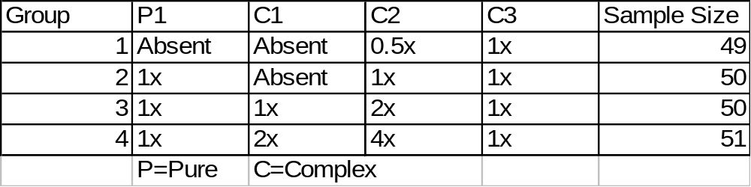
Review of Synthetic Data
Data consists of MALDI-TOF scans generated according to the above design
  Mix of pure peptides and complex peptide mixtures
Two types of problems that can be tested on classifiers with this design:
  Biomarker present/absent (group 1 vs group 4)
  Two groups distinguished by effect size (group 3 vs group 4)

Slide 3
Data Preprocessing Done
Two steps performed on the data
  Data interpolated to common m/z scale
    m/z range: 800-3500, step size = 0.06
    Step size estimated through examination of the raw data
    Data was interpolated in RProteomics with use of approx() (spline based interpolation)
  Negative values winsorized to zero
    Spline-based interpolation introduced some negative values
    Can impact classification
Results reported for both non-winsorized and winsorized data

Slide 4
Methods Compared
Compared original Matlab version of Q5 with current R-Q5
Performance of SVM also compared to both algorithms
3 different train/test ratios were explored
  0.5, 0.75, 0.9
  Results reported for 0.75 (other results available)
100 random/test train splits were performed for each train/test ratio
Averaged Statistics reported with SD:
  PPV, % Correctly Classified, Sensitivity, Specificity

Slide 5
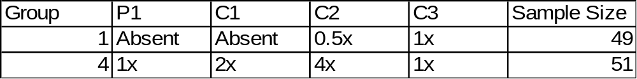
Problem 1: Group 1 versus Group 4
Comparing these two groups, this should be the easiest two groups to distinguish
Present/Absent scenario: 2 different sets of markers are absent in group 1 that are present in group 1

Slide 6
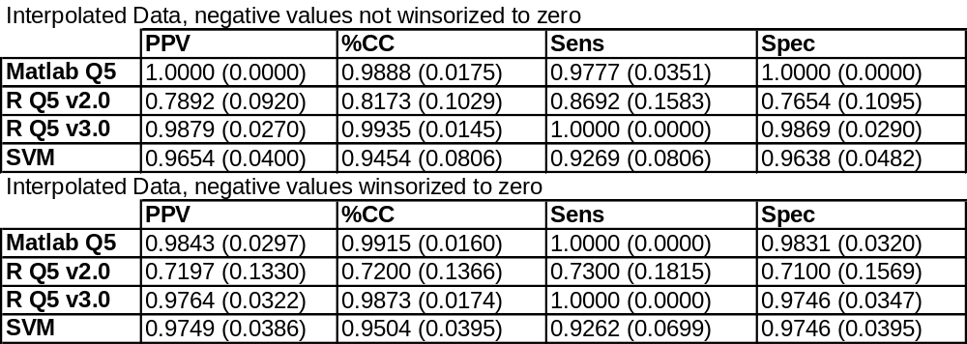
Results: Problem 1
Mean of 100 random test/train splits reported, with SD in parentheses
SVM performs well on this problem
  Suggests a strong signal present in both groups
Matlab Q5 outperforms SVM
R-Q5 2.0 performs differently than Matlab version
  Overall lower performance, higher standard deviation
R-Q5 3.0 performs on par with Matlab version
  Excellent improvement of performance

Slide 7
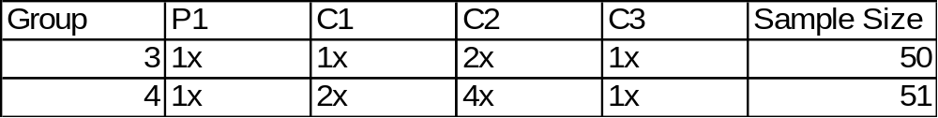
Problem 2: Group 3 versus Group 4
All peptides are present in both mixtures
The two groups are only separated by effect size

Slide 8
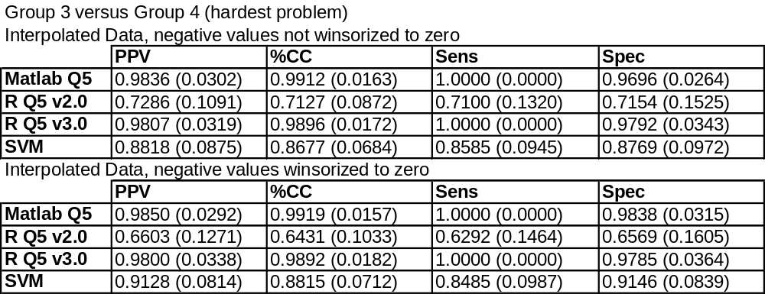
Results Problem 2
Again, R-Q5 2.0 performance is different than Matlab-Q5
R-Q5 3.0 performance is greatly improved
  Outperforms SVM
  Comparable to Matlab version
Both Matlab-Q5 and SVM have good performance
Effect of winsorization:
  Performance of Matlab-Q5 and SVM improved for most part with winsorized data
  R Q5 performs better with non-winsorized data

Slide 9
Conclusions
Data preprocessing for ML algorithms at bare minimum: Spline-based interpolation with winsorization of negative values to zero
Synthetic Dataset is an excellent dataset to compare performance of classification algorithms
Matlab Q5 implementation performs well on both problems, outperforming SVM
Differences between performance for Matlab Q5 and R Q5 2.0 suggest implementation differences
Q5 3.0 has vastly improved performance compared to 2.0
Preprocessed data available for further analysis

