Slide 1
agenda
leftover from part 1
  RNAseq data
  miRNA data
  clinical (tab generation; survival data)
correlations (CN/GE, ME/GE)
filtering for recurrence
data arrays
heatmaps
clusters
chisq’s and Cox models

Slide 2
RNASeq
No formal submissions yet, so download is non-standard
  extract columns from mage-tab & build wget script
COAD and LAML appear to be on different genome builds
LAML uses Ensembl annotations, COAD Entrez Gene
ConvertToZ.pl
most variable genes
  coefficient of variation vs. standard deviation
In general, expression data looks good; exon-level very clean

Slide 3
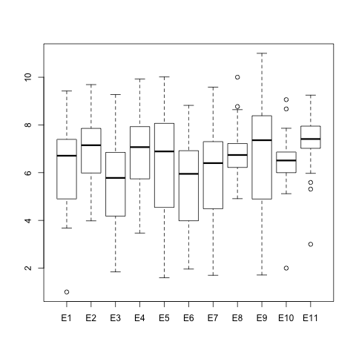
TARGET AML WT1 Affy Exon Expression

Slide 4
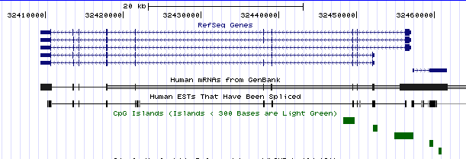
WT1 Transcripts

Slide 5
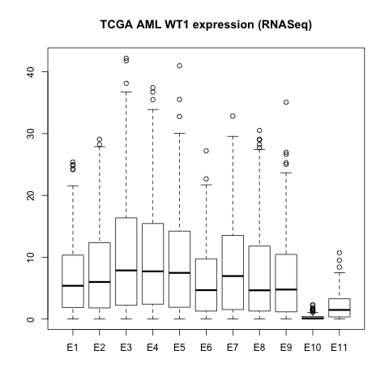
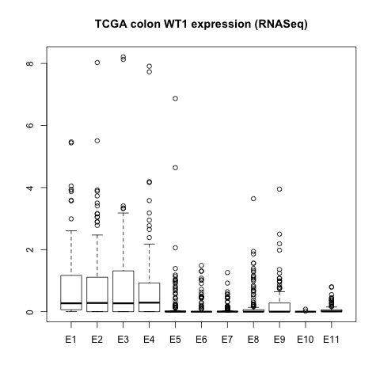
TCGA AML & Colon WT1 RNASeq (RPMK)

Slide 6
more clinical stuff
XML2Tab.csh
  driven by .xsd
  “keys” file to id “foreign keys”
  naïve treatment of name spaces
ExtractColumns.pl to pull survival data

Slide 7
Correlations & Recurrence
goal: focus on genes that are recurrently altered and which seem to be biologically significant
directories $ROOT/Analysis, $ROOT/AnalysisOutput
CN_GE_r.csh
  threshold Pearson r >= 0.60
ME_GE_spearman.csh
  threshold spearman <= -0.50
recurrence.csh
  abs(cn) >= 0.8
  me >= 0.50
  >= 10% of cases

Slide 8
After Filtering for Correlation & Recurrence
Disease | cn,ge >= 0.6 | 10% (abs(cn)<= 0.8) | me,ge <= - 0.50 | 10% (me >= 0.5)
BRCA | 1871 | 235 | 445 | 296
COAD | 724 | 200 | 544 | 377
GBM | 196 | 51 | 194 | 142
KIRC | 1224 | 0 (!) | 621 | 347
LAML | n/a | n/a | 352 | 216
LUAD | 2213 | 15 | 578 | 192
LUSC | 1779 | 141 | 388 | 231
OV | 2407 | 362 | 221 | 159
READ | 876 | 229 | 384 | 201

Slide 9
derived data arrays
cn: log2ratio values
me: z-scores
“ge”: gene expression z-scores for cn, me genes
“ge.ge”: gene expression z-scores for 1,000 most variable genes

Slide 10
analysis(analysis.csh)
survival: 3 quantiles (low, medium, high)
  living cases with last followup before high threshold drop from analysis
clustered heatmaps (Ward method)
  side color for survival group
define 2, 3 clusters with R’s cutree
Cox model for 2, 3 clusters
Individual chisq (3x3) for each gene
For each gene with q-value < 0.05, Cox model
html wrappers (html.csh)

