Slide 1
LOH (Loss of Heterozygosity) Analysis
based on Affymetrix® GeneChip®
10K and 100K Genotyping platform and GDAS (GeneChip DNA Analysis Software) output

Slide 2
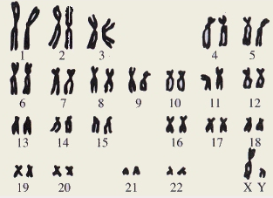
Human Chromosomes
Each human cell contains 23 pairs of chromosomes, which can be distinguished by size and by unique banding patterns.
This set is from a male, since it contains a Y chromosome.
Females have two X chromosomes.

Slide 3
Basic Terms
Locus (pl. loci) – The position on a chromosome of a gene or other chromosome marker; also, the DNA at that position.
Single nucleotide polymorphism (SNP) – DNA sequence variations that occur when a single nucleotide (A, T, C, or G) in the genome sequence is altered.
Allele – Alternative form of a genetic locus; a single allele for each locus is inherited from each parent. (e.g. for a SNP on one chromosome can be allele A or B)
Genotype – The genetic constitution of an organism, as distinguished from its physical appearance (its phenotype). (in case of a SNP it is a combination of alleles from chromosome pair; can be AA, BB or AB)
Heterozygosity – The presence of different alleles at one or more loci on homologous chromosomes (opposite to homozygosity).

Slide 4
Loss of Heterozygosity
Loss of heterozygosity (LOH) is a commonly observed type of genetic alteration, where one allele of a gene is inactivated in most cases by mutation, and the functional allele is deleted.
A
B
A
B
A
A
A
Normal
cells
Deletion (loss)
Amplification (gain)
Tumor-suppressor gene desactivation
Oncogene activation

Slide 5
GDAS® Workflow
GCOS & GDAS are integrated for DNA analysis
Dual applications with data management at desktop level
GDAS
GCOS
Cell
Allele Calling
Data Viewing
Intensity
With
&
Mapping
Data
Quality
NetAffx
Reports
GCOS Database
Scores
Annotations
Basecalling
With
Data Viewing
Cell
Quality
&
Resequencing
Intensity
Scores
Basecall
Reports
Data
&
Editing
Sequence
Alignment
Notes:
- All reports have summary statistics about the call rates.
- The reports also output QC probe intensities.
- Resequencing reports the SNP's for the chip.
- Mapping reports the gender of the sample.

Slide 6
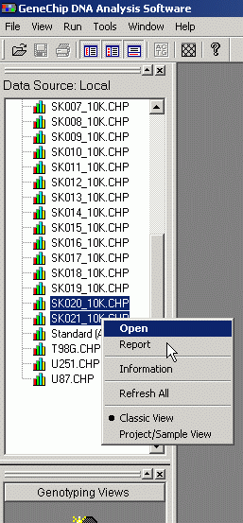
GDAS:
Open Reference and Sample CHP files in Analysis view

Slide 7
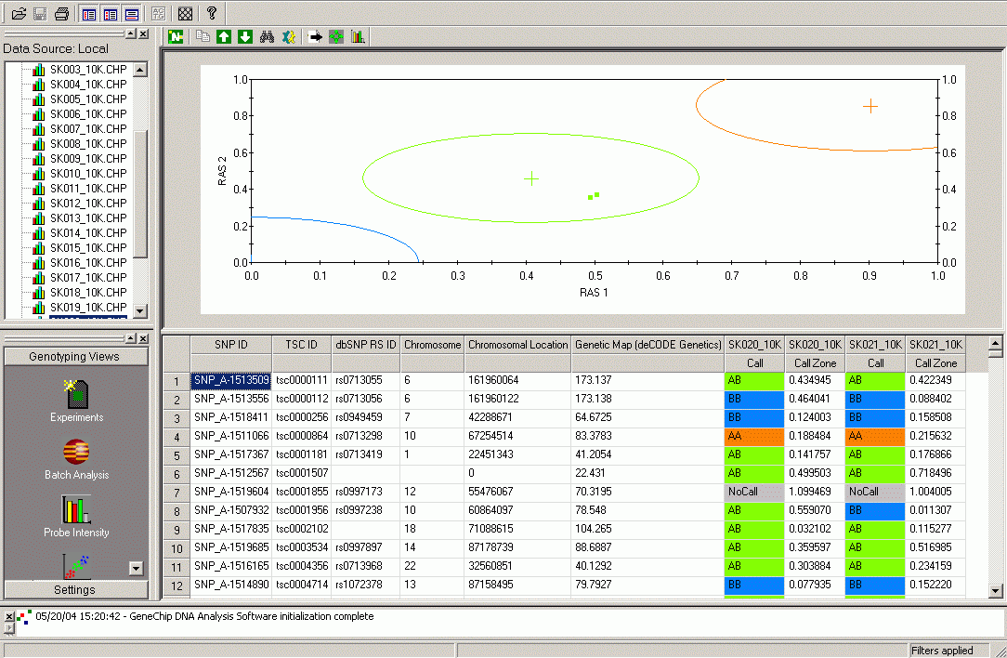
GDAS: 10K Analysis view

Slide 8
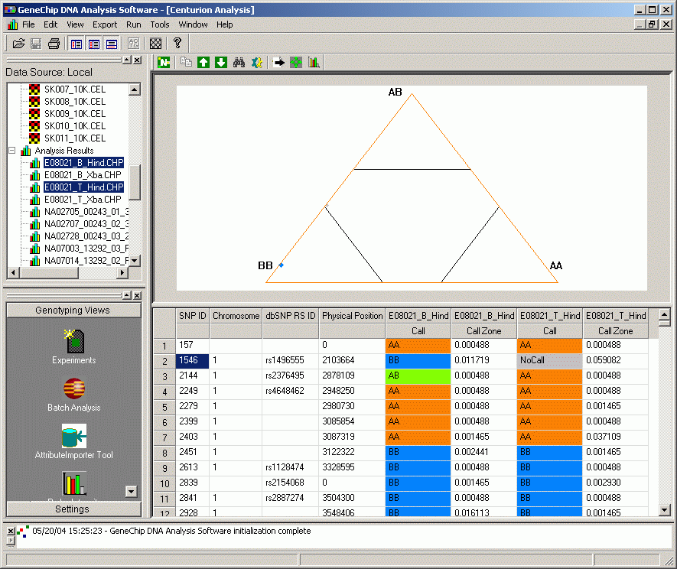
GDAS 3.0: 100K Analysis view

Slide 9
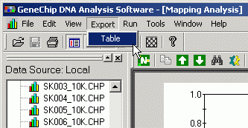
GDAS: Export the Table
The table saved as tab-delimited text file

Slide 10
LOH Analysis Workflow
Allele calling detection in GDAS. Generation of CHP-file from CEL-file.
CHP-files + SNP annotation can be used directly or the combined table can be exported from GDAS.
Open the exported table in Excel
Color genotypes
Insert two new columns (noLOH, LOH) after Chromosome
AutoFilter on
Clean up Chromosome column leaving only numbers; replace X->23, Y->24
Sort by Chromosome , then by Chromosomal Location (Position)
Filter non-blank chromosomes, genotypeR equals “AB”, genotypeS not equals “NoCall” (R – reference, S – sample)
Fill the new columns with
  1: = if( genotypeR=genotypeS, position, ””)
  2: = if( genotypeS<>“AB”, position, ””)
Clean up empty cells in the new columns

Slide 11
LOH Analysis Workflow – The Plot
Select values in three columns: Chromosome, noLOH, LOH
Make XY scatterplot
  Title X axis as “Chromosome”, Y axis as “Position, bp”
  Legends to the bottom
  As separate sheet
Make up the plot
  Symbols: change to “– ”, size 5-10, noLOH – blue, LOH – red
  Y axis: scale – reverse order, number – use 1000 separator
  X axis: scale – major unit 1
  Optional makeup (background, grids, etc)

Slide 12
DEMO

