Slide 1
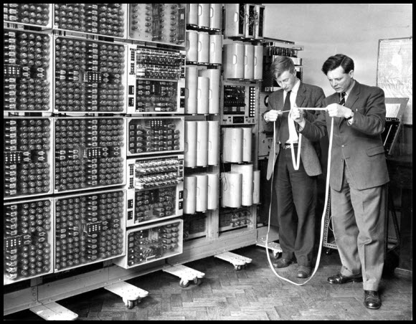
JSDoc – document your code

Slide 2
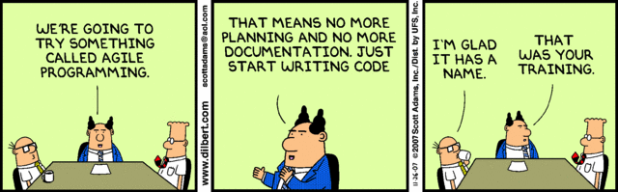
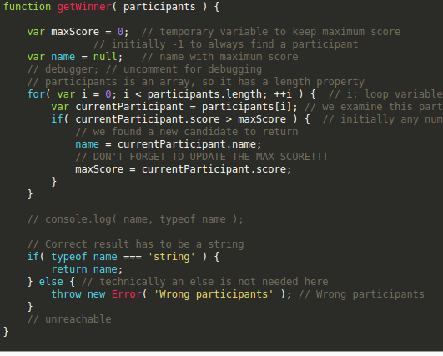

Slide 3
Installation:
  npm install --save-dev jsdoc
  npm install -g jsdoc
Same goes for all the other tools
yarn add global doxdox, esdoc, doxme etc….

Slide 4
Customization:
Create jsdoc.config.json like:
  {
  "plugins": ["plugins/markdown"],
  "recurseDepth": 2,
  "source": {
  "include": ["./"],
  "includePattern": ".+\\.js(doc|x)?$",
  "excludePattern": "(^|\\/|\\\\)_"
  },
  "sourceType": "module",
  "tags": {
  "allowUnknownTags": true,
  },
  "opts": {
  "destination": "./docs"
  },
  "templates": {
  "cleverLinks": false,
  "monospaceLinks": false,
  "theme": "paper"
  }
  }

Slide 5
Automate in package.json
  "scripts": {
  …,
  "create-docs":
  "rm -rf ./docs && jsdoc --jsdoc.config.json --destination ./docs ./README.md",
  "create-esdoc": "esdoc",
    "create-doxdox": "doxdox './**/*.js' --layout bootstrap --output doxs/index.html",
  },

Slide 6
Important ‘tags’:
  @param: for all parameters
  @returns: describes return value
  @example: creates code-highlighted example
  @throws: details about possible errors thrown
  @typedef {Object} User
    @property: {string} id – unique id of user
    @property: {string[]} notes – array of notes
    …
Using typedef like @param {User} currentUser
See them all at usejsdoc.org

Slide 7
Alternatives to JSDoc
They all use the same comment syntax but look much better and have more functionality.
Dox & DoxMe
Documentation
YuiDocs
Runner up: DoxDox, doesn’t seem to do @typedefs out of the box
Winner: Esdoc: searchable, clear layout etc...

Slide 8
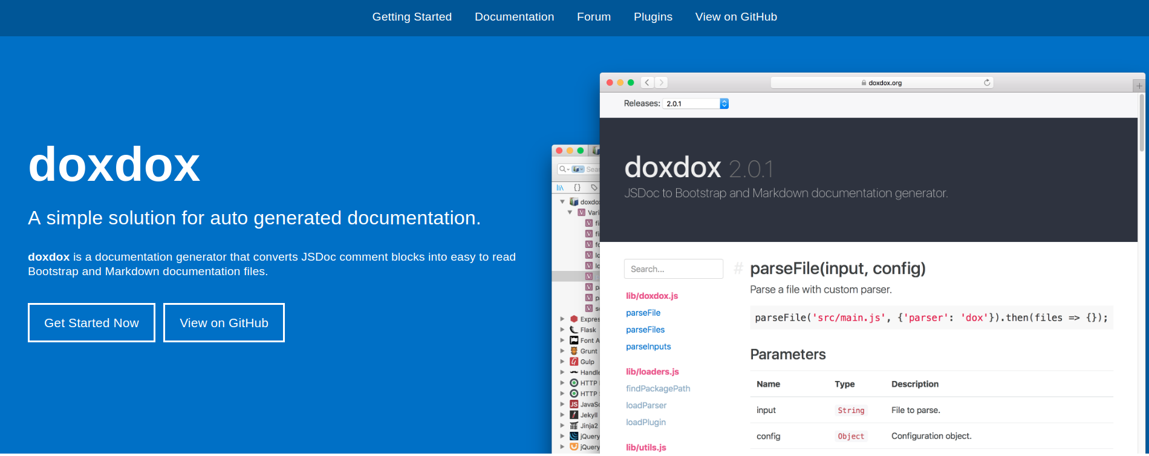
DoxDox: https://doxdox.org/
Easiest to use, most readable
doxdox './**/*.js' --layout bootstrap --output docs/index.html

Slide 9
Drawbacks of DoxDox:
Haven’t figured out how to
  include README.md as ‘main page’ like
  @global @typedefs don’t seem to work like in JSDoc.

Slide 10
Tips for Esdoc:
Install as dev dependicies extra plugins
Config is .esdoc.json
Play around with documentation coverage, integrate test codes…
By default needs to actually import functions etc to be documented.

