Slide 1

ChatterBot
巨量資料分析
Technical Presentations
統計三 李艾霓

Slide 2
安裝套件
> pip install chatterbot

Slide 3
下載語料庫
> pip install chatterbot
reurl.cc/2gjkl4
or
https://github.com/gunthercox/chatterbot-corpus
把「chatterbot_corpus」整個資料夾放到C:\Users\your_user_name裡

Slide 4
ChatterBot 是什麼?
reurl.cc/2gjkl4
ChatterBot是使用Python構建的基於機器學習的對話引擎，它可以基於已知對話的集合來生成回應。
ChatterBot的語言獨立設計使其可以接受任何語言的訓練。

Slide 5
運作方式
未經訓練的ChatterBot一開始不知道如何進行對話。 每次用戶輸入語句時，資料庫都會保存他們輸入的文本以及該語句回應的文本。 隨著ChatterBot收到更多的輸入，它可以答覆的回應數和每個回應相對於輸入語句的準確性都會提高。 該程式透過搜索與輸入最接近的已知語句來選擇最接近的對應回應，然後根據與機器人溝通的用戶發出每個回應的頻率，回傳最有可能的回應。

Slide 6
基本用法(CorpusTrainer)
from chatterbot import ChatBot
from chatterbot.trainers import ChatterBotCorpusTrainer
chatbot = ChatBot('YOUR CHATBOT NAME')
# Create a new trainer for the chatbot
trainer = ChatterBotCorpusTrainer(chatbot)
# Train the chatbot based on the english corpus
trainer.train("chatterbot.corpus.english")
# Get a response to an input statement
chatbot.get_response("Good morning! How are you doing?")

Slide 7
ListTrainer
from chatterbot.trainers import ListTrainer
chatbot = ChatBot('Example Bot')
# Start by training our bot with the ChatterBot corpus data
trainer = ListTrainer(chatbot)
trainer.train([
'Hello, how are you?',
'I am doing well.',
'That is good to hear.',
'Thank you'
])

Slide 8
ListTrainer (cont.)
# You can train with a second list of data to add response variations
trainer.train([
'Hello, how are you?',
'I am great.',
'That is awesome.',
'Thanks'
])
# Now let's get a response to a greeting
response = chatbot.get_response('Hello, how are you?')
print(response)

Slide 9
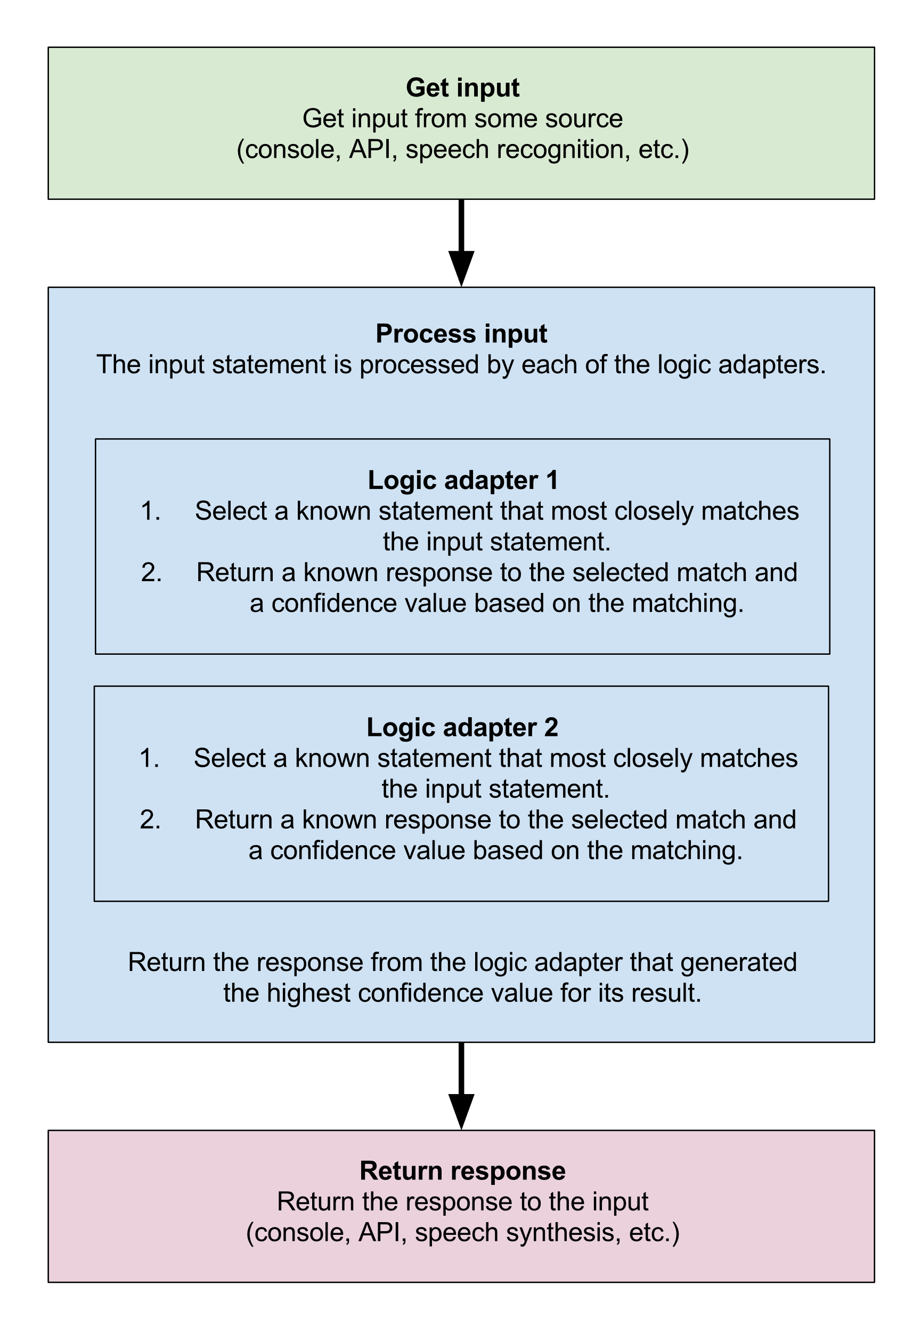
完整結構

Slide 13
單位換算邏輯適配器
bot = ChatBot('Unit Converter',
logic_adapters=['chatterbot.logic.UnitConversion',]
)
questions = [
'How many meters are in a kilometer?',
'How many meters are in one inch?',
'0 celsius to fahrenheit',
'one hour is how many minutes ?'
]
# Prints the convertion given the specific question
for question in questions:
response = bot.get_response(question)
print(question + ' - Response: ' + response.text)

Slide 14
最佳匹配邏輯適配器(預設回應)
# Create a new instance of a ChatBot
bot = ChatBot(
'Example Bot',
storage_adapter='chatterbot.storage.SQLStorageAdapter',
logic_adapters=[
{
'import_path': 'chatterbot.logic.BestMatch',
'default_response': 'I am sorry, but I do not understand.',
'maximum_similarity_threshold': 0.90
}
]
)
trainer = ListTrainer(bot)

Slide 15
最佳匹配邏輯適配器(預設回應) (cont.)
# Train the chat bot with a few responses
trainer.train([
'How can I help you?',
'I want to create a chat bot',
'Have you read the documentation?',
'No, I have not',
'This should help get you started: http://chatterbot.rtfd.org/en/latest/quickstart.html'
])
# Get a response for some unexpected input
response = bot.get_response('How do I make an omelette?')
print(response)

Slide 16
數學及時間邏輯適配器
bot = ChatBot(
'Math & Time Bot',
logic_adapters=[
'chatterbot.logic.MathematicalEvaluation',
'chatterbot.logic.TimeLogicAdapter'
]
)
# Print an example of getting one math based response
response = bot.get_response('What is 4 + 9?')
print(response)
# Print an example of getting one time based response
response = bot.get_response('What time is it?')
print(response)

Slide 17
特定回答邏輯適配器
# Create a new instance of a ChatBot
bot = ChatBot(
'Exact Response Example Bot',
storage_adapter='chatterbot.storage.SQLStorageAdapter',
logic_adapters=[
{'import_path': 'chatterbot.logic.BestMatch'},
{'import_path': 'chatterbot.logic.SpecificResponseAdapter',
'input_text': 'Help me!',
'output_text': 'Ok, here is a link: http://chatterbot.rtfd.org'}
]
)
# Get a response given the specific input
response = bot.get_response('Help me!')
print(response)

Slide 18
其他範例

Slide 19
從回饋學習

Slide 20
輸出資料
chatbot = ChatBot('Export Example Bot')
# First, lets train our bot with some data
trainer = ChatterBotCorpusTrainer(chatbot)
trainer.train('chatterbot.corpus.english')
# Now we can export the data to a file
trainer.export_for_training('./my_export.json')

Slide 21
Mini-Homework

Slide 22
訓練一個繁體中文 ChatBot
TENET.txt 是電影《天能》的繁體中文字幕文字檔，請使用這份資料訓練一個繁體中文的 ChatterBot (雖然它只會講很瞎的電影台詞)。
請設定使它在回應的信心不超過0.5時，一律回答「抱歉，我不太懂。」
請和它對話以確認是否有正確訓練

