Slide 1


BIG DATA ANALYSIS
TA class III
TA : Lee Chi-Hsuan

Slide 2


Git & GitHub

Slide 3
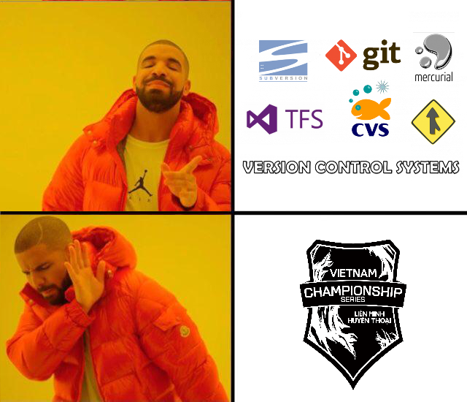
VCS
Version Control System

Slide 4
A system that records changes to files over time so that you can recall specific versions later.

Slide 5

Local VCS

Slide 6
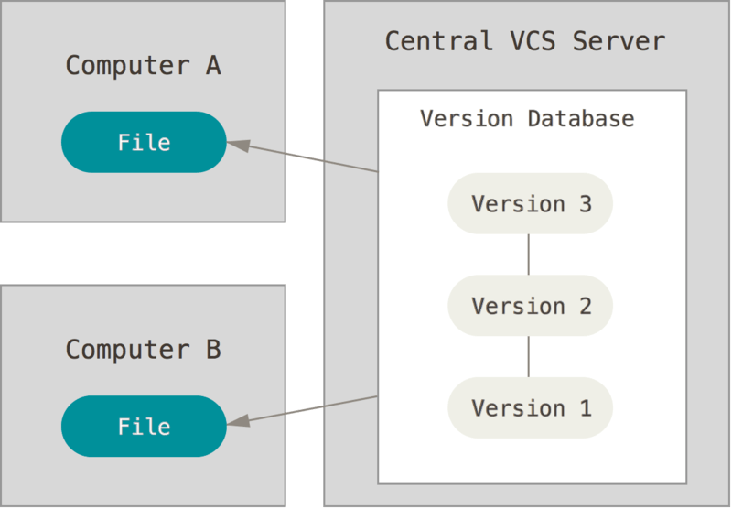
Centralized VCS

Slide 7
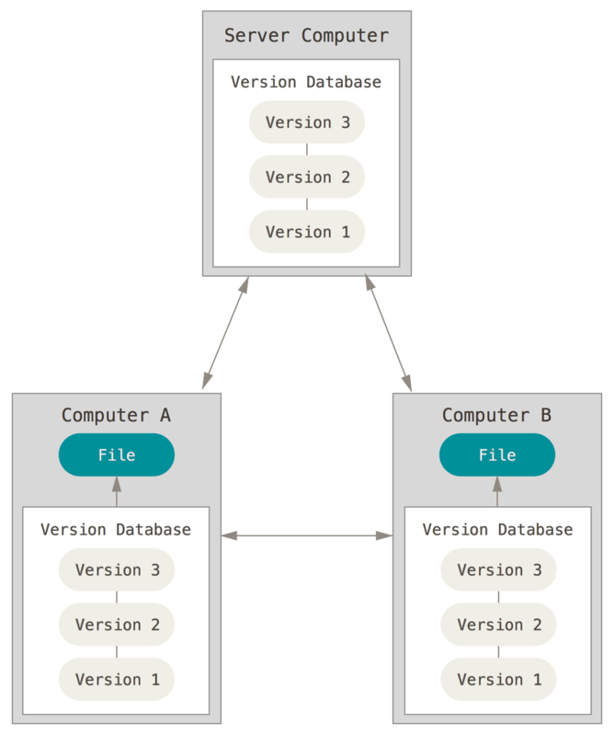
Distributed Version VCS

Slide 8
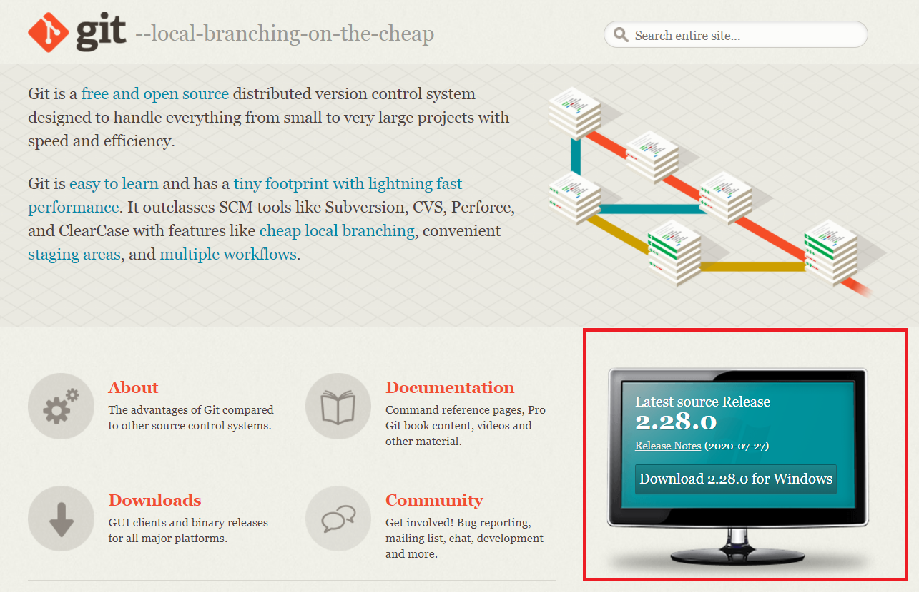

Git

Slide 9
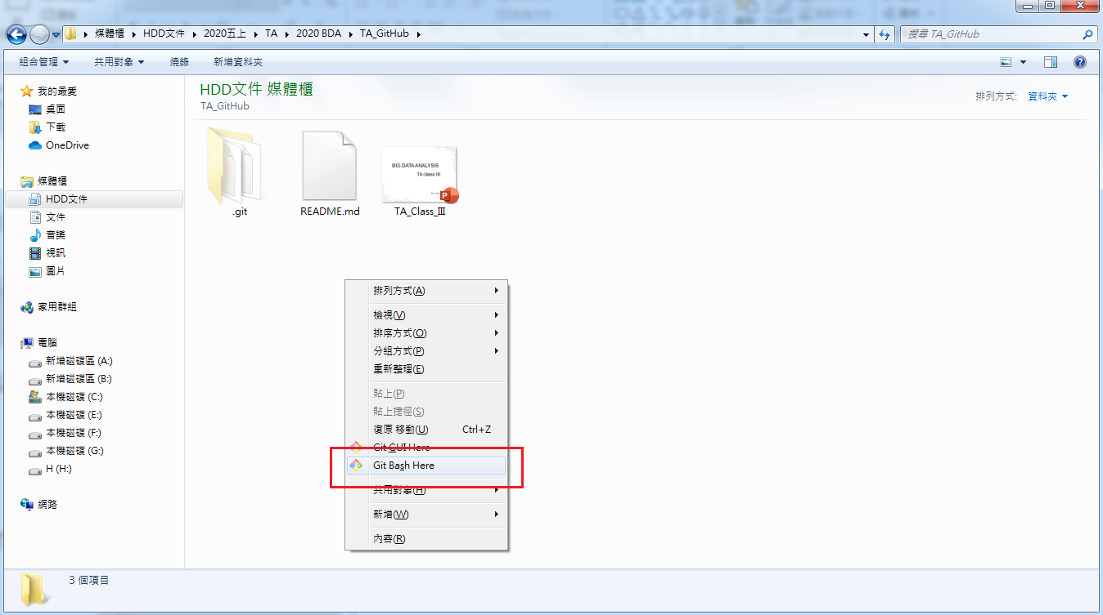
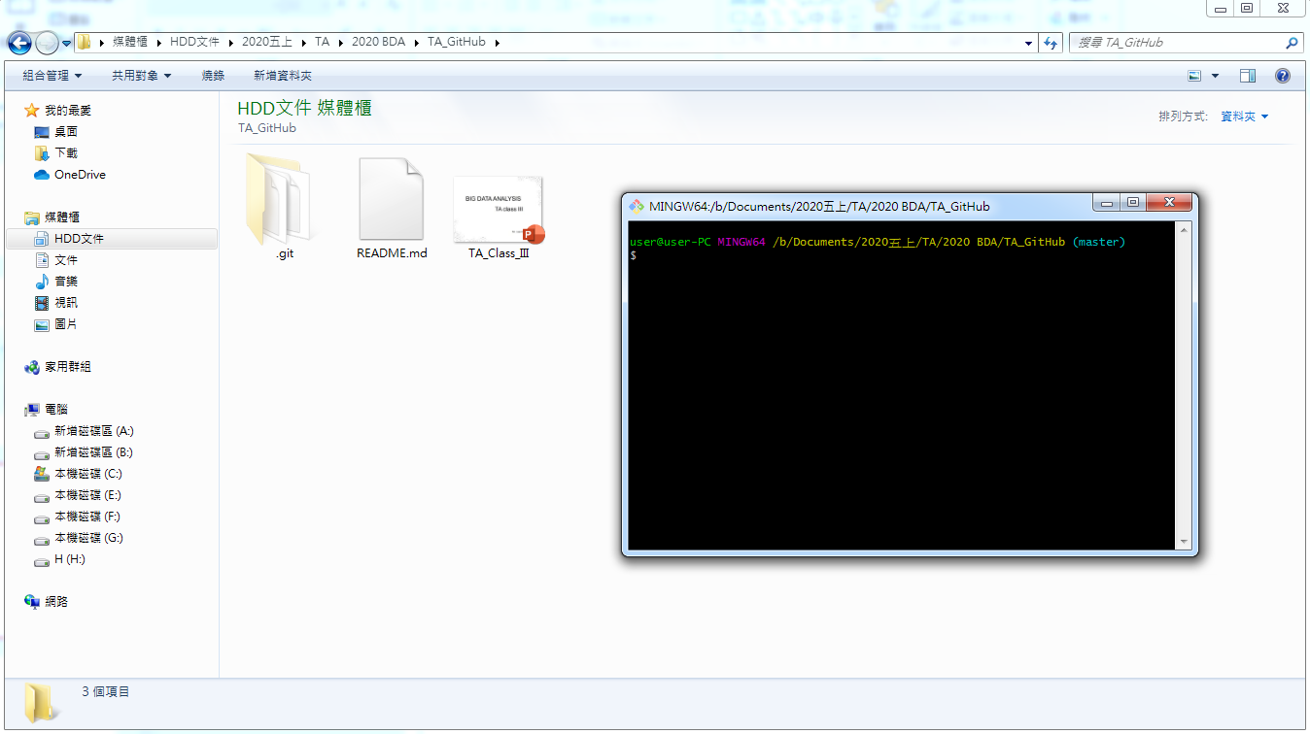
First Steps with Git

Slide 10
Your Identity
．git config --global user.email "your_email_account.gmail.com"
．git config --global user.name "your name"

Slide 11
． git init

Slide 12
Three state of tracking files :
．modified
．staged
．committed
state

Slide 13

．Snapshotting your repository

Slide 14
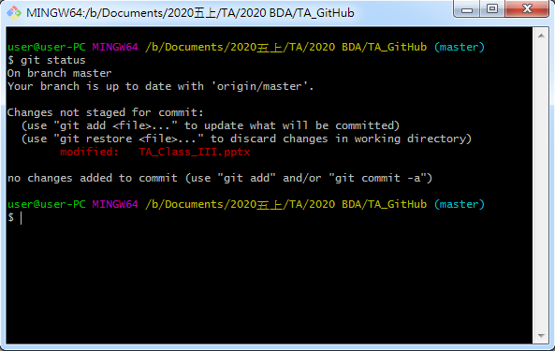
． git status

Slide 15
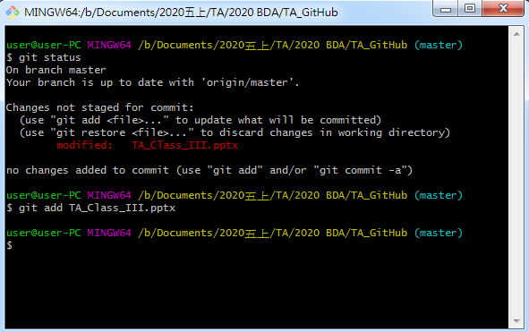
． git add

Slide 16
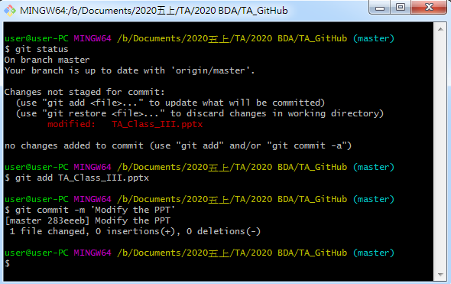
． git commit –m ‘…’

Slide 17
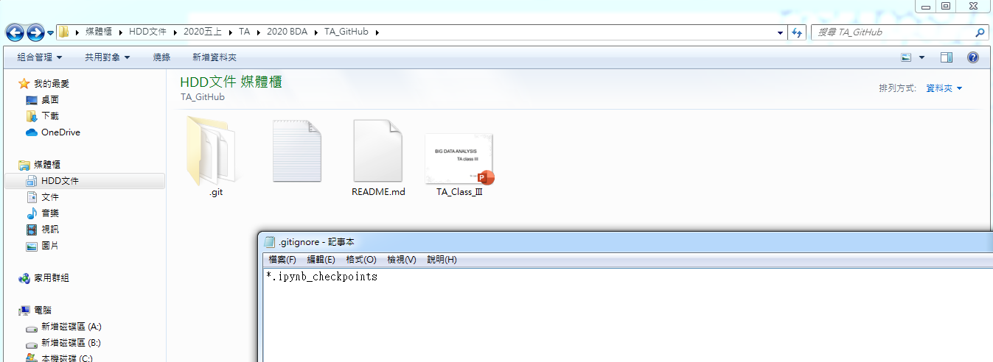
.gitignor

Slide 18
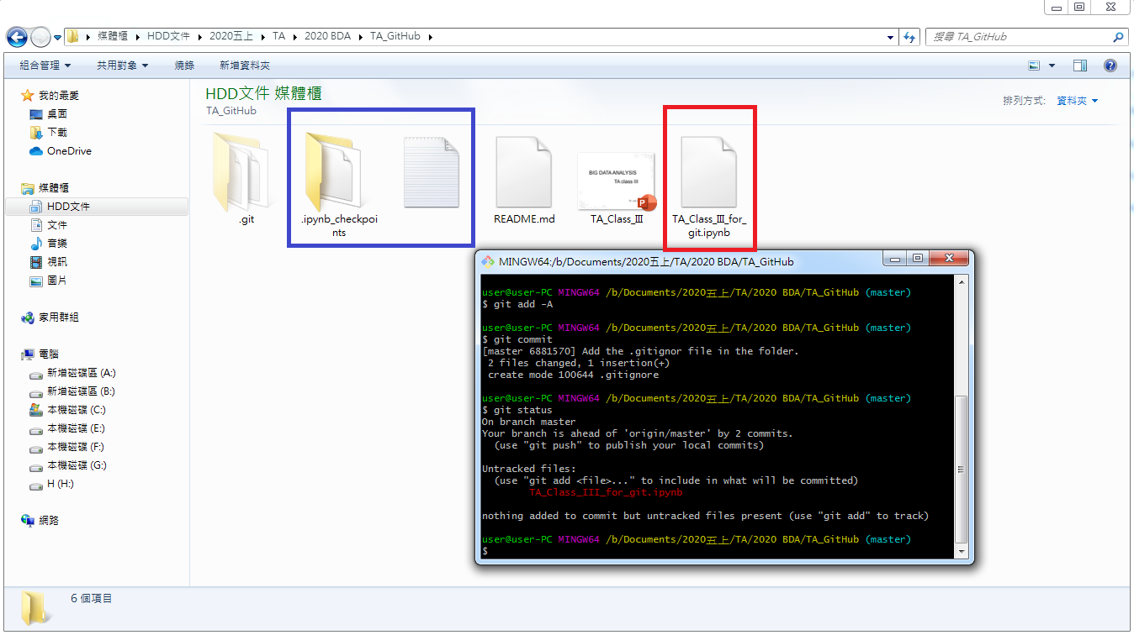
…after adding an ipynb file
(the ipynb_checkpoints is ignored)

Slide 19
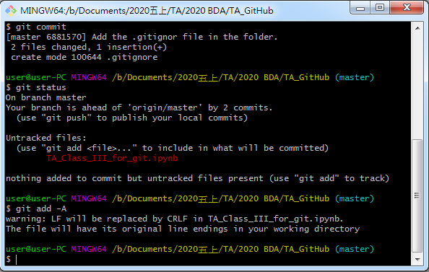
． git add -A

Slide 20
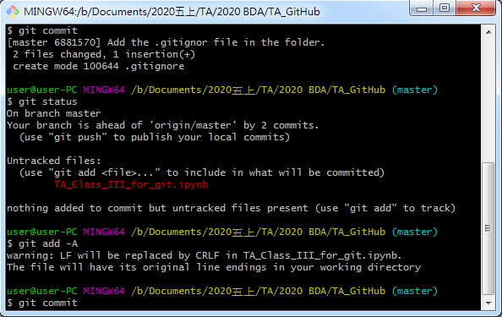
． git commit

Slide 21
． vim
．press ‘i’
．write your commit message
．press ‘Esc’
．type ‘:wq’

Slide 22
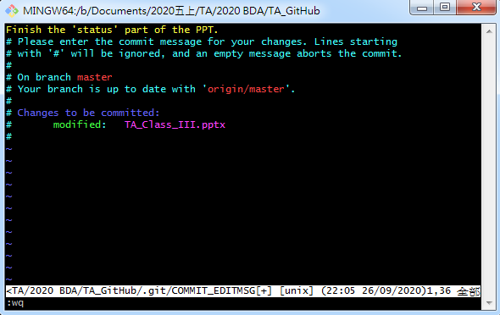

Slide 23
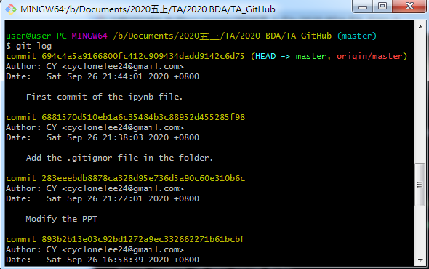
． git log

