Slide 1


BIG DATA ANALYSIS
TA class III
TA : Lee Chi-Hsuan

Slide 2


Git & GitHub

Slide 3

VCS
Version Control System

Slide 4
A system that records changes to files over time so that you can recall specific versions later.

Slide 5

Local VCS

Slide 6
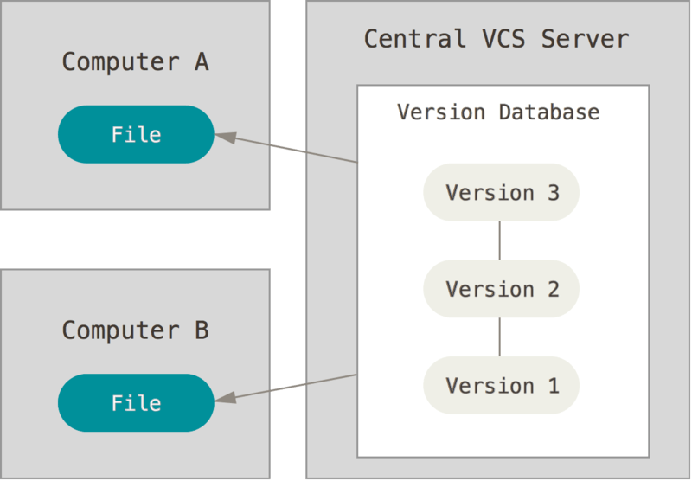
Centralized VCS

Slide 7
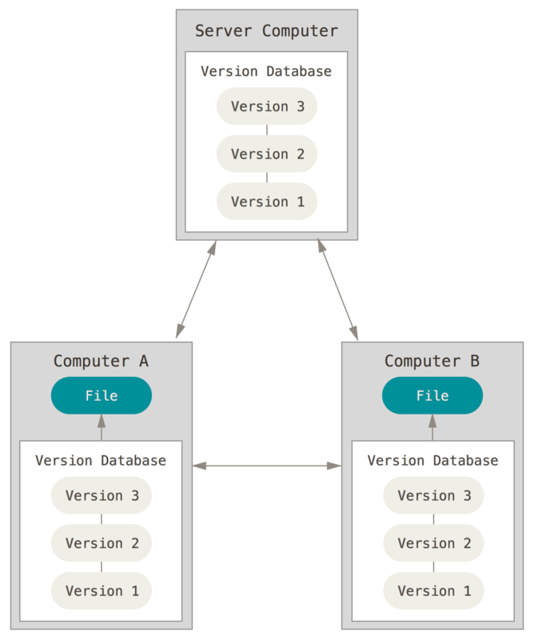
Distributed Version VCS

Slide 8
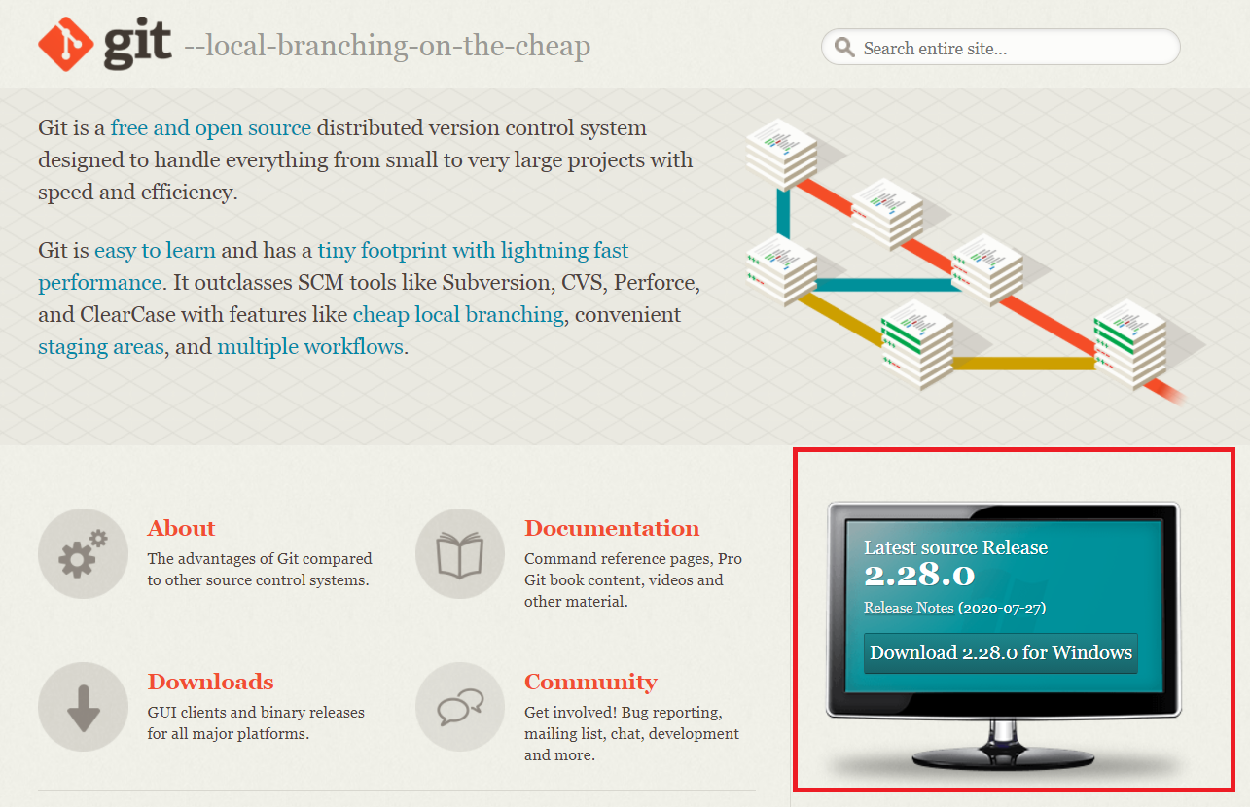

Git

Slide 9
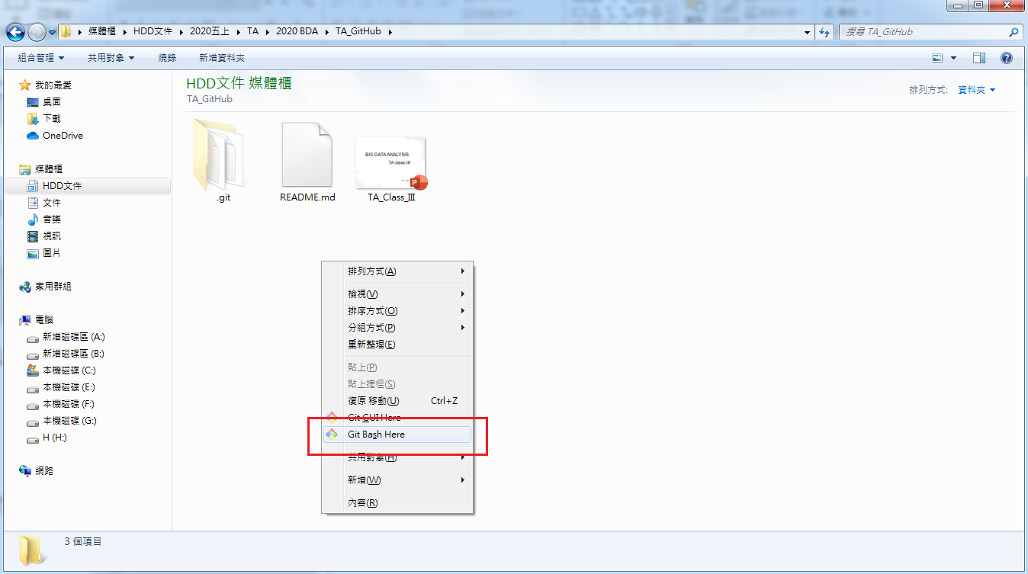
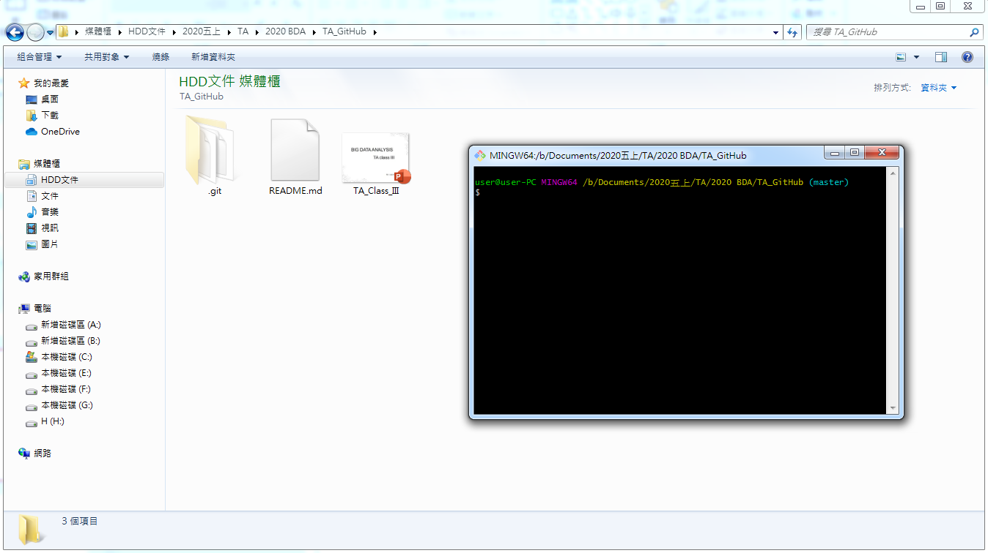
First Steps with Git

Slide 10
Your Identity
．git config --global user.email "your_email_account.gmail.com"
．git config --global user.name "your name"

Slide 11
．git init

Slide 12
Three state of tracking files :
．modified
．staged
．committed
state

Slide 13

．Snapshotting your repository

Slide 14
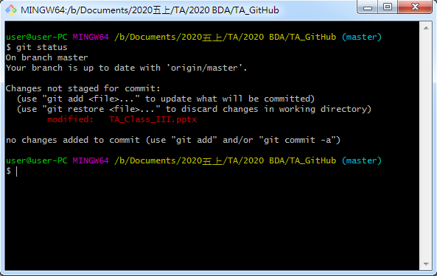
．git status

Slide 15
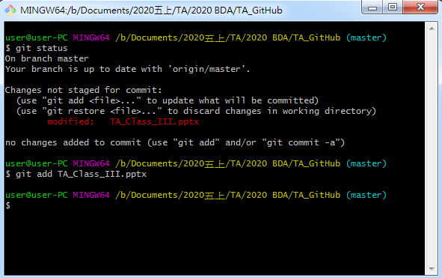
．git add

Slide 16
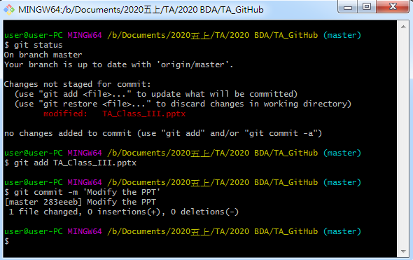
．git commit –m ‘…’

Slide 17
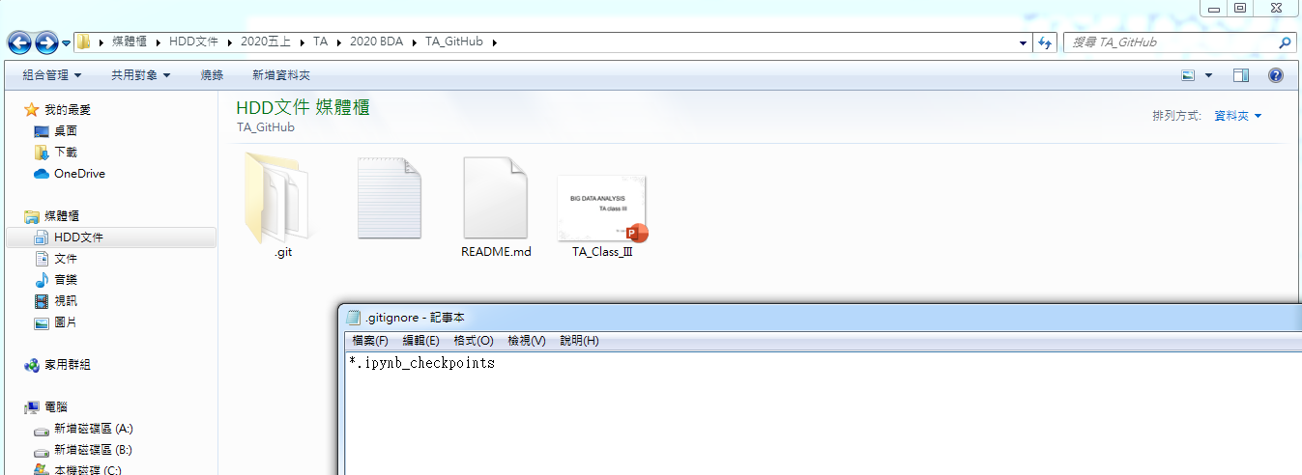
.gitignor

Slide 18
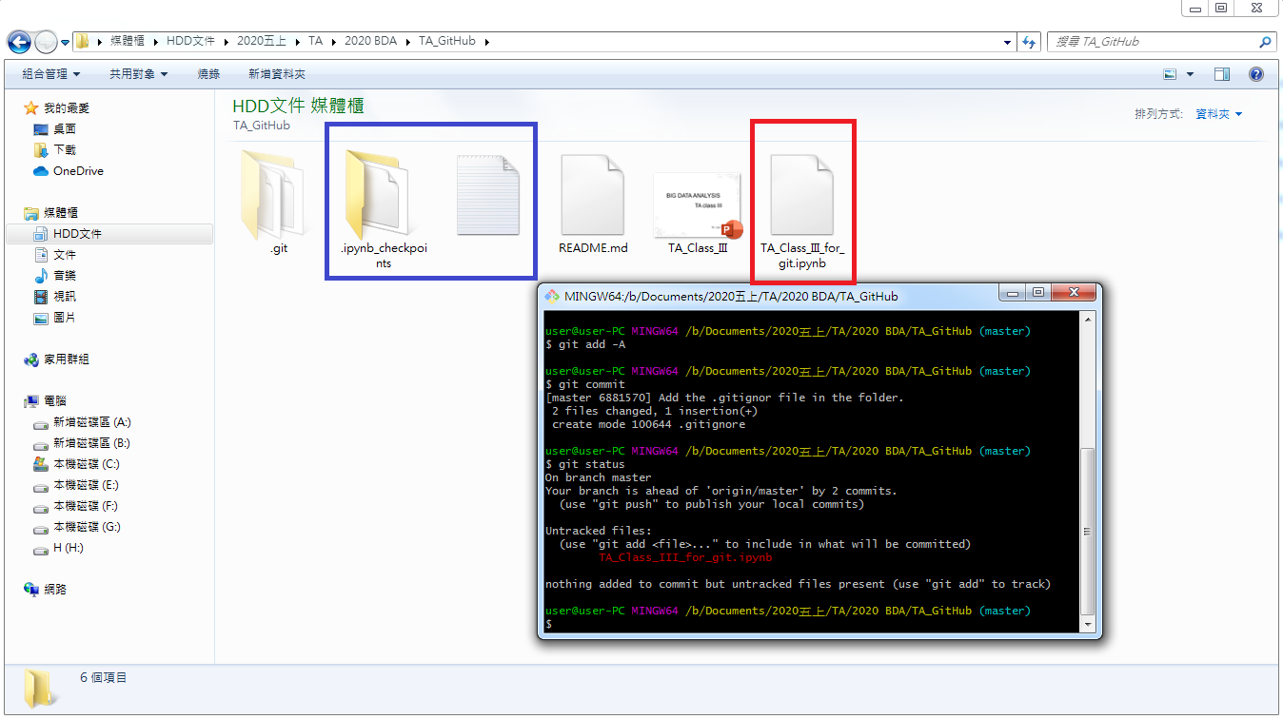
…after adding an ipynb file
(the ipynb_checkpoints is ignored)

Slide 19
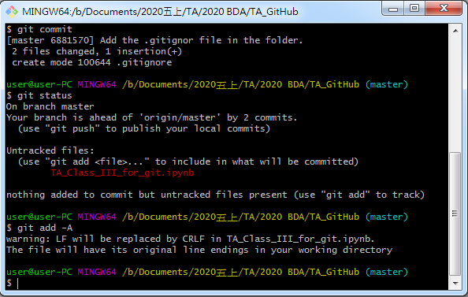
．git add -A

Slide 20
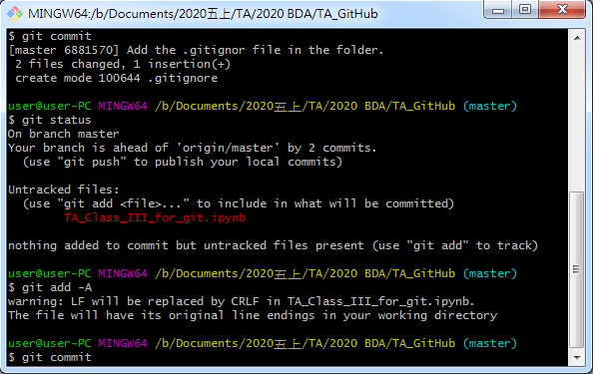
．git commit

Slide 21
．vim
．press ‘i’
．write your commit message
．press ‘Esc’
．type ‘:wq’

Slide 22
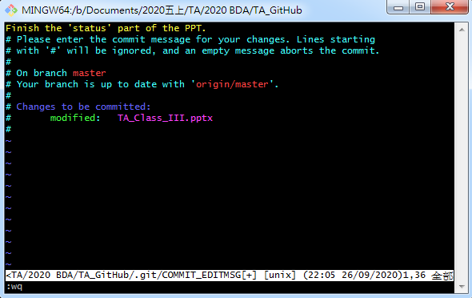

Slide 23
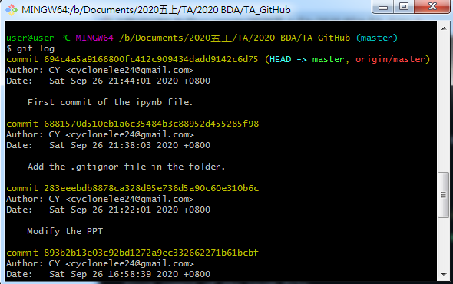
．git log

Slide 24

．git checkout <sha1>
to check out a particular commit
(detached HEAD !)
．git revert <sha1>
to revert a particular commit
<sha1>

Slide 25
branch
The default branch git create for you when a new git repo is initialized is called “master”.

Slide 26
Branches enable changes to be worked on without disruption the most current working state,

Slide 27
．git branch branch_name

Slide 28
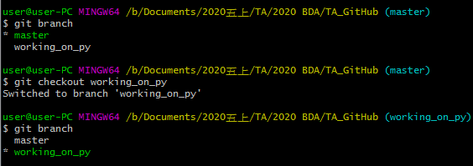
．git branch

Slide 29
＊master
。main file
git checkout –b new_branch
modify
。main file
．new file
。main file
。main file
．new file
add, commit
merge

Slide 30
．history of diff. branches are diff.
．git branch –d branch_name
．git merge branch_name
．fast-forward merge (when no diverge)
．three-way merge (diverge but no conflict)
．conflict ? Fix it, add, and commit

Slide 31

GitHub

Slide 32

．A web-based Git repository
hosting service.
．On top of Git’s functions,
it includes extra features.

Slide 33
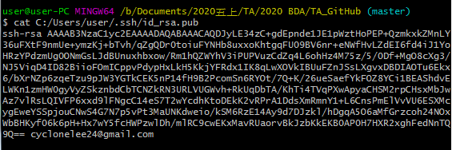
．ssh-key：let GitHub know your identity
．$ ssh-keygen
．you can skip entering the passphrase
．$ cat /directory of your key/id_rsa.pub

Slide 34
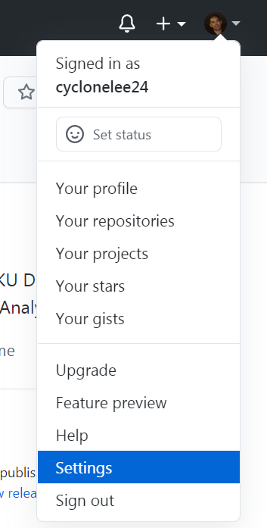
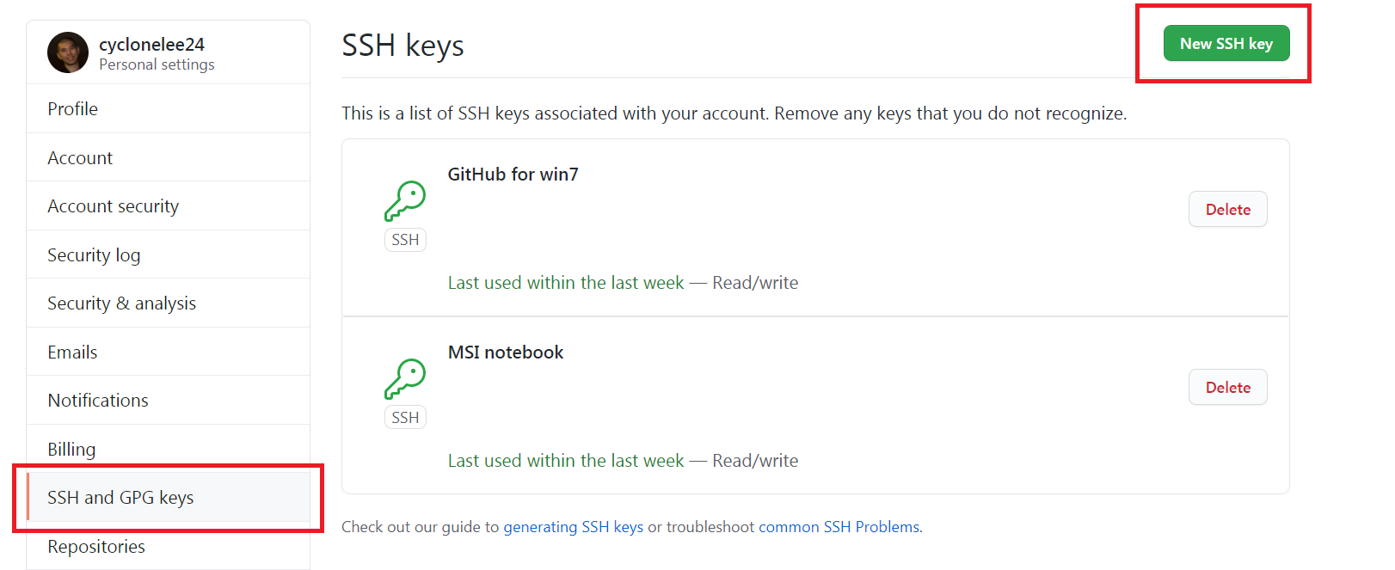
．copy from ssh-rsa… to …@gmail.com
(or to …@pc-name)

Slide 35
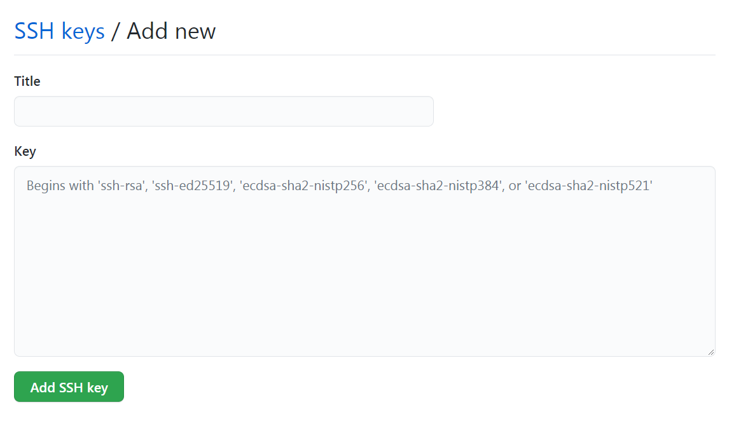
．Identify yourself with id_rsa.pub to GitHub

Slide 36
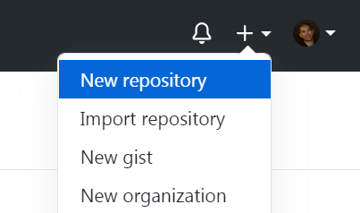
．push your repository to GitHub

Slide 37
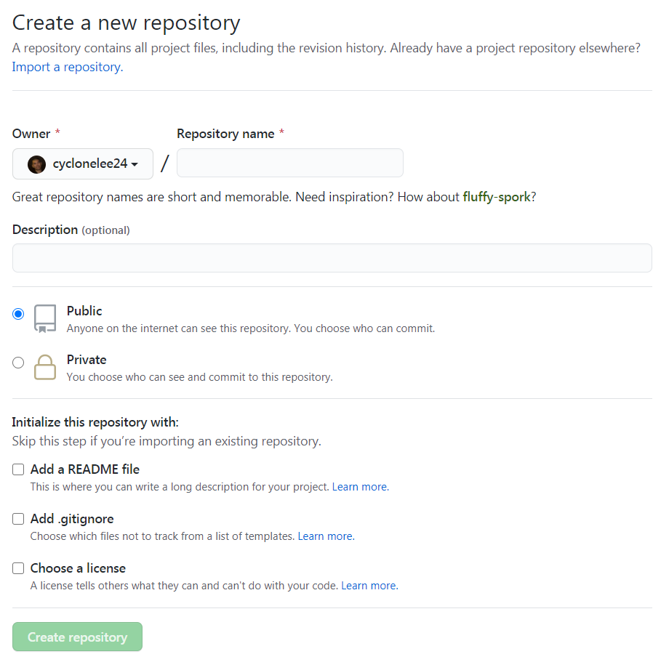

Slide 38
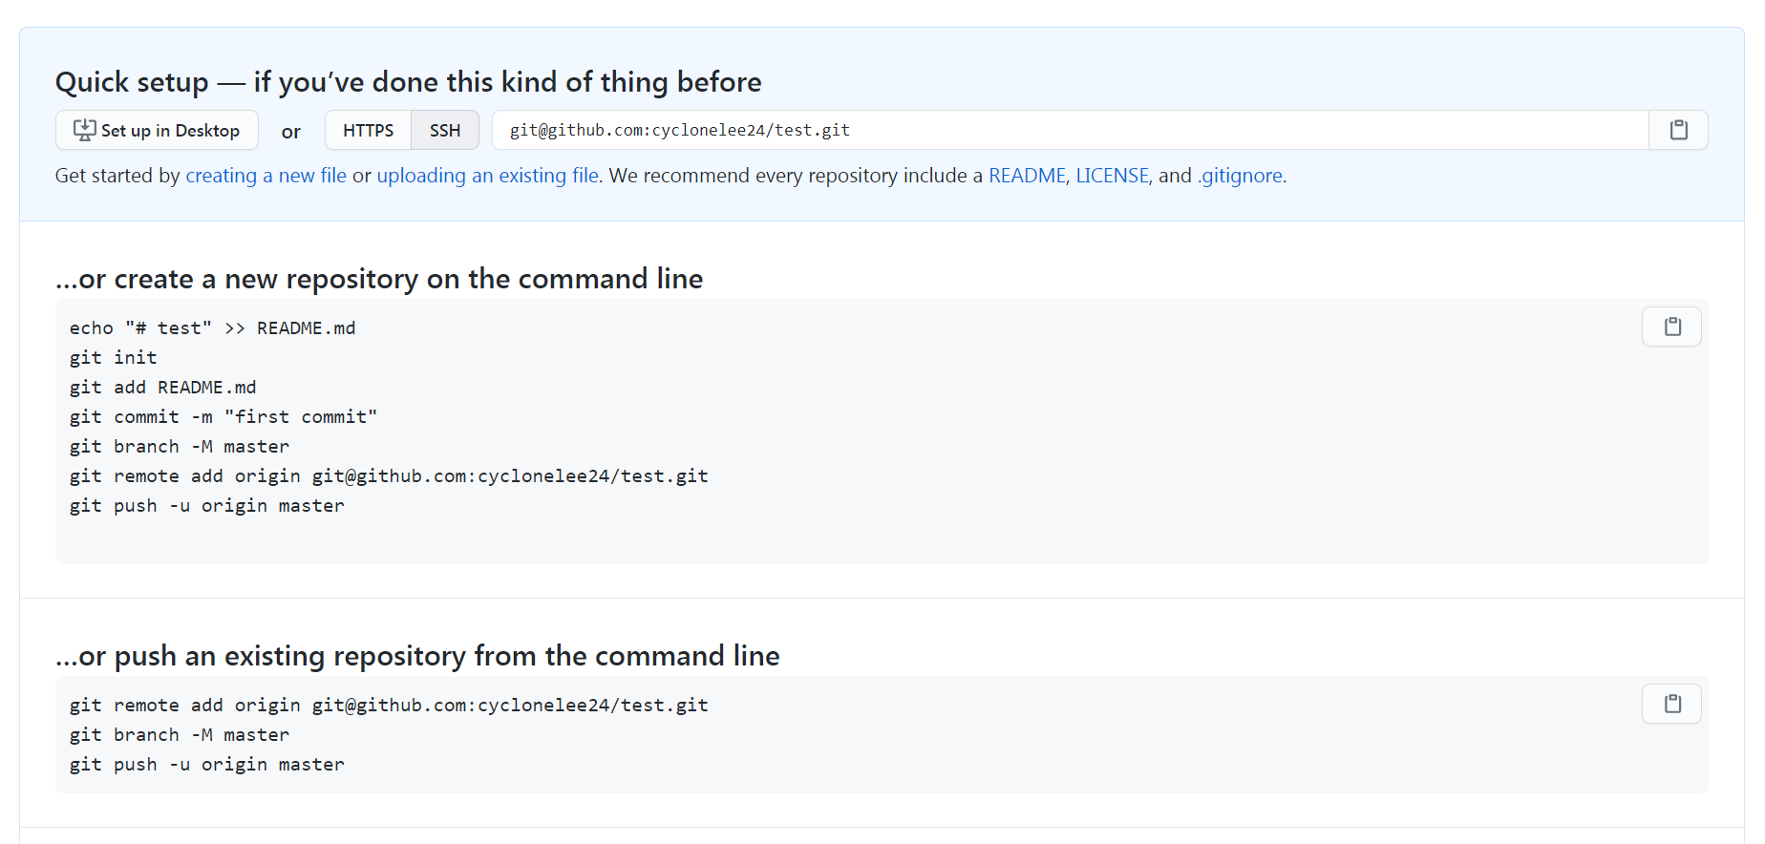

Slide 39
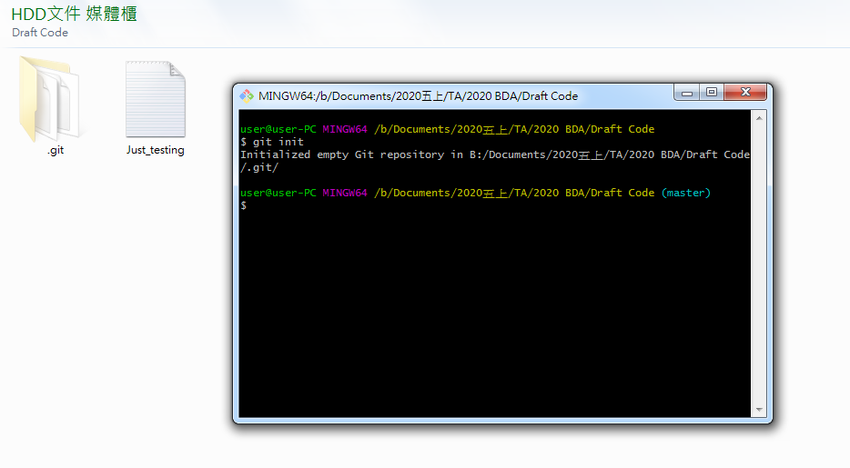

Slide 40
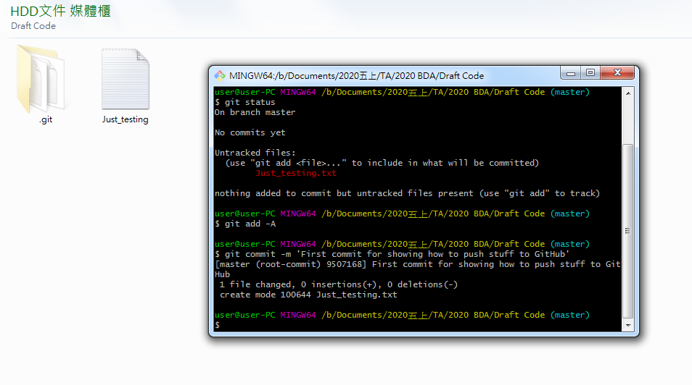
．local

Slide 41
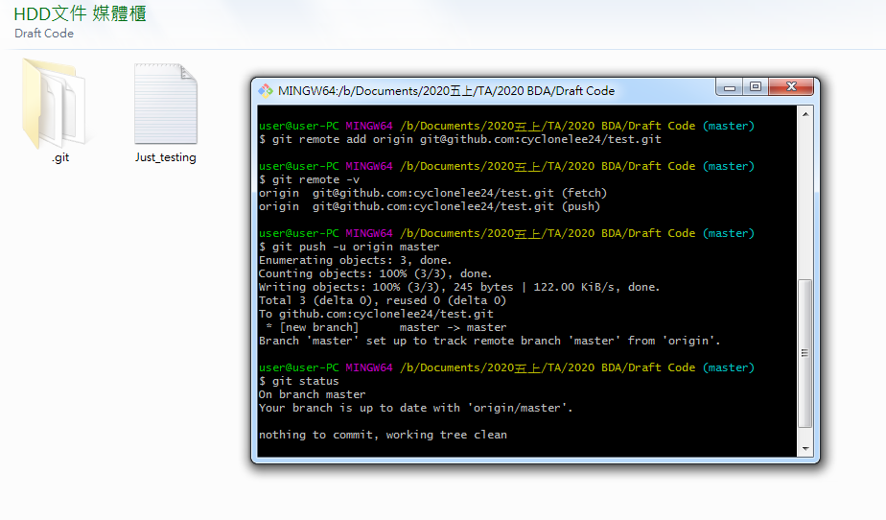
．remote

Slide 42
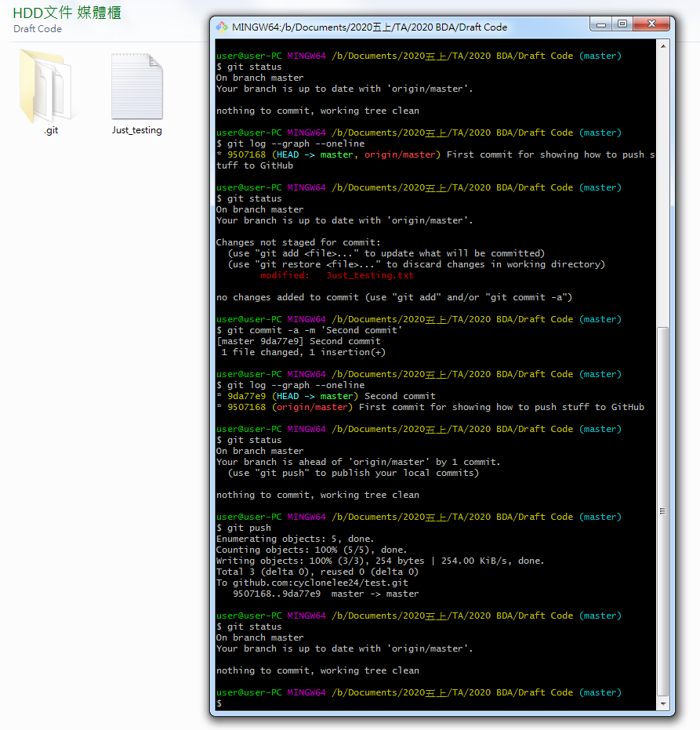
．push

Slide 43
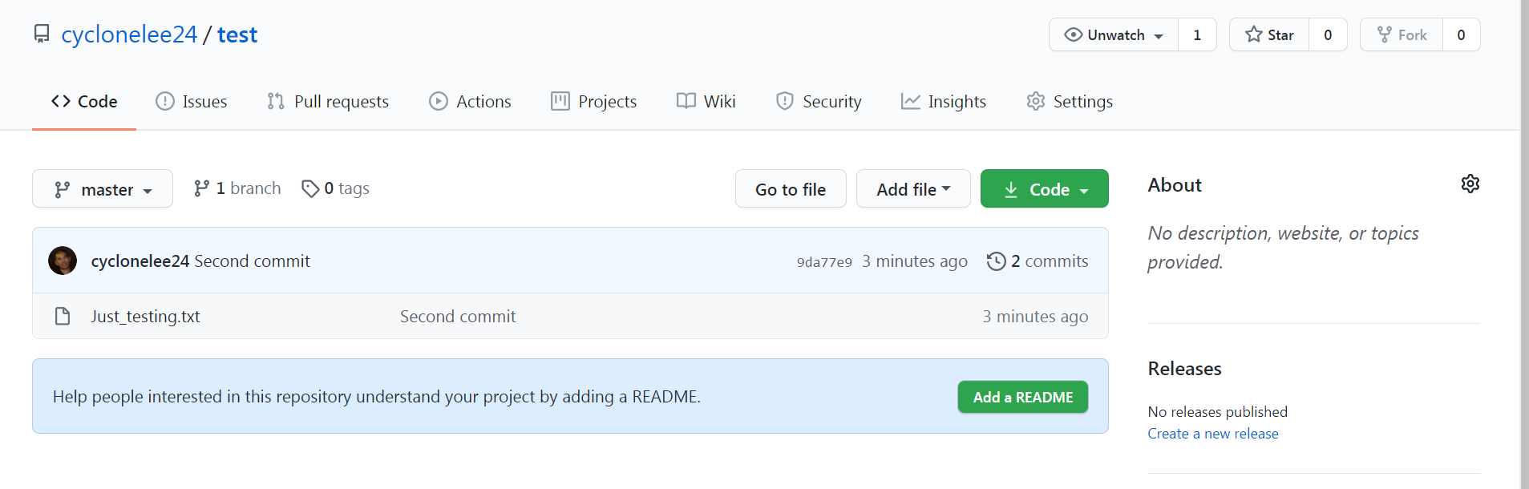

Slide 44
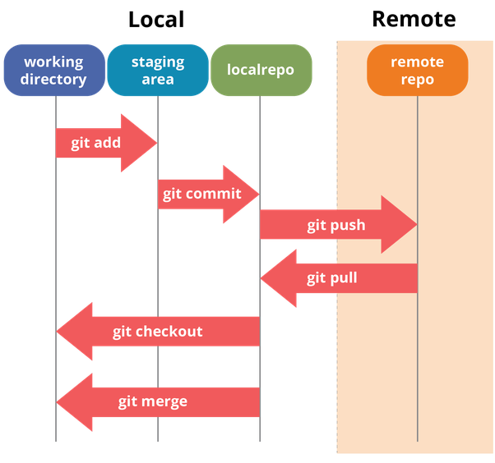

Slide 45
．git fetch：copy the commit done with
the remote repository to your branch
．git merge
．git pull = git fetch + git merge
．case：if origin/master is ahead
→ git merge origin/master

Slide 46
．if remote repository has changes local
repository does not have：
cannot push (can’t fast-forward merge)
→ sync your local repository first

Slide 47
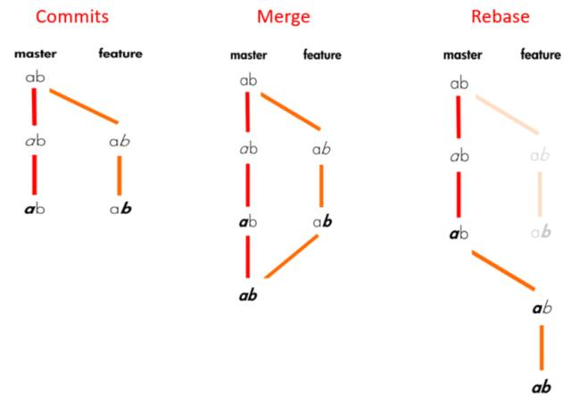
．git rebase：move current branch on top
of the rebased branch

Slide 48
．rebase keep the history linear
．use it when the changes are minor
．be careful when using rebase
．rebase = rewrite the history of commits

Slide 49
Some remarks
．Use remote repository to incorporate
with others.
．Always synchronize your branch
before starting any work on you own.
．Avoid large change that modify a lot of
different things.

Slide 50
．push/pull often to reduce conflict.
．Regularly merge changes made on
the master branch back to your branch.
．Should not rebase changes that have
been pushed to remote repository.

Slide 51
．Forking：A way of creating a copy of
the given repository so that this copy
belongs to you.
．you can push changes to your forks
．pull request：commit(s) that you send
to the owner of the original repository
so that they incorporate it into their tree

Slide 52
．proposed file change：commit on
your fork → then create pull request
．same branch → same pull request
different branch → different pull request
．different projects may have different
pull request guidelines

Slide 53
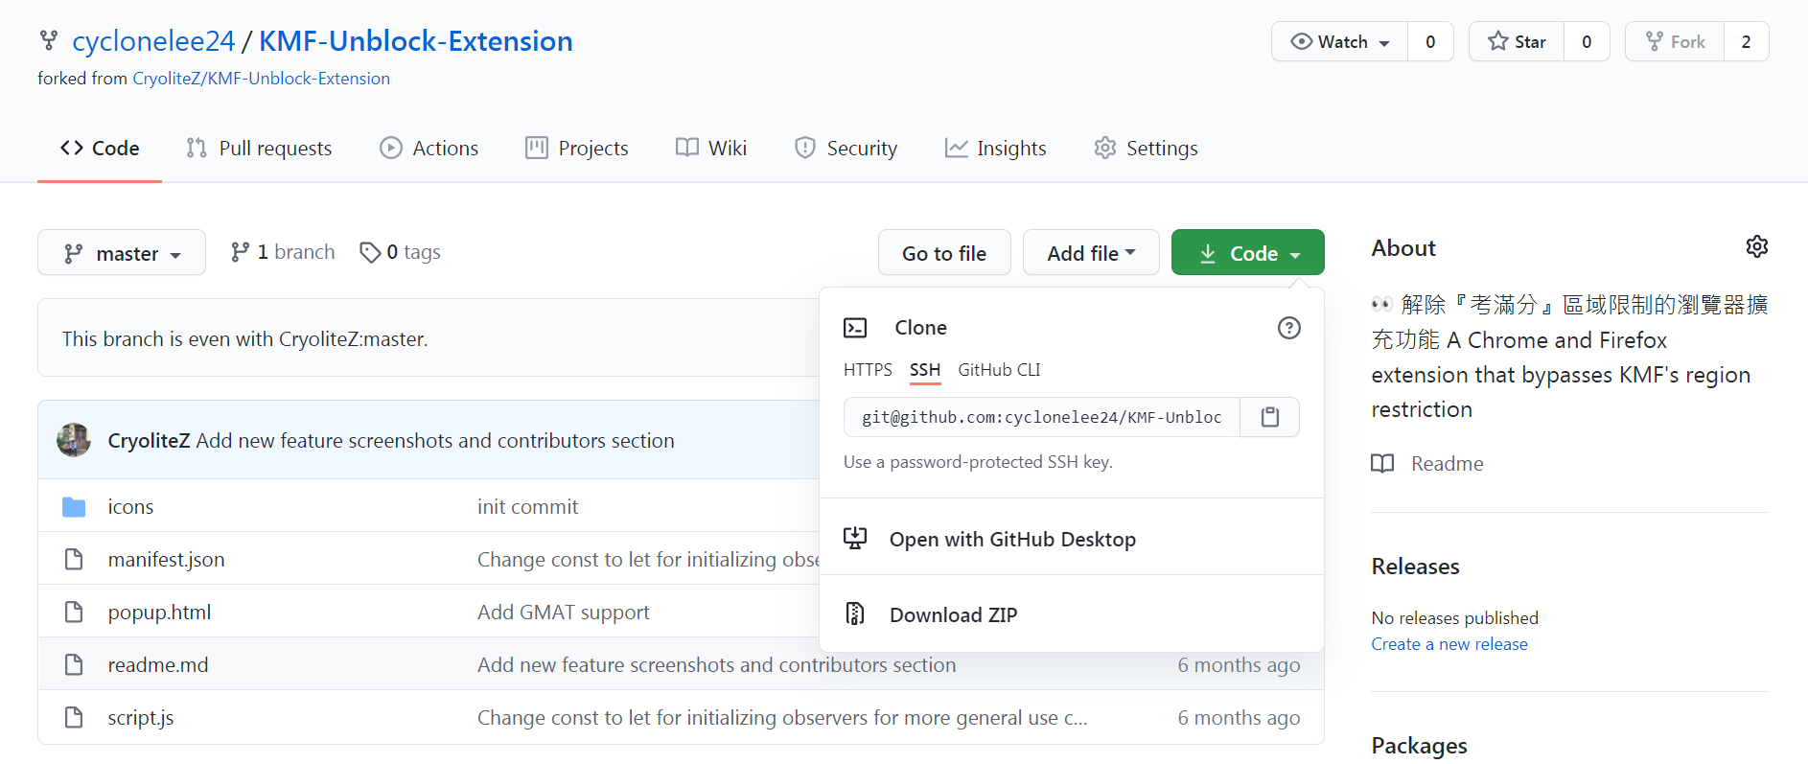

Slide 54
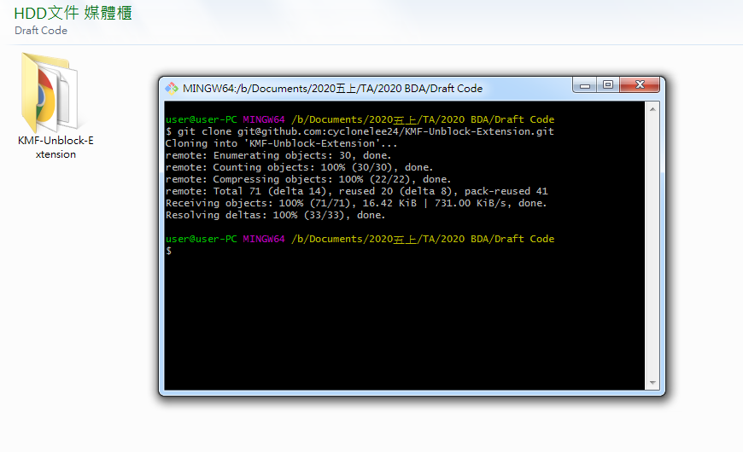
．fork vs. clone ?

Slide 55
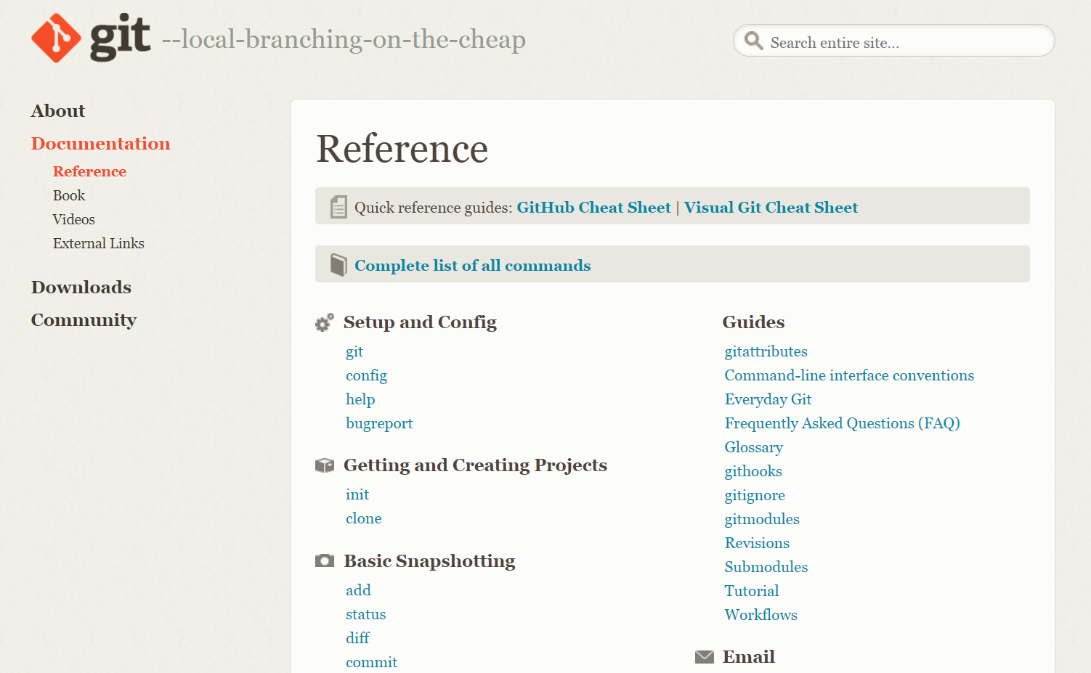
More questions ?

