Slide 1


BIG DATA ANALYSIS
TA class III
TA : Lee Chi-Hsuan

Slide 2


Git & GitHub

Slide 3
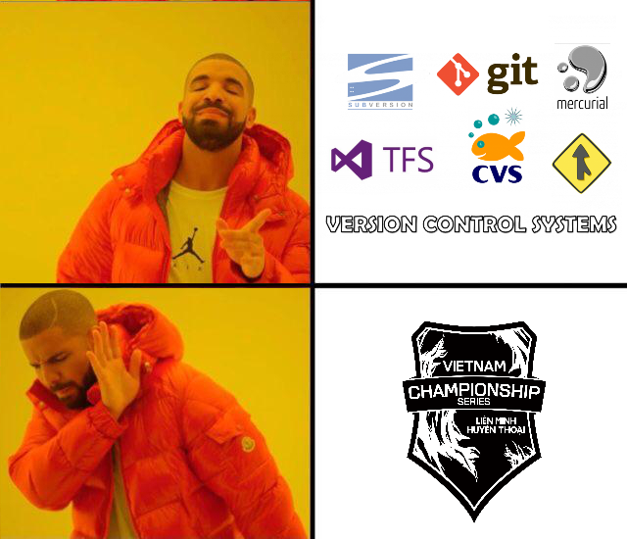
VCS
Version Control System

Slide 4
A system that records changes to files over time so that you can recall specific versions later.

Slide 5

Local VCS

Slide 6
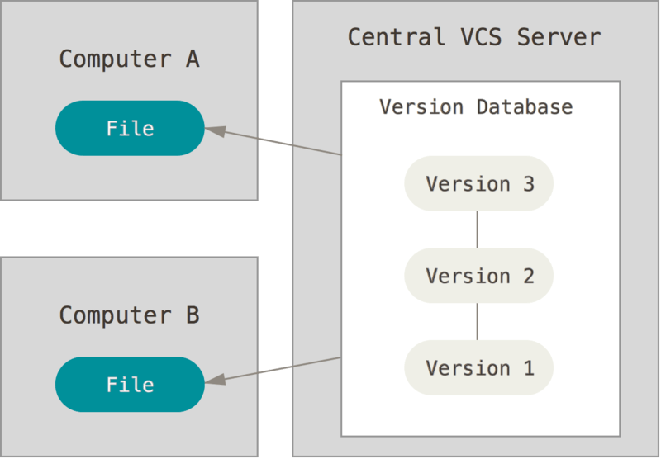
Centralized VCS

Slide 7
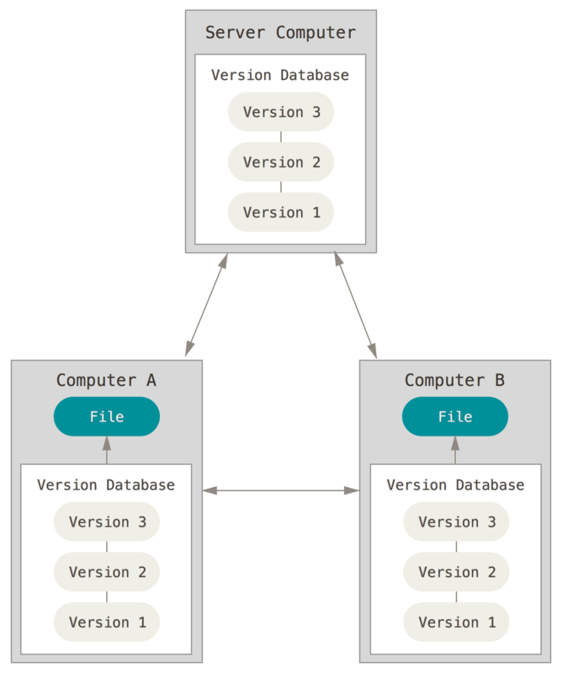
Distributed Version VCS

Slide 8
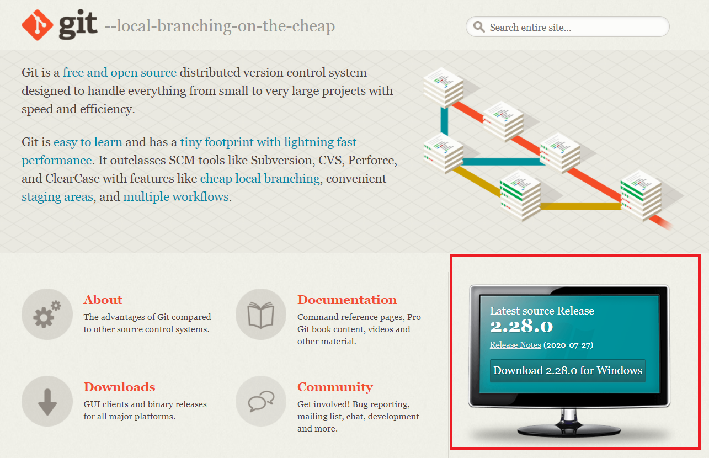

Git

Slide 9
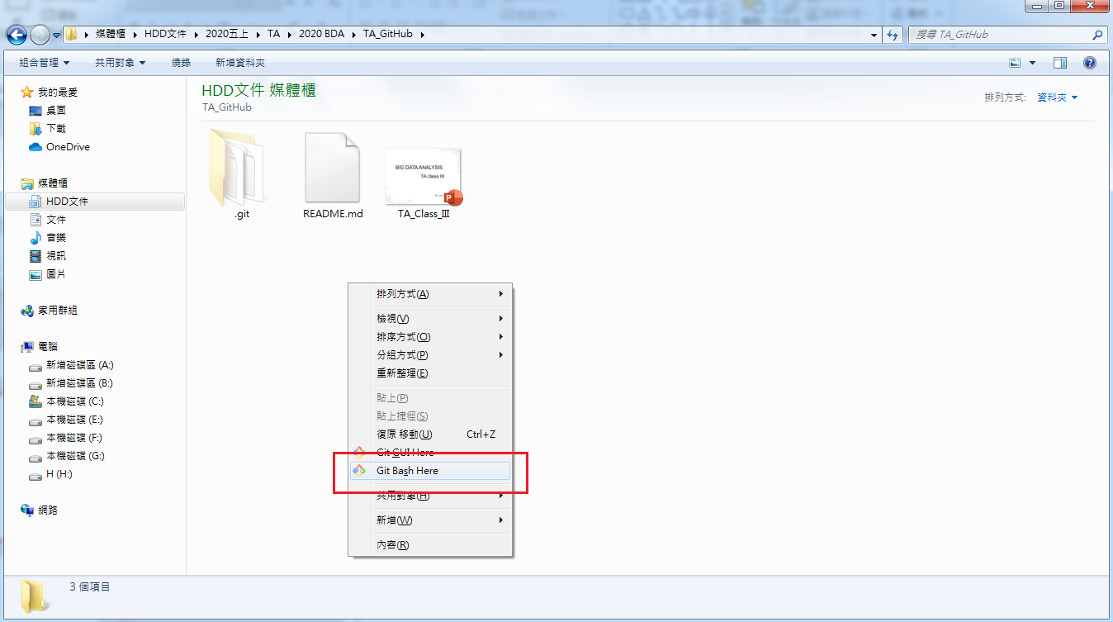
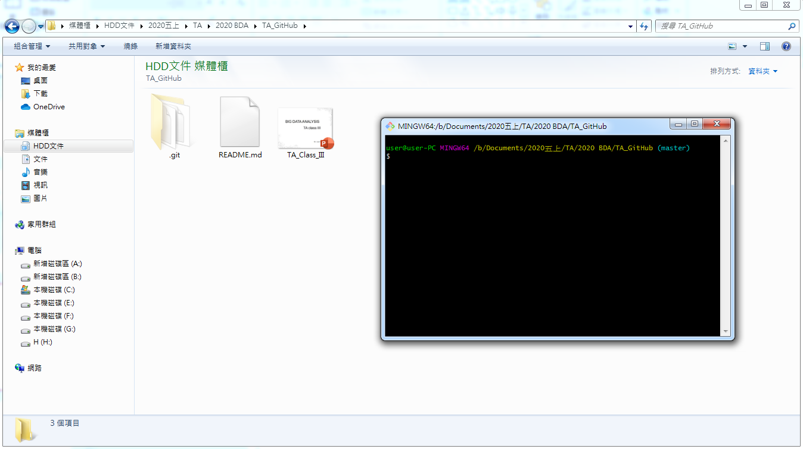
First Steps with Git

Slide 10
Your Identity
．git config --global user.email "your_email_account.gmail.com"
．git config --global user.name "your name"

Slide 11
．git init

Slide 12
Three state of tracking files :
．modified
．staged
．committed
state

Slide 13

．Snapshotting your repository

Slide 14
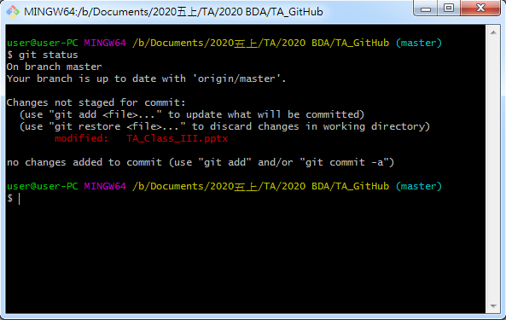
．git status

Slide 15
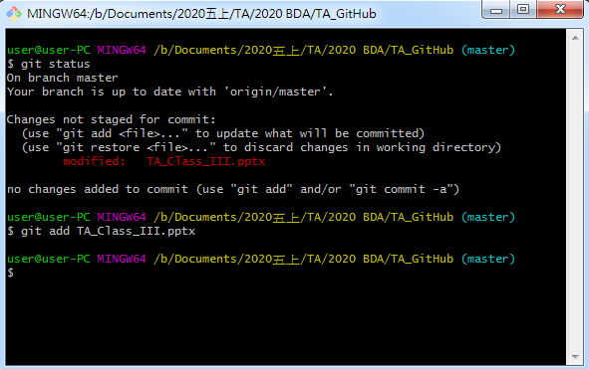
．git add

Slide 16
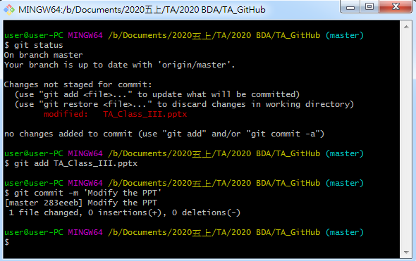
．git commit –m ‘…’

Slide 17
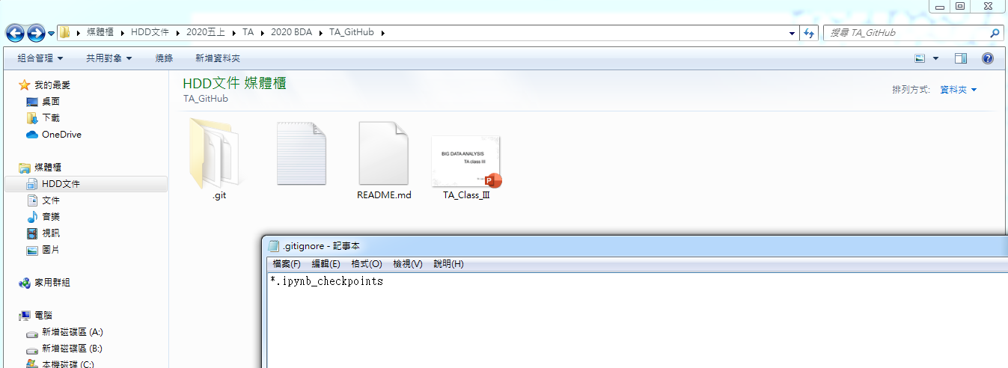
.gitignor

Slide 18
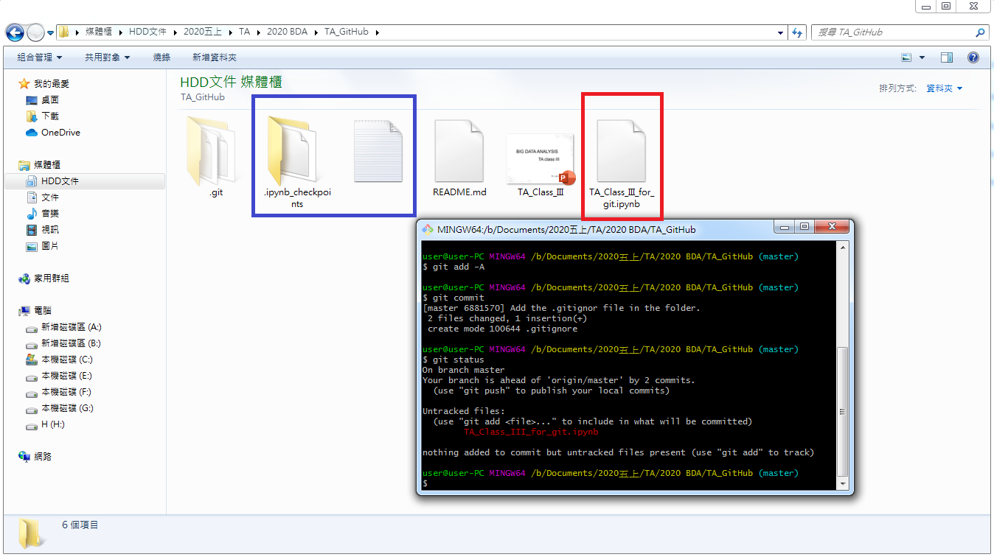
…after adding an ipynb file
(the ipynb_checkpoints is ignored)

Slide 19
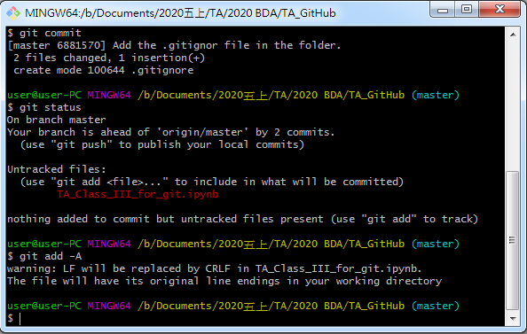
．git add -A

Slide 20
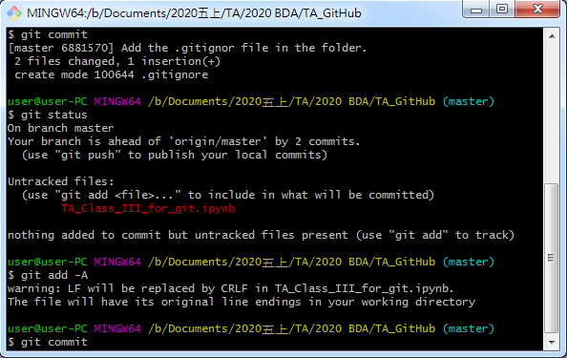
．git commit

Slide 21
．vim
．press ‘i’
．write your commit message
．press ‘Esc’
．type ‘:wq’

Slide 22
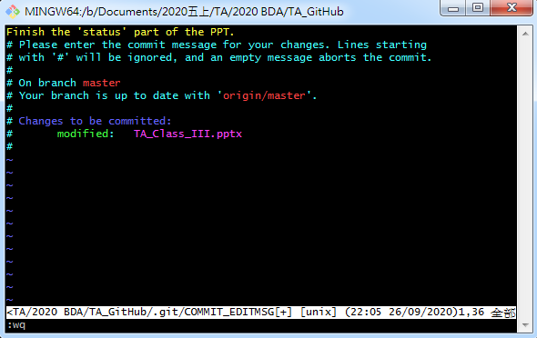

Slide 23
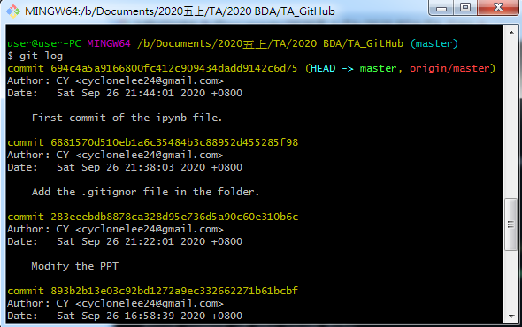
．git log

Slide 24
．git checkout <sha1>
to check out a particular commit
．git revert <sha1>
to revert a particular commit
<sha1>

Slide 25
branch
The default branch git create for you when a new git repo is initialized is called “master”.

Slide 26
Branches enable changes to be worked on without disruption the most current working state,

Slide 27
．git branch branch_name

Slide 28
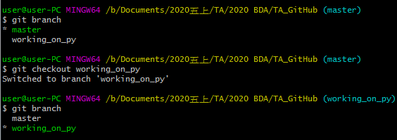
．git branch

Slide 29
＊master
。main file
git checkout –b new_branch
modify
。main file
．new file
。main file
。main file
．new file
add, commit
merge

Slide 30
．history of diff. branches are diff.
．git branch –d branch_name
．git merge branch_name
．fast-forward merge (when no diverge)
．three-way merge (diverge but no conflict)
．conflict ? Fix it, add, and commit

Slide 31

GitHub

